Slide 1
AMENORRHEA
DR. L. GIRIJA. M.d. (Hom.),
Associate professor,
DEPARTMENT OF GYNAECOLOGY AND OBSTETRICS,
SARADA KRISHNA HOMOEOPATHIC MEDICAL COLLEGE,
KULASEKHARAM

Slide 2
Definitions
Primary amenorrhea
Failure of menarche to occur when expected in relation to the onset of pubertal development.
 No menarche by age 16 years with signs of pubertal development.
 No onset of pubertal development by age 14 years.
Secondary amenorrhea
 Absence of menstruation for 3 or more months in a
previously menstruating women of reproductive
age.

Slide 3
CNS-Hypothalamus-Pituitary
Ovary-uterus Interaction
Neural control
Chemical control
Dopamine
(-)
Norepiniphrine
(+)
Endorphines
(-)
Hypothalamus
Gn-RH
±
?
–
Ant. pituitary
FSH, LH
Estrogen
Ovaries
Progesterone
Uterus
Menses

Slide 4
Pathophysiology of Amenorrhea
Inadequate hormonal stimulation of the endomerium “Anovulatory amenorrhea”
- Euestrogenic
- Hypoestrogenic
Inability of endometrium to respond to hormones “Ovulatory amenorrhea”
- Uterine absence - Utero-vaginal agenesis
- XY-Females ( e.g T.F.S)
- Damaged endometrium ( e.g Asherman’s syndrome)

Slide 5
Euestrogenic Anovulatory Amenorrhea
Normal androgens
Hypothalamic-pituitary dysfunction (stress, weight loss or gain, exercise, pseudocyesis)
Hyperprolactinemia
Feminizing ovarian tumour
Non-gonadal endocrine disease (thyroid, adrenal)
Systemic illness
High androgens
PCOS
Musculinizing ovarian tumour
Cushing’s syndrome
Congenital adrenal hyperplasia (late onset)

Slide 6
Hypoestrogenic Anovulatory Amenorrhea
High androgens
- Musculinizing ovarian tumour
- Cushing’s syndrome
- Congenital adrenal hyperplasia (late onset)
Normal androgens
- Hypothalamic-pituitary failure
- Severe dysfunction
- Neoplastic,destructive,
infiltrative, infectious &
trumatic conditions
involving hypothalamus or pituitary
- Ovarian failure
- Gonadal dysgenesis
- Premature ovarian failure
- Enzyme defect
- Resistant ovaries
- Radiotherapy, chemotherapy

Slide 7
AMENORRHOEA
AN APPROACH FOR DIAGNOSIS
HISTORY
PHYSICAL EXAMINATION
ULTRASOUND EXAMINATION
Exclude Pregnancy
Exclude Cryptomenorrhea

Slide 8
Cryptomenorrhea
Outflow obstruction to menstrual blood
- Imperforate hymen
- Transverse Vaginal septum with functioning uterus
- Isolated Vaginal agenesis with functioning uterus
- Isolated Cervical agenesis with functioning uterus
- Intermittent abdominal pain
- Possible difficulty with micturition
- Possible lower abdominal swelling
Bulging bluish membrane at the introitus or absent
vagina (only dimple)

Slide 9
Imperforate hymen

Slide 10
Once Pregnancy and cryptomenorrhea are excluded:
The patient is a bioassay for
Endocrine abnormalities
Four categories of patients are identified
1. Amenorrhea with absent or poor secondary sex Characters
2. Amenorrhea with normal 2ry
sex characters
3. Amenorrhea with signs of
androgen excess
4. Amenorrhea with absent uterus
and vagina

Slide 11
AMENORRHEA Absent or poor secondary sex Characteristics
FSH Serum level
Low / normal
High
Hypogonadotropic
hypogonadim
Gonadal
dysgenesis

Slide 12
AMENORRHEA Normal secondary sex Characteristics
- FSH, LH, Prolactin, TSH
Provera 10 mg PO daily
x 5 days
Prolactin  TSH
+ Bleeding
No bleeing
- Mild hypothalamic
dysfunction
- PCO (LH/FSH)
Further
Work-up
(Endocrinologist)
Review FSH result
And history (next slide)

Slide 13
FSH
High
Low / normal
Ovarian failure
Hypothalamic-pituitary
Failure
head CT- scan or MRI
If < 25 yrs or primary amenorrhea  karyoptype If < 35 yrs R/O autoimmune disease
- Severe hypothalamic
dysfunction
- Intracranial pathology
?? Ovarian biopsy

Slide 14
Amenorrhea Utero-vaginal absence
Karyotype
46-XY
46-XX
. Gonadal regressioon
. Testocular enzyme defenciecy
. Leydig cell agenisis
Andogen Insenitivity (TSF syndrome)
Mullerian
Agenesis
(MRKH syndrome)
Normal breasts
& absent sexual
hair
Normal breasts
& sexual hair
Absent breasts
& sexual hair

Slide 15
Normal FSH, LH; -ve bleeding history is suggestive of amenorrhea trumatica
Asherman’s syndrome
History of pregnancy associated D&C
Rarely after CS , myomectomy T.B endometritis, bilharzia
Diagnosis : HSG or hysterescopy
Treatment : lysis of adhesions; D&C or hysterescopy + estrogen therapy ( ? IUCD or catheter)
Some will prescribe a cycle of Estrogen and
Progesterone challenge Before HSG or Hysterescopy

Slide 16
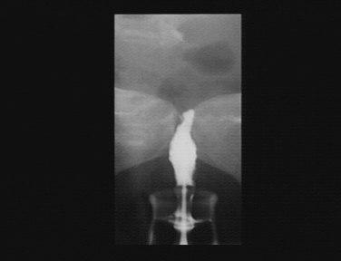
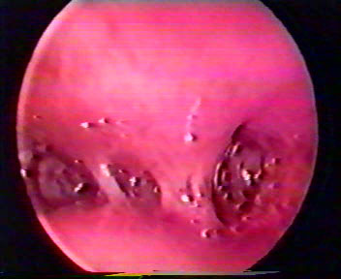
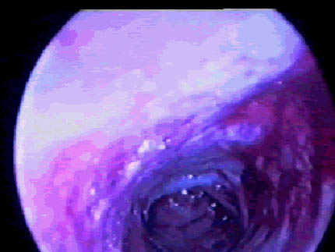
Asherman’s syndrome

Slide 17
Amenorrhea
Signs of androgen excess
Testosterone, DHEAS, FSH, and LH
TEST. >200 ng/dL
DHEAS >700 mug/dL
DHEAS 500-700 mug/dL
U/S ? MRI or CT
↑Serum 17-OH
Progesterone level
Ovarian
Or adrenal
tumor
Adrenal
hyperfunction
Late CAH
Lower elevations  PCOS (High LH / FSH)

Slide 18
Amenorrhea
PRIMARY AMENORRHEA
. Ovarian failure 36%
. Hypogonadotrophic 34%
Hypogonadism.
. PCOS 17%
. Congenital lesions
(other than dysgenesis) 4%
. Hypopituitarism 3%
. Hyperprolactinaemia 3%
. Weight related 3%
SECONDARY AMENORRHEA
. Polycystic ovary syndrome 30%
. Premature ovarian failure 29%
. Weight related amenorrhoea 19%
. Hyperprolactinaemia 14%
. Exercise related amenorrhoea 2%
. Hypopituitarism 2%

Slide 19
Gonadal dysgeneis
Chromosomally incompetent
- Classic turner’s syndrome (45XO)
- Turner variants (45XO/46XX),(46X-abnormal X)
- Mixed gonadal dygenesis (45XO/46XY)
Chromosomally competent
- 46XX (Pure gonadal dysgeneis)
- 46XY (Swyer’s syndrome)

Slide 20
Gonadal dysgenesis
 | Classic Turner’s | Turner Variant | True gonadal Dysgenesis | Mixed Dysgenesis
phenotype | Female | Female | Female | Ambiguous
Gonad | Streak | Streak | Streak | - Streak - Testes
Hight | Short | - Short - Normal | Tall | Short
Somatic stigmata | Classical | ± | Nil | ±
karyotype | XO | XX/XO or abnormal X | 46-XX(Pure) 46-XY (Swyer) | XO/XY

Slide 21
Turner’s syndrome
• Sexual infantilism and short stature.
• Associated abnormalities, webbed neck,coarctation of the aorta,high-arched pallate, cubitus valgus, broad shield-like chest with wildely spaced nipples, low hairline on the neck, short metacarpal bones and renal anomalies.
• High FSH and LH levels.
• Bilateral streaked gonads.
• Karyotype - 80 % 45, X0
- 20% mosaic forms (46XX/45X0)
• Treatment: HRT

Slide 22
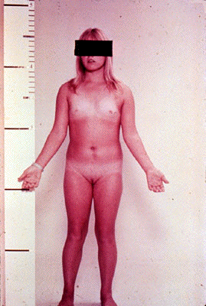
Turner’s syndrome
(Classic 45-XO)
Mosaic (46-XX / 45-XO)

Slide 23
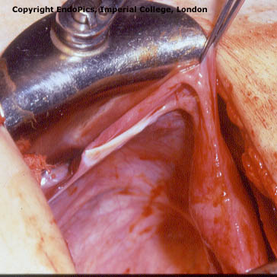
Ovarian dysgenesis

Slide 24
None-dysgenesis ovarian failure
Steroidogenic enzyme defects (17-hydroxylase)
Ovarian resistance syndrome
Autoimmune oophoritis
Postinfection (eg. Mumps)
Postoopherectomy
Postradiation
Postchemotherapy

Slide 25
Premature ovarian failure
Serum estradiol < 50 pg/ml and FSH > 40 IU/ml on repeated occasions
10% of secondary amenorrhea
Few cases reported, where high dose estrogen or HMG therapy resulted in ovulation
Sometimes immuno therapy may reverse autoimmue ovarian failure
Rarely  spont. ovulation (resistant ovaries)
Treatment: HRT (osteoporosis, atherogenesis)

Slide 26
Polycystic ovary syndrome
The most common cause of chronic anovulation
Hyperandrogenism ;  LH/FSH ratio
Insulin resitance is a major biochemical feature ( blood insulin level hyperandrogenism )
Long term risks: Obesity, hirsutism, infertility, type 2 diabetes, dyslipidemia, cardiovasular risks, endometrial hyperplassia and cancer
• Treatment depends on the needs of the patient and preventing long term health problems

Slide 27
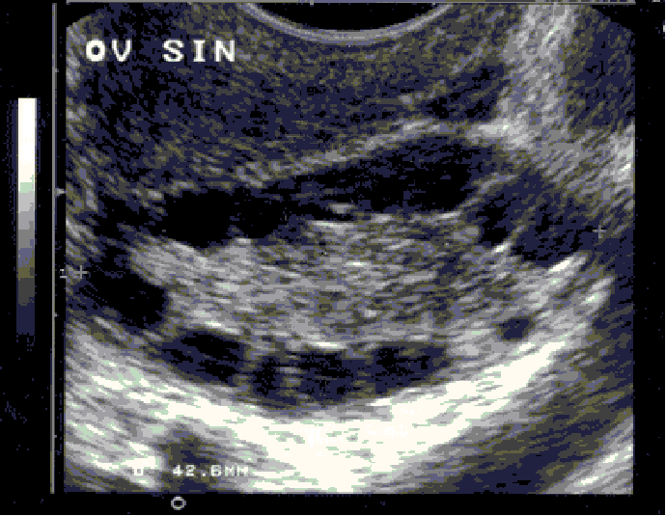
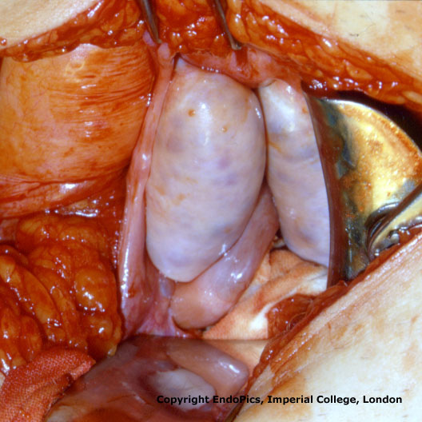

Slide 28
Hypogonadotrophic Hypogonadism
• Normal hight
• Normal external and internal genital organs (infantile)
• Low FSH and LH
• MRI to R/O intra-cranial pathology.
• 30-40% anosmia (kallmann’s syndrome)
• Sometimes  constitutional delay
• Treat according to the cause (HRT), potentially fertile.

Slide 29
Constitutional pubertal delay
• Common cause (20%)
• Under stature and delayed bone age
( X-ray Wrist joint)
• Positive family history
• Diagnosis by exclusion and follow up
• Prognosis is good
(late developer)
• No drug therapy is required – Reassurance (? HRT)

Slide 30
Sheehan’s syndrome
Pituitary inability to secrete gonadotropins
Pituitary necrosis following massive obstetric hemorrhage is most common cause in women
Diagnosis : History and ↓ E2,FSH,LH
+ other pituitary deficiencies (MPS test)
Treatment :
Replacement of deficient hormones

Slide 31
Weight-related amenorrhoea Anorexia Nervosa
1º or 2º Amenorrhea is often first sign
A body mass index (BMI) <17 kg/m² menstrual irregularity and amenorrhea
Hypothalamic suppression
Abnormal body image, intense fear of weight gain, often strenuous exercise
Mean age onset 13-14 yrs (range 10-21 yrs)
Low estradiol → risk of osteoporosis
Bulemics less commonly have amenorrhea due to fluctuations in body wt, but any disordered eating pattern (crash diets) can cause menstrual irregularity.
Treatment : ↑ body wt. (Psychiatrist referral)

Slide 32
Exercise-associated amenorrhoea
Common in women who participate in sports (e.g. competitive athletes, ballet dancers)
Eating disorders have a higher prevalence in female athletes than non-athletes
Hypothalamic disorder caused by abnormal gonadotrophin-releasing hormone pulsatility, resulting in impaired gonadotrophin levels, particularly LH, and subsequently low oestrogen levels

Slide 33
Contraception related amenorrhea
Post-pill amenorrhea is not an entity
Depot medroxyprogesterone acetate
Up to 80 % of women will have amenorrhea after 1 year of use. It is reversible (oestrogen deficiency)
A minority of women taking the progestogen-only pill may have reversible long term amenorrhoea due to complete suppression of ovulation

Slide 34
Late onset congenital adrenal hyperplasia
Autosomal recessive trait
Most common form is due to 21-hydroxylase deficiency
Mild forms Closely resemble PCO
Severe forms show Signs of severe androgen excess
High 17-OH-progesterone blood level
Treatment : cortisol replacement and ? Corrective surgery

Slide 35
Cushing’s syndrome
Clinical suspicion : Hirsutism, truncal obesity, purple striae, BP
If Suspicion is high :
dexamethasone suppression test (1 mg PO 11 pm ) and obtaine serum cortisol level at 8 am :
< 5 µg/ dl excludes cushing’s
24 hours total urine free cortisol level to confirm diagnosis
2 forms ; adrenal tumour or ACTH hypersecretion (pituitary or ectopic site)

Slide 36
Utero-vaginal Agenisis Mayer-Rokitansky-Kuster-Hauser syndrome
15% of 1ry amenorrhea
Normal breasts and Sexual Hair development & Normal looking external female genitalia
Normal female range testosterone level
Absent uterus and upper vagina & Normal ovaries
Karyotype 46-XX
15-30% renal, skeletal and middle ear anomalies
Treatment : STERILE ? Vaginal creation ( Dilatation VS Vaginoplasty)

Slide 37
General Principles of management of Amenorrhea
. Attempts to restore ovulatory function
. If this is not possible HRT (oestrogen and progesterone) is given to hypo-estrogenic amenorrheic women (to prevent osteoporosis; atherogenesis)
. Periodic progestogen should be taken by euestrogenic amenorrheic women (to avoid endometrial cancer)
. If Y chromosome is present gonadectomy is indicated
. Many cases require frequent re-evaluation

Slide 38
Summary
Although the work-up of amenorrhea may seem to be complex, a carefully conducted physical examination with the history, and Looking to the patient as a bioassay for endocrine abnormalities, should permit the clinician to narrow the diagnostic possibilities and an accurate diagnosis can be obtained quickly.
Management aims at restoring ovulatory cycles if possible, replacing estrogen when deficient and Progestogegen to protect endometrium from unopposed estrogen.
• Frequent re-evaluation and reassurance of the patient.

