Slide 1
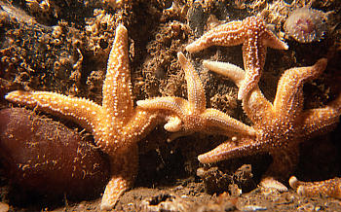
ASTERIAS RUBENS
Dr. C.R. KRISHNAKUMARI AMMA
PROF & HOD
DEPT OF MATERIA MEDICA

Slide 2
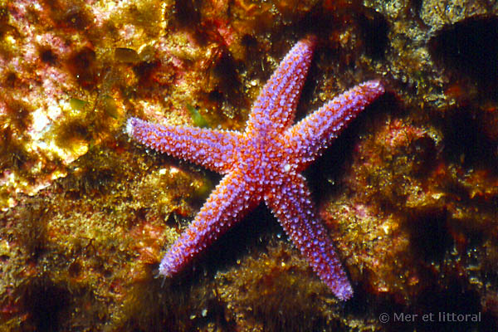
DESCRIPTION Common Name- Star fish. This is a marine animal of the Class- Echinodermata, Order- Asteroidea, Family- Asteriadae. Dilutions from the tincture.

Slide 3
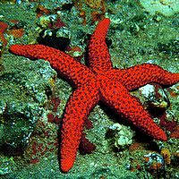
THERAPEUTICS This agent produces cerebral congestion, epilepsy, neuralgia, and chorea. The diseases that are cured by this remedy are functional in origin, with the exception of cancerous diseases, especially cancer of the breast, in which it has been curative even in the stage of ulceration. The patient is flabby and of the lymphatic type, with red face. They complain of great heat of the head.

Slide 4
A remedy for the sycotic diathesis; flabby, lymphatic constitution, flabby with red face. Lancinating pains. Nervous disturbances, neuralgia, chorea, and hysteria come within the range of this remedy. Has been used for cancer of the breast, and has an unquestioned influence over cancer disease. Excitement in both sexes

Slide 5
Easily excited by any emotion, especially by contradictions (Anac., Con.). Heat of the head, as if surrounded by hot air. Sanguineous congestion to the brain. Apoplexy; face red, pulse hard, full, frequent.

Slide 6
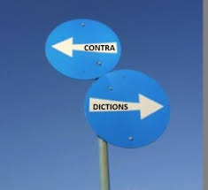
HEAD. Cannot bear contradiction. Shocks in brain; throbbing; heat in head, as if surrounded by hot air.

Slide 7
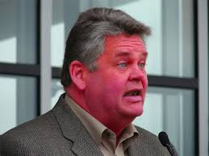
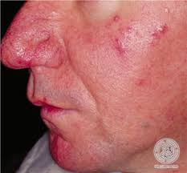
FACE Red. Pimples on side of nose, chin and mouth. Disposition to pimples at adolescence.

Slide 8
CHEST. Breasts swollen, indurated. Neuralgia of left breast and arm (Brom). Pain under sternum and in muscles of precordial region. Left breast feels as if pulled inward, and pain extends over inner arm to end of little finger. Numbness of hand and fingers of left side.

Slide 9
Cancer of mammae; acute lancinating pain; drawing pain in breast; swollen, distended, as before the menses; breast feels drawn in. Cancer mammæ even in ulcerative stage. Axillary glands swollen hard and knotted.

Slide 10
A livid red spot appeared, broke and discharged; gradually invaded entire breast, very fetid odour; edges pale, clevated, mamillary, hard, everted; bottom covered with reddish granulations.

Slide 11
NERVOUS SYSTEM. Gait unsteady: muscles refuse to obey the will (Alum., Gels.). Epilepsy: twitching over the whole body four or five days before the attack.

Slide 12
STOOL Constipation: obstinate; ineffectual desire; stools of hard, round balls, like olives. Diarrhoea: watery, brown, gushing out in a violent jet (Crot. t., Grat., Gum., Jatr., Thuja).

Slide 13
FEMALE. Colic and other sufferings cease with appearance of flow. Breasts swell and pain in breasts; worse left. Ulceration with sharp pains, piercing to scapulæ. Pains down left arm to fingers, worse motion. Excitement of sexual instinct with nervous agitation. Nodes and indurations of mammary gland, dull aching, neuralgic pain in this region (Conium). Sexual desire increased in women (Lit.).

Slide 14
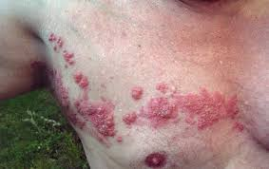
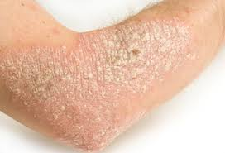
SKIN. Destitute of pliability and elasticity. Itching spots. Ulcers, with fetid ichor. Acne. Psoriasis and herpes zoster worse left arm and chest. Enlarged axillary glands, worse, at night and in damp weather

Slide 15
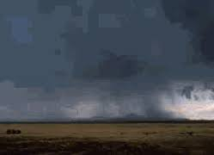
MODALITIES. Worse: coffee, night; left side, cold damp weather.

Slide 16
RELATIONSHIP. SIMILAR: to, Murex, Sepia. COMPARE: Carbo an., Con., Condurango.,Sil. in mammary cancer; Bell., Cal., Sulph. in epilepsy. ANTIDOTES: Plumb; Zinc. INCOMPATIBLE: Nux; Coffea.

