Slide 1
AXILLA
By
Dr.Leena. N
Associate Professor
Department of Anatomy

Slide 2
AXILLA
A pyramidal shaped space between upper chest wall and arm.It has
Apex(cervicoaxillary canal)-bounded anteriorlyby clavicle, posteriorly by superior border of Scapula, medially by outer border of 1st rib
Base-formed by skin, superficial fascia and deep fascia.
Four walls -anterior, posterior, medial & lateral.

Slide 3
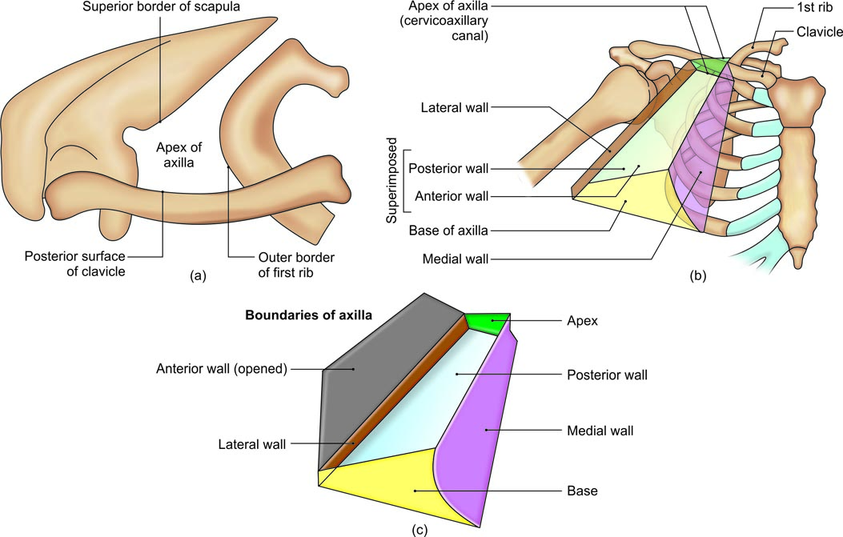
(a) Boundaries of the apex of the axilla, (b) walls of the axilla, and (c) opened up axilla

Slide 4
Walls of Axilla
Ant. –Pectoralis major, Pectoralis minor &clavipectoral fascia
Post. –Subscapularis, teres major, latissimus dorsi.
Med. –upper four ribs and upper digitations of serratus anterior
Lat. –Inertubercular sulcus.

Slide 5
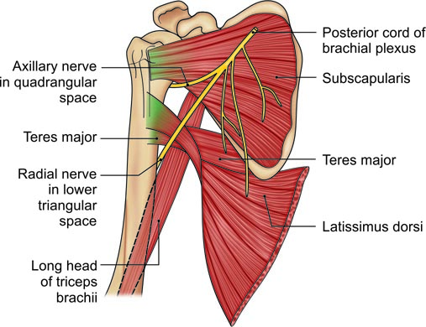
Muscles forming the posterior wall of axilla with their nerve supply

Slide 6
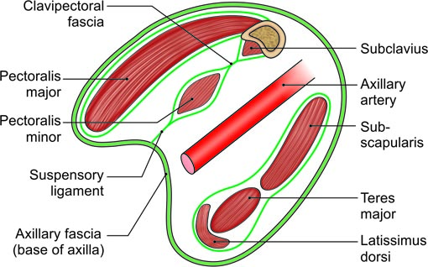
Anterior and posterior walls of the axilla with the axillary artery

Slide 7
Contents of Axilla
Axilary artery & its branches
Axillary vein &its tributaries
Infraclavicular part of Brachial plexus
Long thoracic nerve, intercostobrachial nerve
Axillary group of lymph nodes
Fat

Slide 9
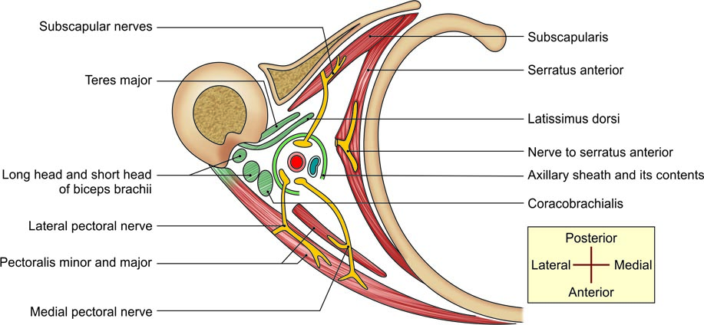
Walls and contents of axilla

Slide 10
Axillary lymph nodes

