Slide 1
ADENOMYOSIS
Dr Shanthi Serene Sylum V
Professor and Head
Dept. Obstetrics and Gynaecology
SKHMC Kulasekharam

Slide 2
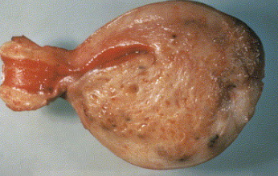
Definition:
Adenomyosis is a condition where there is in growth of the endometrium, both the glandular and stromal components, directly into the myometrium.

Slide 3
Causes:
The cause of such in growth is not known.
It may be related to repeated childbirths, vigorous curettage or excess of estrogen effect.
Pelvic endometriosis co-exists in about 40 percent.

Slide 4
Pathogenesis:
Histologically, it is characterized by the extension of endometrial glands and stroma beneath the endometrial—myometrial interface (EMI).
Endometrial glands lie in direct contact with the underlying myometrium.
It forms nests, deep within myometrium.
Subsequently, there is myometrial hyperplasia around the endometriotic foci.

Slide 5
Pathogenesis….
Myometrial zone anatomy was observed by endometrial—myometrial interface (EMI) in which a junctional zone is defined at the innermost layer of myometrium.
It is thought that the disturbance of normal junctional zone (JZ) predisposes to secondary infiltration of endometrial glands and stroma to inner myometrial zone.
The disturbance of junctional zone (JZ) may be due to the endometrial factors, genetic predisposition or altered immune response.
Trauma to the deeper endometrium (repeated curettage), causing breakdown of EMI is also taken as an important etiologic factor.

Slide 6
Pathology:
The growth and tissue reaction in the endometrium depend on the response of the ectopic endometrial tissues to the ovarian steroids.
If the basal layer is only present, the tissue reaction is much less, as it is unresponsive to hormones.
But, if the functional zone is present which is responsive to hormones, the tissue reaction surrounding the endometrium is marked.
There is hyperplasia of the myometrium producing diffuse enlargement of the uterus, sometimes symmetrically but at times, more on the posterior wall.
The growth may be localized or may invade as adenomyomatous polyp.

Slide 7
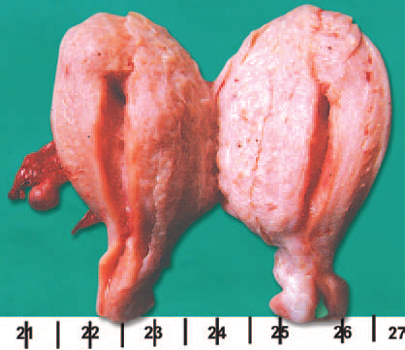
Naked eye appearance:
There is diffuse symmetrical enlargement of the uterus; the posterior wall is often more thickened than the anterior one.
The size usually does not increase more than a large orange (12–14 weeks pregnant uterus).
On cut section, there is thickening of the uterine wall.
The cut surface presents characteristic trabeculated appearances.
Unlike fibroid, there is no capsule surrounding the growth.
There may be visible blood spots at various places.
Note the absence of capsule and presence of dark blood spots

Slide 8
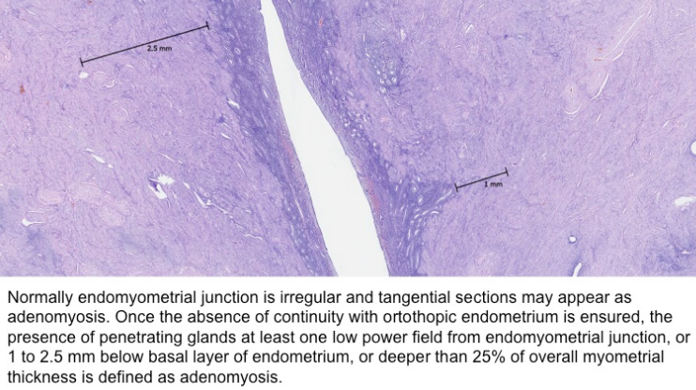
Histological examination:
Histological examination reveals glandular tissue like that of endometrium surrounded by stromal cells in the myometrium.
The response of the ectopic endometrial tissue to ovarian hormones is minimal because the invasion is predominantly in the basal layer.

Slide 9
Clinical Features
In about one-third, it remains asymptomatic being discovered on histological examination.
The patients are usually parous with age usually above 40.

Slide 10
Symptoms: Menorrhagia (70%)
The excessive bleeding is due to increased uterine cavity, associated endometrial hyperplasia and inadequate uterine contraction.
During normal menstruation, there are antegrade propagation of subendometrial contractions from the fundus to the cervix.
In adenomyosis with distorsion of junctional zone myometrial contractions are abnormal and inadequate

Slide 11
Dysmenorrhea (30%)
Progressively increased colicky pain during period is due to retrograde pattern of uterine contractions.
It also depends on the number and depth of adenomyotic foci in the myometrium.
When the depth of penetration is > 80% of the myometrium, the pain is severe.
Other causes of pain are—local tissue edema and prostaglandins.

Slide 12
Dyspareunia or frequency of urination
It is due to enlarged and tender uterus.
Infertility
Women with adenomyosis have a higher incidence of infertility and miscarriage due to:
(a) abnormal function of the subendometrial myometrium
(b) retrograde myometrial contractions
(c) interference in sperm transport and blastocyst implantation
(d) abnormal endomerial immune respose and nitric oxide level.

Slide 13
Signs:
Abdominal examination may reveal a hypogastric mass arising out of the pelvis and occupying the midline.
The size usually does not exceed 14 weeks pregnant uterus.
Pelvic examination—reveals uniform enlargement of the uterus.
The findings, however, may be altered due to associated fibroid or pelvic endometriosis.

Slide 14
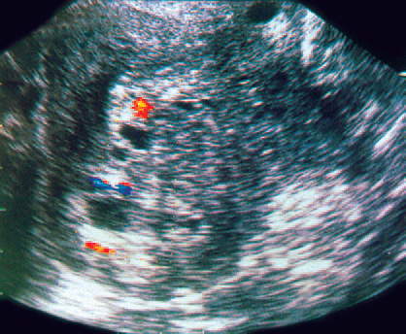
Ultrasound and Color Doppler (TVS) characteristics reveals:
Myometrium normally has three distinct zones of different echogenecity.
The inner layer is hypoechoic relative to the middle and outer layer. This subendometrial halo is characteristic in adenomyosis.
Other features are:
(i) heterogenous echogenecity,
(ii) hypoecoic myometrium with multiple small
cysts in the myometrium (honeycomb appearance),
(iii) increased vascularity within the myometrium
Transvaginal Color Doppler Scan showing diffusely enlarged uterus with anechoic cysts. ‘Swiss cheese’ pattern with increased vascularity is suggestive of adenomyosis

Slide 15
Magnetic Resonance Imaging (MRI):
It is more specific to the diagnosis.
Low signal intensity JZ < 8 mm excludes the disease.
Whereas JZ thickness > 12 mm is suggestive of adenomyosis.

Slide 16
Treatment:
The treatment is surgical.
There is little place of hormone therapy.
Treatment with progestins or cyclic estrogen and progestin have got little benefit.

Slide 17
Bibliography
https://www.sciencedirect.com/science/article/abs/pii/S1521693406000307
https://www.pathologyoutlines.com/topic/uterusadenomyosis.html
DC Dutta’s Textbook of Gynecology including Contraception Enlarged & Revised Reprint of Sixth Edition Edited by Hiralal Conar November 2013 JAYPEE.

Slide 18
Thank you

