Slide 1
Anemia
Dr.Deepa.G.S
Associate Professor
SKHMC

Slide 2
Anemia
Reduction in RBC, Hb and Packed cell volume
Reduction occurs due to
Decreased production
Increased destruction
Excess loss of blood

Slide 3
Classification of Anemia
Morphological classification
Depends on size and color
Size : Determined by Mean Corpuscular Volume (MCV)
MCV - Volume of a single RBC in cubic microns- 78-94 µm³
Colour: Determined by Mean corpuscular Hemoglobin concentration (MCHC)
MCHC- Average amount of hb in single RBC (28-32 pg)

Slide 4
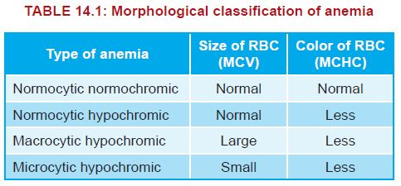
http://my-pharma-notes.blogspot.com/2016/01/anemia-its-types-causes.html

Slide 5
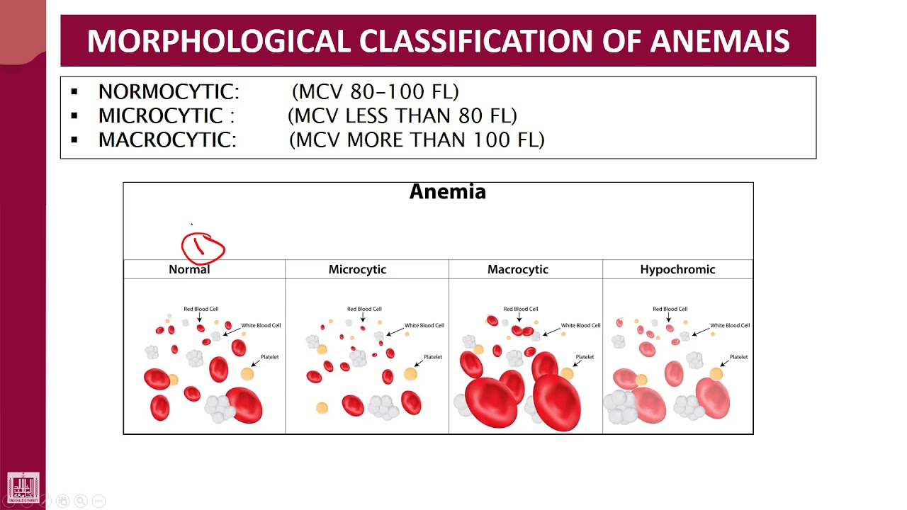

Slide 6
Morphological classification of Anemia
 | Normochromic | Hypochromic
Normocytic | i) After acute haemorrhage ii)All hemolytic anemias except thalassemia iii)Aplastic anemia | After chronic haemorrhage
Macrocytic | All megaloblastic anemias due to deficiency of vitamin B12,folic acid or intrinsic factor | Secondary to liver disease
Microcytic | Chronic infections | i)Iron deficiency anemia ii)Thalassemia

Slide 7
Etiological Classification
Hemorrhagic anemia
Hemolytic anemia
Nutrition deficiency anemia
Aplastic anemia
Anemia of chronic diseases.

Slide 8
Hemorrhagic anemia
Acute Haemorrhage
Plasma Replacement- within 24 hours
Replacement of RBC- 4-6 weeks
So hemodilution occurs leading to Normocytic
normochromic anemia

Slide 9
Hemorrhagic anemia
Chronic hemorrhage
Cause:
Internal or external bleeding for long period
Peptic ulcer
Purpura
Hemophilia
Menorrhagia
Loss of iron leads to microcytic hypochromic anemia

Slide 10
Hemolytic anemia
Excessive destruction of RBC- Normocytic normochromic
Extrinsic hemolytic anemia:
i. Liver failure
ii. Renal disorder
iii. Hypersplenism
iv. Burns
v. Infections – hepatitis, malaria and septicemia
vi. Drugs – Penicillin, antimalarial drugs andsulfa drugs
vii. Poisoning by lead, coal and tar
viii. Presence of isoagglutinins like anti Rh
xi. Autoimmune diseases – rheumatoid arthritis

Slide 11
Hemolytic anemia
Intrinsic hemolytic anemia:
Hereditary disorders
Sickle cell anemia: Sickle shape
Thalassemia: Small and irregular

Slide 12
Sickle cell anemia
Sickle cell anemia is due to the abnormal hemoglobin
called hemoglobin S (sickle cell hemoglobin).
Homozygous disorder inherited from both the parents
α chains are normal and βchains are abnormal.
The molecules of hemoglobin S polymerize into long chains and precipitate inside the cells.
Because of this, the RBCs attain sickle (crescent) shape and become more fragile leading to hemolysis

Slide 13
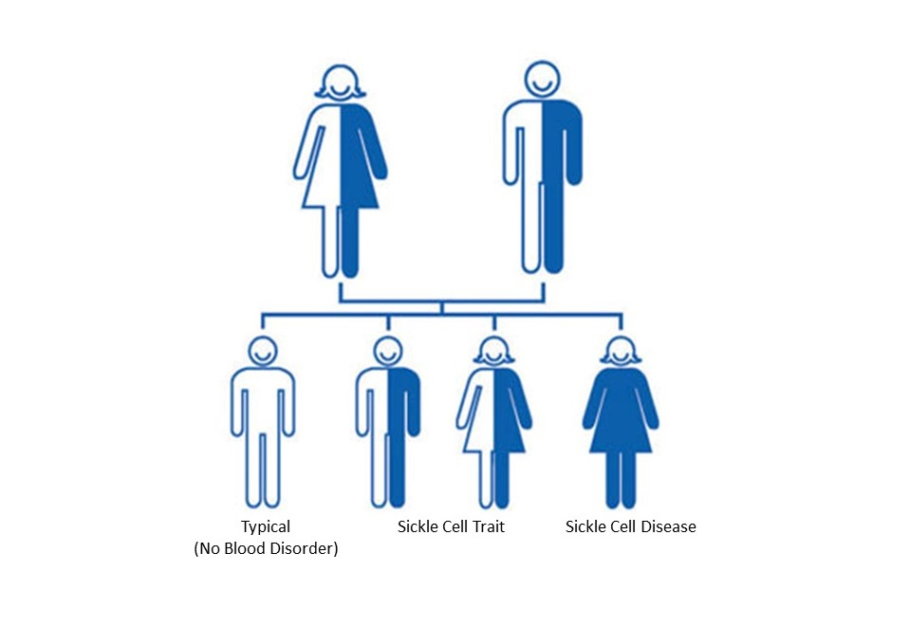
Sickle cell disease-Inheritance
https://www.cdc.gov/ncbddd/sicklecell/traits.html

Slide 14
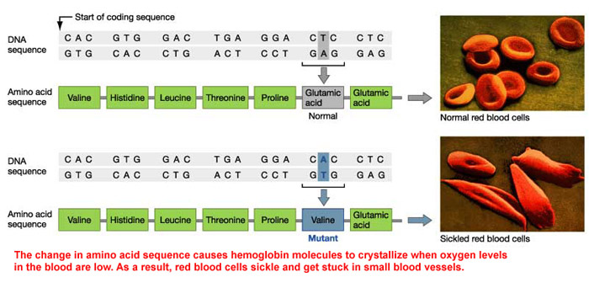

Slide 15
Thalasemia
Thalassemia is an inherited hetrozygous disorder,
characterized by abnormal hemoglobin.
It is also known as Cooley’s anemia Mediterranean anemia
Polypeptide chains are normal but decreased or absent due to defect in regulatory portion of globin genes
Thalassemia is of two types:
i. α thalassemia
ii. βthalassemia

Slide 16
Thalassemia
α-Thalassemia
α chains are less, absent or abnormal. This leads to defective erythropoiesis and hemolysis.
β-Thalassemia
In β thalassemia, βchains are less in number, absent or abnormal with an excess of α chains.

Slide 17
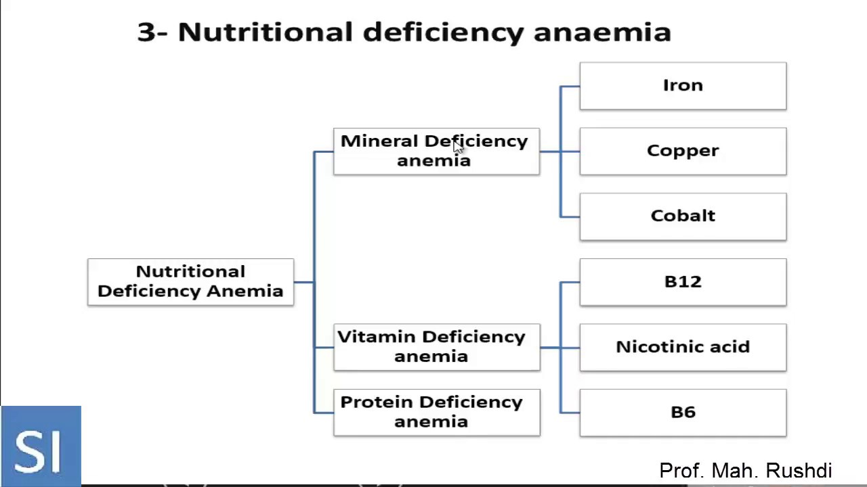
Nutritional deficiency anemia

Slide 18
Iron deficiency anemia
Causes of iron deficiency anemia:
i. Loss of blood
ii. Decreased intake of iron
iii. Poor absorption of iron from intestine
iv. Increased demand for iron in conditions like
growth and pregnancy.

Slide 19
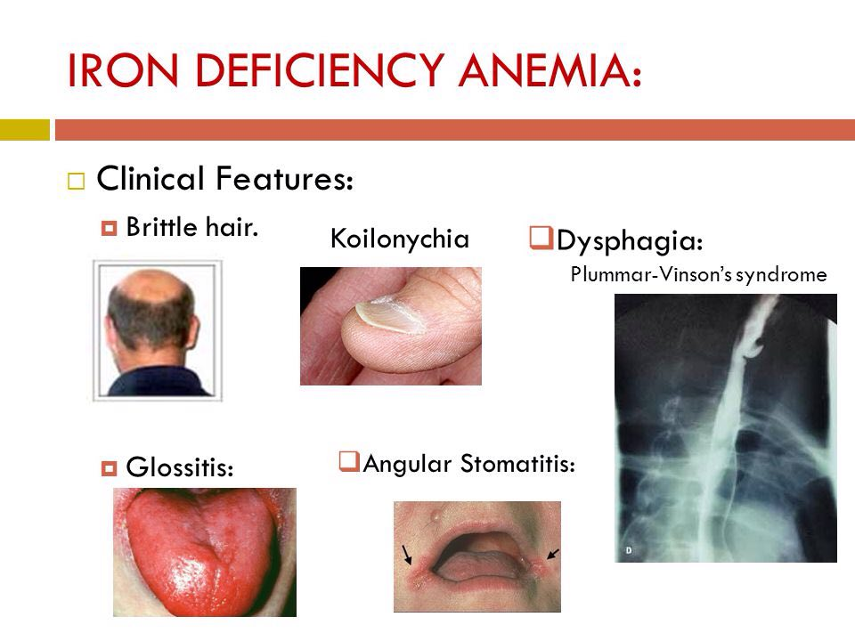
https://twitter.com/pgmedicine/status/1180531875284172803

Slide 20
Pernicious anemia
Due to lack of intrinsic factor with consequent failure in
the absorption of Vit B 12
Characteristic features
Over activity of bone marrow- Megaloblastic hyperplasia
Blood changes : Macrocytic normochromic
Decreased platelets and WBC

Slide 21
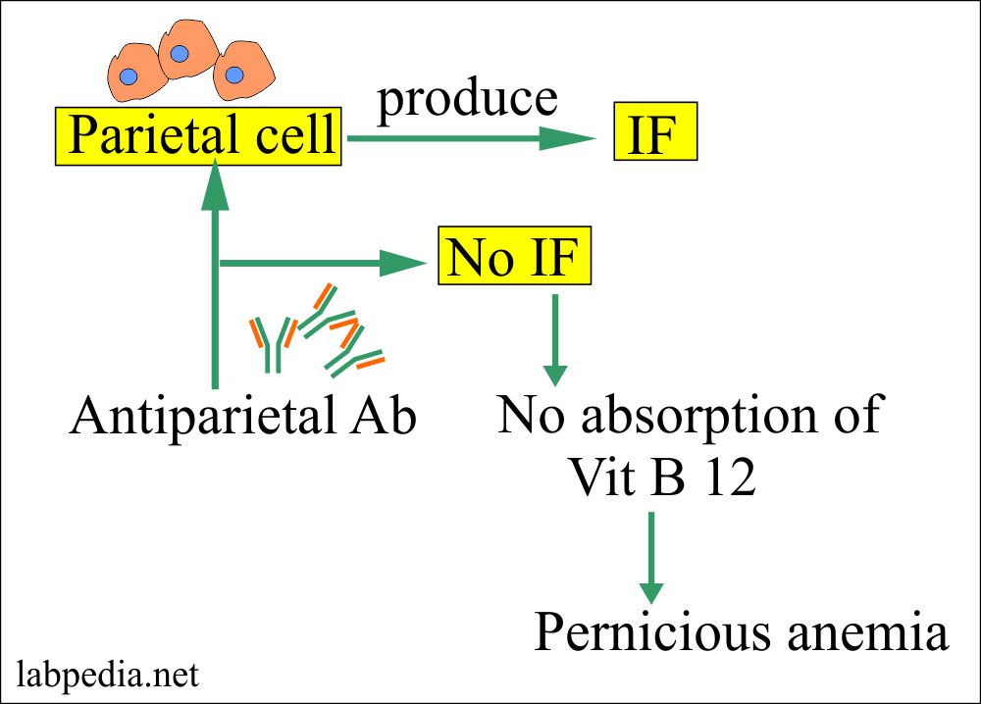
Pernicious anemia/Addison’s anemia

Slide 22
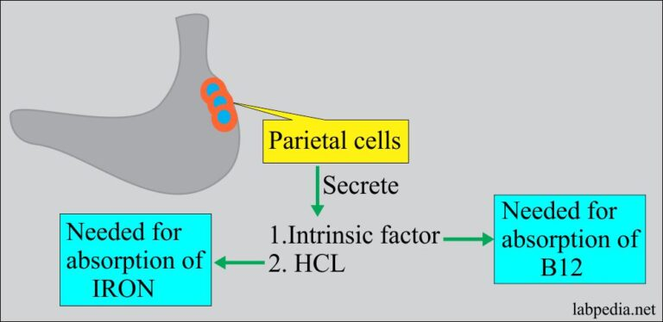
Pernicious anemia/Addison’s anemia

Slide 23
Pernicious anemia/Addison’s anemia
Due to lack of intrinsic factor with a consequent failure
in the absorption of vitamin B 12
Characteristic features
Lemon yellow color of skin (due to anemic paleness and mild jaundice)and red sore tongue.
Neurological disorders such as paresthesia (abnormal sensations like numbness,tingling, burning, etc.)
progressive weakness and ataxia (muscular incoordination) are also observed in extreme conditions.

Slide 24
Megaloblastic anemia
Due to deficiency of another maturation factor called folic acid.
Here, the RBCs are not matured.
The DNA synthesis is also defective, so the nucleus remains immature.
The RBCs are megaloblastic and hypochromic.
Features of pernicious anemia appear in megaloblastic anemia also.
However, neurological disorders may not develop.

Slide 25
Aplastic Anemia
Aplastic anemia is due to the disorder of red bonemarrow.
Red bone marrow is reduced and replaced by fatty tissues.
Bone marrow disorder occurs in the following conditions:
i. Repeated exposure to Xray or gamma ray radiation.
ii. Presence of bacterial toxins, quinine, gold salts,
benzene, radium, etc.
iii. Tuberculosis.
iv. Viral infections like hepatitis and HIV infections.
RBCs are normocytic and normochromic

Slide 26
Anemia of chronic diseases
Common causes anemia of chronic diseases:
i. Non infectious inflammatory diseases such as
rheumatoid arthritis (chronic inflammatory
autoimmune disorder affecting joints).
ii. Chronic infections like tuberculosis
iii. Chronic renal failure, in which the erythropoietin secretion decreases
iv. Neoplastic disorders such as cancer of lung and breast.

Slide 27
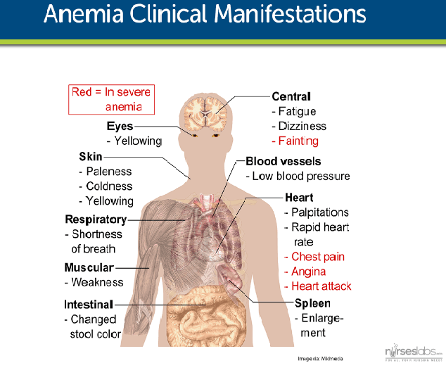

Slide 28
Grading of Anemia
Mild Anemia : Hemoglobin 8-12 gm/dl
Moderate Anemia : Hemoglobin 5-8 gm/dl
Severe Anemia : Hemoglobin less than 5 gm/dl

Slide 29
Thank you

