Slide 1
Bio statistics
Dr.Ezhil arasi

Slide 2
Bio statistics
Statistics is a methodology of collection, compilation, analysis and interpretation of numerical data.
Study of statistics in relation to biological science is known as bio statistics (medical statistics)
study of statistics in relation to health and disease of human population and the different factors related to them is known as health statistics

Slide 3
study of statistics in relation to the vital events of life such as births, deaths and marriages, divorces etc. is known as vital statistics which in turn is a branch of demography which deals with the study of human populations.
In medicine, the diagnosis and treatment depends upon collection of data in numerical figures such as recording blood pressure, serum cholesterol level, hemoglobin level etc. Thus medical statistics or biostatistics is often called as quantitative medicine.

Slide 4
Variability
The measurable variable like height, weight, BP, glucose or cholesterol level in blood etc. Is called quantitative variable
Non measurable variable likes occupation, socioeconomic status etc. Is called qualitative variable.

Slide 5
Applications of biostatistics
Helps in effective comparisons between two groups or two countries
helps in estimating the magnitude of a health problem
helps in analysing the cause of the public health problems including epidemics to the public health personal
helps in monitoring and evaluation of the control measures and also in introducing mid course correction measures wherever necessary.
Helps in health planning and management
Helps in research purposes.

Slide 6
Types of data
QUALITATIVE DATA:
Obtained by enumeration or counting
QUANTITATIVE DATA:
Obtained by measurement such as BP

Slide 7
QUANTITATIVE DATA
CONTINUOUS DATA
Measurement can be made to a precise value eg: Hb
DISCRETE DATA
Measurement is given in whole numbers
(range is given)

Slide 8
Sources of data
Experiments
Surveys
Records

Slide 9
Surveys
Surveys are carried out by epidemiologist or health workers in the field to know the magnitude of the problem or health status etc, or for the implementation of control measures etc.

Slide 10
Sources of health statistics
Health statistics | Sources
Population | Census reports,
Births | Register of births
Deaths | Register of deaths Postmortem reports
Diseases | Hospital records GP records

Slide 11
Presentation of statistical data

Slide 12
Tabulation
Presentation of the data in the form of tables
This is the most common and preliminary way of presentation of data

Slide 13
Tabulation
Information should be in a simple unambiguous and orderly manner
Should have a title which must be brief and comprehensive reflecting the nature and contents of the table.
Rows and columns must have their own captions
Titles of the rows must be entered on the left side of the table
Standard codes or symbols have to be used and are explained as footnote
number of class intervals should depend upon the aims of presentation

Slide 14
Qualitative tables
One way table
Two way table
Higher order tables

Slide 15
One way table
Depicts the data in relation to a single attribute

Slide 16
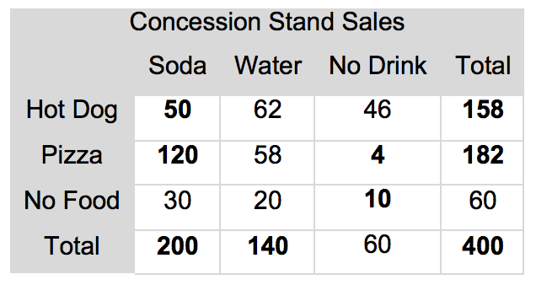
Two way table
Depicts the data in relation to two attributes

Slide 17
Higher order tables
Depicts the data in relation to more than two attributes

Slide 18
Quantitative tables
When a large data is collected by measurement it is presented in the form of a table showing the characteristics as well as the number of observations, both of which are variable. The characteristic may be discrete or continuous. Such tables are called as frequency tables or frequency distribution tables.

Slide 19
Diagrammatic presentation
Bar diagrams for charts
Histogram
Frequency polygon
Line diagram
Frequency curve
Cumulative frequency curve
Scatter diagram
Pie diagram
Pictogram
Map diagram

Slide 20
Bar diagrams or charts
It is a simple diagram or chart, popularly used to compare the magnitude of the qualitative data. Bars are the rectangles drawn along the graph sheet.height of each bar or rectangle corresponds to frequencies in a data while the breadth or base corresponds to the length of the class interval of the variable in quantitative data and to various groups in qualitative data.
Bars are arranged either vertically or horizontally in ascending or descending order.

Slide 21
Types of bar diagrams
Simple bar diagram
Multiple bar diagram
Proportional bar diagram

Slide 22
Multiple bar diagram
Two or more bars can be grouped together
Useful to make comparisons between various groups

Slide 23
Proportional bar diagram
the bars may be divided into two or more parts depending upon the number of subgroups to be compared in proportions or percentages.

Slide 24
Histogram
graphic representation of a frequency distribution table in which the vertical Axis represents the frequency and the horizontal Axis the class interval
consists of a series of bars adjoining to each other the length of each bar is being proportional to the frequency and the width to the class interval.
histograms are ideally suited to represent the distribution of anthropometric values like height, weight, mid arm circumference. They can also represent other types continuous data series such as blood pressure, pulse rate and hemoglobin level.
Provide better understanding of quantitative data of continuous type than frequency distribution table.

Slide 25
Scatter diagram or dot diagram
Helps to study the relationship between the two variables.
One variable is represented on x axis and another variable on y axis
Perpendiculars drawn from these readings meet to give one scatter point.

Slide 26
Pie diagram
circular diagram in which the frequencies of observation are shown as sectors or wedges in a circle, the size of each sector being proportional to the frequency.
the sector's should be arranged clockwise whether in ascending or descending order of magnitude. It is often necessary to indicate the percentage for easy comparison.

Slide 27
Pictogram
It is also called as picture diagram or pictorial diagram.
Consists of a series of small pictures or symbols or each representing a group of data

Slide 28
Measures of Central tendency
When a series of observations of continuous series are made. it is found that a large number of them concentrate at the centre of the series and the small number of them lie at the periphery.
this tendency of the values to aggregate in the centre of the distribution series is called Central tendency
Central value is also called as statistical average

Slide 29
Mean
The arithmetic mean is calculated by summing up all the observations and dividing the total by number of observations.

Slide 30
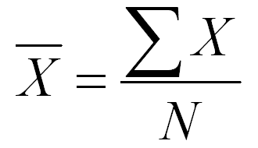
X : the value of each observation in the data
EPSILON: SUM OF
X BAR : mean value
N : number of observations in the data

Slide 32
Median
A series of observations or variables when arranged in a definite order either ascending or descending
For calculation of the median all the numbers are first arranged in the ascending order

Slide 33
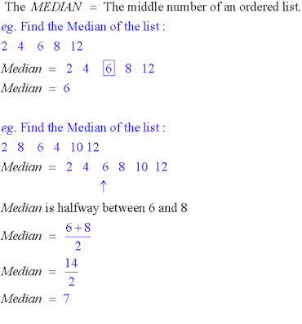

Slide 34
Mode
The most frequently occurring value in a series of values observations

Slide 36
Standard deviation
An improvement of the mean deviation

Slide 37
Calculation of standard deviation
Mean of the observations is calculated
Mean is subtracted from each of the observation to calculate the deviation
square the differences of observations from the mean which removes the problem of signs plus or minus
Total of the squad values to get sum of squares
this sum is divided by the number of observations -1 to get mean squared deviation called variance
finally square root of this variance is obtained to get root mean square deviation called standard deviation

Slide 38
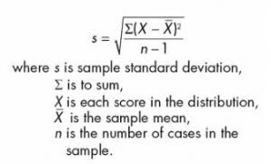

Slide 39
Sampling
Representative portion of the universe is taken for the study it is called a sample
when the investigation is carried out for the entire population it is called the census enumeration
and when it is carried out for the sample it is called sample enumeration
suppose a sample is selected by selecting only those units of the population so that it suits the specific purpose as per the desire of the investigator it is called as purposive sampling

Slide 40
Types of sampling techniques
Probability sampling methods
Non probability sampling methods

Slide 41
Probability sampling methods (random sampling methods)
Simple random methods
Systematic random sampling
Stratified random sampling
Multistage random sampling
Cluster random sampling
Multiphase random sampling

Slide 42
Non probability sampling methods
Accidental or incidental sampling
Judgement sampling or purposive sampling or deliberate sampling

Slide 43
Simple random sampling
this method is fairly applicable when the population is small homogenus and readily available such as a village household or an individual in a community or patients coming to hospital for lying in the wards.

Slide 44
Systematic sampling
this method is preferred when the population is large scattered and not homogeneous such as number of houses in a village or town.
No pre numbering is necessary as in random sampling

Slide 45
Stratified random sampling
in this method the entire population is divided into certain homogeneous subgroups depending upon the characteristics to be studied

Slide 46
Cluster sampling
in this case the enumeration units are not individuals but clusters such as families in a village, villages in a district, schools and wards of a city

Slide 47
Multiphase sampling
in this method study is carried out in several phases.

Slide 48
Non probability sampling
Accidental or incidental sampling: this consists of selecting a group of people among those who have assembled in one place with the common interest.
Judgement sampling: the sample selection depends upon the judgement of the person who is entrusted with the job
Quota sampling: stratified random sampling minus randomisation.
Convenience sampling: the sample is obtained from an available stores like that of telephone directory, automobile registers, stock exchange directory, conveniently.
Sequential sampling:number of sample lots are drawn one after another from one universe depending upon the results of earlier samples. Used as quality control

Slide 49
Errors in sampling
Sampling errors
Non sampling errors

Slide 50
Sampling errors
These are due to
Faulty sampling method
Small size of the sample
These errors can be minimised through proper sampling method.

Slide 51
Non sampling errors
Coverage error
Observational ( or experimental) error
Processing errors.

