Slide 1
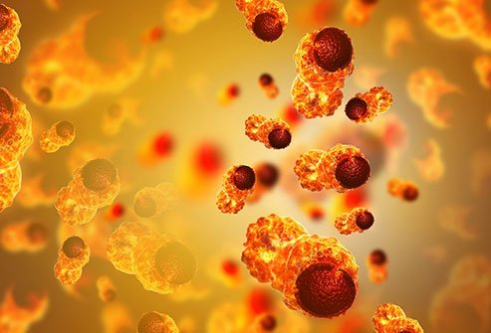
CANCER
Dr Reshma Reghu

Slide 2
Cancer is a most fearful disease, next to AIDS and Rabies.
It is characterized by the following features:
Abnormal and uncontrolled growth of the cells.
The presence of aberrations in the nucleus.
Ability to invade the surrounding tissues and even distant organs (metastasis) later.
Eventual death of the person, if the tumor has progressed beyond a certain stage at which it can be successfully removed.
Cancer can occur at any site, at any time, in any individual.

Slide 4
INDIA
In India, it is estimated to be 2 to 2.5 million cases existing at any given point of time with about 7 lakh new cases being added every year, killing nearly 3 lakhs of people every year only due to cancer.

Slide 5
TRENDS
Westernization trends
Time trends
Cancer pattern

Slide 6
AGENT FACTORS
PHYSICAL
CHEMICAL
BIOLOGICAL
SOCIO ENVIRONMENTAL
NUTRITIONAL

Slide 7
HOST FACTORS
AGE
SEX
GENETIC
OCCUPATION
HABITS

Slide 8
ENVIROMENTAL FACTORS
AIR POLLUTION

Slide 10
PRIMARY PREVENTION
Control of tobacco and alcohol consumption
Personal hygiene
Radiation
occupational exposures
Immunization
Food, drugs and cosmetics
Air pollution
Pre- cancerous lesion
Legislation
Cancer education

Slide 12
SECONDARY PREVENTION
CANCER REGISTRATION
Hospital based registries
Population based registries
EARLY DETECTION OF CASES
TREATMENT

Slide 13
CANCER SCREENING
Search for unrecognised malignancy by means of rapidly applied test.
Cancer screening is possible because
Malignant disease is preceded for a period of months or years by a premalignant lesion removal of which prevents subsequent development of cancer
Most cancer begins as localised lesions and if found at this stage, a high rate of cure is obtainable
As much as 75 % of all cancers occur in body sites that are accessible.

Slide 14
Methods of cancer screening
Mass screening by comprehensive cancer detection examination
Mass screening at single sites
Selective screening

Slide 15
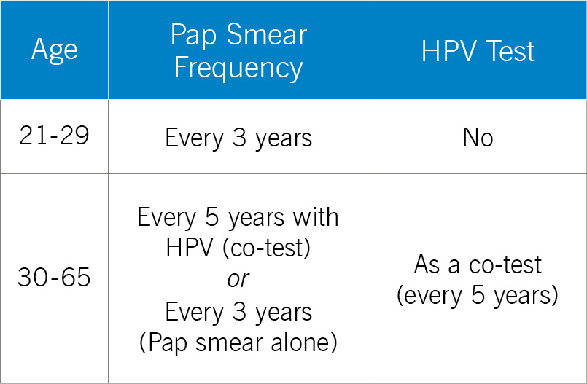
SCREENING FOR CERVICAL CANCER

Slide 16
Visual inspection based screening test
Visual inspection with 5% acetic acid (VIA)
VIA with magnification
Visual inspection post application of Lugol’s iodine (VILI)
Detection of well defined opaque aceto- white lesions close to squamo- columnar junction, well defined circum orificial aceto- white lesions or dense aceto whitening of ulcero- proliferative growth on the cervix
The test is followed by further investigation and management

Slide 17
To sensitize the community
Intensive information
Education
Communication activities

Slide 18
Screening for breast cancer
breast self examination by the patient
Palpation by a physician
Thermography
Mammography- most sensitive and specific in detecting small tumours
Drawbacks of mammography
Exposure to radiation
Requires technical equipment of high standard and radiologist with experience
Biopsy from suspicious lesion may end up by false positive

Slide 19
Screening for lung cancer
Chest radiograph
Sputum cytology

Slide 20
Epidemiology of oral cancer
It is one of the ten most cancers in the world
India in the year 2012, incidence of 10.1 cases per 100000 population and 4.3 per 1,00,000 population in females.
Mortality rate: 6.7 per 1,00,000 population in males and 3 per 1,00,000 population in females
77,000 new cases and 52,000 deaths

Slide 21
Epidemiological features
Tobacco
Alcohol
Pre cancerous stage
High risk groups
Cultural patterns

Slide 22
PREVENTION
PRIMARY PREVENTION
Tobacco habits are eliminated from the community
Intensive public education
Motivation for changing life styles supported by legislative measures
SECONDARY PREVENTION
- Early detection finding pre cancerous stage
Surgery and radiotherapy
Primary heath workers are in strategic position to detect oral cancers at early stage during home visits.

Slide 23
Cancer of the cervix
Second most common cancer among women worldwide with mortality ratio 52 per cent.
Most common cancer among women 88 per cent in developing countries.
In India, second most common and number one killer cancer among women.

Slide 24
NATURAL HISTORY
DISEASE: The disease follows a progressive course from cervical dysplasia to carcinoma in situ to invasive carcinoma.
Carcinoma in situ persist for more than 8 years
Progression to invasive carcinoma will be 15 to 20 years.
Once invasive stage reached the disease spreads by direct extension into lymph nodes and pelvic organs
CAUSATIVE AGENT: Human papilloma virus

Slide 25
RISK FACTORS
AGE- 25 to 45 years
GENITAL WARTS
MARITAL STATUS
EARLY MARRIAGE
ORAL CONTRACEPTIVE PILLS
SOCIO ECONOMIC CLASS- lower socio economic groups

Slide 26
PREVENTION & CONTROL
PRIMARY PREVENTION:
Improving personal hygiene
birth control
SECONDARY PREVENTION:
Early detection through screening
T/t by radical surgery and radiotherapy
prognosis depends upon the stage of the disease at detection and treatment.

Slide 27
BREAST CANCER
Most common cancer among women in developing and developed countries
5th cause of death from cancer
Mortality rate being 12.7 per lac population

Slide 28
RISK FACTORS
AGE- between 35 and 50
FAMILY HISTORY
PARITY- delayed or nulliparous
AGE AT MENARCHE & MENOPAUSE- early menarche and late menopause
HORMONAL FACTORS- high oestrogen and progesterone levels
PRIOR BREAST BIOPSY
DIET – High fat intake and obesity
SOCIO- ECONOMIC STATUS- Higher Socio- economic groups
OTHERS- Radiation, OCP

Slide 29
PREVENTION
PRIMARY PREVENTION
Elimination of risk factors
Cancer education
Reducing fat intake
SECONDARY PREVENTION
Early diagnosis
treatment
Removal of tumour early is more likely to be curative than removal at a later stage

