Slide 1
BIOCHEMISTRY
THE CHEMISTRY OF LIFE
Dr. DEEPA G.S.
Assistant Professor
Dept. of Physiology and Biochemistry

Slide 2
Biochemistry-
Derived from Greek word
BIO – LIFE
CHYMOS - JUICE
By Neuberg in 1903

Slide 3
Essential Chemical Elements in the Body
MAJOR ELEMENTS: 99.3% OF TOTAL ATOMS
Hydrogen H (63%)
Oxygen O (26%)
Carbon C (9%)
Nitrogen N (1%)
MINERAL ELEMENTS: 0.7% OF TOTAL ATOMS
Calcium Ca
Phosphorus P
Potassium K (Latin kalium)
Sulfur S
Sodium Na (Latin natrium)
Chlorine Cl
Magnesium M

Slide 4
Composition of body
Water-60%
Lipids-15%
Protein-15%
Carbohydrates- 2%
Minerals -8%

Slide 5
Molecular structre built from 30 small precursors
Aminoacids -20
Purines -2 (parent substance of adenine and guanine)
Pyrimidines- 3(parent substance of thiamine, uracil and cytosine
Sugars- glucose and ribose
Palmitate –fatty acid
Glycerol
Choline- agent in animal tissue

Slide 6
Bimolecules covalently link to each other forming macromolecules
eg: glucose to glycogen, amino acids to protein
Macromolecules by non covalent bonds form supramolecular systems
eg: ribosomes

Slide 7
CARBOHYDRATES
Carbohydrates are defined as poly hydroxy aldehydes or poly hydroxy ketones or compounds which produce them on hydrolysis.
They are commonly referred as hydrates of carbon.
They contain carbon, hydrogen & oxygen in the ratio of 1:2:1. General formula Cn (H₂O)n.
Main source of energy 4kcal/g
Excess carbohydrate is converted to fat

Slide 8
Classification
Carbohydrates are classified into simple and compound
1.Monosaccharides or simple carbohydrates:
Poly hydroxy aldehydes or poly hydroxy ketones which cannot be further hydrolysed.
They are simple sugars & sweet to taste.
General formula (C_{n}H₂O)_{n}.
Based on the number of carbon atoms present, they are named as trioses (3C), tetroses (4C), pentoses (5C), hexoses (6C) and so on.

Slide 9
Based on type of reducing group present, they
are divided into two groups
1.aldoses – Reducing group- aldehyde (-CHO)
2.ketoses -Reducing group- ketone group(C=O)

Slide 10
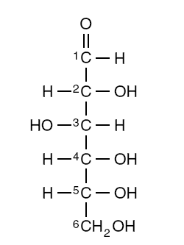
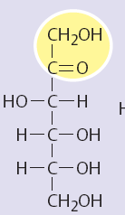
Glucose (aldose) Fructose (ketose)

Slide 11
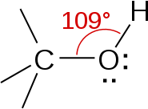
General properties:
1.They are colourless crystalline compounds having sweet taste
2. Chemically they are derivatives of poly hydric alcohol
In chemistry, an alcohol is any organic compound in which a
hydroxyl functional group (-OH) is bound to a carbon atom,
usually connected to other carbon or hydrogen atoms.

Slide 12
3.Formation of esters
Hydroxyl groups of sugars can be esterified to form acetates,propionates,benzoates,phosphates
Sugar phosphates are of great physiological importance.
Metabolism of sugars inside the body starts with phosphorylation

Slide 13
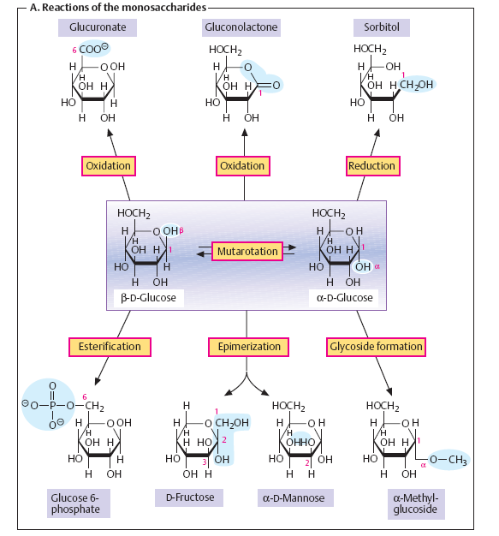

Slide 14
4.Reducing power:
By virtue of aldehyde and ketone groups they are powerful
reducing agents, reduce to corresponding alcohol
Osmotic effect of sorbitol and dulcitol leads to cataract
peripheral neuropathy when in excess
5.Isomerism:
Due to the presence of asymmetric carbon atom they remain
in different isomeric forms
6. Optical rotation:
They may exist in dextro (+)or laevo(-) forms
7.Condensation:
Condense and form bigger polysaccharides

Slide 15
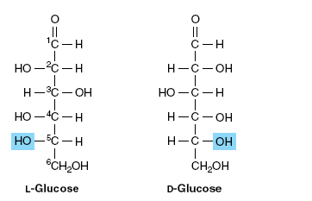

Slide 16
8.Formation of glycosides:
Glycoside-Replaceable hydrogen atom from a sugar substituted with other radicle
eg: phlorizin (glucose+ phloretin)
9.Osazone formation:
All reducing sugars condense with phenylhydrazine to form osazone compounds
Needle shaped crystals –glucososazone
Pin cushion with pins or touch-me-not plant-lact0sosazone
Sunflower shaped -maltosazone

Slide 17
10.Ring structures of the sugars
Ring may contain
Six members-5 carbon atom and oxygen atom (pyranoses)
Five members-4 carbon atoms and 1 oxygen atom (furanoses)

Slide 18
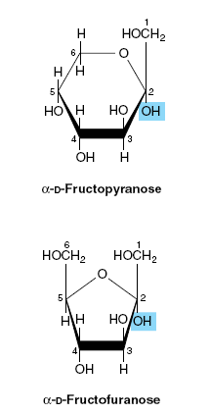
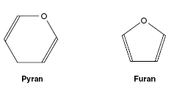

Slide 19
11.Fermentation.
Undergoes fermentation by yeast and other micro organisms
12. Oxidaton
Depending upon the oxidation agent used terminal aldehyde(keto) or terminal alcohol or both groups may be oxidised
CHO COOH (Gluconic acid)
CH2OH COOH(Glucoronic caid)

Slide 20
The glycosides that are important in medicine
cardiac glycosides because of their action on the heart (contain steroids)
These include derivatives of digitalis and strophanthus such as ouabain, an inhibitor of the Na+-K+ ATPase of cell membranes.
Other glycosides include antibiotics such as streptomycin.

Slide 21
2. Oligosaccharides:
Oligosaccharides contain 2-10 monosaccharide molecules which are liberated on hydrolysis.
Based on the number of monosaccharide units present, the oligosaccharides are further subdivided
Disaccharides – two monosaccharide units held together by glycosidic bonds.
General formula is Cn(H₂O)n-1.
Eg: Maltose Glucose + Glucose
Lactose Glucose + Galactose
Sucrose Glucose + Fructose

Slide 22
Disaccharides are of two types.
a.Reducing disaccharides with free aldehyde or keto group e.g. maltose, lactose.
b. Non- reducing disaccharides with no free aldehyde or keto group. E.g. sucrose,trehalose
The other important oligosaccharides include tri- , tetra- or pentasaccharides, respectively containing 3, 4, or 5 monosaccharide units.

Slide 23
Maltose:
Contains two glucose residues
Reducing disaccharide , free aldehyde group present on c₁ of second glucose answers the reducing reaction
Forms sunflower shaped or petal shaped crystals of
maltose-osazone

Slide 24
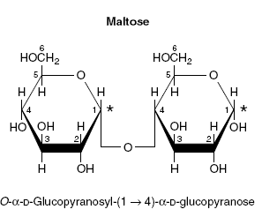

Slide 25
Lactose:
Commonly known as milk sugar
Composed of glucose and galactose
Anomeric carbon of c₁ glucose is free ,hence exhibits reducing property and forms powder puff or flower of touch –me-not plant crystals osazone

Slide 26
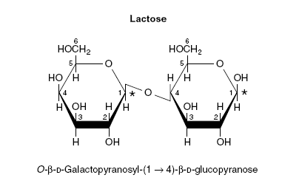

Slide 27
Sucrose (cane sugar)
Present in sugar cane and various fruits
Contains glucose and fructose
Reducing groups of glucose and fructose are involved in glycosidic bond ,hence sucrose is a non-reducing sugar,and cannot form osazone
When sucrose is hydrolyzed, the products have reducing action.

Slide 28
A sugar solution which is originally nonreducing but becomes reducing after hydrolysis is inferred as sucrose(specific sucrose test)
Sucrose as such is dextrorotatory (+), but when hydrolysed, sucrose becomes levorotatory (-)
This process of change in optical rotation is reffered to as inversion.

Slide 29
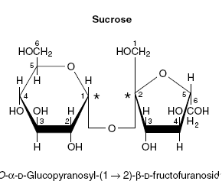

Slide 30
The α and β refer to the configuration at the anomeric carbon atom (asterisk).
When the anomeric carbon of the second residue takes part in the formation of the glycosidic bond, as in sucrose, the residue becomes a glycoside
As the disaccharide no longer has an anomeric carbon with a free potential aldehyde or ketone group, it no longer exhibits reducing properties.

Slide 32
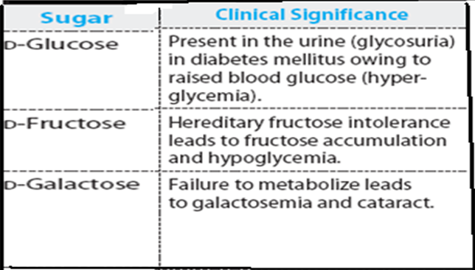

Slide 33
Polysaccharides :
Polysaccharides are non- sugars giving more than 10 monosaccharide molecules on hydrolysis.
They have higher molecular weight and form colloids with water.
They are two types
1. Homopolysaccharides (homoglycans) :
They contain monosaccharide units of single type. E.g. starch, glycogen,cellulose, inulin.

Slide 34
2. Heteropolysaccharides (heteroglycans) :
They possess 2 or more different types of monosaccharide units or their derivaties.

Slide 35
Homopolysaccharides:
Starch:
Reserve carbohydrate of plant kingdom
Sources:Potatoes,tapioca,cereals and other food grains
Contains two polysaccharide components
Water soluble amylose ( 15-20%)with non branching
helical structure containing 200-1000 D-glucose
units
Water insoluble amylopectin (80-85%)–branched
chain with 24-30 glucose units

Slide 36
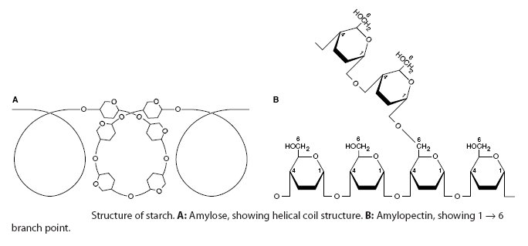

Slide 37
Forms blue coloured complex with iodine, which disappears on heating and reappears on cooling . This is the sensitive test for starch
Non-reducing sugar
Hydrolysis by mild acid
1.Amylodextrin-violet colour on iodine-nonreducing
2.Erythrodextrin-red colour-mildly reducing
3.Achrodextrin-no colour-reducing
4.Maltose- powerfully reducing

Slide 38
Glycogen (animal starch)
The storage polysaccharide in animals.
Composed of glucose units
High concentration in liver followed by muscle,brain

Slide 39
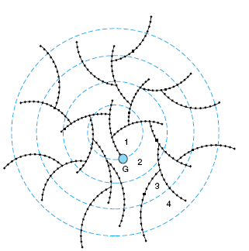
The glycogen moleculeGeneral structure

Slide 40
Cellulose
The chief constituent of the framework of plants.
It is insoluble
Cellulose cannot be digested by mammals because of the absence of an enzyme that hydrolyzes the β linkage.
It is an important source of fiber in the diet.
Fiber-
Decrease absorption of glucose and cholestrol from
intestine
Increase bulk of feces ,prevents constipation

Slide 41
Chitin is a structural polysaccharide in the exoskeleton
of crustaceans and insects and also in mushrooms
Heteropolysaccharides:
Glycosaminoglycans (mucopolysaccharides) arecomplex carbohydrates characterized by their content of amino sugars and uronic acids.
When these chains are attached to a protein molecule, the result is a proteoglycan.
Proteoglycans provide the ground or packing substance of connective tissues.

Slide 42
Their property of holding large quantities of water and occupying space, thus cushioning or lubricating other structures, is due to the large number of OH groups and negative charges on the molecules, which, by repulsion, keep the carbohydrate chains apart. Examples : hyaluronicacid, chondroitin sulfate, and heparin, keratin sulphate

Slide 43
Heparin :
Anticoagulant in lung ,liver,kidney,spleen
Serves as lubricant and shock absorber.
Promotes wound healing
Chondroitin sulphate :
cartilage,bone ,skin,blood vessel walls
Helps to maintain structure and shape of tissue

Slide 44
Dermatan sulphate :
skin,blood vessel valves,heart valves
Maintain shape of tissue
keratan sulphate :
cartilage,cornea,connective tissue
Keeps cornea transparent
Hyaluronic acid :
Cartilage,cornea,connective tissues
lubricant & shock absorbant,promotes wound healing

Slide 45
Glycoproteins (mucoproteins)
Proteins covalently bound to carbohydrates(1-90%)
Situations in fluids and tissues, including the cell membranes
Eg:
Collagen-structure
Hydrolase,proteases,glycosidases-enzymes
Ceruloplasmin- transport

Slide 46
Immunoglobulins-defence aginst infection
Thyropoetin,erythropoetin-hormones
Intrinsic factor-absorption of vit.B12
Blood group substances-antigens
Synovial glycoprotein-lubrication

Slide 47
General points
Maltose – malt sugar, does not exist free form in body produced during digestion α (1 - 4).
Lactose – milk sugar, linkage present is β (1 - 4).
Sucrose – cane sugar, on hydrolysed form is known as invert sugar (change in dextrorotatory to laevorotatary), major carbohydrate produced in photosynthesis.

Slide 48
Starch – carbohydrate reserve in pants, has two components water soluble amylose α (1 - 4) & water insoluble amylopectin α (1 - 6), hydrolysed by amylase.
Glycogen - carbohydrate reserve in animals, structure similar to starch.
Cellulose – absent in animals, composed of glucose units linked by β (1 - 4) glycosidic bonds, cannot be digested by humans due to absence of enzyme that cleaves β – glycosidic bonds.

Slide 49
Inulin – polymer of fructose, occurs in dahlia bulbs, garlic, onion etc, easily soluble in water, not utilized by the body, used in measurement of glomerular filtration rate.
Identification Tests
Molisch test – Carbohydrates ( dehydration)
Benedict’s test & Fehling’s test – Reducing sugar (reducing property)
Barfoed’s test - Monosaccharide
Seliwanoff’s test – Keto sugar (fructose)
Mucic acid test – Galactose

Slide 50
Iodine test - Starch
Osazone test – Crystallisation of sugars (Glucose & Fructose – needle shaped , Galactose – broken glass pieces, Maltose – star or sunflower shaped, Lactose – powder puff shaped, Sucrose – no crystals i.e., non- reducing sugar)

