Slide 1
CLEMATIS
PRESENTED BY,
DEPT OF MATERIA MEDICA

Slide 2
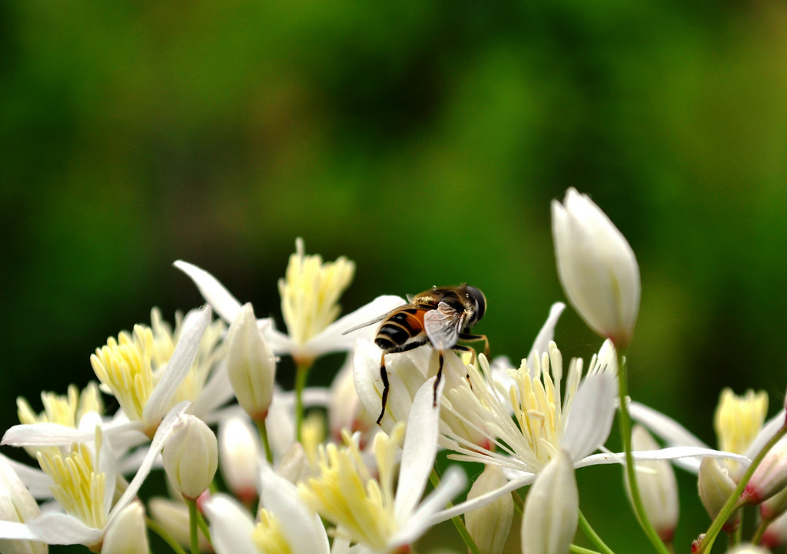

Slide 3
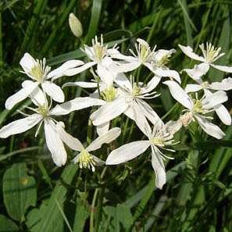
Natural Order: Ranunculacea Common Name: Upright Virgin’s Bower, Clematis , Devil's-darning-needle , Old-man's Beard , Traveler's-joy , Vine Bower , Virgin's Bower , Woodbine , Umdlonzo (Zulu) Habitat: Europe

Slide 4
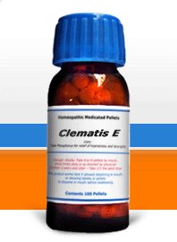
PREPARATIONS: Mother tincture prepared from the fresh leaves and dilutions.

Slide 5
USES Clematis has been evaluated for its anti-inflammatory, cytotoxic, and antimicrobial effects. PROTOANEMONIN – present in the fresh leaves, alkaloid responsible for the irritation of the skin.

Slide 6
The leaves and flowers when bruised irritate the eyes and throat giving rise to a flow of tears and coughing; applied to the skin they produce inflammation and vesication. They are diuretic and diaphoretic, and are useful locally and internally in syphilitic, cancerous and other foul ulcers. Best suited to fair people, much used by homoeopathists for eye affections, gonorrhoeal symptoms and inflammatory conditions.

Slide 7
CLEMATIS ERECTA
This is a good remedy for gonorrhœa when there are on account of slow or intermittent flow of urine indications of formation of a stricture, and will, if given early, often prevent it So much pain and suffering often necessitating operation for the relief of stricture has been experienced that everything possible should be done to avert it. In the first place the cauterization method, or fashionable local treatment, is responsible for nearly, if not quite, all strictures.

Slide 8
I know that such practice is neither scientific nor curative in the remotest sense, and on the other hand I know that constitutional treatment alone is adequate to cure the worst cases, and that in the shortest possible time. Another use for Clematis is for curing the orchitis arising from the suppression of gonorrhœa, or when it may have extended to the testicles without such suppression, which latter condition seldom occurs.

Slide 9
The testicle becomes greatly swollen, and if not promptly relieved becomes indurated and hard as a stone. I have cured this very promptly with Clematis. Puls is undoubtedly the remedy oftenest indicated in orchitis from suppressed gonorrhœa, but if after it has reduced the pain and restored the discharge it fails to reduce the swelling or induration, Clematis will do the rest. It has not disappointed me. Clematis has a symptom similar to Coffea, viz., "Toothache > by holding cold water in the mouth."

Slide 10
Scrofulous, rheumatic, gonorrhœal, and syphilitic patients. Acts especially on skin, glands and genito-urinary organs, especially testicles. A remedy of much importance in disturbances of sleep, and neuralgic pains in various parts. Many of these pains are relieved by perspiration. Muscles relaxed or twitching. Great emaciation. Great sleepiness. Distant pulsation in whole body.

Slide 11
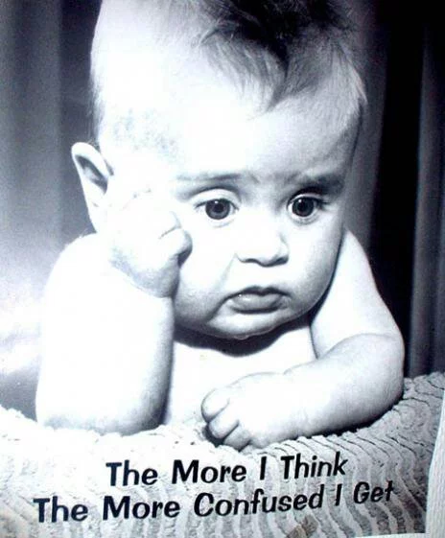
HEAD. Boring pain in temples. Confused feeling; better in open air. Eruption on occiput at base of hair, moist, pustular sensitive, itching.

Slide 12
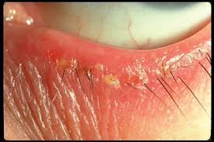
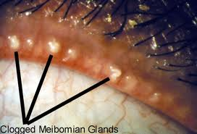
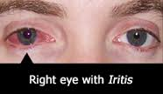
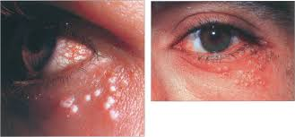
EYES. Heat in eyes and sensitive to air; must close them. Chronic blepharitis, with sore and swollen meibomain glands. Iritis, great sensitiveness to cold. Flickering before eyes. Pustular conjunctivitis, with tinea capitis; eyes inflamed and protruding.

Slide 13
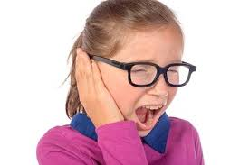
EARS Burning pain in exterior of the ear. Tinkling in the ear. Ringing as , from bells in the ear.

Slide 14
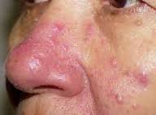
NOSE Purulent pimples, painful on being touched at the root, and on the point of the nose. Fluent coryza, with abundant secretion of mucus, streaked with blood.

Slide 15
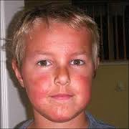
FACE. White blisters on face and nose, as if burned by sun. Swelling of submaxillary glands, with hard tubercles, throbbing, aggravated on being touched. Pain in right side of face to eye, ear and temple; better, holding cold water in mouth.

Slide 16
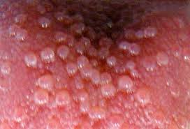
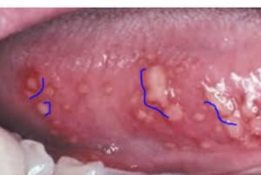
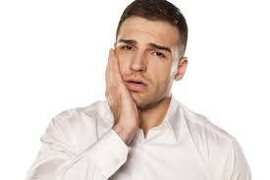
TEETH. Toothache; worse, at night and from tobacco. Teeth feel too long. MOUTH Dryness of tongue in the morning. Small blisters on the tongue and in the throat, which soon become ulcers.

Slide 17
STOMACH. After eating, weakness in all limbs and pulsation in arteries.

Slide 18
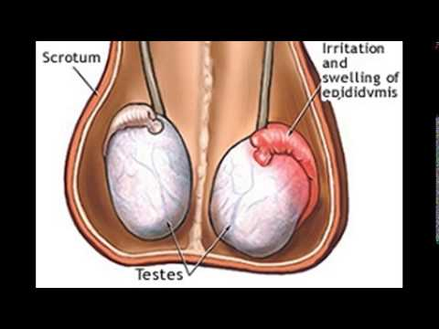
MALE. Ilio-scrotal neuralgia. Testicles indurated with bruised feeling. Swelling of scrotum (Orchitis). Right half only. Troubles from suppressed gonorrhœa. Violent erections with stitches in urethra. Testicles hang heavy or retracted, with pain along spermatic cord; worse, right side.

Slide 19
URINARY. Tingling in urethra lasting some time after urinating. Frequent, scanty urination; burning at orifice. Interrupted flow. Urethra feels constricted. Urine emitted drop by drop. Inability to pass all the urine; dribbling after urinating. Pain worse at night, pain along the spermatic cord. Commencing stricture.

Slide 20
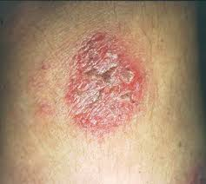
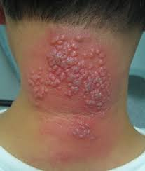
SKIN. Red, burning, vesicular, scaly, scabby. Itches terribly; worse, washing in cold water; worse face and hands and scalp around occiput. Glands hot, painful, swollen; worse inguinal glands. Glandular indurations and tumours of breast. Varicose ulcers.

Slide 21
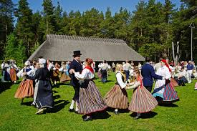
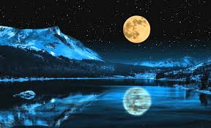
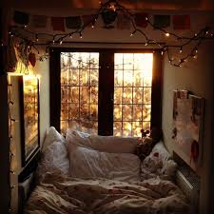
MODALITIES. Better, in open air. Worse, at night, and warmth of bed (washing in cold water); new moon--(monthly aggravation).

Slide 22
RELATIONSHIP. Compare: Clematis vitalba (varicose and other ulcers); Sil; Staph; Petrol; Oleand; Sarsap; Canth; Phos ac; Pulsat. Antidotes: Bryon; Camph. Dose.--Third to thirtieth potency.

