Slide 1
clostridium
DR.R.S.GOPIKA
DEPT OF PATHOLOGY AND MICROBIOLOGY
SKHMC

Slide 2
CLOSTRIDIUM

Slide 3
CLOSTRIDIUM
Anaerobic
Sporing
Diameter of the spore is larger than the cell
Kloster - spindle

Slide 4
GENERAL
Some are commensals of the animal & human gut which invade the blood and tissue when host die and initiate the decomposition of the dead body.
Causes diseases such as
gas gangrene,
tetanus,
botulism &
pseudo-membranous colitis
producing toxins which attack the neurons pathways.

Slide 5
Classification based on the type of disease produced
A . Tetanus Cl. tetani
B. Gas gangrene
- Established Cl. perfringens
Cl. septicum
Cl. novyi
- Less pathogenic Cl. histolyticum
Cl. fallax

Slide 6
Cl. tetani

Slide 7
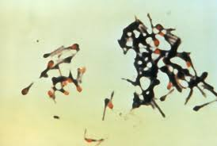
Cl. tetani
G- tetanos, to stretch
Gram +ve, straight, slender rod with rounded ends
endospore (drumstick)
Obligate anaerobe
peritrichous flagella

Slide 8
Culture
strict anaerobic conditions.
obligatory anaerobe,
37°C,
grows on NA medium
under anaerobic condition

Slide 9
BA
Irregular ,2-5mm, translucent,
Haemolysis, greyish yellow, butyrous. swarming

Slide 10
Cooked meat media
Before inoculation RCM/CMB medium is boiled to make it oxygen free.
After inoculation it is covered with a layer of sterile liquid paraffin oil to prevent entry of oxygen in the medium.
The ingredients present in the medium help to maintain the anaerobic environment.

Slide 11
Robertson’s cooked meat medium
After 48 hrs – small amount of growth.
Turbidity with small amount of gas.
Meat is not digested or slight digestion
and blackening of meat due
to sulphur containing amino acid.
Unpleasant slightly pungent smell.

Slide 12
Resistance
C. tetani spores remain viable in soil for many years.
The spores of some strains are resistant to boiling in water for up to 3 hours.
killed by autoclaving at 121 °C for 15 minutes.
resist to 5% phenol for 10 hours or more.
Vegetative cells of C. tetani are heat-labile.

Slide 13
Antigen
All C. tetani strains share a common somatic (O) antigen.
The 10 types (I-X) of C. tetani can be distinquished by specific flagellar (H) antigens.
Antigenic types I and III most often cause tetanus in humans
Type VI of CI. tetani is a non-flagellar strain which is only one non-motile strain
All types produce the same toxin which is pharmacologically and antigenically identical

Slide 14
Toxins
Cl. tetani produces two types of toxins:
Tetanolysin,
which causes lysis of RBCs - heat and oxygen labile.
Tetanospasmin
is neurotoxin and essential pathogenic product

Slide 15
Neurotoxin
Vegetative cells produce tetanospasmin during the stationary phase and release it mainly when they lyse
Tetanospasmin is a heat-labile ,is destroyed at 65 °C in 5min and by intestinal proteases.
LD - for mice is 0.0001 μg.
The human lethal dose is 2.5 ng/Kg
The toxin interferes with the release of inhibitor neurotransmitters, Leading to muscle contraction and spasm

Slide 16
Tetanospasmin- transport
initially binds to peripheral nerve terminals.
It is transported within the axon and across synaptic junctions until it reaches the central nervous system.
There it becomes rapidly fixed to gangliosides at the presynaptic inhibitory motor nerve endings, and is taken up into the axon by endocytosis.

Slide 17
Action of tetanospasmin
block the release of inhibitory neurotransmitters (glycine and gamma-amino butyric acid) across the synaptic cleft, which is required to check the nervous impulse.
If nervous impulses cannot be checked by normal inhibitory mechanisms, it produces the generalized muscular spasms characteristic of tetanus.

Slide 19
Pathogenesis
enters body through a wound
the spores germinate and produce toxins.
toxins disseminated via blood and lymphatics.
Toxins act at peripheral motor end plates, spinal cord, and brain, and in the sympathetic nervous system.
interferes with the release of inhibitor neurotransmitters
Leading to muscle contraction and spasm

Slide 20
Pathogenesis….
Spores germinate toxin motor nerve endings along the motor neurones of the peripheral nerve to the anterior horn cells local tetanus
Ascending tetanus – when toxins spreads upwards along the spinal cord towards C.N.S. Gives generalized spasms.
IP -10-14 days

Slide 21
types
local: affecting the muscles at site of infection
Cephalic: following otitis media and affecting the cranial nerves.
Generalized tetanus: the most common (80%)
The neonatal tetanus: generalized form, in non-immunized mother, via the umbilical cord stump in developing countries.

Slide 22
Localized tetanus
It remains confined to the muscles at the site of primary wound and infection.
has a good prognosis.
Another variant of localized tetanus is so called cephalic tetanus. The incubation of this variant is very short and its prognosis is considerably poor.

Slide 23
Symptoms of generalized tetanus
Incubation period -3 to 21 days
Early symptom is trismus (lock jaw) – spasms of the masseter muscle
Elevated temperature, sweating, hypertension.
Risus sardonicus - in which trismus is combined with facial spasm.
In severe cases, spasms of the back muscles produce the opisthotonus.
The patients are fully conscious, and pain may be very intensive.

Slide 24
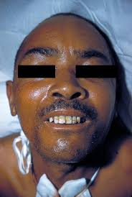
Risus sardonicus

Slide 25
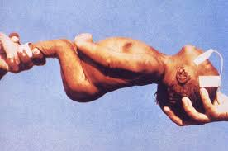
opisthotonus.

Slide 26
Symptoms of tetanus in later stages
high temperature is usually present.
Tachycardia.
Breathlesness and cyanosis are expressed when the respiratory muscles are affected by spasms.
Laryngospasms.
In severe cases violent spasms will last for few seconds to 3-4 mins.
If convulsions appear soon after the initial symptoms, it is very serious.
In fatal cases death results from respiratory or circulatory failures.

Slide 27
Tetanus of newborns/ tetanus neonatorum.
Tetanus of newborns follows infections of the umbilical stump.
At birth under unhygienic conditions.

Slide 28
Lab diagnosis
The diagnosis of tetanus depends primarily upon the clinical manifestation of tetanus including muscle spasm and rigidity.
Specimen:
Wound exudates using capillary tube
Culture:
On blood agar and incubated anaerobically
Growth appears as a fine spreading film.
Gram stain

Slide 29
Ospe 1
A 5 year boy was brought to outpatient department complaining of fever and sore throat. On examination his temp. was 38.5°C, the tonsil area and pharynx were obviously inflammed with some foci of pus.
What is the differential diagnosis?
What investigation should be done?

Slide 30
Osce -2
A 28 Year Old Female after an accident ,presented with a sudden onset of fever, right sided chest pain and productive cough of purulent sputum.
On examination her temperature was 39 °C.
There were Rhonci and dullness on the right side of the chest X-ray showed massive consolidation on the right side of the chest.
What investigation should be done?
What is the differential diagnosis?

Slide 31
Osce -3
A 5 year-old boy attended to the OP complaining of sore throat , fever (38.5°C), and a noticed pharyngeal pseudomembrane
What is the differential diagnosis?
What investigation should be done ?

Slide 32
C. botulinum

Slide 33
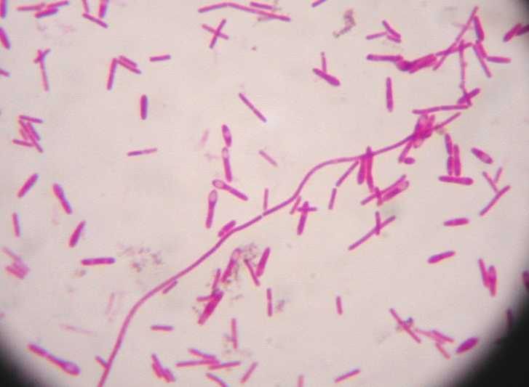
Morphology
Rods with rounded ends.
4-6 x .9 µm
Spores oval at or near ends
Peritrichate
Sluggishly motile
Non capsulated.

Slide 34
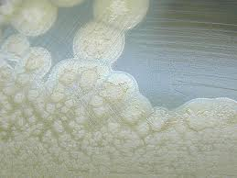
Cultural characters
Anaerobic
35ºC
NA -Irregularly round , fimbriated edges , 3mm.

Slide 35
Resistance
Spores are highly heat resistant ,withstand 100º C
for 3-5 hrs.
Heat resistance is reduced by acid pH or high salt
concentrations

Slide 36
Botulinal toxins
Botulinal toxins are among the most poisonous natural substances known.
Seven main types of C. botulinum designated A-G produce antigenically distinct toxins with pharmacologically identical actions
Released during growth and autolysis of bacteria.
The principle cause for human disease A,B,E &F
Toxin is neurotoxic protein
Destroyed by heating at 100C for 20 mins.

Slide 37
Toxin
A,B - Variety of foods
E - Fish products
C - in birds- Limberneck /Avian Botulism
D - botulism in mammals
LD - for man – 0.1 -1 µg
Released as protoxin - proteases of the host – active form .

Slide 38
Pathogenesis- action of Botulinal toxin
Food- Protoxin
intestinal Proteases
Active form- 0.01% absorbed
duodenum and jejunum
blood stream
peripheral neuromuscular synapses.
blocks the release of the neurotransmitter acetylcholine
flaccid paralysis.

Slide 39
Pathogenesis
Transmitted in three ways:
– Food or water - toxin contamination.
– Wound infected with C. Botulinum.
– Ingestion of C. botulinum.

Slide 40
Pathogenicity
Not an infection.
Botulism is an intoxication resulting from the ingestion of food in which C.botulinum has produced toxin.
Food borne botulism
Infant botulism
Wound botulism

Slide 41
Food borne Botulism
Botulism is a severe, often fatal, form of food poisoning characterized by pronounced neurotoxic efects.
The preformed toxin in the food is absorbed from the intestinal tract.
Although it is protein, it is not inactivated by the intestinal proteolytic enzymes.
Usual incubation period is 10 – 12 hours.

Slide 42
Clinical presentation
Descending symmetrical paralysis beginning with cranial nerve involvement
Onset begins with blurry vision, followed by ocular muscle paralysis, dry mouth and difficulty in swallowing and speaking.
Respiratory paralysis occur in severe cases.
Mental status in unaffected.
Incubation is shortest for type E strain (hours), longest for type A strains (up to 10 days), and is inversely proportional to the quantity of toxin.

Slide 43
Wound botulism
Wound botulism (types A or B)
follow C. botulinum entry
drug abuser injection site, surgical or traumatic wounds.

Slide 44
INFANT BOTULISM
Less than 6 months old children
Floppy child syndrome
Associated with ingestion of honey
Honey has endospores in it naturally→ bees pick up the endospores from the flowers
Immature intestinal microflora of infants leads to infant botulism
The diagnosis is confirmed by the detection of the organism or its toxin in the infant’s stool

Slide 45
INFANT BOTULISM

Slide 47
Symptoms of botulism
appear between 3 to 30 days after an infant consumes the spores.
Constipation is often the first sign of botulism that parents notice
Other symptoms can include:
flat facial expression
poor feeding (weak sucking)
weak cry
decreased movement
trouble swallowing with excessive drooling
muscle weakness
breathing problems

Slide 48
Clostridium septicum
The terminal or sub-terminal spore causes them to appear like drumstick.
have peritrichous flagellae.
Culture
BA- 3mm,48 hrs, circular with filamentous border.

Slide 49
pathogenesis
C. septicum is highly pathogenic in humans because they produce a variety of toxins.
the alpha toxin, a potent toxin responsible for non-traumatic gas gangrene.
associated with malignancy (colon carcinoma, leukemia, and breast carcinoma), pericarditis, and mycotic aneurysm.
The precise mechanisms are unknown.

Slide 50
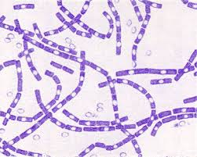
Ospe – gram positive bacterias
Identify the organism
Explain its morphological features

Slide 51
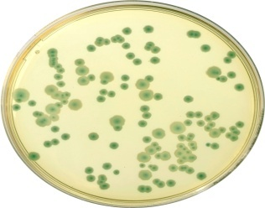
2
Identify the organism
by noting the colony morphology

Slide 52
3.
Identify the lesion ,
name the condition ,
causative organism responsible for it .

Slide 53
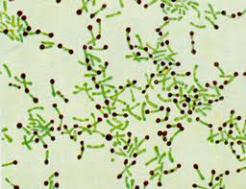
4
Identify the organism
Explain its morphological features
Name the Special Stain used

Slide 54
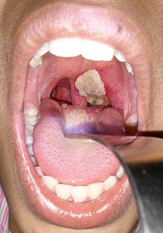
4.
Identify the lesion
name the condition
causative organism responsible for it

Slide 55
5
Name the test
Its importance

Slide 56
6
Identify the organism responsible for this type of colony
Culture media used

Slide 57
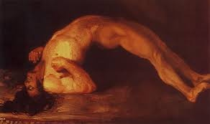
7
Name the condition
Organism responsible for this
Its pathogenesis

Slide 58
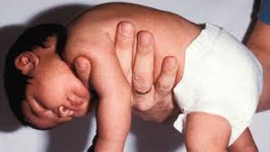
8
Name the condition
Organism responsible for this
Its pathogenesis

Slide 59
Clostridium perfringens

Slide 60
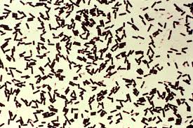
Clostridium perfringens
C. welchii/ Bacillus welchii)
anaerobic, non motile
Spore -oval subterminal
5x1µm
found as a normal component of decaying vegetation,
marine sediment, intestinal tract of humans
and other vertebrates, insects, and soil.

Slide 61
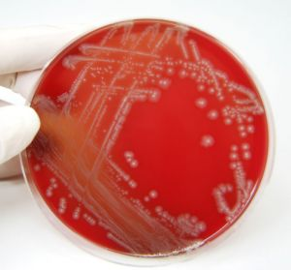
Cultural characters
BA- in anaerobic conditions,
IP-2days - a double zone of beta ,alpha hemolysis.
Colonies - circular semitransparent

Slide 62
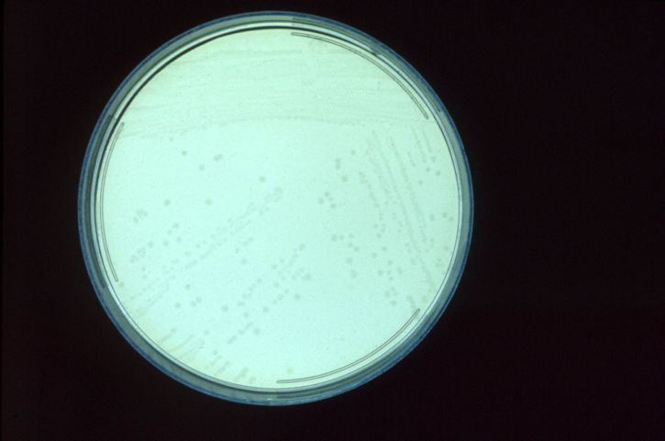
Tryptone Sulfite Cycloserine Agar
described by Harmon for the selective isolation and enumeration of Clostridium perfringens in water and food samples. black colonies

Slide 63
Reaction on Cooked Meat Medium
Saccharolytic reaction
It causes fermentation of glycogen of muscles
Production of acid and gas
Meat particles remain intact
e.g Cl. perfergines
Proteolytic Reaction
It causes digestion of meat particles
Formation of black, foul smelling due to sulfur compounds

Slide 64
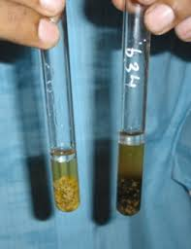
Cooked Meat Medium
IP- 4-6 hrs,
OT- 45 º C
Cl per- Meat is not digested but slightly reddened with gas production

Slide 65
Virulence factors
toxins
collagenase
hyaluronidase
DNase

Slide 66
Toxins
Major toxins – α, β, ε, ι
Minor toxins – γ, η , δ, κ, λ, μ, ν,θ
Enterotoxin – Heat labile
Neuraminidase – RBC agglutination, blood viscosity , capillary thrombosis.

Slide 67
The toxins of Cl. perfringens
α toxin (phospholipase C, lecithinase) is the most important toxin- Lyses of RBCs, platelets, WBCs and endothelial cells
Increased vascular permeability with massive hemolysis and bleeding tissue destruction
Hepatic toxicity and myocardial dysfunction
β-toxin is responsible for necrotic lesions in necrotizing enterocolitis
Enterotoxin is heat labile toxin produced in colon → food poisoning

Slide 68
Toxins….
epsilon, iota- necrotizing properties
Delta – haemolytic
Theta - haemolysin

Slide 69
Biochemical Tests
Cl. perfringnes characterized by:
It ferments many carbohydrates with acid & gas
It acidified litmus milk with stormy clot production
Nagler reaction is positive

Slide 70
Nagler’s Reaction
test is done to detect the lecithinase activity
inoculated on the medium containing human serum or egg yolk (contains lecithin)
The plate is incubated anaerobically at 37 º C for 24 hr
Colonies of Cl. perfringens are surrounded by zones of turbidity due to lecithinase activity.
the effect is specifically inhibited if Cl. perfringens antiserum containing α antitoxin is present on the medium

Slide 71
Biochemical reaction

Slide 72
Virulence Mechanisms:
Primary cause of virulence is exotoxin
Primary toxin is alpha toxin - hydrolyzes substances essential to membranes and other cellular structures.
beta, epsilon and iota toxins effect vascular endothelium causing increased permeability.
delta and theta toxins cause haemolysis.
Tissue degeneration causes even less blood flow, in an environment that was already ischemic.

Slide 73
Pathogenesis
Causes
Soft tissue infections-
cellulitis, fascitis, suppurative myocytis and myonecrosis or Gas gangrene
Septicemia
Endometritis
GIT
Necrotizing enteritis
Food poisoning.

Slide 74
Food poisoning/ Gastroenteritis
Spores contaminate food that has not been cooked thoroughly enough to destroy spores.
Spores germinate and multiply (especially if unrefrigerated).
IP – 8-24 hrs
When consumed, toxin is produced in the intestine; acts on epithelial cells, acute abdominal pain, diarrhea, and nausea but no fever.
Rapid recovery

Slide 75
Pig bell disease / Necrotising enteritis/ enteritis necroticans
Beta toxin
New Guinea.
Infective dose- Viable bacilli - 10⁸
Pig feast – lack of trypsin due to low protein diet
Enterotoxin
necrotizing inflammation of the small bowel (especially the jejunum but also the ileum).

Slide 76
Clinical
vary from mild diarrhea to a life-threatening sequence of
severe abdominal pain,
vomiting (often bloody),
bloody stool,
ulceration of the small intestine with perforation into the peritoneal cavity and
death within a day due to peritonitis.

Slide 77
"Clostridial myonecrosis/gas gangrene
IP- 10-48 hrs
bacteria may enter the muscle through a wound and proliferate in necrotic tissue and secrete powerful toxins
toxins destroy nearby tissue, generating gas
A gas composition of 5.9% hydrogen, 3.4% carbon dioxide, 74.5% nitrogen and 16.1% oxygen

Slide 78
Pathology
Muscles – coagulative necrosis/ liquefactive
Muscle fibers & other connective tissue elements become seperated from each other due to gas & oedema fluid.
Bl.v.- hyperemic, thrombosis of venules, haemorrhages
Ischaemia spread of gangrenous process, less or no infl reaction.

Slide 79
Macroscopically
–part swollen, oedematous, discoloured, crepitant,
- skin blisters, tissues- dripping of serosangunous fluid "sweetly putrid" or "dishwater pus" because it is much thinner than normal pus
-foul odour
- Bubbles of gases escape from deeper tissues.

Slide 80
c/f
Sudden onset of excruciating pain at the site
Rapid development of serosangunous discharge
Crepitus in muscles
Brawny oedema and induration
Liquified tissue sloughed off
Shock and organ failure

Slide 81
Gas gangrene

Slide 82
Lab
?

Slide 83
1
trisomy 21 is also known as

Slide 85
2
trisomy 18 syndrome is also known as

Slide 86
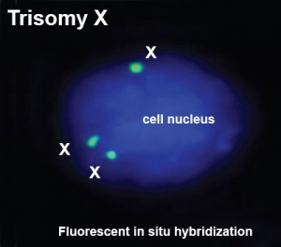
3
Triple X syndrome is also known as

Slide 87
4
Sex chromosome anomalies- (45,X) is known as

Slide 88
5
Sex chromosome anomalies- (47,XXY) is known as

Slide 89
6
fragile X syndrome is
a) monosomy X
b) trisomy X

Slide 90
7
"TORCH" is an acronym meaning

Slide 91
TORCH
(T)oxoplasmosis,
(O)ther Agents,
(R)ubella
(C)ytomegalovirus, and
(H)erpes Simplex.
TORCH Syndrome refers to any of a group of infections in newborns due to one of the TORCH infectious agents having crossed the placenta during pregnancy.
Leads to - miscarriage, stillbirth, delayed fetal growth and maturation (IUGR), or early delivery

Slide 92
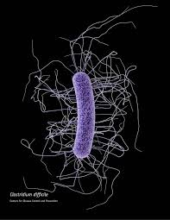
Clostridium difficile
Gram-positive
spore-forming bacterium
motile
causing antibiotic-associated diarrhea (AAD).

Slide 93
Pathogenesis
Produces enterotoxins that damage intestines
Major cause of diarrhoea in hospitals
Increasingly more common in community acquired diarrhea

Slide 94
Pathogenesis
C. difficile is transmitted from person to person by the fecal-oral route.
cause disease when competing bacteria in the gut have been wiped out by antibiotic treatment.
In severe cases, cause "pseudomembranous colitis.
Latent symptoms often mimic some flu-like symptoms.

Slide 95
c/f
Symptoms range from mild diarrhea to severe life-threatening colitis
In adults- significant diarrhea ("new onset of more than three partially formed or watery stools per 24 hour period"), recent antibiotic exposure, abdominal pain, fever (up to 40.5°C or 105°F), and a distinctive foul stool odour

Slide 96
pseudomembranous colitis

Slide 97
Diagnosis
Clinical suspicion
Culture of faeces
Detection of toxin

Slide 98
commons.wikimedia.org
en.wikipedia.org
Text Book of Microbiology-Anandanarayanan

