Slide 1
CARBOHYDRATE
Dr RESHMY K.R
Professor
Dept. of Physiology

Slide 2
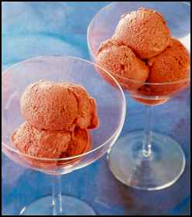
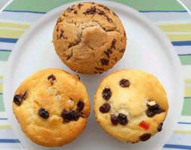
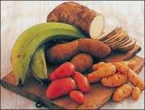
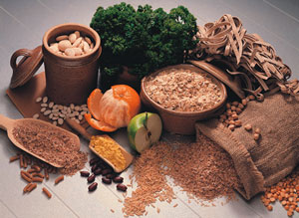
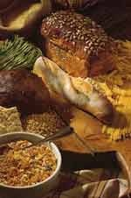
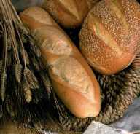
Carbohydrates

Slide 3
Carbohydrates are polyhydroxy aldehydes or ketones or compounds which yield these on hydrolysis
made of carbon, hydrogen and oxygen in the ratio 1:2:1
primary fuel source for body cells
the general formula of carbohydrate Cn(H₂O)n

Slide 4
CARBOHYDRATES
60% of our food should come from carbohydrates.
percursors for many organic compounds(fats, aminoacids)

Slide 5
CARBOHYDRATES
Carbohydrates give the body energy.
They are the best source of fuel for the body.
Carbohydrates also help to digest protein and fat.

Slide 6
Carbohydrates also play a vital part of the metabolism and oxidation of protein
Carbs help feed the brain and nervous system and helps keep the body lean.

Slide 7
Simple Carbohydrates
Simple carbohydrates are quick energy sources.
They come from sugar.
They do not usually supply any other nutrients or fiber.

Slide 8
Simple Carbohydrates
  monosaccharides – single sugars
  disaccharides – 2 monosaccharides

Slide 9
CARBOHYDRATES
Polyhydroxy aldehydes or ketones, or substances that yield these compounds on hydrolysis
Aldehyde
group
O H
C
H- C - OH
CH₂OH
CH₂OH
C O
CH₂OH
Keto
group
Glyceraldehyde Dihydroxyacetone
Carbohydrate with an aldehyde group: Aldose
Carbohydrate with a ketone group: Ketose

Slide 10
O H
C
H- C - OH
CH₂OH
CH₂OH
C O
CH₂OH
Both can be
written
C₃H₆O₃ or
(CH₂O)₃
Glyceraldehyde Dihydroxyacetone
Empirical formula of many simpler carbohydrates: (CH₂O)_{n}
(hence the name hydrate of carbon)

Slide 11
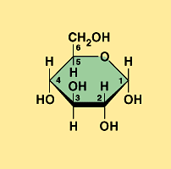
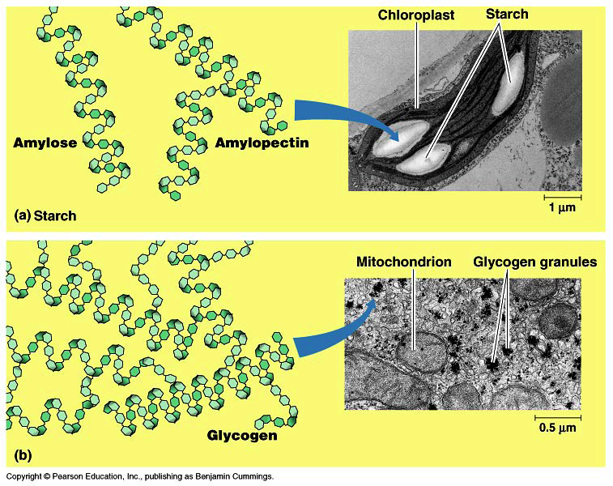
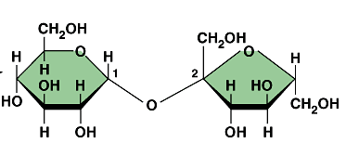
What does a carbohydrate look like?
glucose
C₆H₁₂O₆
sucrose
starch

Slide 12
What are carbohydrates made of?
Building block molecules =
sugars
sugar - sugar - sugar - sugar - sugar
sugar
sugar
sugar
sugar
sugar
sugar
sugar
sugar

Slide 13
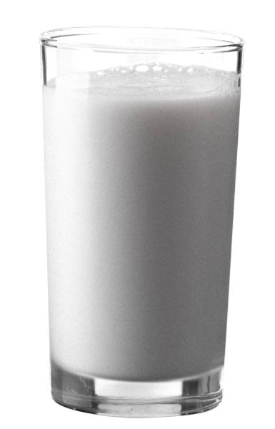
Sugars = building blocks
Names for sugars usually end in
  Glucose
  Fructose
  Sucrose
  Lactose
-ose

Slide 14
Simple Carbs
monosaccharides
  all are 6 carbon hexes
    6 carbons
    12 hydrogens
    6 oxygens
    arrangement differs
      accounts for varying sweetness
  glucose, fructose, galactose

Slide 15
Monosaccharides
Polyhydroxy aldehydes or ketones that can’t easily be further hydrolyzed
“Simple sugars”
Number of carbons Name Example
3 Trioses Glyceraldehyde
4 Tetroses Erythrose
5 Pentoses Ribose
6 Hexoses Glucose, Fructose
7 Heptoses Sedoheptulose
9 Nonoses Neuraminic acid

Slide 16
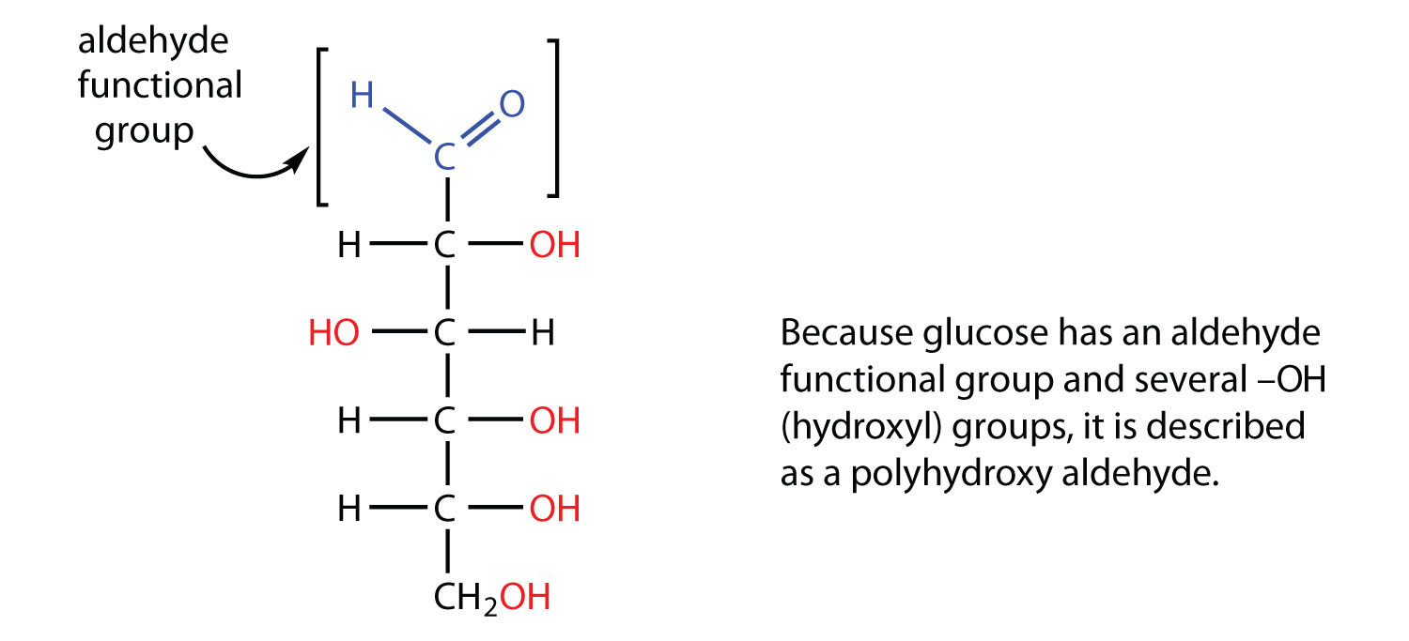
nomenclature
monosaccharides- molecules having only one actual or potential sugar group
glucose is a aldohexose
fructose is a ketohexose

Slide 17
Disaccharides--- when 2 monosaccharides are combined together with elimination of a water molecules

Slide 18
oligosaccharides---trisaccharides further addition of sugar groups will correspondingly produce tetra, penta & so on.

Slide 19
polysaccharides---more than 10 sugar units combined
polymers of monosaccharide units with high molecular weight
tasteless and form colloides with water.
2 types- Homopolysaccharides, Heteropolysaccharides

Slide 20
homopolysaccharides---only one type of monosaccharide units
heterosaccharides----different monosaccharide units

Slide 21
Oligosaccharides
Hydrolyzable polymers of 2-6 monosaccharides
Disaccharides composed of 2 monosaccharides
Examples: Sucrose, Lactose
Polysaccharides
Hydrolyzable polymers of > 6 monosaccharides
Homopolysaccharides:
polymer of a single type of monosaccharide
Examples: Glycogen, Cellulose
Heteropolysaccharides:
polymer of at least 2 types of monosaccharide
Example: Glucosaminoglycans

Slide 22
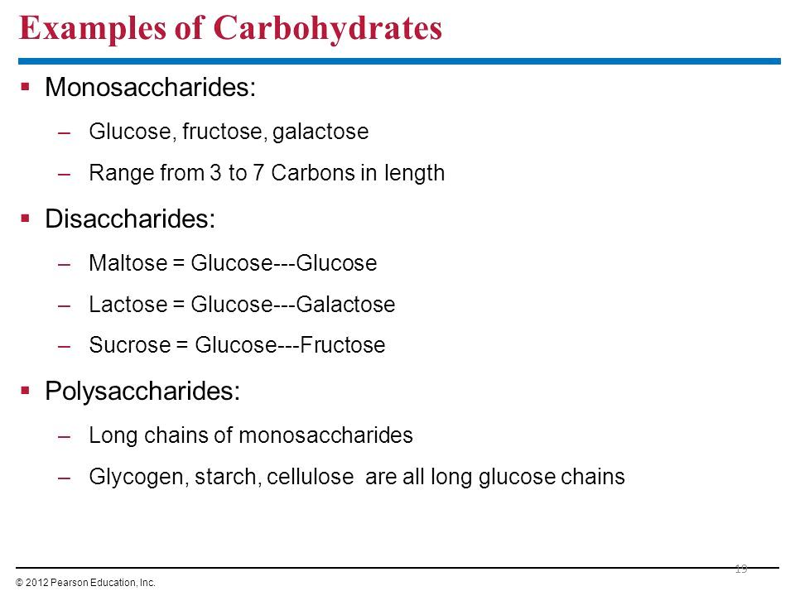

Slide 23
structural aspect--stereoisomers
compounds having same structural formula, but differ in spatial configuration.
spacial arrangement of H and OH group are important
the reference molecule is Glyceraldehyde which has a single asymmetric carbon atom

Slide 24
asymmetric carbon
a carbon is said to be asymmetric when it is attached to four different atoms or groups.
possible isomers of a given compound which is equal to 2^{n}
glucose contains 4 asymmetric carbons and thus has 16 isomers.
glyceraldehyde -1 asymmetric carbon atoms

Slide 25
Structural isomers
Compounds with the same molecular formula but with
different structures
Functional group isomers
with different functional groups
E.g. glyceraldehyde and dihydroxyacetone
Positional isomers
with substituent groups on different C-atoms
E.g.
COO⁻-CHOPO₃⁻-CH₂OH and COO⁻-CHOH-CH₂OPO₃⁻
2-Phosphoglycerate 3-Phosphoglycerate

Slide 26
D and L Isomerism of Glucose
monosaccharides can be considered as molecules derived from Glyceraldehyde.
depending on the configuration of H and OH around the reference carbon atom , the two mirror forms are designated as L and D forms
D and L types , produces a mirror image
all naturally occuring sugars are D sugars

Slide 27
ISOMERISM
B
A C D
E
B
D C A
E
Mirror
One member of an enantiomeric pair will rotate a plane of polarized light in a clockwise direction.
It is said to be dextrorotatory which is labelled (+)
The other member of the pair will then rotate the light in a counterclockwise direction.
It is said to be levorotatory which is labelled (-)

Slide 28
Reference compound for optical isomers is the simplest monosaccharide with
an asymmetric carbon: glyceraldehyde
O H
C
H- C - OH
CH₂OH
C-atom 1
C-atom 2 (an asymmetric carbon)
C-atom 3
O H
C
H- C - OH
CH₂OH
O H
C
HO- C - H
CH₂OH
CH₂OH
C O
CH₂OH
D-Glyceraldehyde L-Glyceraldehyde Dihydroxyacetone
D-Glyceraldehyde is assigned to be the isomer that has the hydroxyl group
on the right when the aldehyde group is at the top in a Fischer projection formula.
It is also dextrorotatory, so it is also D(+)-Glyceraldehyde

Slide 29
If a compound has n asymmetric carbon atoms then there are
2^{n} different optical isomers
Number of Number of Number of
carbon atoms Aldose/Ketose asymmetric carbon atoms optical isomers
3 Aldose 1 2
4 Aldose 2 4
5 Aldose 3 8
6 Aldose 4 16
3 Ketose 0 -
4 Ketose 1 2
5 Ketose 2 4
6 Ketose 3 8

Slide 30
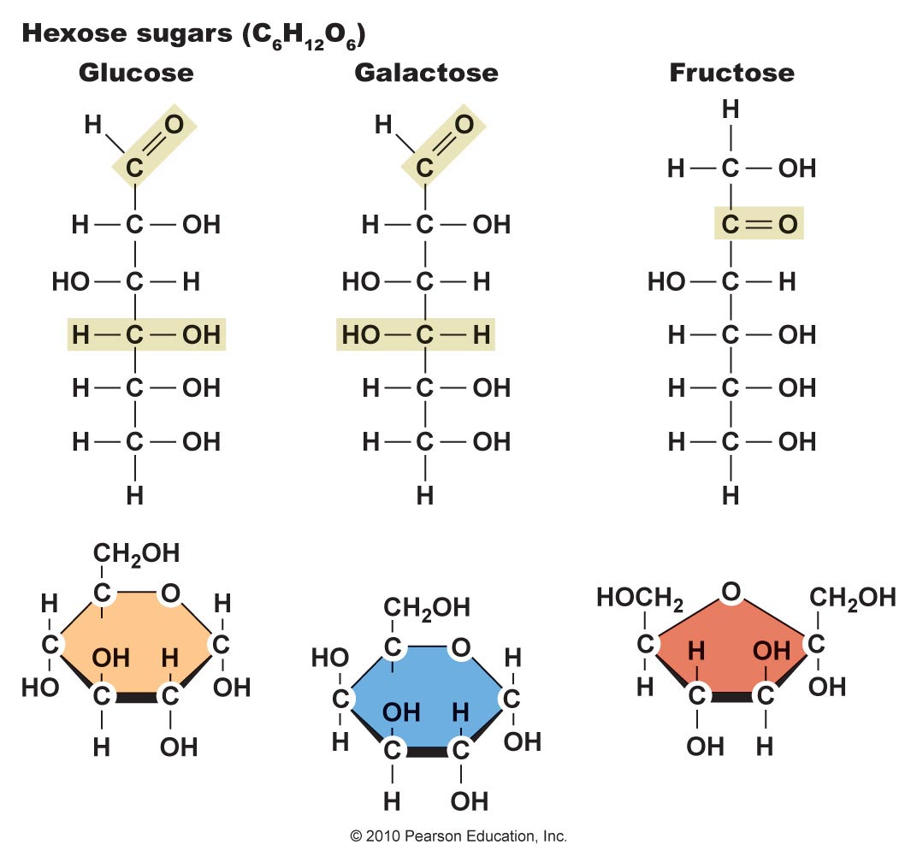
Structural Differences between Glucose, Galactose, and Fructose
Figure 4.2

Slide 31
Epimers
If 2 monosaccharides differ from each other in their configuration around a single specific carbon atom, they are referred to as epimers to each other.
eg- glucose & galactose are epimers with regard to carbon 4
they differ in the arrangement of -OH group at C4.
the interconversion of epimers is called as epimerization and a group of enzyme -epimerase catalyse the reaction

Slide 32
Enantiomers
Enantiomers are a special type of sterioisomers that are mirror images of each other

Slide 33
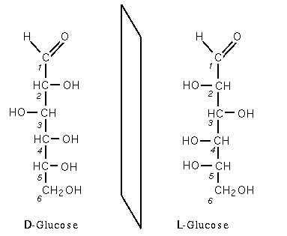

Slide 34
Anomers
alpha & beta cyclic form of D glucose
they differ from each other in the configuration onlyaround C1 known as anomeric carbon

Slide 35
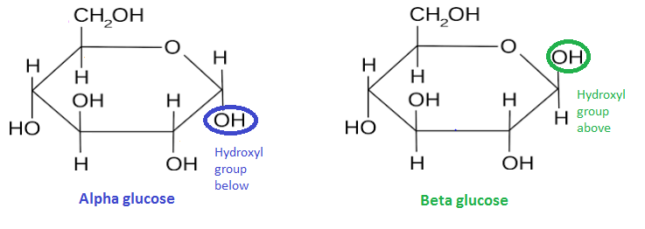
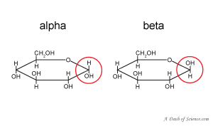
Alpha& beta glucose

Slide 36
Reactions of Carbohydrate
Enediol formation
Benedict's reaction
Osazone formation
Reduction to form alcohols
Oxidation of sugars
Furfural derivatives
Formation of Esters

Slide 37
Furfural derivatives- basis of molish test
occurs dehydation with the removal of 3 molecules of water when treated with con H ₂SO ₄
The furfural derivatives can condense with phenolic compounds to give a coloured product

Slide 38
basis of reduction test of sugar---enediol formation
Process of shifting a hydrogen atom from one carbon to another to produce enediols is called as tautomerization
In mild alkaline solution cho. containing free sugar groups will tautomerise to form enediols, where 2 hydroxyl groups are attached to the double bonded carbon

Slide 39
glucose is a reducing sugars, all sugars with free aldehyde / keto gp will reduce Benedict reagent
cupric ions of coppersulphate to cuprous ions which forms a yellow ppt of cuprous hydroxide or a red ppt of cuproues oxide

Slide 40
osazone formation
Forms osazone with excess of phenylhydrazine when kept at boiling temperature

Slide 41
https://www.slideshare.net/syed_ismail/carbohydrates-28872311
https://www.slideshare.net/SaifulIslam750/carbohydrates-and-its-classification
https://webstor.srmist.edu.in/web_assets/srm_mainsite/files/files/CARBOHYDRATES.pdf
THANK YOU

