Slide 1
CEREBELLUM
Dr.DEEPA.G.S
Associate Professor
SKHMC

Slide 2
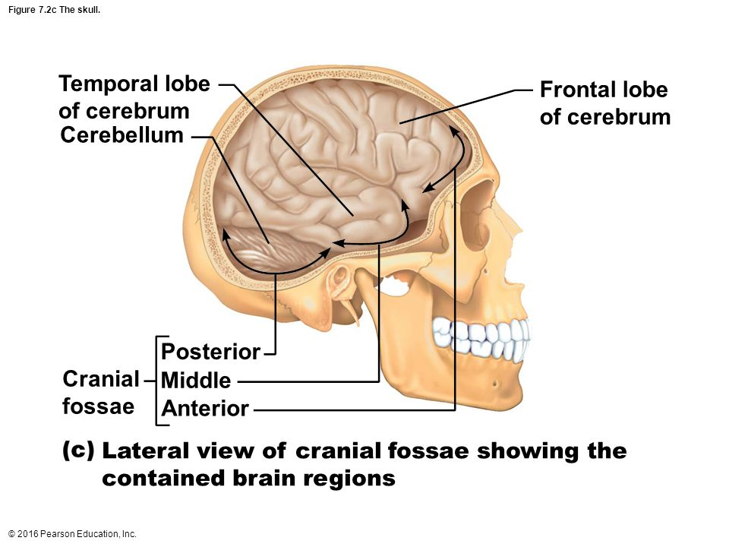
CEREBELLUM-LITTLE BRAIN
Location: Posterior cranial fossa

Slide 3
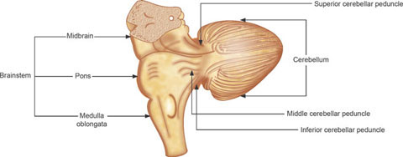
Cerebellum
Connected to brain stem through 3 peduncles
Superior cerebellar peduncle-to midbrain
Middle cerebellar peduncle-to pons
Inferior cerebellar peduncle-to medulla
https://www.jaypeedigital.com/book/9789350909409/chapter/ch6

Slide 4
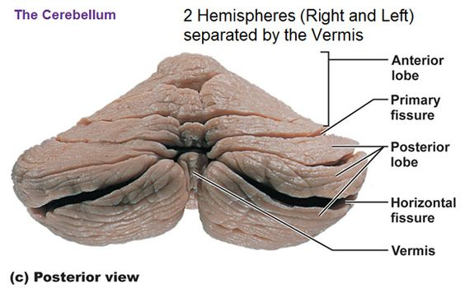
Parts of cerebellum
Vermis- a narrow, worm-like central body
Two lateral lobes
the right and left cerebellar hemispheres
https://in.pinterest.com/pin/556405728946822753/

Slide 5
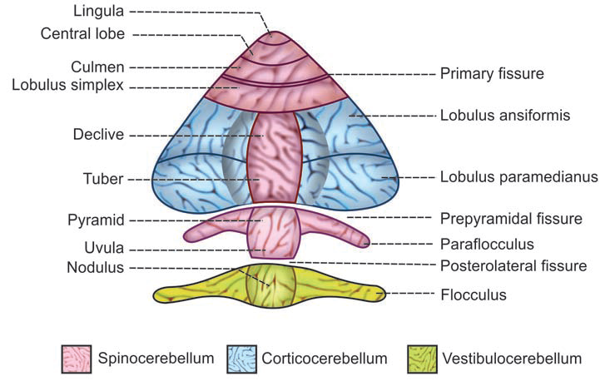
Parts of cerebellum
Vermis is divided into 9 primary lobules
1.Lingula
2.Central lobe
3.Culmen
4.Lobulus simplex
5.Declive
6.Tuber
7.Pyramid
8.Uvula
9.Nodulus

Slide 6
Parts of cerebellum
Nodulus is continued on either side as an elongated and somewhat lobulated structure called flocculus.
Nodulus and flocculi are together called flocculonodular lobe.
On either side of pyramid, there is another extension named paraflocculus.

Slide 7
Parts of cerebellum
Fissures Present Over the Surface of Vermis
1.Primary fissure between culmen and lobulus simplex
2.Prepyramidal fissure between tuber and pyramid
3.Posterolateral fissure between uvula and nodulus

Slide 8
CEREBELLAR HEMISPHERES
Cerebellar hemispheres are the extended
portions on either side of vermis.
Each hemisphere has two portions:
1.Lobulus ansiformis or ansiform lobe
2. Lobulus paramedianus or paramedian lobe

Slide 9
DIVISIONS OF CEREBELLUM
Division of cerebellum into different major
parts is done by 3 methods:
A. Anatomical divisions
B. Phylogenetic divisions
C. Physiological or functional divisions.

Slide 10
DIVISIONS OF CEREBELLUM
ANATOMICAL DIVISIONS
On structural basis, the whole cerebellum is
divided Into three portions:
1. Anterior lobe
2. Posterior lobe
3. Flocculonodular lobe.

Slide 11
DIVISIONS OF CEREBELLUM
Anterior Lobe
Anterior lobe includes lingula, central lobe and
culmen.
It is separated from posterior lobe by primary
fissure.
Posterior Lobe
Posterior lobe consists of lobulus simplex,
declive, tuber,pyramid, uvula, paraflocculi and
the two portions of hemispheres, viz.
ansiform lobe and paramedian lobe

Slide 12
DIVISIONS OF CEREBELLUM
Flocculonodular Lobe
Flocculonodular lobe includes nodulus and the lateral extension on either side called flocculus.
It is separated from rest of the cerebellum by posterolateral fissure.

Slide 13
PHYSIOLOGICAL OR FUNCTIONAL DIVISIONS
Based on functions, the cerebellum is divided into
Three divisions:
Vestibulocerebellum
Vestibulocerebellum includes flocculonodularlobe
Spinocerebellum
Spinocerebellum includes lingula, central lobe
culmen,lobulus simplex, declive, tuber, pyramid,
uvula and paraflocculi and medial portions of
lobulus ansiformis and lobulusparamedianus.

Slide 14
PHYSIOLOGICAL OR FUNCTIONAL DIVISIONS
Corticocerebellum
Corticocerebellum includes lateral portions of
Lobulus ansiformis and lobulus paramedianus.

Slide 15
FUNCTIONAL ANATOMY OF CEREBELLUM
Cerebellum is made up of
Outer gray matter or cerebellar cortex
Inner white matter.
White matter
Formed by afferent and efferent nerve fibers of cerebellum.
Gray masses called cerebellar nuclei are located within the white matter.

Slide 16
CEREBELLAR CORTEX-GRAY MATTER
Gray matter or cerebellar cortex is made up
of structures arranged in three layers
Layers of gray matter:
1. Outer molecular or plexiform layer
2. Intermediate Purkinje layer
3. Inner granular layer

Slide 17
Cerebellar cortex-Layers
https://veteriankey.com/the-cerebellum/

Slide 18
CEREBELLAR CORTEX-GRAY MATTER
Molecular or Plexiform Layer
Molecular or plexiform layer is the outermost layer of cortex having the cells arranged in two strata.
Superficial stratum contains few star-shaped cells known as stellate cells.
Deep stratum contains basket cells.

Slide 19
CEREBELLAR CORTEX-GRAY MATTER
Molecular layer contains the following
structures:
i.Parallel fibers, which are the axons of granule cells, present in granular layer
ii.Terminal portions of climbing fibers (afferents from medulla)
iii.Dendrites of Purkinje cells and Golgi cells.

Slide 20
STRUCTURE OF CEREBELLAR CORTEX.

Slide 21
CEREBELLAR CORTEX-GRAY MATTER
Purkinje Layer
It is the thinnest layer, having a single layer of flask-shaped Purkinje cells.
Purkinje cells are the largest neurons in the body.
Dendrites of these cells ascend through the entire thickness of molecular layer and arborize there.

Slide 22
CEREBELLAR CORTEX-GRAY MATTER
These dendrites terminate either on climbing fibers or the parallel fibers.
Axons of Purkinje cells descend into the white matter and terminate on the cerebellar nuclei and vestibular nuclei via cerebellovestibular tract.

Slide 23
CEREBELLAR CORTEX-GRAY MATTER
Purkinje cells are termed as ‘final common path’ of cerebellar cortex.
It is because the impulses from different parts of cerebellar cortex are transmitted to other parts of brain only through Purkinje cells.

Slide 24
Purkinje cells-Final common pathway
https://neurotransporter.org/Cerebellum.html

Slide 25
CEREBELLAR CORTEX-GRAY MATTER
Granular Layer
It is formed by interneurons called granule cells and Golgi cells.
Total number of interneurons in this layer is about half the number of all neurons in the whole nervous system.

Slide 26
CEREBELLAR CORTEX-GRAY MATTER
Axon of granule cell ascends into molecular layer and forms the parallel fiber, which synapses with dendrites of Purkinje cells, stellate cells, basket cells and Golgi cells.
Dendrites of granule cells and the axon and few dendrites of a Golgi cell synapse with Mossy fiber.
The synaptic area of these cells is called glomerulus and it is encapsulated by the processes of glial cells.

Slide 27
Cell junctions-Grey matter
Stellate cells
Dendrites –Parallel fibers
Axons-dendrites of purkinje cells
Basket cells
Dendrites –Parallel fibers
Axons-Soma of purkinje cells
Purkinje cells
Dendrites- climbing fibers and parallell fibers
Axons-cerebellar nuclei

Slide 28
Cell Junctions-Grey matter
Granule cells
Dendrites-Mossy fibers
Axons-Parallel fibers-Dendrites of pukinje
stellate, basket,golgi cells
Golgi cells
Dendrites-Parallel fibers
Axons and few dendrites-Mossy fibers

Slide 29
Afferent Fibers to Cerebellar Cortex
Cerebellar cortex receives afferent signals
(input) from other parts of brain through two
types of nerve fibers:
1. Climbing fibers
2. Mossy fibers.

Slide 30
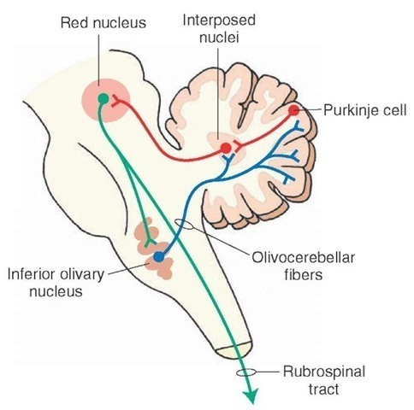
Afferent Fibers to Cerebellar Cortex
Climbing fibers
Origin:From inferior olivary nucleus situated in medulla and reach the cerebellum via olivocerebellar tract.
http://what-when-how.com/neuroscience/the-cerebellum-motor-systems-part-4

Slide 31
Afferent Fibers to Cerebellar Cortex
Inferior olivary nucleus relays the output signals from motor areas of cerebral cortex and the proprioceptive signals from different parts of the body to the cerebellar cortex via climbing fibers.
Proprioceptive impulses from different parts of the body reach the inferior olivary nucleus through spinal cord and vestibular system.

Slide 32
Afferent Fibers to Cerebellar Cortex
After reaching the cerebellum, the climbing fibers ascend into molecular layer and terminate on the dendrites of Purkinje cells
While passing through cerebellum, climbing fibers of olivocerebellar tract send collaterals to cerebellar nuclei.
Each climbing fiber innervates one single Purkinje cell.

Slide 33
Afferent Fibers to Cerebellar Cortex
Mossy fibers:
Origin: motor areas of cerebral cortex, pons, medulla and spinal cord, cerebellar nuclei
Fibers arising from all these areas send collaterals to cerebellar nuclei before reaching the cerebellar cortex.
Mossy fibers reach the granular layer of cerebellar cortex and divide into many terminals.

Slide 34
Afferent Fibers to Cerebellar Cortex
Each terminal enters a specialized structure called glomerulus.
Dendrites of granule cells and axon and dendrites of Golgi cells synapse on the mossy fiber giving a thick bushy appearance.
Sequence:
Mossy fiber-granule cell-parallel fibers-
excitation of Purkinje cells

Slide 35
Neural circuits
Output of granule cell-Excitatory
Output of Purkinje cell, Basket cell, golgi cells –Inhibitory
Thus cerebellar neural circuit concerned with modulating or timing the excitatory output of deep cerebellar nuclei to brain stem and thalamus.Thus helping in coordinating the muscle movements

Slide 36
NEURAL CIRCUITS OF CEREBELLAR CORTEX.

Slide 37
Neural circuits
Out put from Granule cells-Excitatory
Output from Purkinje cell, Basket cell, stellate cells,
golgi cells –Inhibitory
Climbing fibers- Excites purkinje cells and cerebellar nuclei
Mossy fibers-Excites granule cells, golgi cells, cerebellar nuclei

Slide 38
Neural circuits
Granule cells-Excites Purkinje cells, stellate cells, basket cells through parallel fibers
(Mossy fiber-Granule cells- Purkinje cells, stellate cells, basket cells)
Stellate cells and basket cells-Inhibits purkinje cells, pukinje cells inhibit cerebellar nuceli and vestibular nuclei
Golgi cells-inhibits granule cells
(Mossy fiber-excites Golgi cells- inhibits Granule cells)

Slide 39
CEREBELLAR NUCLEI
Cerebellar nuclei are the masses of gray matterscattered
in the white matter of cerebellum.
There are four nuclei on either side
1.Fastigial Nucleus
2.Globosus Nucleus
3.Emboliform Nucleus
4.Dentate Nucleus
It is the largest cerebellar nucleus.
It is situated lateral to all the other nuclei

Slide 40
CEREBELLAR NUCLEI

Slide 41
VESTIBULOCEREBELLUM
Vestibulocerebellum includes the flocculonodular lobe
Uvula of vermis is also considered as the part of vestibulocerebellum by some physiologists.

Slide 42
VESTIBULOCEREBELLUM-AFFERENT CONNECTIONS
Vestibulocerebellar tract
Origin:Vestibular nuclei, situated in pons and medulla.
Course:passes through inferior cerebellar peduncle of the same side and reaches the cerebellar nuclei nucleus globosus, nucleus emboliformis and nucleus Fastigi

Slide 43
VESTIBULOCEREBELLUM-AFFERENT CONNECTIONS
Termination:Fibers from these nuclei, reach the vestibulocerebellum (flocculonodular node).
Vestibular nuclei in turn, receive fibers from vestibularapparatus situated through vestibular division of cochlear (VIII cranial) nerve.

Slide 44
CONNECTIONS OF VESTBULOCEREBELLUM

Slide 45
VESTIBULOCEREBELLUM- EFFERENT CONNECTIONS
1.Cerebellovestibular tract
Origin: Flocculonodular lobe
Course: Pass through the inferior cerebellar
peduncle of the same side
Termination: Vestibular nuclei in brainstem.

Slide 46
VESTIBULOCEREBELLUM- EFFERENT CONNECTIONS
Fibers from vestibular nuclei form medial and
lateral vestibulospinal tracts, which terminate on the medial group of alpha motor neurons in the spinal cord.
This pathway forms the part of medial system of motorpathway (extrapyramidal system).

Slide 47
VESTIBULOCEREBELLUM- EFFERENT CONNECTIONS
Fastigiobulbar tract
Origin: from fastigial nucleus
Course: pass through inferior cerebellar
peduncle of the same side
Termination: on vestibular nuclei and reticular
formation in medulla oblongata.

Slide 48
VESTIBULOCEREBELLUM- EFFERENT CONNECTIONS
From vestibular nuclei, vestibulospinal tracts arise and terminate on alpha motor neuron
From reticular formation, reticulospinal tract arises and terminates on gamma motor neurons in the spinal cord forming the part of medial motor system (extrapyramidal system)

Slide 49
FUNCTIONS-VESTIBULOCEREBELLUM
Vestibulocerebellum regulates tone, posture and equilibrium by receiving impulses from vestibular apparatus.
Vestibular apparatus sends information regarding gravity, linear movement and angular acceleration to vestibulocerebellum through vestibulo cerebellar tract.
Vestibulocerebellum, in turn, sends signals to spinal cord via vestibulospinal and reticulospinal tracts.

Slide 50
FUNCTIONS-VESTIBULOCEREBELLUM
Mechanism of Action of Vestibulocerebellum
Vestibular nuclei facilitate the movements of trunk, neck and limbs through vestibulospinal tracts and alpha motor neurons.
Medullary reticular formation inhibits the muscle tone through reticulospinal tract and gamma motor neurons.

Slide 51
FUNCTIONS-VESTIBULOCEREBELLUM
As a result, the movements of neck, trunk and limbs are checked
Because of these effects, any disturbance in posture and equilibrium is corrected.

Slide 52
SPINO CEREBELLUM-AFFERENT CONNECTIONS

Slide 53
SPINO CEREBELLUM-AFFERENT CONNECTIONS
Dorsal and ventral spinocerebellar tract-proprioceptive impulses from limbs
Cuneocerebellar tract-proprioceptive impulse from head and neck
Olivocerebellar tract-proprioceptive inputs from whole body and output signals from cerebral cortex
Pontocerebellar tract-motorcortex via pontine nuclei

Slide 54
SPINO CEREBELLUM-AFFERENT CONNECTIONS
Tectocerebellar tract
Visual information from sup.colliculus
Auditory information from inf .colliculus
Trigeminocerebellar tract-proprioceptive impulses from jaw and temperomandibualr joint, periodantal tissues

Slide 55
Spinocerebellar tracts

Slide 56
SPINO CEREBELLUM-FUNCTIONS
Spinocerebellum regulates tone, posture and equilibrium by receiving sensory impulses form tactile receptors, proprioceptors, visual receptors and auditory receptors.
It also receives the cortical impulses via pontine nuclei.
Tactile and proprioceptive impulses are localized in the spinocerebellum.

Slide 57
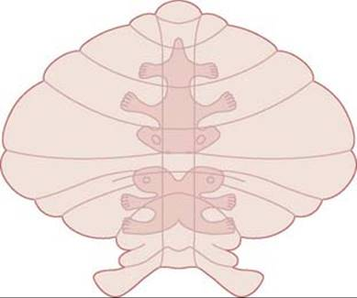
SPINO CEREBELLUM-FUNCTIONS
The different parts of the body are represented
in the spinocerebellum in the following
manner:
Lingula : Coccygeal region
Central lobe : Hind limb
Culmen : Forelimb
Lobulus simplex :
Face and head.

Slide 58
SPINO CEREBELLUM-FUNCTIONS
Spinocerebellum regulates the postural reflexes by modifying muscle tone.
It facilitates the discharge from gamma motor neurons in spinal cord via cerebellovestibulospinal and cerebello-reticulospinal fibers
Increased discharge from gamma motor neurons increases the muscle tone.

Slide 59
SPINO CEREBELLUM-FUNCTIONS
Spinocerebellum also receives impulses from optic and auditory pathway and helps in adjustment of posture and equilibrium in response to visual and auditory impulses.

Slide 60
CORTICOCEREBELLUM
Afferent Connections
1. Pontocerebellar tract
Origin: pontine nuclei
Course:
crosses the midline and enters corticocerebellum
via middle cerebellar peduncle
It is the largest tract in the body having about 20
million nerve fibers.
Function:
It helps the cerebellum in planning the movements
initiated by the cerebral cortex.

Slide 61
CORTICOCEREBELLUM
Afferent connections:
2.Olivocerebellar tarct
Origin:inf.Olivary nucleus
Course: Cross opposite side-inf.crebellar peduncle
Termination: Dentate nucleus and cerebellar cortex
Function:
Carries impulses from brainstem, spinal cord,
cerebral cortex

Slide 62
CORTICOCEREBELLUM-CONNECTIONS

Slide 63
CORTICOCEREBELLUM
Efferent connections:
Output signals from corticocerebellum are relayed mainly through the dentate nucleus.
Fibers from dentate nucleus pass through superior cerebellar peduncle, cross the midline and form decussation with the fibers of opposite side. After forming the decussation, these fibers divide into two tracts:
1. Dentatothalamic tract
2. Dentatorubral tract.

Slide 64
CORTICOCEREBELLUM-CONNECTIONS
Dentatothalamic tract
Some fibers pass through Red nucleus terminate in lateral ventral nucleus of thalamus.
Thalamus in turn, projects into the motor area of cerebral cortex via thalamocortical fibers.

Slide 65
CORTICOCEREBELLUM-CONNECTIONS
2. Dentatorubral tract
Remaining fibers terminate in the red nucleus of
opposite side as dentatorubral tract.
Three tracts arise from red nucleus:
i. Rubrothalamic tract:
Red nucleus to lateral ventral nucleus of thalamus to
cerebral cortex.

Slide 66
CORTICOCEREBELLUM-CONNECTIONS
ii.Rubroreticular tract:
Fibers from Red nucleus descends down and ends in reticular formation and projects into spinal cord via reticulospinal tract.
iii.Rubrospinal tract:
Red nucleus also projects directly into
spinal cord through rubrospinal tract

Slide 67
Corticocerebellum-functions
Integration and well cooridnated muscular
activities
Mechanism of action
Damping action
Control of ballistic movements
Timing and programming the movements
Servomechanism
Comporator function

Slide 68
FUNCTIONS OF CEREBELLUM
Muscle tone-Facilitatory action
Control of movements-
Error detection and correction
(comparing informations what the muscles should be doing with information about what they are actually doing)
Regulation of time, rate , range,force and direction of muscular activity

Slide 69
FUNCTIONS OF CEREBELLUM
Predictive function-By damping action
Control of body posture and equilibrium by vestibulocerebellum
Learning

Slide 70
CEREBELLAR LESIONS
Cause:
Tumor, abscess or an injury.
Excess alcohol ingestion
Degenerative changes in cerebellar cortex, cerebellar nuclei, cerebellar peduncles and spinocerebellar tracts.

Slide 71
CEREBELLAR LESIONS
Disturbance of posture
Atonia or hypotonia-Loss or decreased muscle
tone
Change in Attitude in unilateral lesion
Rotation of head towards unaffected side
Lowering of shoulder in the same side
Abduction of leg on affected side
Weight of body is thrown on leg of affected
side

Slide 72
CEREBELLAR LESIONS
Deep reflexes weak and pendular
Disequilibrium: Standing with Legs apart, body
sways with oscillations of head
Gait: Drunken gait
Disturbances in movements
Asthenia-Weakness and slowness of muscle
Ataxia-incordination of movement

Slide 73
CEREBELLAR LESIONS
Asynergia: Lack of coordination between different
groups of muscles
Dysmetria: Inability to check exact strength and
duration of muscular contractions required for any
voluntary act.
While reaching for an object, the arm may overshoot
(past pointing) or it may fall short of the object.
Overshooting is called hypermetria and falling short is
known as hypometria.

Slide 74
CEREBELLAR LESIONS
Intention tremor: Tremor that occurs while attempting to do any
voluntary act.
Astasia: Unsteady voluntary movements
Nystagmus: To and fro movement of eyeball is called nystagmus.
Rebound phenomenon: It is due to the absence of breaking
action of antagonistic muscle

Slide 75
CEREBELLAR LESIONS
Dysarthria: Disturbance in speech.
Adiadochokinesis:
Inability to do rapid alternate successive
movements is called adiadochokinesis.

Slide 76
Tests for cerebellar lesion
Speech
Eye movements-Nystagmus
Gait
Romberg’s test –cerebellar ataxia
Resting Tremor
Tone
Co-ordination test
Test for Adiadochokinesis
Finger nose test
Heel-Knee test
Rebound phenomena
Reflexes- Pendular movements

Slide 77
Reference
1.Essentials of medical Physiology:K.sembulinhgam Prema sembulingam,Eigth edition
2.Comprehensive Textbook of medical Physiology,Gopal Krishna Pal,Pravati Pal,Nivedita Nanda.First edition
3.Text book of Physiology:Prof.A.K.Jain,Fourth edition

Slide 78
For further reference visit :
https://stanfordmedicine25.stanford.edu/the25/cerebellar.html
https://www.youtube.com/watch?v=J1t_I9fD_hI
https://www.youtube.com/watch?v=KFFIAhAXqgs
https://www.youtube.com/watch?v=kcrs3b2xQsw

Slide 79
Revision questions
1.Cerebellar nuclei
2.Functions of cerebellum
3.Connections of cerebellum

Slide 80
Cerebellar Nuclei
Cerebellar nuclei are the masses of gray matterscattered
in the white matter of cerebellum.
There are four nuclei on either side
1.Fastigial Nucleus
2.Globosus Nucleus
3.Emboliform Nucleus
4.Dentate Nucleus
It is the largest cerebellar nucleus.
It is situated lateral to all the other nuclei

Slide 81
CEREBELLAR NUCLEI

Slide 82
Functions
Vestibulocerebellum
Control of body posture and equilibrium by vestibulocerebellum by receiving impulses from vestibular apparatus
Afferents-
Vestib.apparatus-vestibular nuclei- Vestibulocerebellum
Efferents-
Vestibulocerebellum-vestibular nuclei-spinal cord

Slide 83
CONNECTIONS OF VESTBULOCEREBELLUM

Slide 84
Functions-Spinocerebellum
Spinocerebellum regulates tone, posture and equilibrium by receiving sensory impulses form tactile receptors, proprioceptors, visual receptors and auditory receptors.
It also receives the cortical impulses via pontine nuclei.

Slide 85
Corticocerebellum
Integration and well cooridnated muscular
activities
Mechanism of action
Damping action
Control of ballistic movements
Timing and programming the movements
Servomechanism
Comporator function

Slide 86
Functions of cerebellum
Control of Muscle tone
Control of movements-
Error detection and correction
(comparing informations what the muscles should be doing with information about what they are actually doing)
Regulation of time, rate , range,force and direction of muscular activity

Slide 87
Functions of cerebellum
Control of body posture and equilibrium by vestibulocerebellum
Predictive function-By damping action
Learning

Slide 88
THANK YOU

