Slide 1
Dr.M.P.Lal Professor and Head Department of Surgery
DYSPHAGIA

Slide 2
DYSPHAGIA
Dysphagia means difficulty in swallowing

Slide 3
TYPES
Based on
location - Oropharyngeal
Eosophageal
Circumstances - Structural
Populsive
Onset - Acute
Chronic
Progression - Progressive
Intermittent

Slide 4
CAUSES- IN THE MOUTH
Tonsilitis
Quinsy
CA Tongue
Paralysis of soft palate etc

Slide 5
CAUSES- IN THE PHARYNX
1.In the lumen-Impaction of foreign body
2.In the wall – Acute pharyngitis, malignant growth, hysterical spasm , Paterson kelly syndrome, CNS disease eg.CVA, Parkinson’s disease, bulbar poliomyelitis ,multiple sclerosis, amyotrophic lateral sclerosismuscular diseases, metabolic myopathy ,myasthenia gravis etc
3.Outside the wall-Retropharyngeal abscess, malignant thyroid etc

Slide 6
CAUSES- IN THE OESOPHAGUS
1.In the lumen- Impaction of foreign body
2.In the wall-a.Benign stricture
b.spasm
c.Diverticulum and cyst
d.Neoplasms
e.Nervous disorders
3. Outside the wall-Malignancy,retrosternal goitre,pharyngeal diverticulum,aneurism of Aorta,mediastinal growth etc

Slide 7
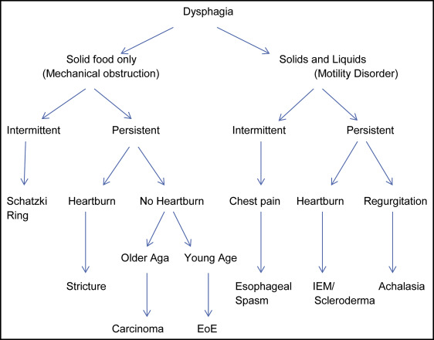
Approach to the patient with Dysphagia

Slide 8
Dysphagia Diagnosis
Medical history, visual examination, and palpation
Laryngopharyngeal endoscopy
Pharyngo-esophagography
Simple Tests for Dysphagia
Dry swallowing
Repetitive saliva swallowing test
Water swallow test

Slide 9
HOMOEOPATHIC MANAGEMENT
Baptisia tinctoria . If you can swallow only liquids; especially if you have a red, inflamed throat that is relatively pain free.
Baryta carbonica . If you have large tonsils.
Carbo vegatabilis .
Ignatia .
Lachesis .

