Slide 1
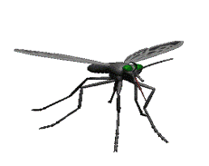
DENGUE
DR.T.AJAYAN
PROF. & H.O.D.
PM

Slide 2
Origin
The word "dengue” has an African origin.
The term "dengue" is a Spanish version at the Swahili phrase "ki denga pepo", meaning "cramp-like seizure caused by an evil spirit". It emerged during a Caribbean outbreak in 1827-1828.

Slide 3
The first case report dates back from 1789 and is attributed to Benjamin Rush, who coined the term "breakbone fever" (because of the symptoms of myalgia and arthralgia). The viral etiology and the transmission by mosquitoes were only known in the 20th century. The socioeconomic impact of World War II resulted in increased spread globally.

Slide 4
Outbreak in India
The most recent serious outbreak of Dengue Fever in India was in 2006. In total around 3400 cases of dengue fever were reported across 11 states.
Outbreaks started first from New Delhi in early September and by end of September other states in India also started to report deaths.

Slide 5
List of Outbreaks by State
Chandigarh: 159 cases of dengue fever were reported from the union territory of Chandigarh. Most of these victims arrived from other states seeking treatment.
New Delhi: More than 590 cases of dengue fever were reported from Delhi and over 367 arrived from neighbouring states looking for treatment.
Rajasthan: By September 12, more than 35 patients were treated for dengue in Rajasthan
Uttar Pradesh: Over 214 suspected cases.
Andhra Pradesh: One person succumbed to the disease and at least five were treated for the dengue fever in Andhra Pradesh.
West Bengal: Over 30 people were treated for dengue fever in Kolkata.
By October 9, 2006 more than fifty deaths were reported to dengue fever and more than 3613 patients were treated for this disease.

Slide 6
Definition
An acute infectious disease caused
by a flavivirus, transmitted by aedes
mosquitoes, and characterized
by headache, severe joint pain,
and a rash. It occurs in two forms: Dengue Fever and Dengue
Haemorrhagic Fever(DHF) or Dengue Shock Syndrome(DSS).

Slide 7
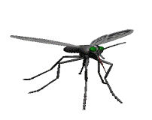
Dengue viruses are arboviruses capable of infecting humans & causing disease.
Dengue fever is a self – limiting disease & represents the majority of cases of dengue infection.

Slide 8
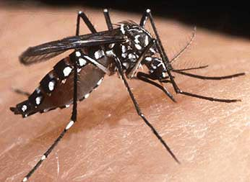
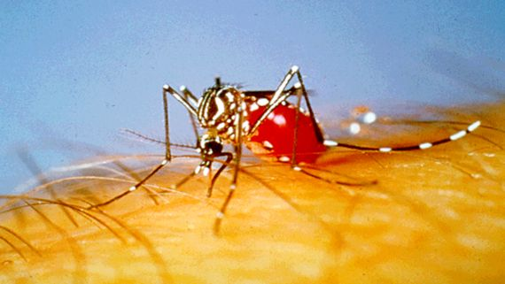
Vector – Aedes aegypti which breeds in standing water, collections of water in containers & tyre dumps.
Also known as “Tiger Mosquito”; its a day-biting mosquito.

Slide 9
Classification
Dengue virus infection
Asymptomatic
Symptomatic
Undifferentiated
Dengue fever
Dengue h’aghic fever
without h’age
without unusual h’age
No shock
Dengue shock syndrome

Slide 10
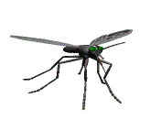
Dengue viruses replicate
phagocytic cells
Dengue antibody enhance
dengue virus infection in these cells
regulates dengue disease in human beings
Antigenic epitopes on dengue viruses
These epitopes serve
to regulate disease
PATHOGENESIS
Enhancing antibodies
alone result in heightened disease response

Slide 11
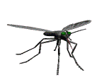
Pathogenesis
Dengue viruses replicate in cells of mononuclear phagocyte lineage, and subneutralizing concentrations of dengue antibody enhance dengue virus infection in these cells. This antibody-dependent enhancement of infection regulates dengue disease in human beings, although disease severity may also be controlled genetically, possibly by permitting and restricting the growth of virus in monocytes. Monoclonal antibodies show heterogeneous distribution of antigenic epitopes on dengue viruses. These epitopes serve to regulate disease: when antibodies to shared antigens partially neutralize heterotypic virus, infection and disease are dampened; c Further knowledge of the structure of dengue genomes should permit rapid advances in understanding the pathogenetic mechanisms of dengue.

Slide 12
Classical Dengue Fever
It is a acute viral infection, caused by at least 4 serotypes of dengue virus. Dengue fever can occur epidemically or endemically.
Epidemics may be explosive & often start during the rainy season when the breeding of the vector mosquitoes is generally abundant. Temperature also plays an important role in the transmission of dengue virus by mosquitoes. Mosquitoes kept at 26ºC, fail to transmit dengue virus. Hence the low incidence of dengue can be explained in certain seasons.

Slide 13
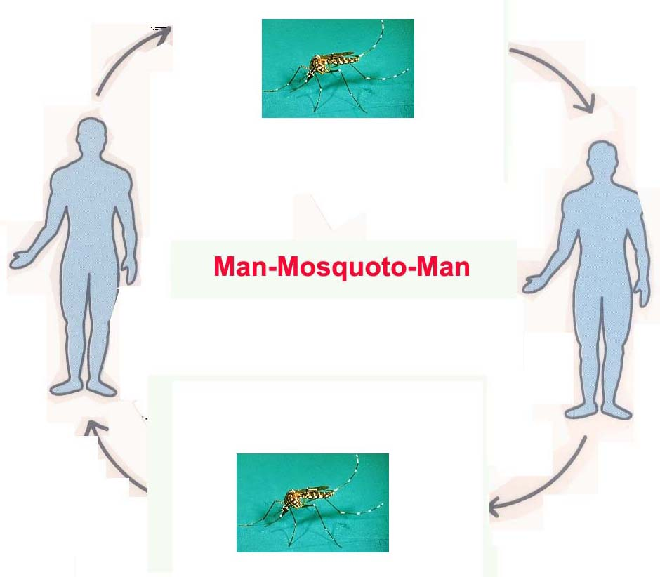
The reservoir of infection is both man & mosquito. The transmission cycle is “Man – Mosquito – Man”.

Slide 14
The aedes mosquito becomes infective by feeding on a patient from the day before the onset to the 5th day [viraemia stage] of illness. After an extrinsic incubation period of 8 to 10 days, the mosquito becomes infective, & remains so for life.
All ages & both sexes are susceptible to dengue fever. Children usually have a milder disease than adults.

Slide 15
Clinical features
The illness is characterized by an incubation period of 3 to 10 days [commonly of 5 – 6 days]. The onset is sudden.
Abrupt onset of high fever – continuous / saddle back fever with break on 4th or 5th day, usually lasts for 7 – 8 days.
Severe frontal headache.
Pain behind the eyes (retro-orbital pain) which worsens with eye movement with photophobia & lachrymation.
Muscle and joint pains, backache, generalized pain.

Slide 16
Loss of sense of taste and appetite, nausea and vomiting, insomnia.
Measles-like rash over chest and upper limbs. Transient macular rash on first 1 – 2 days, maculopapular rash, scarlet, morbilliform rash on 3 – 5 days present mainly on trunk which blanches on pressure, spreading centrifugally & sparing palms & soles, may desquamate on resolution.
Minor hemorrhagic manifestations like petechiae, bleeding from nose or gums may occur.
Lymphadenopathy.

Slide 17
Laboratory Abnormalities
Leucopenia - neutropenia and relative lymphocytosis are common. Thrombocytopenia (platelet count < 1,00,000/mm³)
Raised transaminases occur less frequently.
Treatment:
Entirely symptomatic, with analgesics & antipyretics [paracetamol but not aspirin, so that platelet function will not be impaired]
Patients may rest, oral fluids to compensate for losses via diarrhoea or vomiting.
IV fluids if necessary.

Slide 18
CLINICAL AND LABORATORY DIAGNOSIS & CASE DEFINITIONS
SUSPECT CASE: Acute onset and high fever of 2-7 days duration, and two or more of the following:
Headache, retro-orbital pain, myalgia, arthralgia, rash, hemorrhagic manifestations, and leucopenia.
PROBABLE CASE: Suspect case and one or more of the following:
Detection of IgM antibody. IgM antibody indicates current or recent infection and is detectable 6-7 days after onset of illness. If available Mc- Elisa test is more specific.

Slide 19
CONFIRMED CASE: Suspect or probable case and one or more of the following:
Isolation of virus or detection of viral genomic sequences. fourfold rise in titres of IgG or IgM antibody. For this at least 2 samples are to be taken- one at the time at the time of reporting to a clinic or a hospital and second shortly before discharge . The optimum interval between two samples should be 10 days. Although serological tests are simpler, they can give false positive results due to cross reaction between antibodies against dengue and other flaviviruses. Confirmatory tests are not necessary for management of cases and should be done to confirm the aetiology of the outbreak.

Slide 20
Dengue Haemorrhagic fever
DHF has been most extensively studied in south – east Asia where it first appeared & primarily affected children.
DHF is a severe form of dengue fever caused by infection with more than one dengue virus. [type 1, 2, 3, & 4].
DHF is defined as an acute febrile illness with minor or major bleeding, thrombocytopenia[ < 1,oo,ooo,mm³ ] & evidence of plasma leakage documented by haemoconcentration [ heamatocrit value increased], pleural and other effusions, or hypoalbunaemia or hypoprotenamia.
DHF/ DSS usually develops around 3rd to 7th day of illness.

Slide 21
Pathogenesis
Major pathophysiological change that differentiates DHF from DF is the leakage of plasma.
Extravasation occurs through endothelial gaps, without necrosis or inflammation of the capillary endothelium.
Susceptibility to DHF/DSS drops considerably after 12 yrs of age.
Females are more often affected than males.
Caucasians are more affected than blacks.

Slide 22
Clinical Features of DHF
Sudden rise in temperature 38⁰ C – 40⁰ C & continues for 2 – 7 days.
The most common haemorrhagic feature is the positive tourniquet test, petechiae, easily bruised skin & subcutaneous bleeding at venepuncture sites, epistaxis, bleeding from mouth & gums are present in most cases.
Transudate due to excessive capillary permeability collects at the pleural & abdominal cavities.
During recovery phase of fever patient’s condition worsens markedly with severe weakness, marked restlessness, facial pallor and circumoral cyanosis, severe continuous pain abdomen. Liver may be enlarged.
Thrombocytopenia ( platelet count <1,00,000/mm³ ) also occurs during this phase.
In most severe forms after 3 – 4 days of fever, hypotension circulatory failure with features of Capillary leak syndrome.

Slide 23
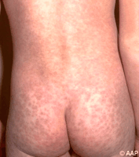
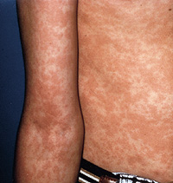
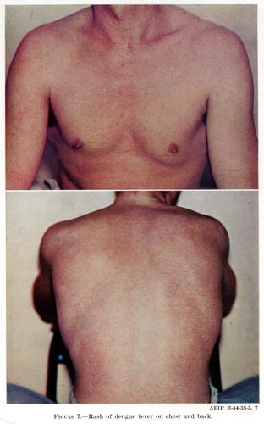
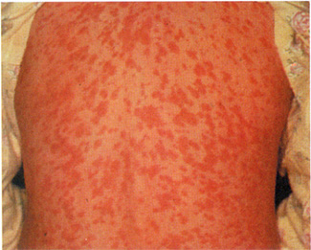
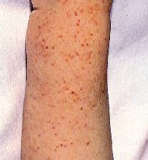
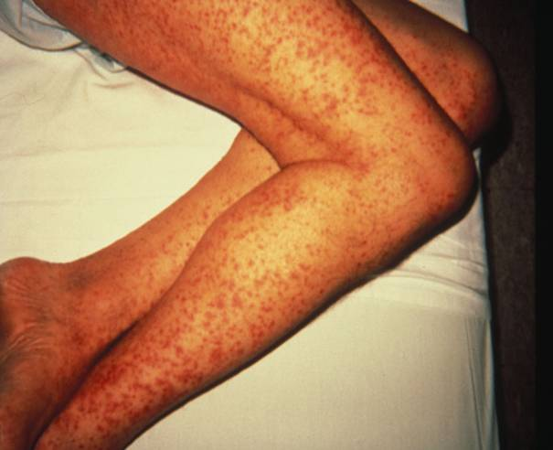

Slide 24
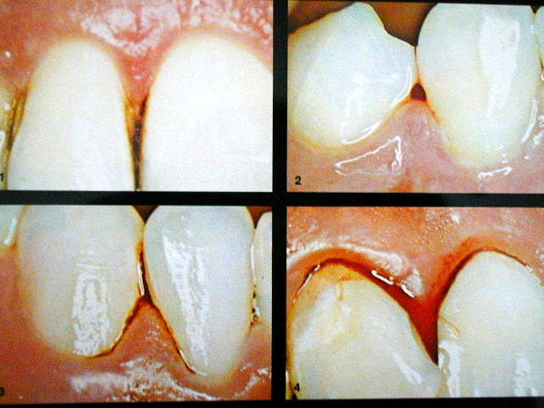
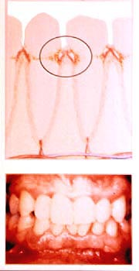

Slide 25
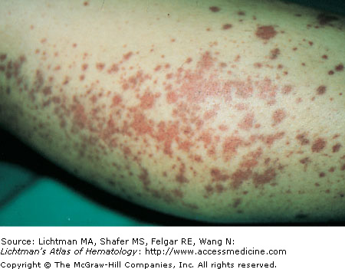

Slide 26
Clinical features
Immune mediated reaction to infection
Maximum affected group
1st – 3rd day
3rd – 4th day
4th – 5th day
Vascular leak platelets.
0 – 1 yr & 3 – 5yr.
Fever, URTI, Myalgia, Arthralgia, bone pain.
Tourniquet test positive, Spontaneous bleeding.
Circulatory failure & agitation, Profound shock.

Slide 27
Lab Diagnosis:-
Increased haematocrit,
Decreased platelet - < 1,00,00/mm³
Increased PT,
Chest X-ray – pleural effusion.

Slide 28
CLINICAL AND LABORATORY DIAGNOSIS & CASE DEFINITIONS
Probable or confirmed case of dengue, and
Haemorrhagic tendencies as described under DHF.
Thrombocytopenia(platelet count <1,00,000/mm³ ).Evidence of plasma leakage due to increased vascular permeability, manifested one or more of the following: a rise in average haematocrit signs of plasma leakage indicated by pleural effusion or ascites , hypoproteinemia. Slight elevation of liver enzymes, hypoproteinemia and low levels of C 3 complement proteins are commonly observed. Prothrombin, partial thromboplastin, thrombin times may be prolonged in many cases. While a normal WBC count or leukopenia with neutrophils predominating is common initially, a relative lymphocytosis with more than 15% atypical lymphocytes is common when fever subsides..

Slide 29
Management
During febrile phase treatment is similar to that of DF.
Rise in haematocrit value indicates significant plasma loss & a need for parenteral fluid therapy.
In grade 1 & 2, volume replacement can be given for a period of 12 – 24hrs.
Volume & type of fluid should be similar to that used in treatment of diarrhoea.
Rate of administration adjusted throughout the 24 – 48hr period of leakage.

Slide 30
Serial haematocrit determination , every 4 – 6hrs & frequent recording of vital signs recommended for adjusting the fluid replacement & avoid over transfusion.
Excessive transfusion can cause respiratory distress, pulmonary congestion & oedema.
Fluids - 5% dextrose-concentrated/crystalloid in RL.
A rough estimate of flow may be derived from the formula:
ml/hour = (drop/min) x 3

Slide 31
Grading of DHF
Severity of DHF has been classified into 4 grades:-
Grade 1:- Fever accompanied by non – specific constitutional symptoms. The only haemorrhagic manifestation is a positive tourniquet test.
Grade 2:- Spontaneous bleeding usually in skin or other haemorrhages in addition to grade1.
Grade 3:- Circulatory failure manifested by rapid & weak pulse, narrowing of pulse pressure [ 20mmHg or less] or hypotension with presence of cold clammy skin & restlessness.
Grade 4:- Profound shock with undetectable blood pressure & pulse.

Slide 32
Dengue Shock Syndrome
DSS is defined as DHF with signs of circulatory failure including narrow pulse pressure [ < 30mmhg] , hypotension, or frank shock.
The 4 warning signs of impending shock are intense sustained abdominal pain, persistent vomiting, restlessness or lethargy & a sudden change from fever to hypothermia with sweating & prostration
Patient may go into shock manifested by :Pale, cold or clammy skin, sleepiness and restlessness ,thirst and mouth becomes dry, rapid weak pulse and difficulty in breathing. .
The development of these signs or any suggestion of hypotension are indications for hospital admission & management to prevent shock.
The patient may recover rapidly after volume replacement but shock may recur during the period of excessive capillary permeability.

Slide 33
Management
DSS is a medical emergency that requires vigorous volume replacement therapy. There will also be electrolyte (sodium) & acid – base disturbances. It must be considered that there is high potential for developing DIC & that stagnant acidaemic blood will promote or enhance DIC which may lead to irreversible shock
Replacement of Plasma Loss:-
Immediate replacement of plasma loss with 5% Dextrose in NS at the rate of 10 - 20ml/kg body weight/h, or in case of profound shock Grade4 – bolus of 10ml/kg body weight(once or twice).

Slide 34
In case of continued & profound shock (high haematocrit value), colloidal fluid – dextran should be given with following the initial fluid rate of 10 – 20ml/kg/h.
FFP given in cases with persistent shock despite declining haematocrit value after initial fluid replacement .
When improvement is apparent, the rate of IV fluid replacement should be reduced & adjusted 1 – 2 hrly through out the 24 hrs period.

Slide 35
Intravenous fluid should be discontinued when the haematocrit reading drops to around 40% & vital signs are stable.
A good urine output indicates sufficient circulating renal volume. In general there is no need for fluid therapy for more than 48hrs after the onset of leakage or shock.
Reabsorption of extravasated plasma takes place one or two days thereafter and may cause hypervolaemia, heart failure & pulmonary oedema if more fluid is given.

Slide 36
Control Measures

Slide 37
Mosquito control:-
The vectors of DF & DHF breed in & around houses & can be controlled by individual & community action using anti mosquito & antilarval measures .
Vaccines:-
So far, there is no satisfactory vaccine & no immediate prospect of preventing disease by immunization.
Other measures:-
Isolation under bed nets during the first few days; individual protection against mosquitoes.

Slide 38
PERSONAL PROPHYLATIC MEASURES
Use of mosquito repellent creams, liquids, coils, mats etc.
Wearing of full sleeve shirts and full pants with socks
Use of bed nets for sleeping infants and young children during day time to prevent mosquito bite
DO’S AND DON’TS
Remove water from coolers and other small containers at least once in a week
Use aerosol during day time to prevent the bites of mosquitoes
Do not wear clothes that expose arms and legs
Children should not be allowed to play in shorts and half sleeved clothes
Use mosquito nets or mosquito repellents while sleeping during day time

Slide 40
HOMOEOPATHIC THERAPEUTICS

Slide 41
Aconite
Cold stage most marked in fever.
Cold sweat and icy coldness of face.
Cold waves pass through him.
Thirst and restlessness always present.
Drenching sweat relieving all symptoms.
Urine – scanty red hot painful.
Retention of urine with screaming & restlessness.
Great fear, worry, anguish accompanying
all ailments.
Fear of death, predicts the day.

Slide 42
Eup Perf
Aching in bones of extremities with soreness of flesh.
Gouty soreness and inflamed nodosities of joints, associated with headache.
Chill between 7 and 9 am, preceded by thirst with great soreness and aching of bones.
Nausea, vomiting of bile at close of chill or hot stage; throbbing headache.
Marked periodicity.
Top and back of head with pain and soreness of eyeballs.
Perspiration relieves all symptoms except headache.
Known as "Bone-set", from the prompt manner in which it relieves pain in limbs and muscles that accompanies some forms of febrile disease.

Slide 43
Bryonia alba
General character of the pain here produce is a stitching, tearing; worse by motion, better by rest
Knees stiff and painful. Hot swelling of feet.
Joints red, swollen, hot, with stitches and tearing; worse on least movement.
Every spot is painful on pressure.
Chill with external coldness, dry cough, stitches.
Internal heat. Easy, profuse perspiration.

Slide 44
Rhus tox.
Hot, painful swelling of joints.
Pains tearing in tendons, ligaments, and fasciae.
Rheumatic pains spread over a large surface at nape of neck, loins, and extremities; better motion.
Limbs stiff paralyzed. Tenderness about knee-joint.
Fever adynamic; restless, trembling.
Intermittent; chill, with dry cough and restlessness.
During heat, urticaria.
Skin red, swollen; itching intense.
Vesicles, herpes; urticaria; pemphigus; erysipelas; vesicular suppurative forms.

Slide 45
Phosphorus
Fever with chills every evening.
Internal heat < night. Heat between shoulder blades.
Adynamic with lack of thirst, but unnatural hunger.
Viscid night sweats.
Purpura haemorrhagia.
Urine – turbid brown with red sediment.
Abdomen very weak, empty, gone
sensation.
Liver congested, fatty degeneration.

Slide 46
Ledum pal
Gouty pains shoot all through the foot and limb, and in joints, but especially small joints.
Swollen, hot, pale. Cracking in joints; worse, warmth of bed.
Gouty nodosities. Rheumatism begins in lower limbs and ascends.
Ankles swollen. Soles painful, can hardly step on them.
Coldness, want of animal heat.
Sensation as of cold water over parts; general coldness with heat of face.
Itching of feet and ankles; worse, scratching and warmth of bed.

Slide 47
Ars alb
Among these the all-prevailing debility, exhaustion, and restlessness, with nightly aggravation, are most important.
Unquenchable thirst.
Trembling, twitching, spasms, weakness, heaviness, uneasiness.
Swelling of feet.
Urticaria, with burning and restlessness.
High temperature. Periodicity marked with adynamia.
Paroxysms incomplete, with marked exhaustion.

Slide 48
Gelsemium
Loss of power of muscular control.
Excessive trembling and weakness of all limbs.
Fatigue after slight exercise.
Dumb-ague, with much muscular soreness, great prostration, and violent headache.
Chill, without thirst, along spine; wave-like, extending upward from sacrum to occiput.
Hot, dry, itching, measles-like eruption.
General prostration.
Dizziness, drowsiness, dullness, and trembling.

Slide 49
China
Debility from exhausting discharges, from loss of vital fluids, calls for this remedy.
Pains in limbs and joints, as if sprained; worse, slight touch; hard pressure relieves.
Joints swollen; very sensitive, with dread or open air.
Great debility, trembling, with numb sensation.
Weariness of joints; worse, mornings and when sitting.
Fever - all stages well marked. Debilitating night-sweats.

Slide 50
Nux vom
Legs numb; feel paralyzed; cramps in calves and soles.
Cracking in knee-joints during motion.
Sensation of sudden loss of power of arms and legs in the morning.
Urticaria, with gastric derangement.
Excessive rigor, with blueness of finger-nails.
Aching in limbs and back, and gastric symptoms.
Chilly; must be covered in every stage of fever.

Slide 51
Belladonna
Shooting pains along limbs. Tottering gait.
Joints swollen, red, shining, with red streaks radiating.
Shifting rheumatic pains.
Dry and hot; swollen, sensitive; burns scarlet, smooth.
Eruption like scarlatina, suddenly spreading.
A high feverish state with comparative absence of toxaemia.
Burning, pungent, steaming, heat.
No thirst with fever.

Slide 52
Sulphur
Often great use in beginning the treatment of chronic cases and in finishing acute ones.
Rheumatic gout, with itching.
Burning in soles and hands at night.
Stiffness of knees and ankles. Cannot walk erect; stoop-shouldered.
Frequent flashes of heat. Dry skin and great thirst.
Dry, scaly, unhealthy; every little injury suppurates.
Itching, burning; worse scratching and washing.

Slide 53
THANK YOU

