Slide 1
Dialysis
Dr Reshmy K.R
Professor
Dept. of Physiology
SKHMC

Slide 2
Dialysis
Removal of waste materials and toxic substances and restoration of normal volume and composition of body fluid by means of an artificial kidney.
Artificial kidney can be used in acute renal failure due to circulatory shock, Hg poisonong and chronic renal failure.
Two types of Dialysis- Hemodialysis& Peritonial dialysis

Slide 3
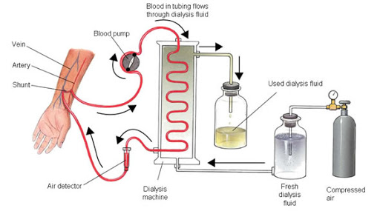
The basic principle of the artificial kidney is to pass blood through minute blood channels bounded by a thin membrane.
On the other side of the membrane is a dialyzing fluid into which unwanted substances in the blood pass by diffusion.

Slide 4
Blood flows continually between two thin membranes of cellophane, outside the membrane is a dialyzing fluid.
The cellophane is porous enough to allow the constituents of the plasma, except the plasma proteins, to diffuse in both directions—from plasma into the dialyzing fluid or from the dialyzing fluid back into the plasma.

Slide 5
mechanism of function
If the concentration of a substance is greater in the plasma than in the dialyzing fluid, there will be a net transfer of the substance from the plasma into the dialyzing fluid.( diffusion of solutes from an area of higher conc. to the area of lower conc through a semi paermeable membrane.)
The rate of movement of solute across the dialyzing membrane depends on
(1) the concentration gradient of the solute between the two solutions,
(2) the permeability of the membrane to the solute,
(3) the surface area of the membrane,
(4) the length of time that the blood and fluid remain in contact with the membrane.

Slide 6
Blood flows continually or intermittently back into the vein.
Total amount of blood in the artificial kidney at one time is usually less than 500 ml.
Rate of flow may be several hundred ml per minute.
Total diffusion surface area is 0.6 - 2.5 sqm.

Slide 7
To prevent coagulation of the blood in the artificial kidney, a small amount of heparin is infused into the blood as it enters the artificial kidney.
Bulk flow
Mass transfer of solutes and water can be produced by applying a hydrostatic pressure to force the fluid and solutes across the membranes of the dialyzer.

Slide 8
No phosphate, urea, urate, sulfate, or creatinine in the dialyzing fluid; however, these are present in high concentrations in the uremic blood.
when a uremic patient is dialyzed, these substances are lost in large quantities into the dialyzing fluid.
The effectiveness of the artificial kidney can be expressed in terms of the amount of plasma that is cleared of different substances in each minute

Slide 9
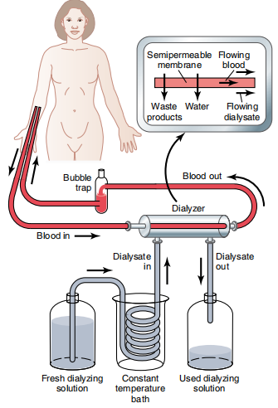
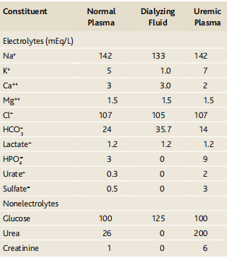
Comparison of dialysing fluid with normal& uremic plasma
Principles of dialysis with artificial kidney

Slide 10
features
Rate of clearence of urea from the plasma - 100 to 225ml/min
Functions about twice as rapidly as two normal kidneys together, whose urea clearance is only 70ml/min.
It is used for only 4 to 6 hours per day, three times a week

Slide 11
Artificial kidney cannot replace some of the other functions of the kidneys, such as secretion of erythropoietin, which is necessary for red blood cell production.
overall plasma clearance is limited when it replaces the normal kidneys.

Slide 12
Peritoneal dialysis
Peritoneal membrane is used as a semipermeable membrane
Less expensive, simple procedure.
-can leads to complications by infections.

Slide 13
Uremia
Excessive accumulation of products of protein digestion- increased level of blood urea, nitrogen & creatinine

Slide 14
THANK YOU
https://ib.bioninja.com.au/standard-level/topic-1-cell-biology/14-membrane-transport/kidney-dialysis.html https://www.thekidneydr.com/learning-center/dialysis/peritoneal/

