Slide 1
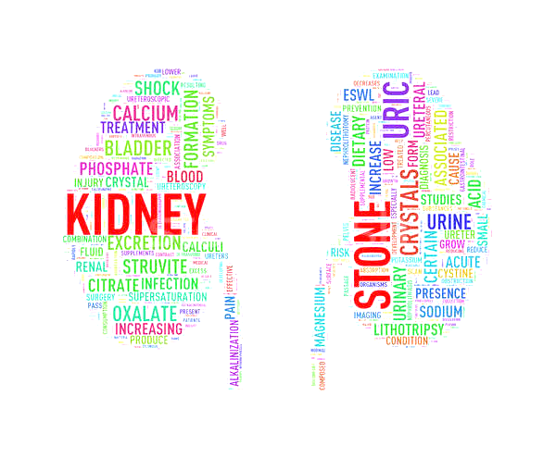
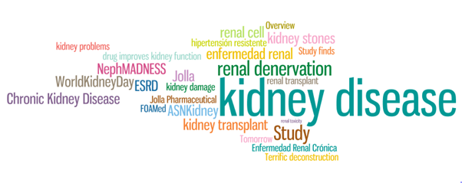
DIALYSIS
Dr. Hari Sankar V
Associate Professor, Dept. of PM

Slide 2
There are broadly two forms of dialysis namely:
Peritoneal dialysis
Hemodialysis.
Either of them can be used as a short-term measure in ARF patients (acute dialysis) or as a long term option in ESRD (chronic dialysis).
HEMODIALYSIS
Principles
Hemodialysis is the modality of extracorporeal purification of blood using an artificial filter.
At its simplest, blood and dialysate are pumped into a dialyser using a dialysis machine.
The dialysate is a solution of specially treated water, sodium, potassium, magnesium, calcium, chloride and dextrose with bicarbonate as buffer.

Slide 3
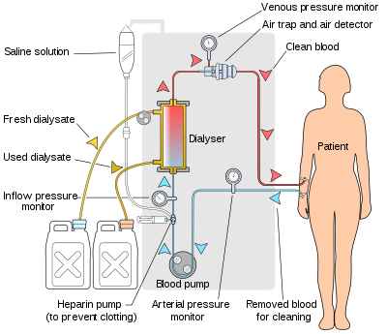
Its constitution is akin to plasma water except that potassium levels are usually kept low.
A semipermeable membrane separates the blood from the dialysate.
During the passage through the dialyser, diffusion occurs across the membrane depending on the concentration gradient.
Diffusion is maximised by maintaining high flow rates of blood and dialysate in a counter current manner Fluid can be removed from the blood compartment by exerting a transmembrane pressure.

Slide 4
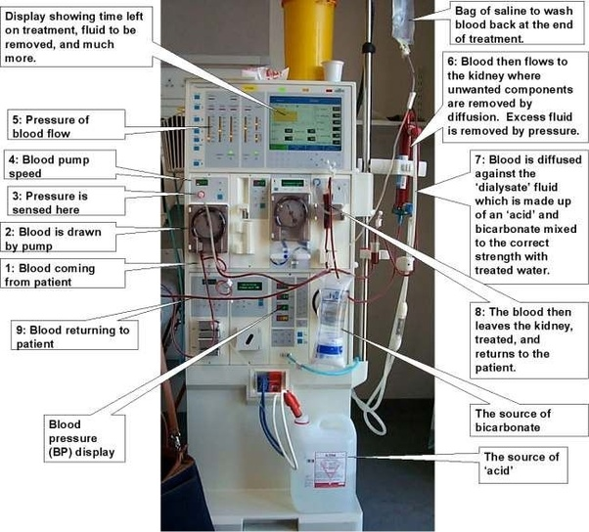
Modern machines are equipped with electronic devices to monitor blood flow, dialysate flow, temperature and conductivity of dialysate, ultrafiltration rate and to detect blood leak into the dialysate or air in the blood circuit.
Blood is drawn into the extracorporeal circuit and returned to the patient through a vascular access.
Arteriovenous shunt or cannulation of major veins are used fortemporary vascular access.
For permanant access, an arteriovenous fistula or graft is created.

Slide 5
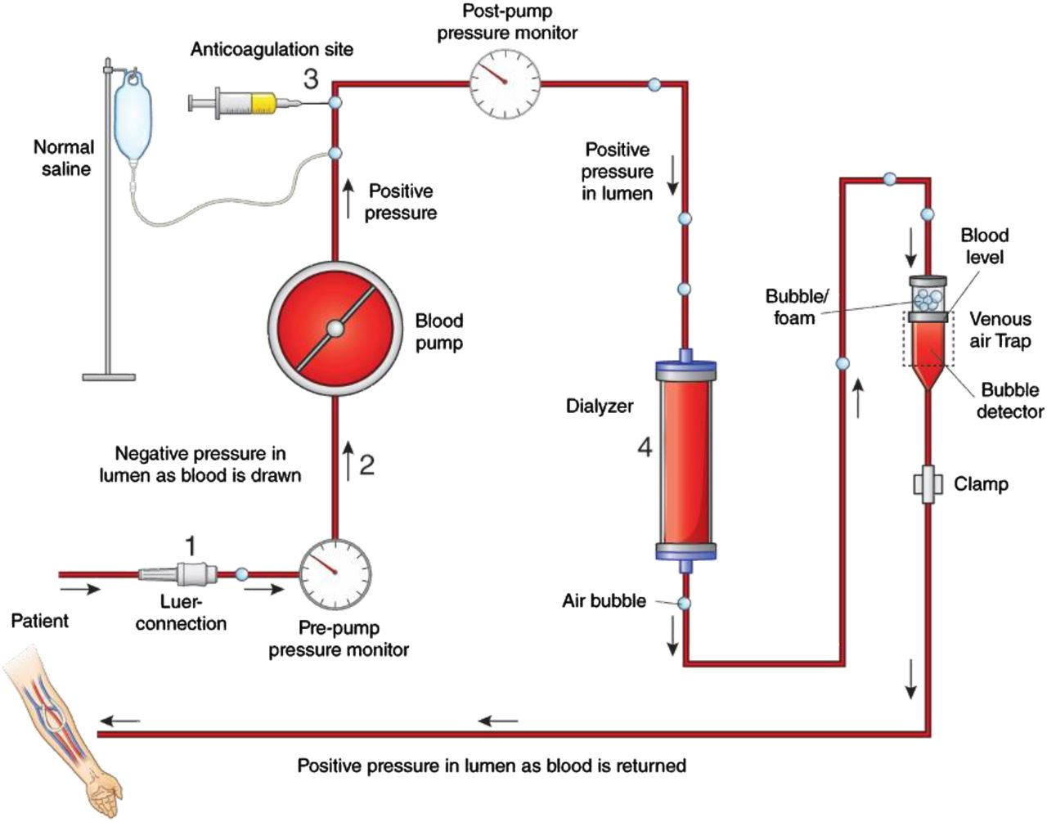
Dialysis in ARF
In acute renal failure, the objective of dialysis is to prevent complications such as fluid overload, encephalopathy, hyperkalemia, hypokalemia, metabolic acidosis and other life-threatening complications.
This serves to gain time for the recovery of kidney functions.
Dialysis is usually initiated early in the course of the illness.

Slide 6
Definite indications for dialysis in ARF
Clinical indications include, anuria of >48 hours, fluid overload, pulmonary edema, metabolic encephalopathy, uremic bleeding or pericarditis. The biochemical indications are
Blood urea > 150 mg/dL
Daily rise of urea > 50 mg/dL
S. creatinine > 7 mg/dL
Daily rise of S creatinine > 1 mg/dL
S. sodium < 125 mmol/L
Daily fall of sodium > 8 mmol/L
S. potassium > 5.5 mmol/L
Daily rise of potassium > 1.0 mmol/L
S. bicarbonate < 15 mmol/L
Daily fall of bicarbonate > 5 mmol/L.

Slide 7
Hemodialysis in ESRD
Chronic maintenance hemodialysis (MHD) in ESRD should be carefully planned in advance.
The patient and the family should be appraised of the eventual need for dialysis sufficiently early.
Other forms of dialysis and transplantion should also be discussed.
If the patient opts for MHD and is clinically suitable, a permanent vascular access (A-V fistula) is created and allowed to mature.
An AV fistula is usually created between the radial artery and cephalic vein at the wrist or occasionally between brachial artery and cephalic vein in the cubital fossa.
Dialysis should be initiated when GFR falls below 15 mL/min or if the patient is symptomatic.

Slide 8
The duration and frequency of dialysis is prescribed taking into account the body mass index of the individual, nutritional status, occupation and comorbidities such as cardiac and vascular disease.
Ideally 4 hours dialysis should be done thrice weekly in adults.
The patient should be periodically evaluated for adequacy of dialysis, general well-being, bone disease, calcium-phosphorus balance, nutritional status and anemia.
Most patients on dialysis require treatment with antihypertensive medication.
Other supportive measures include erythropoietin with parenteral iron for correction of anemia, water soluble vitamin supplements, phosphate binders and active form of vitamin D3 for treating bone disease

Slide 9
The 10 years survival in young patients exceeds 80% if they are initiated into maintenance dialysis early.
In those above 55 years, the 5 years survival is below 20%.
In India, financial constraints seriously impair the long term results.
Complications of Maintenance Hemodialysis
Hypotension, pyrogen reactions, first use syndrome and dialysis disequilibrium are the common acute complications.
Rapid removal of urea during the initial dialysis sessions may cause symptoms due to brain edema as a result of concentration gradient of urea between brain and blood. This is referred to as disequilibrium syndrome.

Slide 10
PERITONEAL DIALYSIS
Peritoneal dialysis (PD) was first done in 1936 for a patient of acute renal failure.
The peritoneal membrane with its underlying capillary bed acts as the semipermeable membrane across which exchange occurs by diffusion between blood and dialysate.
The peritoneal dialysate is a sterile solution of water with its solute concentration
similar to that of plasma water.
The buffer used is lactate and dextrose is used as an osmotic agent to facilitate
ultrafiltration.
Acute intermittent PD is performed by introducing a rigid or soft cannula into the peritoneal cavity using a trocar.

Slide 11
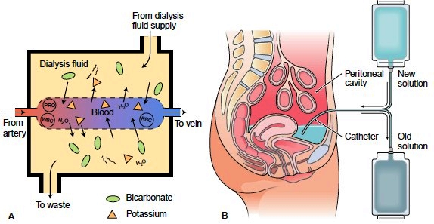
Fluid exchanges of 500 mL to 2L are given at a time.
The fluid is allowed to dwell in the peritoneal cavity for 30-45 minutes and drained off under strict sterile precautions. This process is repeated.
Each exchange takes about 1 hour.
20 such exchanges constitutes one session of acute PD and is particularly effective in children where the ratio of peritoneal surface area to body surface is greater.
PD is advantageous in hemodynamically unstable patients and in those with multiple organ failure.

Slide 12
Complications include infection, bleeding, perforation of hollow viscera, and blockage of the cannula.
Disequillibrium is uncommon in PD, as the solute exchange is slow.
PD may be inadequate in hypercatabolic patients.

