Slide 1
Diphtheria
Dr. Reshma Reghu
Assistant Professor
Dept of Community medicine

Slide 15
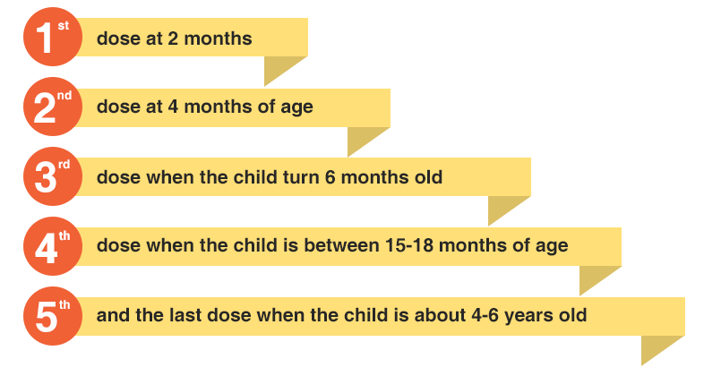

Slide 17
REACTIONS
Fever and mild local reactions
fever of 39 deg. C or higher,
swelling and induration or pain lasting more than 48 hours.
The most severe complications following DPT immunization are neurological (encephalitis/ encephalopathy, prolonged convulsions, infantile spasms and Reye's syndrome)

Slide 18
Contraindications
Children who are seriously ill or need hospitalization are not vaccinated.
DPT should not be repeated if a severe reaction occurred after a previous dose.
Such reactions include collapse or shock-like state, persistent screaming episodes, temperature above 40 deg.C, convulsions, other neurological symptoms and anaphylactic reactions.
Since the severity of pertussis infection decreases with age, the pertussis component in DPT vaccine is not usually recommended after the age of 6 years.
Children over the age of 5 years who have not received DPT, need only 2 doses of DT vaccine, 4 weeks apart, with a booster dose 6 months to· 1 year later.
Those children who received the primary course of DPT earlier, should receive only DT as booster at 5-6 years or at school entry.
For immunizing children over 12 years of age and adults, the preparation of choice is dT, which is an adult-type of diphtheria tetanus vaccine . This preparation contains no more than 2 Lf of diphtheria toxoid per dose, compared with 25 Lf in the ordinary (paediatric) DPT/OT vaccines.
Administration of dT vaccine to adults is carried out in 2 doses at an interval of 4 to 6 weeks, followed by a booster 6 to 12 months after the second dose. This vaccine (dT) is not followed by the high incidence of reactions associated with the use of DPT or DT.
For primary immunization of adults, FT or TAF may be used and they cause fewer reactions than APT or PTAP.

Slide 19
SINGLE VACCINE
Single vaccines (e.g., FT, PTAP, APT, PTAH) are less frequently used.
They are all good immunizing agents.
APT is hardly used because it is prone to give rise to serious reactions.
Each dose of these antigens generally contains 25 Loeffler (Lf) units of diphtheria toxoid.

Slide 20
ANTISERA
Diphtheria antitoxin prepared in horse serum is still the mainstay of passive prophylaxis and also for treatment of diphtheria.
Protection against diphtheria toxin is a quantitative phenomenon, so that a serum antitoxin titre that protects against a small dose of toxin may not protect against a large dose. for this reason, failures of diphtheria immunization may take place

