Slide 1
EPISTAXIS
DR.LAL.M.P.
Prof & Head .dept of surgery

Slide 2
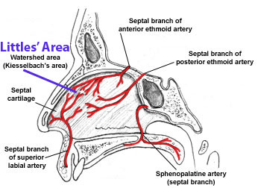
LITTLE’S AREA

Slide 3
AETIOLOGY OF EPISTAXIS (NOSE BLEED)
1.local
2.Systemic disease
3.Hormonal factors
4.Idiopathic

Slide 4
LOCAL CAUSES
Trauma
Infection
granulomatous diseases
fungal infection
Physiological epistaxis
Congenital
tumours

Slide 5
SYSTEMIC DISEASES
Hypertension
Bleeding diathesis
Leukaemia
Anaemia
Uraemia
Exanthematous fevers
Hodgkin’s disease
Cirrhosis of liver
Acute nephritis
Vitamin k deficiency
Mitral stenosis

Slide 6
HORMONAL FACTORS
Puberty
Pregnancy
Granuloma gravidarum
Vicarious menstruation

Slide 7
MANAGEMENT
GENERAL ASSESMENT OF THE PATIENT.
MONITOR THE PULSE AND BP.
CLEAN THE NOSE WHICH IS THEN PINCHED FOR ABOUT TEN MINUTES .ONCE THE BLEEDING IS CONTROLLED ,THE NOSE IS EXAMINED AND SITE IS LOCATED.
IF NECESSORY ,IV INFUSIONS AND BLOOD TRANSFUSION.
CAUTERISATION,NASAL PACKING,ADJUVENT THERAPY AND LIGATION OF BLOOD VESSELS.

Slide 8
HOMOEOPATHIC THERAPEUTICS
AMMONIUM CARB
BELLADONNA
ARNICA MONTANA
HAMAMELIS
MELILOTUS
MILLEFOLIUM
CROCUS SATIVUS
CROTALUS HORRIDUS
PHOSPHORUS
SECALE COR
TUBERCULINUM
IPECAC

