Slide 1
Edema
DR MANOJ RADHAKRISHNAN
DEPT OF PATHOLOGY AND MICROBIOLOGY
SKHMC

Slide 2
Distribution of body water
Two main components
Intracellular , comprising two thirds of total body fluid
Extracellular , comprising one third of total body fluid
Extracellular component is further divided into
Interstitial compartment-75% of ECF
Intravascular compartment-<25% of the ECF.

Slide 3
Defn of Edema
Edema is accumulation of fluid in the interstitial spaces and the body cavities.

Slide 4
Classification of edema
(according to distribution of the fluid)
Localised edema:typically this involves one organ or part of edema eg brain edema, lung edema,accumulation of fluid in the thoracic cavity (hydrothorax), or abdominal cavity (ascites)
Generalised edema:
When it involves the whole body it is called anasarca

Slide 5
Mechanisms by which edema occur
Increased intravascular (hydrostatic pressure)
Increased permeability of vessel wall
decreased oncotic pressure of the plasma
Sodium retention in the kidneys
Obstruction of lymph flow

Slide 6
what is hydrostatic edema?
Results from increased intravascular pressure owing to:
Impaired venous return : Increased central venous pressure caused by heart failure leads to generalized edema.
Obstruction of veins by thrombi may lead to localized edema (eg edema of the calf as a result of thrombosis of popliteal veins)
Increased influx of arterial blood : Arterial dilatation owing to heat or in the course of inflammation also may lead to edema

Slide 7
Causes of increased vascular permeability
Most common cause is Inflammation.
Inflammatory edema results from the action of mediators such as histamine, complement fragments (C3a ,C5a) bradykinin, Platelet activating factor, and leukotreines.

Slide 8
Oncotic edema
Oncotic pressure of the plasma is primarily maintained by albumin .reduced concentration of albumin in plasma (hypoalbuminemia ) may result from :
Decreased protien synthesis : Most plasma protiens are synthesized in the liver ,end stage liver disease caused by reduced protien synthesis.
Increased protien loss : loss of protiens may occur through the kidneys in nephrotic syndrome or in the stool in protien losing enteropathy.
Inadequate protien intake : low protien diet as in african children with kwashiorkor.

Slide 9
How does sodium retention cause edema?
Heart failure is accompanied by reduced perfusion of the kidneys , which stimulates the juxta-glomerular apparatus to secrete renin.
Renin activates the angiotensin system ,resulting in increased secretion of aldosterone from the adrenal cortex.
Aldosterone acts on the distal convoluted tubules of the kidney stimulating them to retain sodium
Retention of sodium- water retention-expands intravascular volume-increased hydrostatic pressure-edema

Slide 10
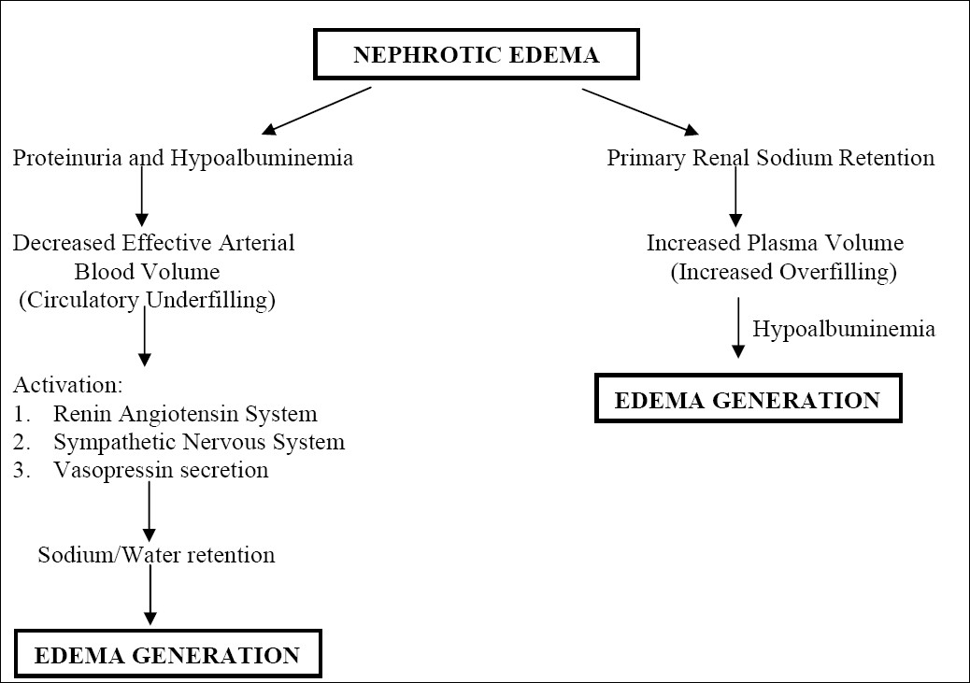
Causes of renal edema

Slide 12
Pathogenesis of pulmonary edema
Most often caused by increased pumonary venous pressure secondary to left heart failure.
In lung infections (pneumonia) ,adult respiratory distress syndrome, shock the cause is increased permeability of pulmonary capillaries.
In liver disease or nephrotic syndrome, it maybe due to hypoprotienemia

Slide 14
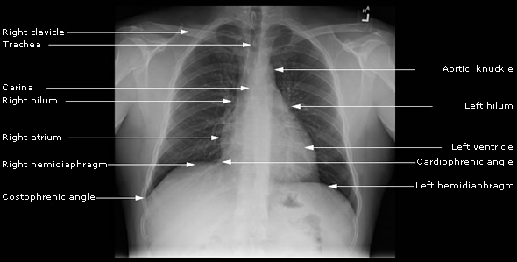
Normal CXR

Slide 15
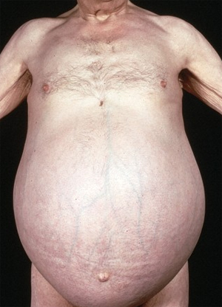
Ascites

Slide 16
Pathogenesis of ascites in cirrhosis
Transudate that develops due to
Hypoalbuminemia
Portal hypertension
Impaired lymph drainage
Increased retention of sodium and water

