Slide 1
Hormones
Dr.Deepa.G.S
Associate Professor
SKHMC

Slide 2
Types of Hormones
1. Steroid hormones
Synthesized from cholesterol or its derivatives.
Secreted by adrenal cortex, gonads and placenta

Slide 3
2. Protein hormones
large or small peptides
Secreted by pituitary gland, parathyroid glands, pancreas and placenta (‘P’s).
3. Tyrosine derivatives
Derived from the amino acid tyrosine.
Thyroid hormones and adrenal medullary hormones

Slide 4
Classification of hormones base on chemical nature

Slide 5
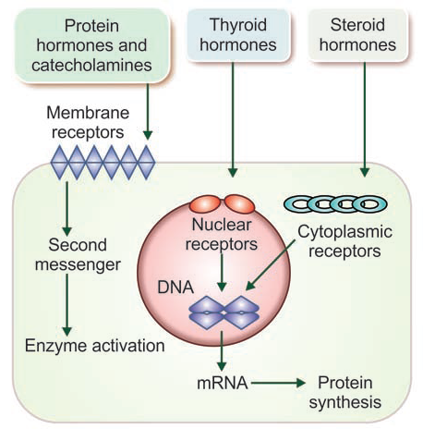
Hormone Receptors
Large proteins present
in target cells
Thousands in number
in each cell
Specificity-Each receptor is specific
for one single hormone

Slide 6
Hormone receptors- regulation
Generally, when a hormone is secreted in excess, the number of receptors of that hormone decreases due to binding of hormone with receptors. This process is called down regulation.
During the deficiency of the hormone, the number of receptor increases, which is called upregulation
Eg: ACTH increases no of ACTH receptors on adrenal cortex

Slide 7
Receptor antibodies
Graves disease
Myasthenia gravis

Slide 8
Hormone receptors- regulation
Hormone in the form of hormone-receptor complex enters the target cell by means of endocytosis and executes the actions. The whole process is called internalization.
After internalization, some receptors are recycled, whereas many of them are degraded and new receptors are formed.
Formation of new receptors takes a long time. So, the number of receptors decreases when hormone level increases

Slide 9
MECHANISM OF HORMONAL ACTION
1. By altering permeability of cell membrane
2. By activating intracellular enzyme
3. By acting on genes.

Slide 10
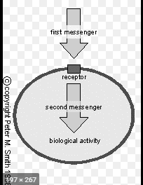
BY ACTIVATING INTRACELLULAR ENZYME
Protein hormones and the catecholamines act by
activating the intracellular enzymes.
First Messenger
The hormone which acts on a
target cell, is called first
messenger or chemical
mediator.
It combines with the receptor
and forms hormone-receptor
complex.

Slide 11
BY ACTIVATING INTRACELLULAR ENZYME
Second Messenger
Hormone-receptor complex
activates the enzymes of the cell
and causes the formation of
another substance called the
second messenger or
intracellular hormonal mediator.
Second messenger produces the
effects of the hormone inside the cells
Protein hormones and the catecholamines
act through second messenger.
Most common second messenger is cyclic AMP.

Slide 12
Cyclic AMP
Most common second messenger
Cyclic AMP, cAMP or cyclic adenosine 3’5’-monophosphate acts as a second messenger for protein hormones and catecholamines.

Slide 13
Formation of cAMP-Role of G proteins

Slide 15
Other second messengers
Inositol triphosphate
Diacylglycerol
Cyclic guanosine monophosphate

Slide 17
BY ACTING ON GENES-THYROID AND STEROID HORMONES

Slide 18
Short and long loop feed Back regulation

Slide 19
Thank You

