Slide 1
FACE
By
Dr.Leena. N
Associate Professor
Department of Anatomy

Slide 2
FACE
Extents
Superiorly from the adolescent position of hairline,
Inferiorly to the chin and the base of the mandible, and
Each side to the auricle

Slide 3
Skin
Is very vascular.
Is rich in sebaceous and sweat glands.
Is very elastic and thick because the facial muscles are inserted into it.

Slide 4
FACIAL MUSCLES
Embryologically, they develop from the mesoderm of the second branchial arch, and are, therefore, supplied by the facial nerve..

Slide 5
I. Muscle of the Scalp
Occipitofrontalis
II. Muscles of the Auricle—Vestigeal
III. Muscles of the Eyelids/Orbital Openings
1. Orbicularis oculi
2. Corrugator
3. Levator palpebrae superioris
IV. Muscles of the Nose
1. Procerus
2. Compressor naris
3. Dilator naris
4. Depressor septi

Slide 6
V. Muscles around the Mouth
1. Orbicularis oris
2. Buccinator (Latin cheek)
3. Levator labii superioris alaeque nasi
4. Zygomaticus major
5. Levator labii superioris
6. Levator anguli oris
7. Zygomaticus minor
8. Depressor anguli oris
9. Depressor labii inferioris
10. Mentalis (Latin chin)
11. Risorius (Latin laughter)
VI. Muscles of the Neck
Platysma

Slide 9
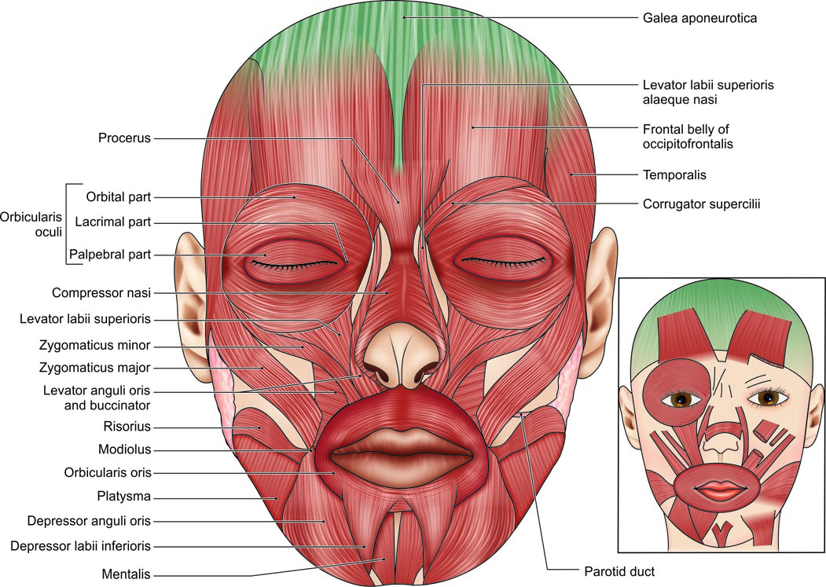
The facial muscles

Slide 10
Muscle | Origin | Insertion | Nerve supply | Action
Orbicularis occuli a)Orbital part b)Palpabral part c)Lacrimal part | Medial part of medial palpebral ligament. Lateral part of medial palpebral ligament. Lacrimal fascia | Concentric rings returns to the point of origin. Lateral palpebral raphae. Pass in front of eyelids to lateral palpebral raphae. | Facial nerve | Forcible closure of eyelids. Closes lids gently. Dilates lacrimal sac.

Slide 11
Muscle | Origin | Insertion | Nerve supply | Action
Orbicularis oris a)Intrinsic part-deep stratum, very thin b)Extrinsic part –two strata | Superior incisivus from Maxilla, Inferior incisivus from Mandible. Thickest middle stratum from Buccinator &thick superficial stratum from dilators of mouth | Angle of mouth Lips and angle of mouth | Facial nerve | Closes lips &protrude lips
Muscle | Origin | Insertion | Nerve supply | Action
Orbicularis occuli a)Orbital part b)Palpabral part c)Lacrimal part | Medial part of medial palpebral ligament. Lateral part of medial palpebral ligament. Lacrimal fascia | Concentric rings returns to the point of origin. Lateral palpebral raphae. Pass in front of eyelids to lateral palpebral raphae. | Facial nerve | Forcible closure of eyelids. Closes lids gently. Dilates lacrimal sac.
Orbicularis oris a)Intrinsic part-deep&thin. b)Extrinsic part -2 strata | Superior incisivus from maxilla & inferior incisivus from mandible Thckest middle stratum from Buccinator. Thick superficial stratum from dilators of mouth | Angle of mouth Lips and angle of mouth | Facial nerve | Closes lips and protrude lips
Buccinator | a)Upper fibres from Maxilla opposite molar teeth. b)Lower fibres Mandible oppositr molar teeth. c)Middle fibres from pterygomandibular raphae | Upper lip. Lower lip Middle fibres deccusate | Facial nerve | Flattens cheek against gums and teeth ,prevents accumulation of food in thevestibule.Whisling muscle

Slide 12
Muscle | Origin | Insertion | Nerve supply | Action
Buccinator– muscle of cheek | a)Upper fibres from maxilla opposite molar teeth b)Lower fibres from mandible opposite molar teeth c)Middle fibres from pterygomandibular raphae | Straight to upper lip Straight to lower lip Middle fibres deccusate | Facial nerve | Whistling muscle.Flattens cheek against gums &teeth, prevents accumulation of food in vestibule.

Slide 13
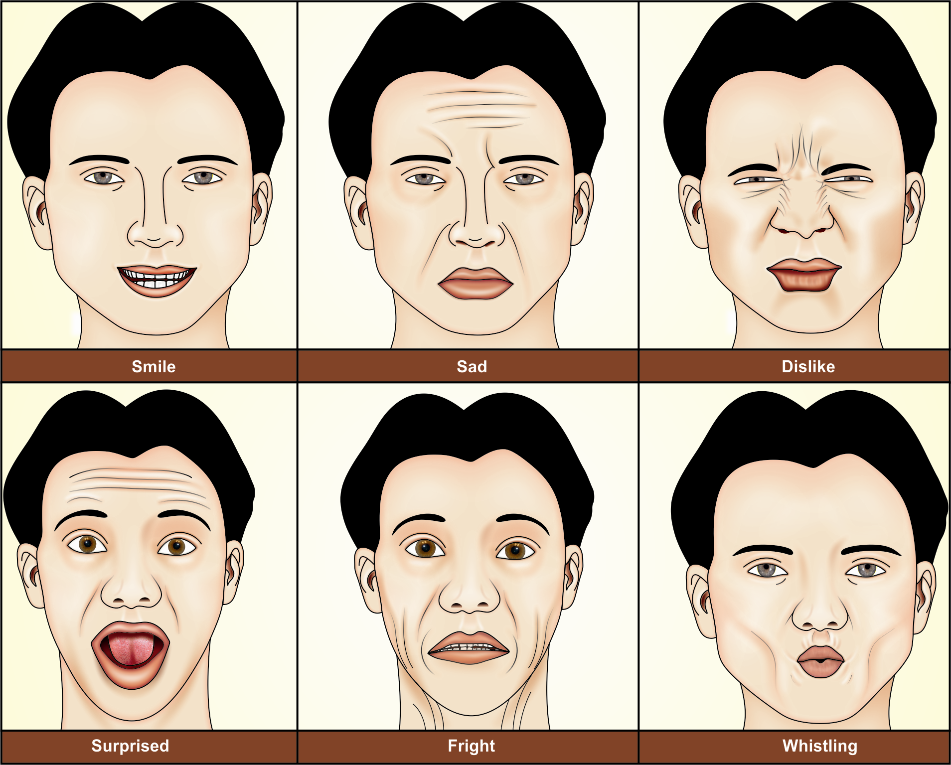
Some common facial expressions

Slide 14
ACTIONS OF THE MUSCLES
A few of the common facial expressions and the muscles producing them are
1. Smiling and laughing: Zygomaticus major.
2. Sadness: Levator labii superioris and levator anguli oris.
3. Grief: Depressor anguli oris.
4. Anger: Dilator naris and depressor septi.
5. Dislike: Corrugator supercilii and procerus.
6. Horror, terror and fright: Platysma
7. Surprise: Frontalis, 8. Doubt: Mentalis,
8. Grinning: Risorius
9. Contempt: Zygomaticus minor.
10. Closing the mouth: Orbicularis oris
11. Whistling: Buccinator, and orbicularis oris.

Slide 15
NERVE SUPPLY OF FACE
Motor Nerve Supply
The facial nerve is the motor nerve of the face. Its five terminal branches supply the various facial muscles as follows.
• Temporal—frontalis, auricular muscles, orbicularis oculi.
• Zygomatic—orbicularis oculi (lower eyelid part).
• Buccal—muscles of the cheek and upper lip.
• Marginal mandibular—muscles of lower lip.
• Cervical—platysma.

Slide 16
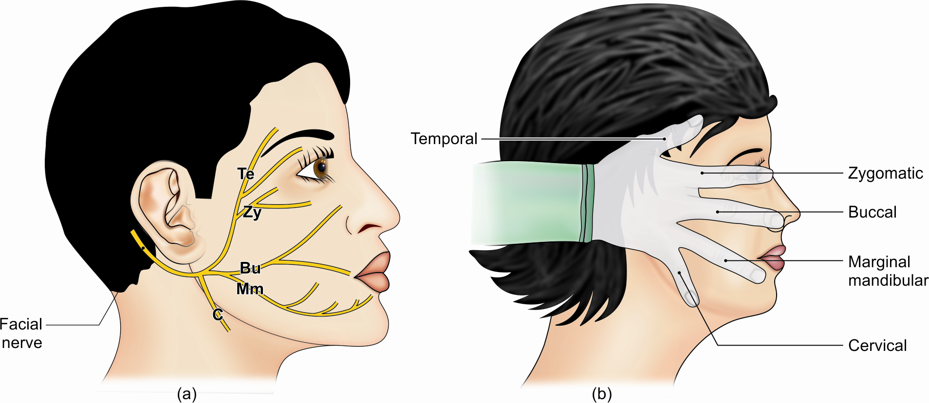
Terminal branches of the facial nerve

Slide 17
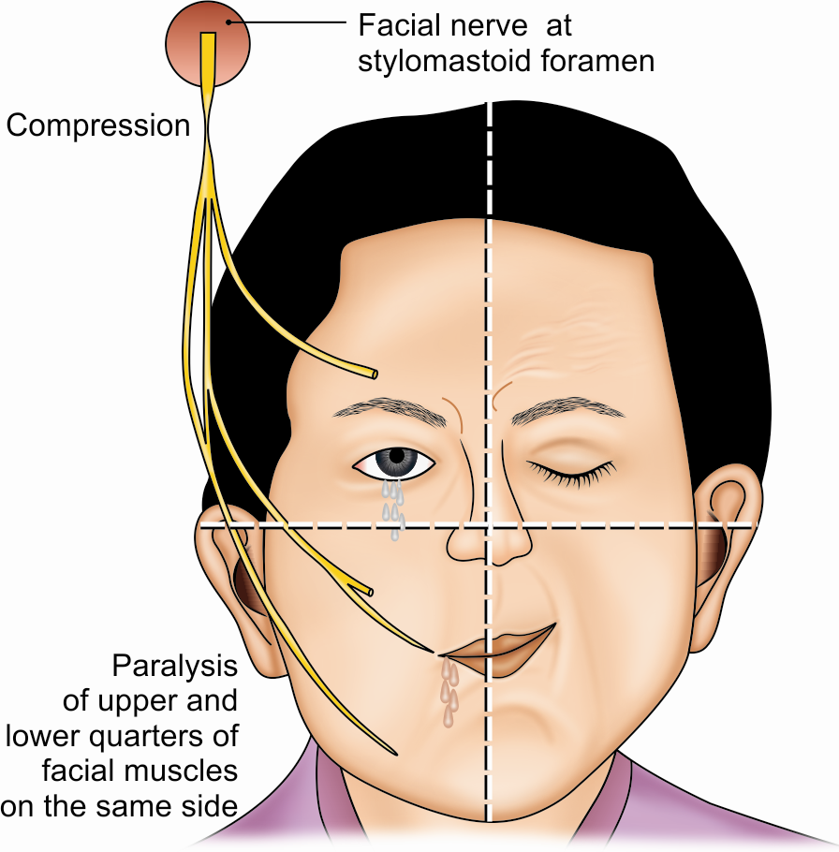
CLINICAL ANATOMY
Infranuclear lesion of right facial nerve or Bell’s palsy

Slide 18
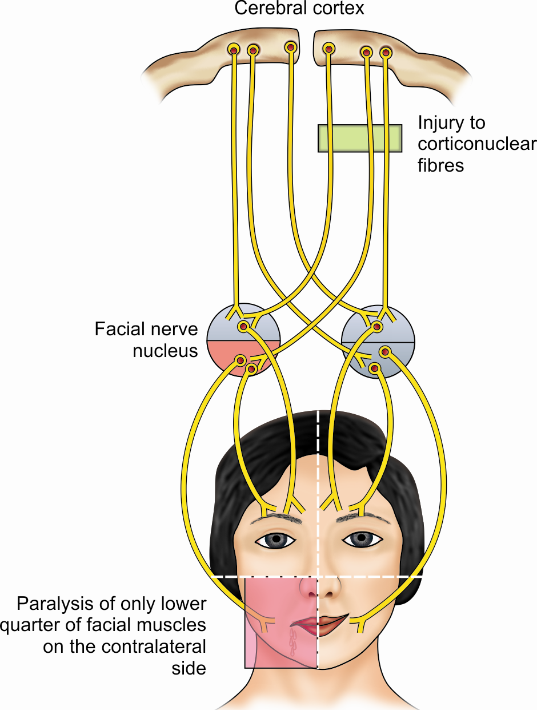
Supranuclear lesion of left facial nerve

Slide 19
Sensory nerves of Face
Mainly by the branches of
Ophthalmic (Supratrochlear, Supraorbital, palpebral branch of lacrimal, infratrochlear, external nasal)
Maxillary(infraorbital,zygomaticofacial,zygomaticotemporal) &
Mandibular (auriculotemporal, buccal &mental)
divisions of Trigeminal nerve.
Also branches from Cervical plexus-
Anterior div of great auricular nerve and upper div of transverse cutaneous nerve of neck

Slide 20
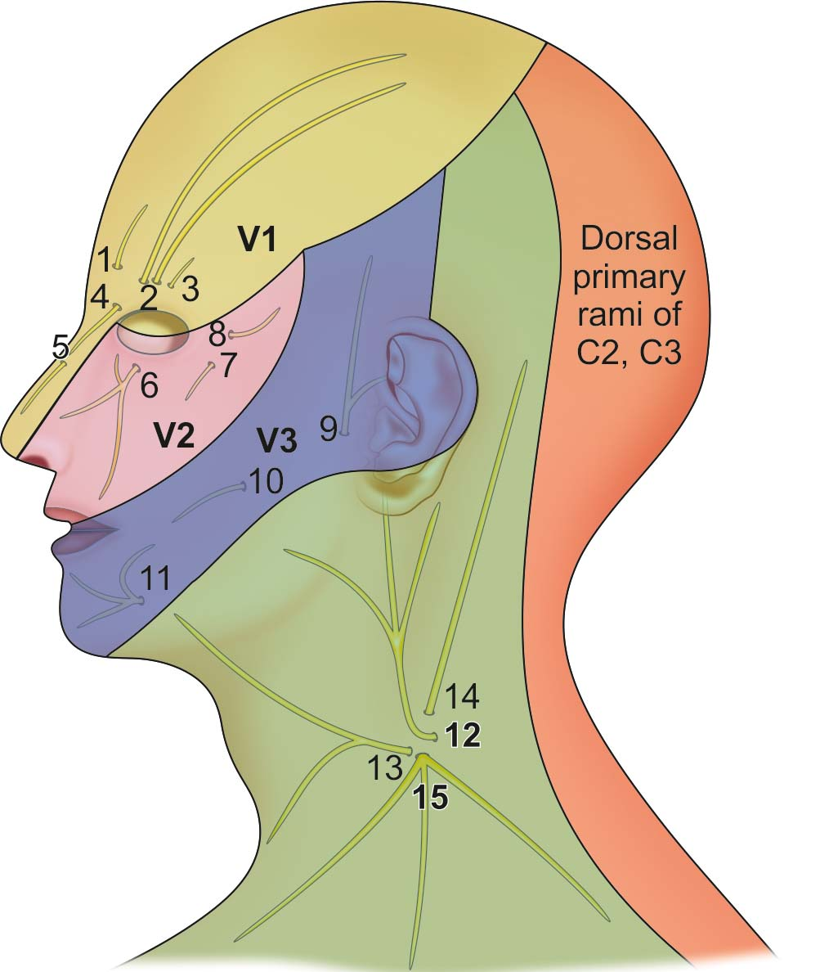
Sensory Nerve Supply
The sensory nerves of the face and neck.
(1) Supratrochlear, (2) Supraorbital, (3) palpebral branch of lacrimal,
(4) infratrochlear, (5) external nasal, (6) infraorbital,(7) zygomaticofacial,
(8) zygomaticotemporal, (9) auricu-lotemporal, (10) buccal, (11) mental, (12) great auricular, (13) transverse cutaneous nerve of neck, (14) lesser occipital, and (15) supraclavicular

Slide 21
ARTERIES OF THE FACE
The face is richly vascular. It is supplied by:
The facial artery,
The transverse facial artery, and
Arteries that accompany the cutaneous nerves.

Slide 22
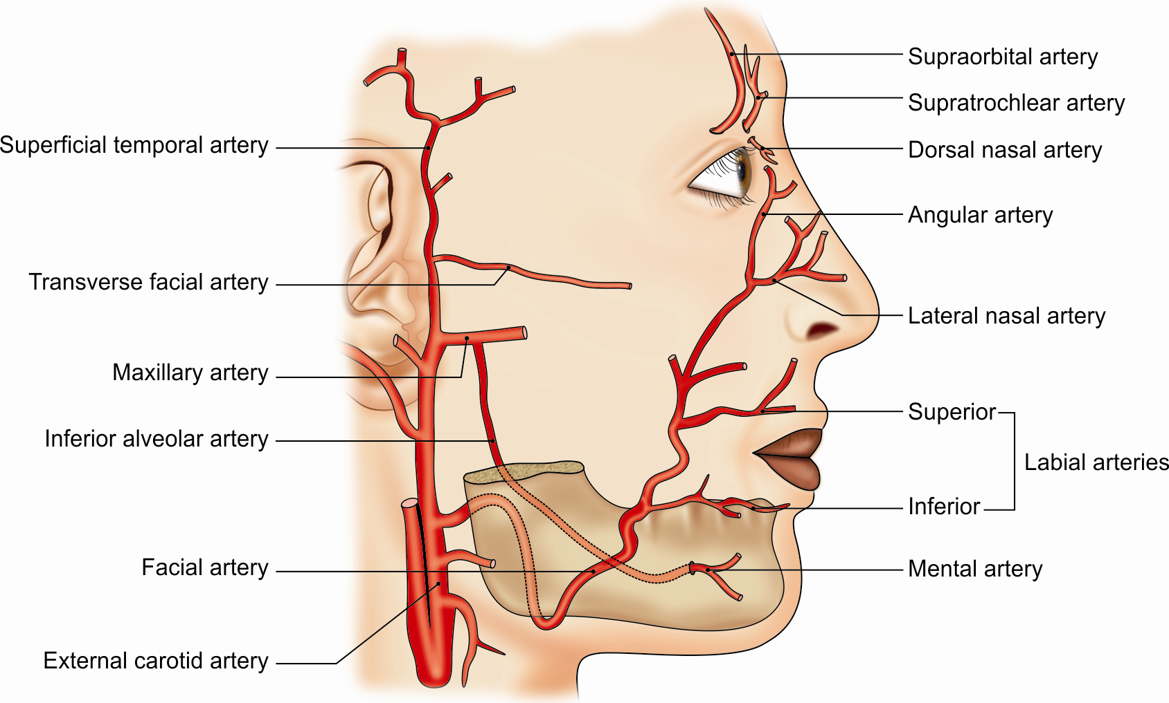
Arteries of the face

Slide 23
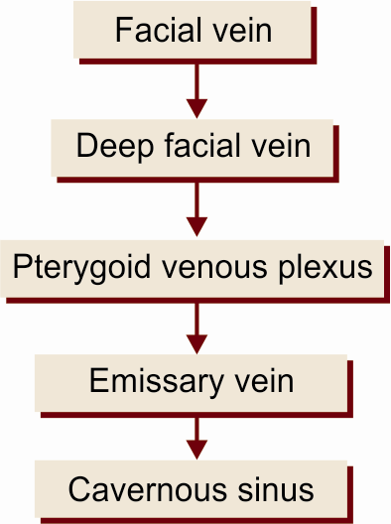
VEINS OF THE FACE: These accompany the arteries
Deep Connections:
A communication between the supraorbital and superior ophthalmic veins.
Another connection with the pterygoid plexus in.

Slide 24
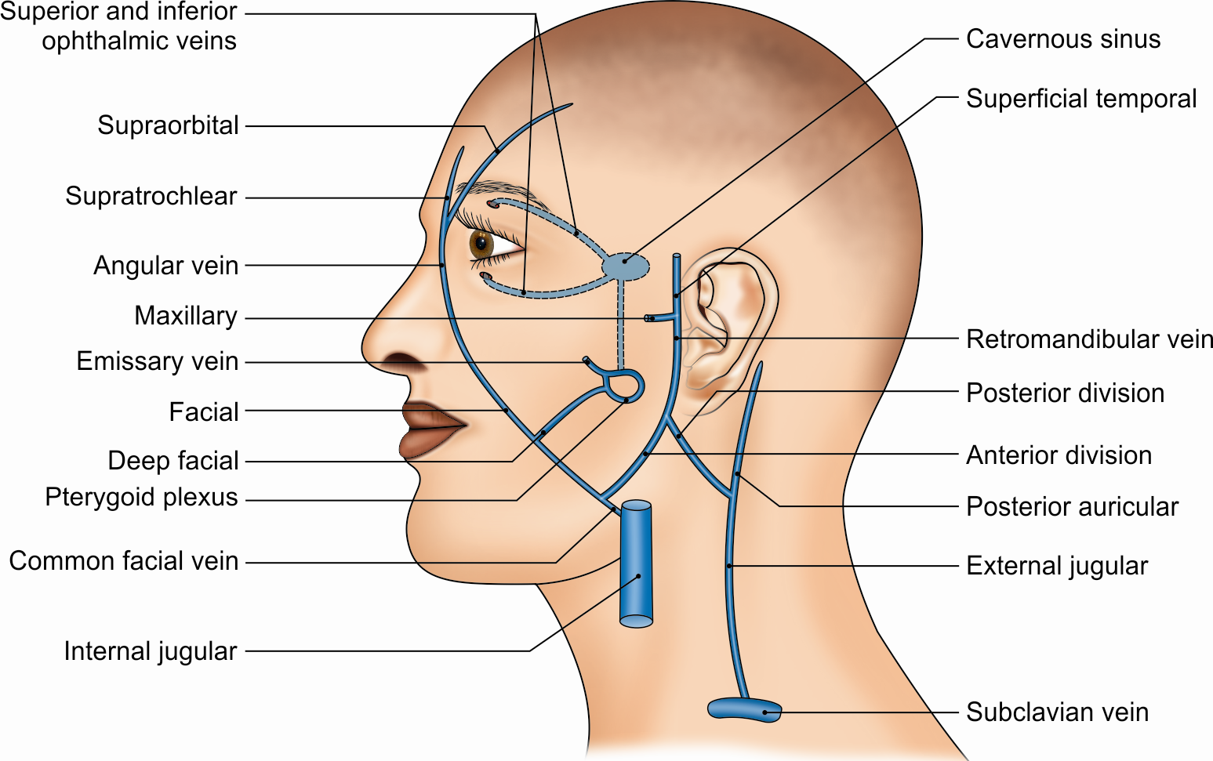
VENOUS DRAINAGE
The veins of the scalp, face and their deep connections with the cavernous sinus and the pterygoid plexus of veins

Slide 25
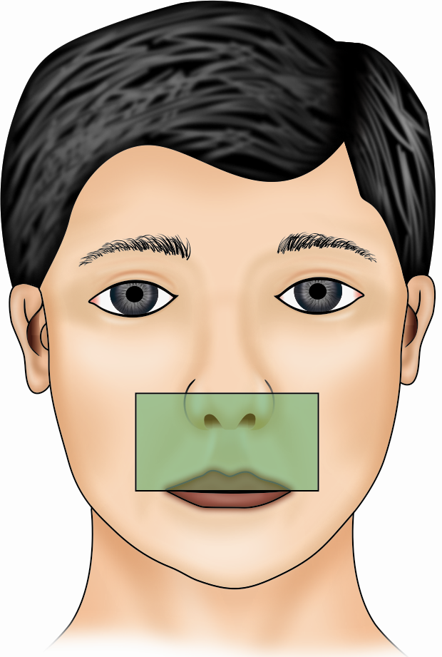
DANGEROUS AREA OF FACE
Dangerous area of the face (stippled). Spread of infection from this area can cause thrombosis of the cavernous sinus

Slide 26
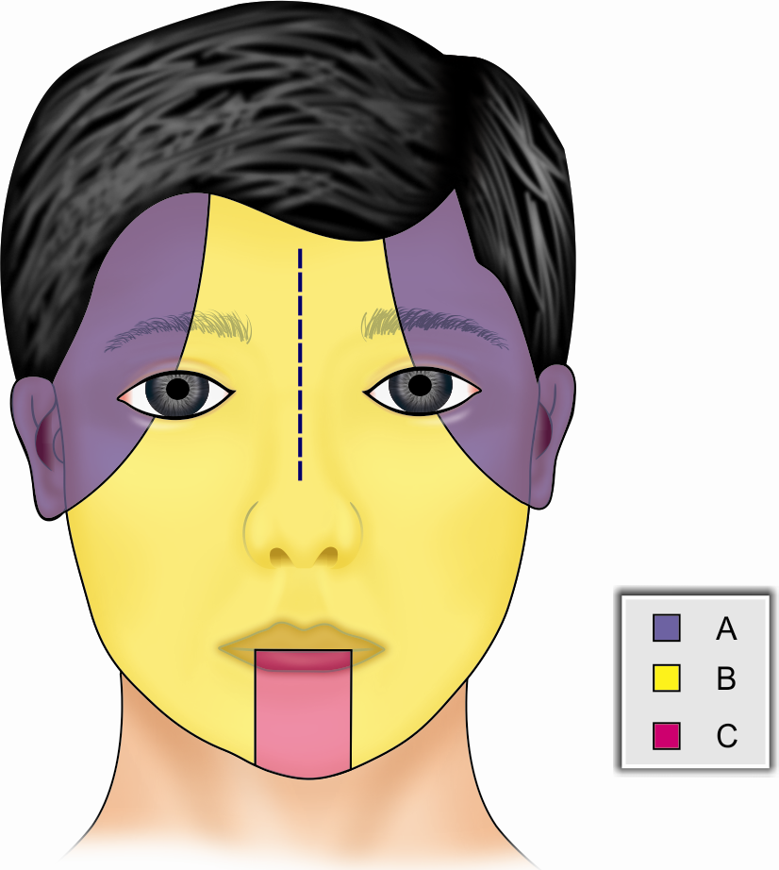
LYMPHATIC DRAINAGE OF THE FACE
The lymphatic territories of the face. Area (a) drains into the preauricular nodes, area (b) drains into the submandibular nodes, and area (c) drains into the submental nodes

