Slide 1
FRACTURE
DR.M.P.LAL
Professor and Head of Dept of Surgery

Slide 2
FRACTURES
A fracture is a complete or partial break in the continuity of a bone .
CLASSIFICATION
Fractures caused solely by sudden injury
Fragility fractures
Fatigue or stress fractures
Pathological fractures

Slide 3
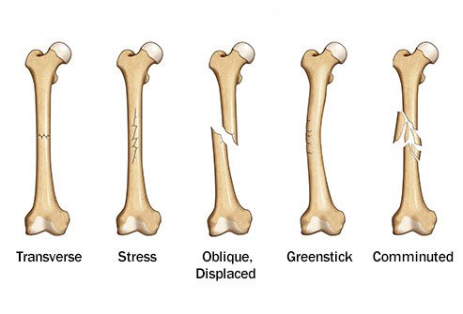
FRACTURES

Slide 4
CLOSED AND OPEN FRACTURES
A fracture is closed or simple when there is no communication between the site of fracture and the exterior of the body.
A fracture is open or compound when there is a wound of the skin surface leading down to the site of fracture.

Slide 5
PATTERNS OF FRACTURE
Transverse fracture
Oblique fracture
Spiral fracture
Comminuted fracture
Compression fracture
Greenstick fracture

Slide 6
REPAIR OF TUBULAR BONE
The process of healing of tubular bone may be considered as occurring in five stages
Stage of haematoma
Stage of subperiosteal and endosteal cellular proliferation
Stage of callus
Stage of consolidation
Remodelling

Slide 7
PRINCIPLES OF FRACTURE TREATMENT
first aid
clinical assessment
Resuscitation
TREATMENT OF UNCOMPLICATED CLOSED FRACTURES
Reduction
Immobilisation
rehabilitation

Slide 8
COMPLICATIONS OF FRACTURES
RELATED TO FRACTURE ITSELF
ATTRIBUTABLE TO ASSOCIATED INJURY
Infection
Delayed union
Non – union
Avascular necrosis
Mal-union
shortening
Injury to major blood vessels
Injury to nerves
Injury to viscera
Injury to tendons
Traumatic affections of joints
Fat embolism
Compartment syndrome

Slide 9
HOMOEOPATHIC THERAPEUTICS
ARNICA MONTANA
HYPERICUM
SYMPHYTUM
RUTA
SILICEA

