Slide 1
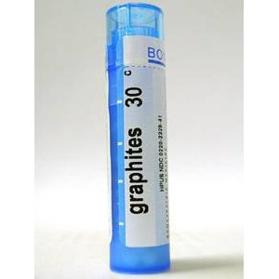
GRAPHITES PRESENTED BY, DEPT OF MATERIA MEDICA

Slide 3
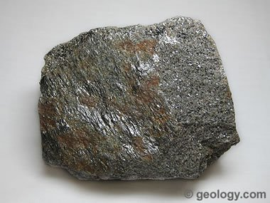
Graphite owes its name to the Greek term ‘grahein' which denotes ‘to write'. Hence, it is not surprising that this form of carbon constitutes the major part of pencils. While it is used to prepare a homeopathic remedy called Graphites, this carbon form has various industrial uses too, such as polishes, lubricants, batteries as well as electric motors.

Slide 4
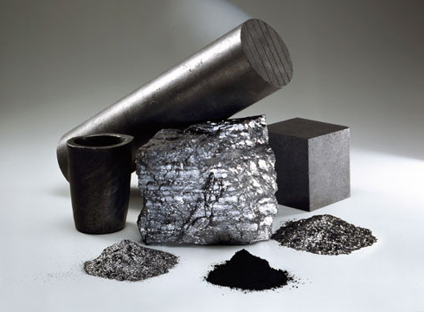

Slide 5
In homeopathy, the efficacy of the remedy graphites was established by none other than Dr. Samuel Hahnemann. Hahnemann had come to know that workers in a mirror factory were applying graphite powder to cure their cold sores (a vesicular eruption on the face, usually near the mouth). Over the years, it has been proved that the homeopathic remedy graphites is an excellent remedy for skin conditions as well as metabolic problems.

Slide 6
The homeopathic remedy graphites has the potential to provide a variety of help in specific health conditions. Graphite powder is the active ingredient of this medication. Graphites is prepared by triturating or pulverizing graphite powder with milk sugar (lactose) with a view to make it soluble.

Slide 7
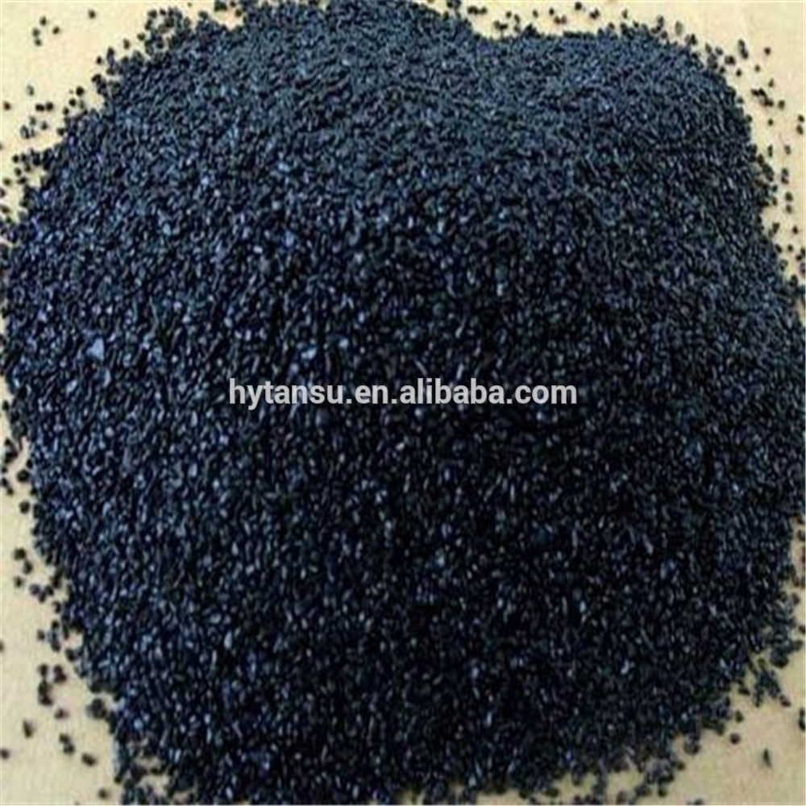

Slide 8
The mineral graphite, which forms the basis of the homeopathic remedy graphites, is found in abundance in the United States, Sri Lanka, Canada and Mexico.

Slide 9
Suited to women, inclined to obesity, who suffer from habitual constipation; with a history of delayed menstruation. "What Pulsatilla is at puberty, Graphites is at the climacteric.".

Slide 10
Like all the carbons, this remedy is an anti-psoric of great power, but especially active in patients who are rather stout, of fair complexion, with tendency to skin affections and constipation, fat, chilly, and costive, with delayed menstrual history, take cold easily.

Slide 11
Children impudent, teasing, laugh at reprimands. Has a particular tendency to develop the skin phase of internal disorders. Eradicates tendency to erysipelas. Anæmia with redness of face. Tendency to obesity. Swollen genitals. Gushing leucorrhœa. Aids absorption of cicatricial tissue. Induration of tissue. Cancer of pylorus. Duodenal ulcer.

Slide 12
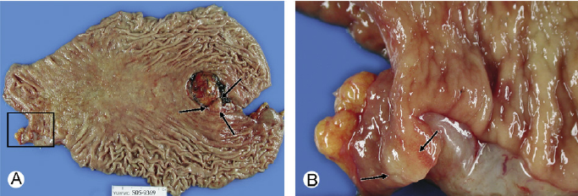

Slide 14
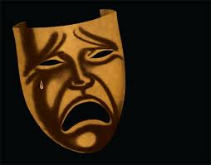
MIND Great tendency to start. Timid. Unable to decide. Want of disposition to work. Fidgety while sitting at work. Music makes her weep. Apprehensive, despondency, indecision. Excessive cautiousness; timid; hesitates; unable to decide about anything. Sad, despondent; music makes her weep; thinks of nothing but death.

Slide 15
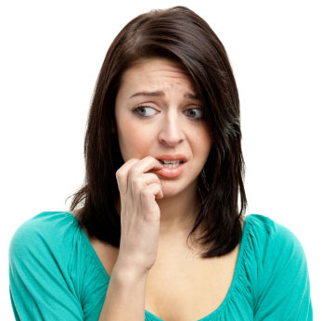
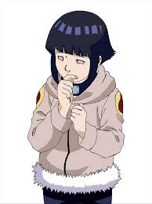
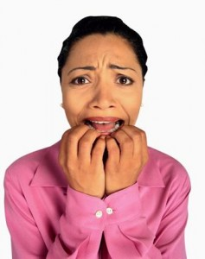

Slide 16
HEAD Rush of blood to head with flushed face also with nose bleed and distension and flatulence. Headache in morning on waking, mostly on one side, with inclination to vomit. Sensation of cobweb on forehead. Feels numb and pithy. Rheumatic pains on one side of head, extending to teeth and neck. Burning on vertex. Humid, itching eruption on hairy scalp, emitting a fetid odor. Cataleptic condition.

Slide 17
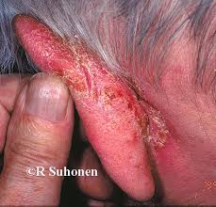
EARS Dryness of inner ear. Cracking in ears when eating. Moisture and eruptions behind the ears. Hears better in noise. Hardness of hearing. Hissing in the ears. Detonation in ear like report of a gun. Thin, white, scaly membrane covering membrane tympani, like exfoliated epithelium. Fissures in and behind the ear.

Slide 18
NOSE Sore on blowing it; is painful internally. Smell abnormally acute; cannot tolerate flowers. Scabs and fissures in nostrils.

Slide 19
FACE Feels as if cobwebs were on it. Eczema of nose. Itching pimples. Moist eczema around mouth and chin. Erysipelas, burning and stinging. MOUTH Rotten odor from mouth. Breath smells like urine. Burning blisters on tongue, salivation. Sour eructations.

Slide 20
STOMACH Aversion to meat. Sweets nauseate. Hot drinks disagree. Nausea and vomiting after each meal. Morning sickness during menstruation. Pressure in stomach. Burning in stomach, causing hunger. Eructation difficult. Constrictive pain in stomach. Recurrent gastralgia. Flatulence. Stomach pain is temporarily relieved by eating, hot drinks especially milk and lying down.

Slide 21
ABDOMEN Nauseous feeling in abdomen. Fullness and hardness in abdomen, as from incarcerated flatulence; must loosen clothing; presses painfully at abdominal ring. Inguinal region sensitive, swollen. Very fetid gas preceded by colic.

Slide 22
STOOL Constipation; large, difficult, knotty stools united by mucus threads. Burning hæmorrhoids. Prolapse, diarrhœa; stools of brown fluid, mixed with undigested substance, very fetid, sour odor. Smarting, sore anus, itching. Lump stool, conjoined with threads of mucus. Varices of the rectum. Fissure of anus. URINE Turbid, with sediment. Sour smelling.

Slide 23
RESPIRATORY Constriction of chest; spasmodic asthma, suffocative attacks wakes from sleep; must eat something. Pain in middle of chest, with cough, scraping and soreness. Chronic hoarseness with skin affections. Inability to control the vocal chords; hoarseness on beginning to sing and for breaking voice.

Slide 24
FEMALE.— Menses too late, with constipation; irregular; delayed from getting feet wet; pale and scanty, with tearing pain in epigastrium, and itching before. Morning sickness during menstruation ; very weak and prostrated. Leucorrhœa, pale, thin, profuse, white, excoriating; occurs in gushes day and night; before and after menses with great weakness in back.

Slide 25
Mammæ swollen and hard. Induration of ovaries and uterus and mammæ. Nipples sore, cracked, and blistered. Decided aversion to coitus. Hard cicatrices remaining after mammary abscess, retarding the flow of milk; cancer of breast, from old scars and repeated abscesses.

Slide 26
MALE Sexual debility, with increased desire; aversion to coition; too early or no ejaculation; herpetic eruption on organs.

Slide 27
EXTREMITIES. Pain in nape of neck, shoulders and back and limbs. Pain in small of back with great weakness. Excoriation between thighs. Œdema of lower limbs. Toe-nails crippled. Stiffness and contraction of toes. Cracks or fissures in ends of fingers.

Slide 28
SKIN Rough, hard, persistent dryness of portions of skin unaffected by eczema. Early stage of keloid and fibroma. Pimples and acne. Eruptions, oozing out a sticky exudation. Rawness in bends of limbs, groins, neck, behind ears. Unhealthy skin; every little injury suppurates. Ulcers discharging a glutinous fluid, thin and sticky. Swelling and induration of glands. Gouty nodosities. Cracks in nipples, mouth, between toes, anus. Swelling of feet.

Slide 29
MODALITIES Worse, warmth, at night, during and after menstruation. Better, in the dark, from wrapping up. DOSE. Sixth to thirtieth potency. Locally as a cerate, in sore nipples.

Slide 30
RELATIONS. - FOLLOWS WELL: after Lyc., Puls., after Cal. in obesity of young women with large amount of unhealthy adipose tissue; follows Sulph. well in skin affections; after Sepia in gushing leucorrhoea. SIMILAR: to, Lyc., Puls. in menstrual troubles. COMPLEMENTARY: Argent nit (gastric derangements); Caustic; Hep; Lycop; Ars; Tuberc. COMPARE: Petrol; Sep; Sulph; Fluor ac. The associated constipation with mucus-covered stools and gastric flatulency should be taken into consideration and differentiate it from such remedies as Petrol and Lycop. ANTIDOTE: Nux; Acon; Ars.

