Slide 1
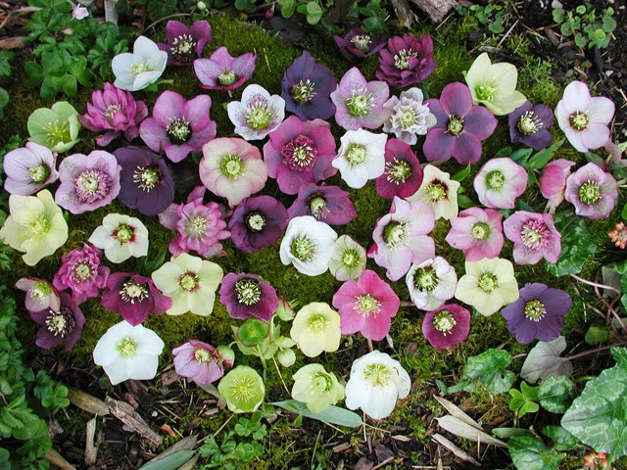
HELLEBORUS

Slide 3
PRESENTED BY Dept Of Materia Medica

Slide 4
HELLEBORUS FOETIDUS HELLEBORUS NIGER HELLEBORUS ORIENTALIS HELLEBORUS VIRIDIS

Slide 5
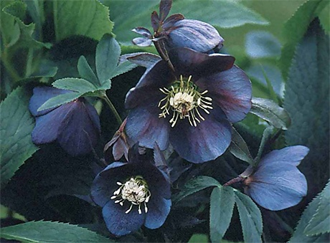

Slide 6
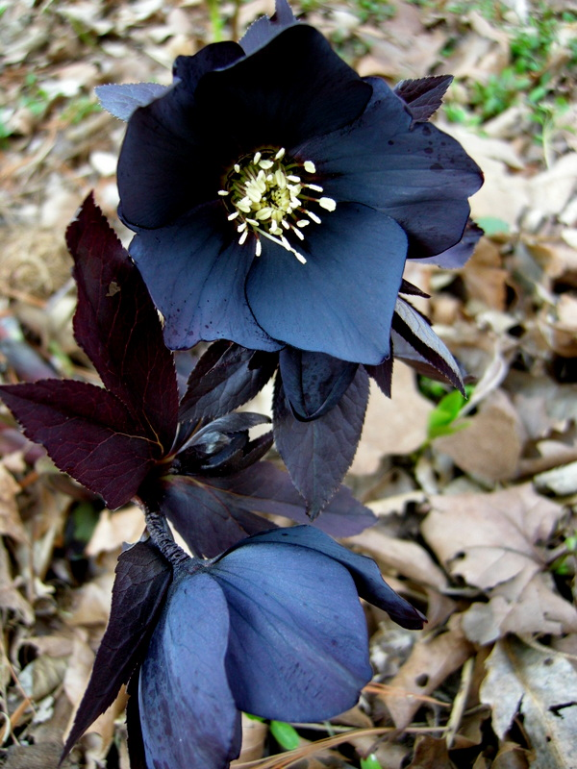
HELLEBORUS NIGER

Slide 7
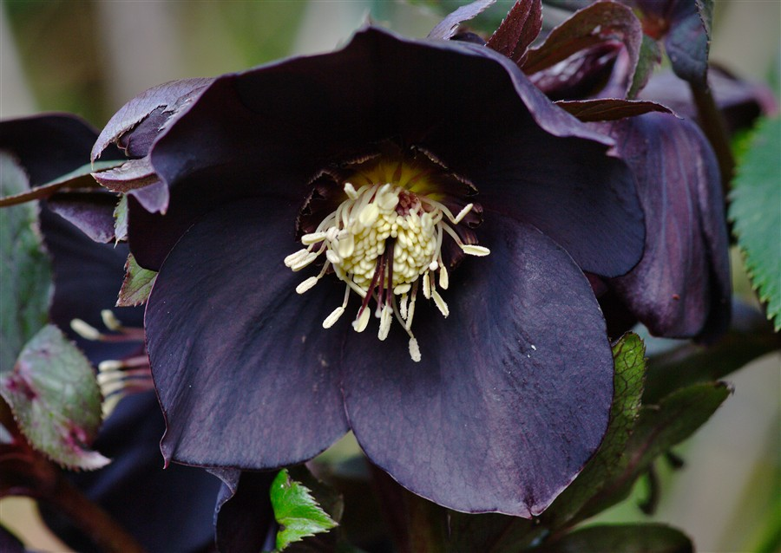
Natrual Order: Ranunculaceae Common name: Black Helleborus Habitat: Europe Preparations: Mother tincture of the fresh root; and dilutions. Dosage: Of the tincture,1 to 30 drops.

Slide 8
Produces a condition of sensorial depression. Sees, hears, tastes imperfectly, and general muscular weakness, which may go on to complete paralysis, accompanied by dropsical effusions. Hence, a remedy in low states of vitality and serious disease. Characteristic aggravation from 4 to 8 pm (Lycop). Sinking sensation. State of effusion in hydrocephalus. Mania of a melancholy type.

Slide 9
PHYSIOLOGICAL ACTION: Produces salivation, stimulates the secretion of the liver & pancreas; also increases the peristaltic action of the intestine. Hyperaemia of the kidney, while the urine is scanty. Uterine mucous membrane is congested. Brain, cord and serous membrane show a general hyperaemia and anasarca. Toxic doses – paralysis, with rapid pulse and sudden arrest of the heart.

Slide 10
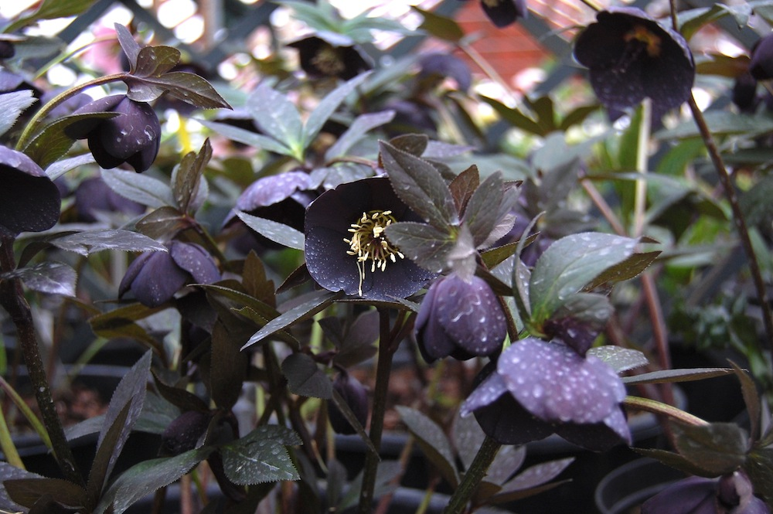
With paralysis tremor followed by violent convulsions. Active principles are– Hellebrein (cardiac poison) and Helleborin ( narcotic effect).

Slide 11
Mind.— Slow in answering. Thoughtless; staring. Involuntary sighing. Complete unconsciousness. Picks lips and clothes.

Slide 12
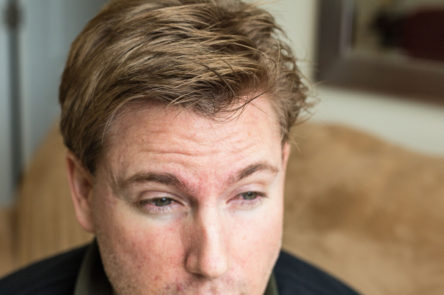
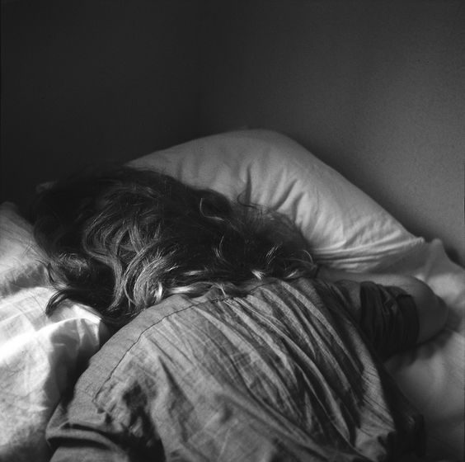
Head.— Forehead wrinkled in folds. Cold sweat. Stupefying headache. Rolls head day and night; moaning, sudden screams. Bores head into pillow; beats it with hands. Dull pain in occiput, with sensation of water swashing inside. Headache culminates in vomiting.

Slide 13
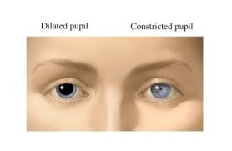
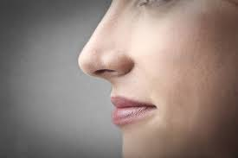
Eyes: Eyeballs turn upwards; squinting, vacant look. Pupils dilated. Eyes wide open, sunken. Night-blindness. Nose: Dirty, dry nostrils. Rubs nose. Smell diminished. Nose pointed. Face: Pale, sunken. Cold sweat. Wrinkled. Neuralgia on left side; parts so tender he cannot chew.

Slide 14
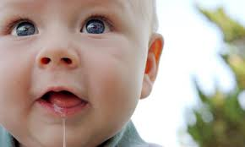
Mouth.— Horrible smell from mouth. Lips dry and cracked. Tongue red and dry. Falling of lower jaw. Meaningless picking of lips. Grinding of teeth. Chewing motion. Greedily swallows cold water, though unconscious. Child nurses greedily, with disgust for food. Ptyalism, with sore corners of mouth.

Slide 15
Abdomen.--Gurgling, as if bowels were full of water. Swollen, painful to touch. Stool.--Jelly-like, white mucus; involuntary.

Slide 16
Urine.--Suppressed; scanty, dark; coffee-grounds sediment. Frequent urging. Child cannot urinate. Bladder overdistended.

Slide 17
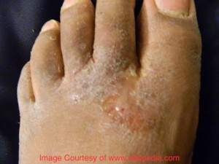
Respiratory.--Frequent sighing. Respiration irregular. Chest constricted; gasps for breath. Hydrothorax (Merc sulph). Extremities.--Automatic motion of one arm and leg. Limbs heavy and painful. Stretching of limbs. Thumb drawn into palm (Cupr). Vesicular eruption between fingers and toes.

Slide 18
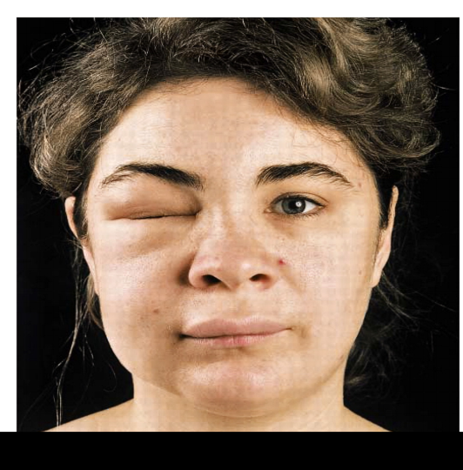
Sleep.--Sudden screams in sleep. Soporous sleep. Cri encephalique. Cannot be fully aroused. Skin.--Pale, dropsical, itching. Livid spots on skin. Sudden, watery, swelling of skin. Falling off of hair and nails. Angio-neurotic œdema.

Slide 19
Modalities.--Worse, from evening until morning, from uncovering.

Slide 20
Relationship.--(Hellebor fætidus, or, Polymnia-Bear's foot--Acts especially on spleen (Ceanothus); also rectum and sciatic nerve. Splenic pains extend to scapula, neck and head, worse left side and evening; chronic ague cake; hypertrophied uterus; glandular enlargements; hair and nails falling off; skin peeling). Hellebor orientalis (salivation).

Slide 21
Antidote: Camphor; Cinch. Compare: Threatening effusion; Tuberc; Apis; Zinc; Opium; Cinch; Cicuta; Iodoform. Dose.--Tincture, to third potency.

Slide 22
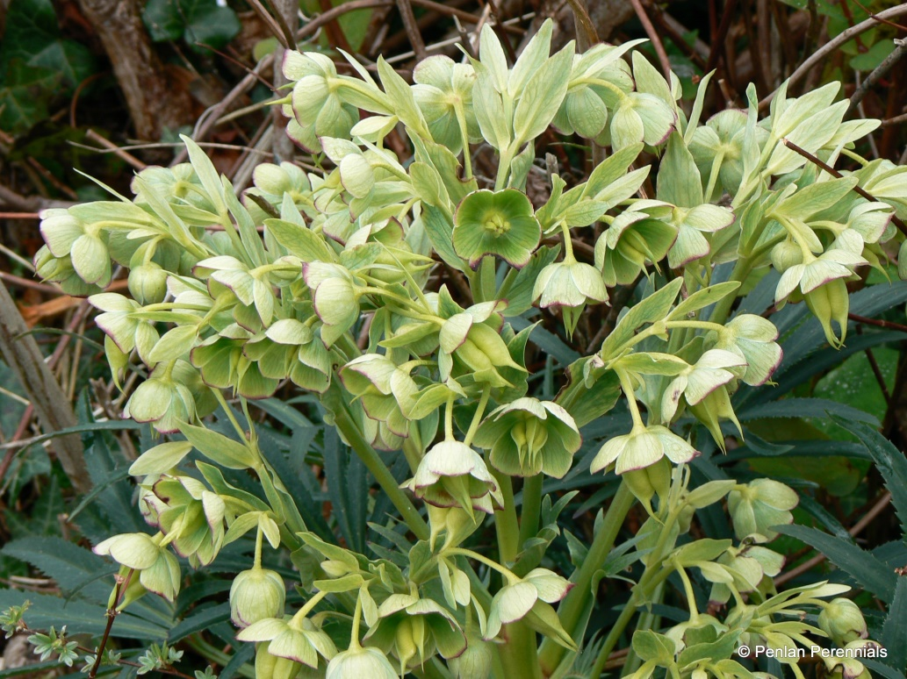
HELLEBORUS FOETIDUS

Slide 23
Helleborus foetidus, known variously as stinkinghellebore, dungwort, setterwort and bear's foot, is a species of flowering plant in the buttercup family Ranunculaceae, native to the mountainous regions of Central and Southern Europe, Greece and Asia Minor. It is found wild in many parts of England, especially on limestone soil.

Slide 24
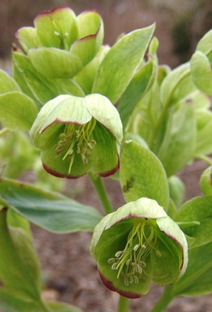
CN: Bear’s foot Preparation: tincture of root Clinical: Cholera, hair and nail falling off. Scarlatina. Skin peeling. Stiff neck.

Slide 25
The effect of the Hel. F have been observed on several persons. It is a violent narcotic – acrid poison, and in fatal poisoning cases death has taken place in convulsions.

Slide 26
The vision is disordered; choleraic symptoms occur; skin, hair exfoliate. The anxiety is > after vomiting.

Slide 27
RELATIONS: Compare: Verat.alb, Hell. n., Hell.v., Colch.

Slide 28
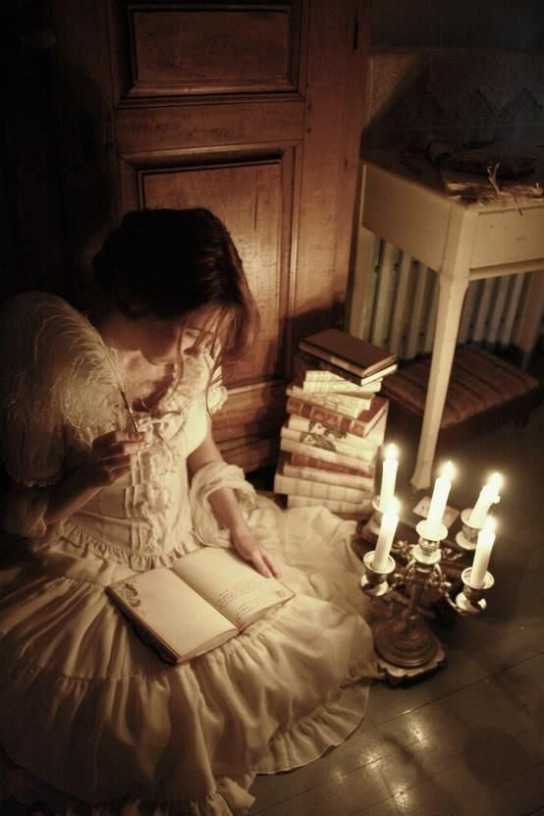
Mind: Dreadful anxiety, better after vomiting. Eyes: Great difficulty in reading, in evening, by candle-light, the sensation is as when the light flickers from a draught of air, cannot follow the lines. Ears: Thumping pain below and behind left ear.

Slide 29
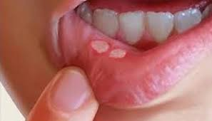
Mouth Smarting at tip of tongue. Painful sensation like aphthae in mouth. Taste of manure, tongue yellow in middle. Excoriation of mouth and throat. Stomach and Abdomen Nausea and vomiting of food. Constant inclination to vomit. When pounding the plant it seems that the epigastrium with difficulty keeps time with the inflation of the chest on inspiration. Frightful pain in pit of stomach. Colic.

Slide 30
Stool and Anus Violent purging and vomiting with pain in stomach. Abundant liquid stool during night, next day two liquid, whitish stools, again a liquid stool forty-eight hours later.

Slide 31
Chest Tightness of chest, can scarcely half draw his breath. Back Numbness in muscles of neck, sensibility to touch blunted, it becomes stiff eighteen hours later. Generalities Fatal convulsions. Swooning.

Slide 32
Skin of whole body peels, hair falls out, all the nails fall off Profuse discharge from ulcerated surface (from application). Sleep Stirs a good deal in his sleep.

Slide 33
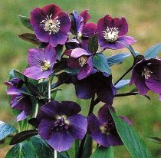
Helleborus Orientalis.

Slide 34
Helleborus orientalis, Lam. N. O. Ranunculaceć. Prepartion: Tincture of root. Clinical.─Diarrhea. Indigestion. Salivation. Characteristics: This was proved by V. Schroff on Lederer, and produced symptoms like those of the other Hellebores. These are peculiar: Accumulation of water in the mouth with clean tongue. Bad taste, with clean tongue. Prostration, exhaustion, and disinclination to work; burning in stomach; diarrhea. The symptoms were > by coffee.

Slide 35
Head: Heaviness; fullness; headache. Mouth: Accumulation of water in mouth; with clean tongue. Bad taste with clean tongue. Stomach: Loss of appetite. Eructations. Hiccough. Nausea. Burning, extending from stomach to lower portion of oesophagus. Epigastria region: Feeling of fullness with inclination to vomit; slight burning, afterwards extending to intestines, followed by pressure in stomach.

Slide 36
Abdomen and Stool. Frequent rumbling along bowels, in morning on waking, soon followed by four liquid stools in succession. Pain esp. in region of l. transverse colon. Urinary Organs. Urine more profuse and paler than usual. Pulse. Pulse more frequent, body warmer. Pulse slowed.

Slide 37
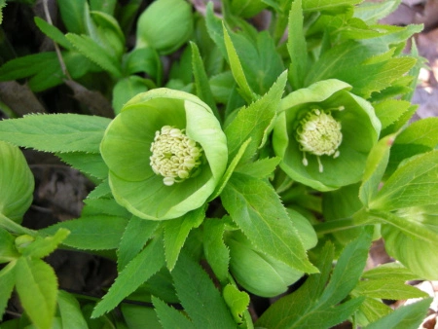
Helleborus Viridis.

Slide 38
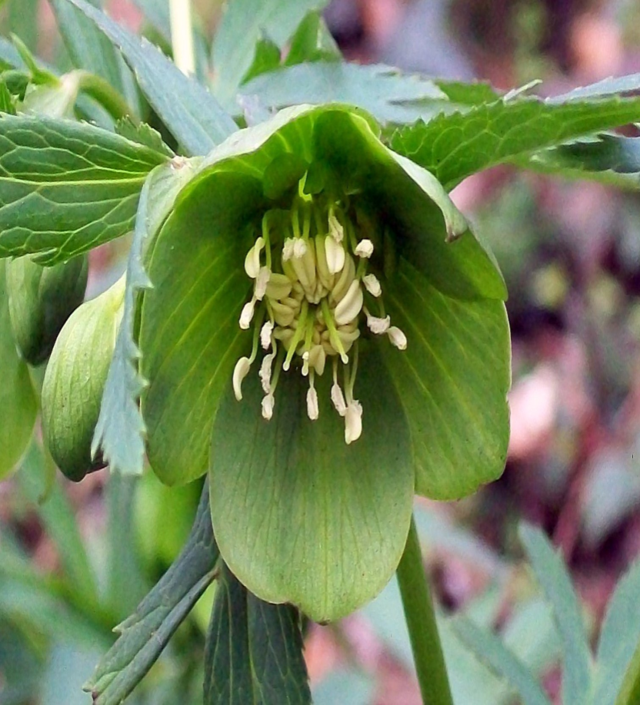
Green Hellebore. N. O. Ranunculaceć. Prepared from: Tincture of root; of young shoots. Clinical.─ Colic. Diarrhea. Epilepsy. Sore throat. Ulcers.

Slide 39
Characteristics.─This was also proved by Schroff. It produced roaring in the ears; itching in the nose; and prickling of the tongue; diarrhoea of liquid stools; a condition of sopor. Cooper has cured with it ulcers of the leg, near the ankle, after the failure of Hell. n. Also a case of epilepsy in a child, the concomitant symptoms being: "Head sweats before the fit; diarrhoea for four days sleepy."

Slide 40
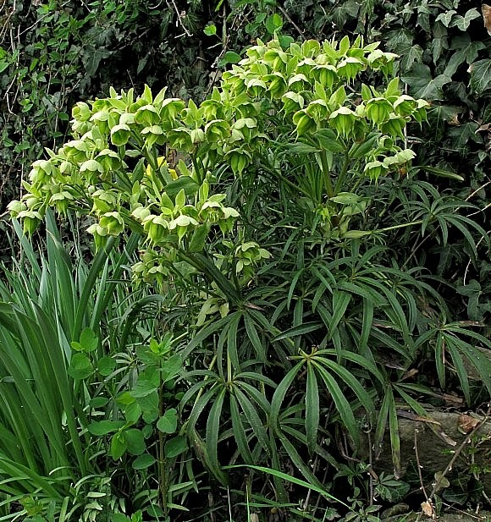

Slide 41
Ears: Ringing and roaring in the ears; with feeling of stoppage in both ears. Nose: Violent itching of nose with frequent violent sneezing (from application of extract to mucous membrane of nose). Throat: Feeling of warmth in pharynx and stomach, gradually becoming a dull burning, not > by drinking much water.

Slide 42
Mouth: Prickling on tongue > by frequent rinsing of mouth with water. Burning in mouth. At first profuse secretion of saliva and mucus in mouth, soon followed by dryness. The taste was so intensely bitter and rancid, that she suffered for a long time from nausea and great inclination to vomit.

Slide 43
Stomach and Abdomen: Frequent eructations, and gurgling in abdomen. Digestion disturbed several days. Abdomen somewhat sensitive and distended. Stool: Very profuse liquid stools. Three liquid evacuations from bowels, at short intervals, with intense colic, the last stool accompanied by tenesmus, great nausea, with inclination to vomit, violent headache and thirst.

Slide 44
Urinary Organs: Micturition frequent, painless, urine pale. Pulse: The pulse rose during the first hour several beats in frequency (apparently caused by the excessive nausea from the bad taste of the drug), and afterwards sank below the normal in one case; while in those who took doses of 2 to 4 grains enveloped in a vehicle, the pulse immediately sank several beats.

Slide 45
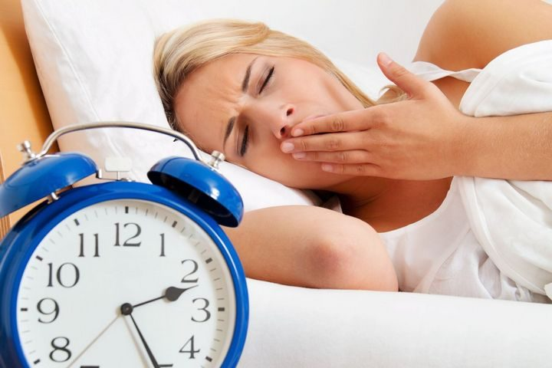
Sleep: A condition bordering on sopor, lasting the whole night, and preventing refreshing sleep. Night restless, sleep frequently interrupted. Fever: Sensation of heat at times over the whole body.

