Slide 1
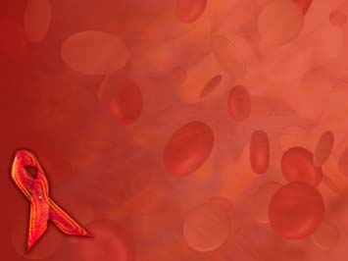
Retro viruses
DR.R.S.GOPIKA
Prof,& HoD
Dept Pathology
SKHMC

Slide 2
Retroviruses
RNA viruses, single stranded, enveloped, icosahedral.
enzyme reverse transcriptase
2genera –
- Human immunodeficiency viruses
- Human T-cell lymphotropic virus

Slide 3
HIV
Human immunodeficiency virus
First emerged in early 1980s
spherical and 80–110 nm in size
Enveloped-
• Gp 120 are projected as knob like spikes on the surface
• Gp 41 They form anchoring transmembrane pedicles.
HIV contains 3 structural genes:
gag, pol, and env

Slide 4
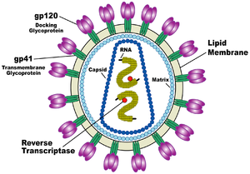

Slide 5
HIV Serotyping
Based on env gene, two serotypes HIV-1 and 2.
HIV–1 is divided into three distinct groups (M, N and O). Recently, group P has been identified.
• ‘M’is the dominant group worldwide.

Slide 6
Genotype distribution:HIV-1
Subtype A - is common in West Africa
Subtype B – in Europe, America, Japan, and Australia
Subtype C - is the MC form worldwide (47%). It is also the dominant form in South East Africa, India, and China
In Cameroon (West Africa), all HIV virus groups and subtypes are found.

Slide 7
HIV-2
HIV-2comprises of eight groups (A–H)
they are confined to Africa and some places including India.
Group A is the MC form.

Slide 8
HIV
HIV-1 may have originated from a chimpanzee virus
1959 first documented case of AIDS
Viral genes permanently integrated into host DNA

Slide 9
Human Immunodeficiency Virus (HIV) –
the cause of Acquired Immunodeficiency Syndrome (AIDS)
HIV can only infect host cells that have the required CD4 marker plus a coreceptor
HIV-1: isolated in1983
Responsible from AIDS pandemic
HIV-2: isolated in 1986
HIV-2 less pathogenic
slow progression to AIDS

Slide 10
Resistence
Moist heat -121°C – 20min
Dry heat -170°C – 1 hr
Boiling – 20 - 30 min

Slide 11
Major Ags
Envelope Ags-
Spike Ag-gp120
Shell Ags –
nucleocapsid Ag
Core Ag-
principal core Ag-p53
other core Ag-p15,p55
Polymerase Ag-
p31,p51,p66

Slide 12
Most common mode of transmission in World:
Sexual (75%)
Parent to child (10%)
Injection drug abuse(10%)
Blood transfusion (5%)
Needle stick exposure (0.1%)

Slide 13
Most common mode of transmission in India:
Heterosexual (87.4%)
Parent to child (5.4%)
Injection ,drug abuse (1.6%)
Homosexual (1.5%)
Blood transfusion and Needle stick exposure (together 1%).
HIV does not survive long outside of the body.

Slide 14
Pathogenesis
2 major targets of HIV infection are the immune system and the central nervous system.
CD4 T cells, macrophages, astrocytes, retinal cells, BM stem cells, cervical cells, and enterochromaffin cells in the duodenum, colon, and rectum

Slide 15
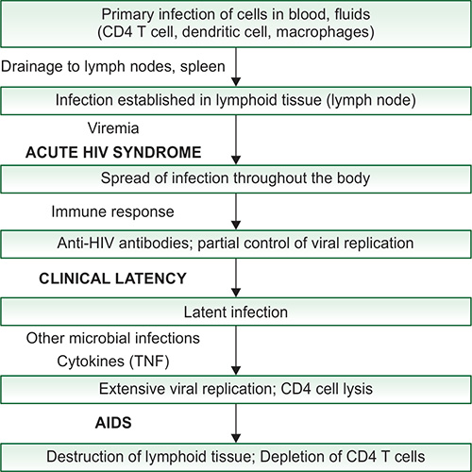
PATHOGENESIS

Slide 16
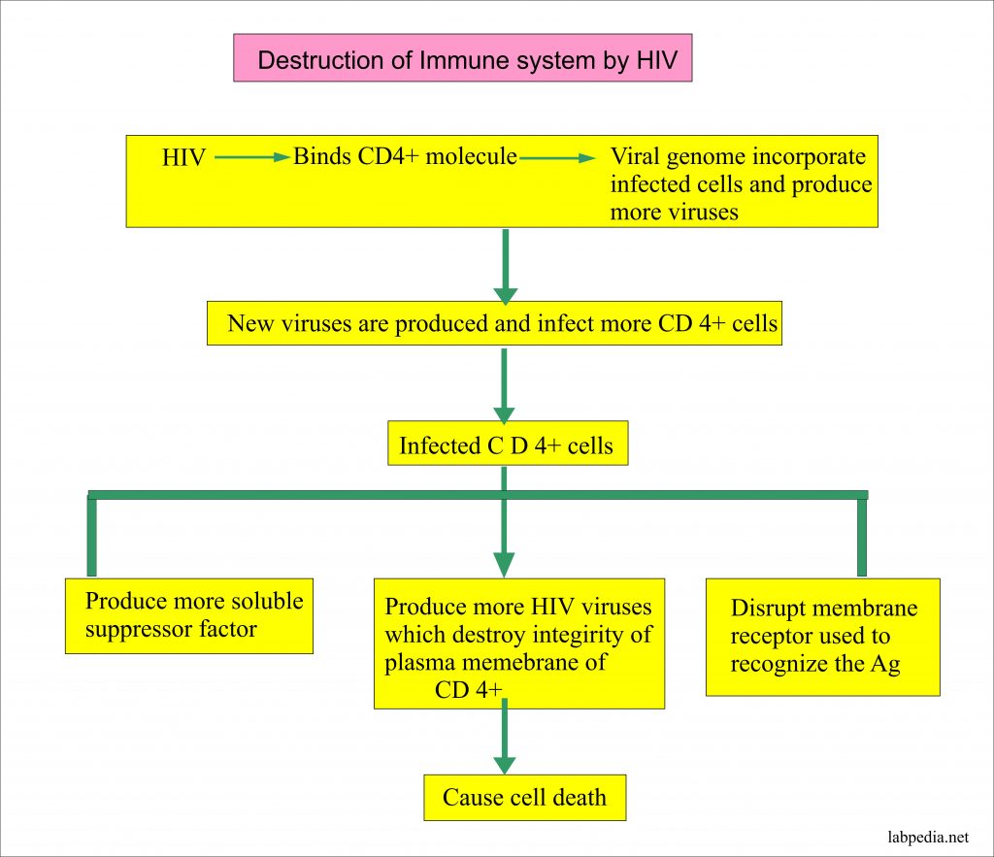

Slide 17
Natural History of HIV Infection
Four phases reflecting the dynamics of virus-host interaction can be recognized:
(1) an acute retroviral syndrome/ seroconversion
(2) asymptomatic or latent
(3) persistent generalised lymphadenopathy
(4) full-blown AIDS

Slide 18
Acute seroconversion
Within 3-6 weeks
mononucleosis-like symptoms that soon disappear
HIV Abs - ve

Slide 19
The acute retroviral syndrome
It is characterized initially by a high level of virus production,viremia, and widespread seeding of the lymphoid tissues.
40% to 90% of individuals develop the viral syndrome
3 to 6 weeks after infection, and this resolves spontaneously in 2 to 4 weeks

Slide 20
c/f-
a self-limited acute illness with nonspecific symptoms, -sore throat, myalgias, fever, rash, weight loss, and fatigue, resembling a flulike syndrome.
Other clinical features - rash, cervical adenopathy, diarrhea, and vomiting

Slide 21
Asymptomatic or latent
after Initial infection –
Asymptomatic phase 2-15 years (avg. 10)
During this time the CD4+ count remains normal but the number of infected CD4+ cells increases.

Slide 22
Persistent generalised lymphadenopathy
Patients are develop persistent generalized lymphadenopathy- 1cm dia
minor opportunistic infections, such as thrush and herpes zoster.
Thrombocytopenia
Persistent lymphadenopathy with significant constitutional symptoms (fever, rash, fatigue) reflects the onset of immune system decompensation,
onset of the crisis phase.

Slide 23
AIDS related complex
Symptoms of HIV are directly related to viral blood level and level of T cells
When T4 cell levels fall below 200/mL, AIDS

Slide 24
AIDS
It is characterized by
a breakdown of host defense,
increase in plasma virus, and
clinical disease.

Slide 25
Typically the patient presents with long lasting fever (>1 month), fatigue, weight loss, and diarrhea.
After a variable period, serious opportunistic infections, secondary neoplasms, or clinical neurologic disease supervene

Slide 26
Opportunistic infections:
Protozoal:Toxoplasmosis
Fungal:Candidiasis, Pneumocystis carinii
Viral :Cytomegalovirus, HSV
Bacterial: Mycobacterium avium-intracellular
Opportunistic neoplasias: Kaposi’s sarcoma

Slide 27
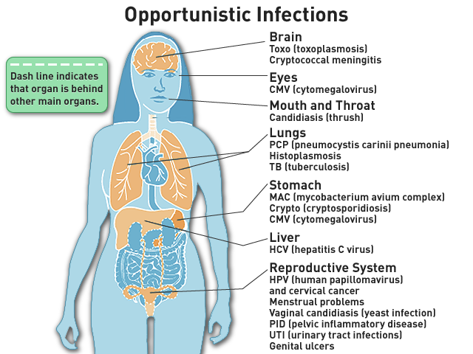

Slide 28
Other symptoms
Rapid weight loss (hence the name ‘slim disease’ in Africa)
AIDS dementia complex (the virus infected macrophages can cross the blood-brain barrier).
Further complications arise
From the fact that patients are often co-infected with other viruses such as hepatitis B and C.

Slide 30
Clinical Diagnosis of HIV/AIDS
1. CDC classification system(revised 1993):
This system classifies HIV infection based on associated clinical conditions and CD4 T-cell count of the patient.
WHO clinical staging of HIV/AIDS for adults(revised 2007)
is based only on the clinical manifestation.
where facilities for the CD4 T-cell count are not available widely.

Slide 31
CDC classification system-2013
Divide HIV infection into 5 categories - 0,1,2,3, and unknown
Advanced HIV / AIDS into 3 categories – A,B,C based on CD4+ count, each further into 3 stages – 1,2,3,

Slide 32
REVISED CDC HIV CLASSIFICATION SYSTEM-2013
Clinical Phase | Early, Acute | Middle, Chronic | Final, Crisis
Period after infection CDC clinical category | 3-6 weeks Category A: Asymptomatic infection Acute HIV syndrome definition PGL | 10 to 12 years Category B: Symptomatic disease neither A nor C) Condition secondary to impaired CMI | Any period up to death Category C: AIDS indicator conditions( constitutional ds, neurological ,neoplasms)
CDC- CD4 + T cell stage > 500/μl 200-499/μl < 200/μl | A1 A2 A3 | B1 B2 B3 | C1 C2 C3

Slide 33
WHO clinical staging of HIV/AIDS for adults(revised 2007
4 stages

Slide 34
Clinical Stage 1
Asymptomatic HIV infection
Persistent generalized lymphadenopathy

Slide 35
Clinical Stage 2
Unexplained moderate weight loss (< 10%)
Recurrent respiratory tract infection (sinusitis, tonsillitis, otitis media, pharyngitis)
Herpes zoster
Angular cheilitis
Recurrent oral ulcers
Papular pruritic eruptions
Seborrheic dermatitis
Fungal nail infection

Slide 36
Clinical Stage 3
Unexplained severe weight loss ( > 10%)
Unexplained chronic diarrhea > 1 month
Unexplained persistent fever 1 month
Oral candidiasis
Oral hairy leukoplakia
Pulmonary tuberculosis
Severe bacterial infection
Acute necrotizing ulcerative stomatitis, gingivitis, and periodontitis
Unexplained anemia

Slide 37
Clinical Stage 4
HIV Wasting syndrome(Slim disease)
Opportunistic infections – Bacterial, Viral, Fungal , Parasitic
Neoplasia
Other conditions (direct HIV induced):
○ HIV encephalopathy
○ Symptomatic HIV associated nephropathy or cardiomyopathy

Slide 38
Diagnosis
HIV infection is diagnosed with a combination of screening and confirmatory tests.
Newer HIV diagnostic tests involve combined antibody and antigen assays, leading to earlier detection of HIV infection.
Diagnosing acute HIV infection (ie, before the formation of HIV antibodies, a period when antibody-based HIV test results may be falsely negative) remains a challenge.

Slide 39
Lab investigations
categorised into 3 groups:
tests for establishing HIV infection
tests for defects in immunity
tests for detection of opportunistic infections and secondary tumours

Slide 40
Tests for establishing HIV infection
i) Antibody tests:
a) ELISA
b) Western blot
ii) Direct detection of HIV
a) p24 antigen capture assay
b) HIV RNA Detection methods- RT-PCR
c) DNA-PCR by amplification of proviral DNA
d) Culture of HIV in neoplastic Tcell lines

Slide 41
ELISA
Initial screening is done finding Antibodies against gag and env proteins.
WESTERN BLOT
If ELISA is positive, confirmation is done by Western blot for presence of specific antibodies against all three HIV antigens: gag, pol and env.

Slide 42
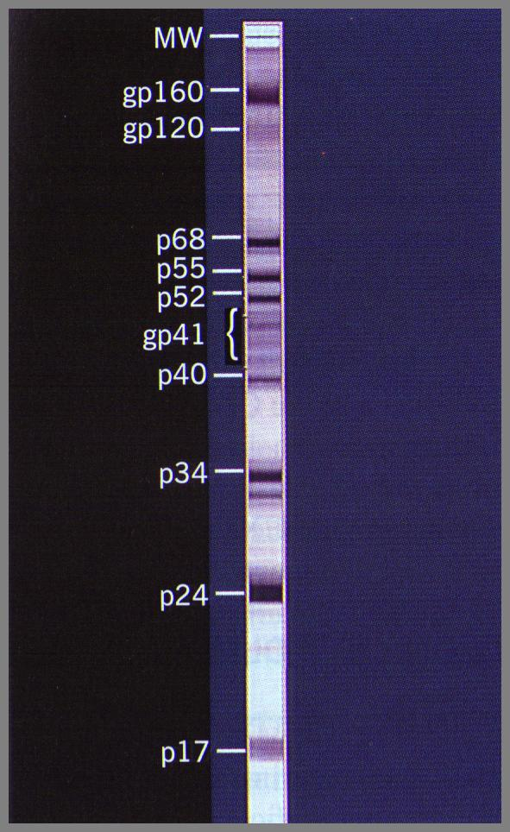
Western-blot

Slide 43
HIV RNA testing
HIV RNA testing can be done just 9 to 11 days after exposed to HIV.

Slide 44
Tests for defects in immunity:
i ) CD4+ T cell counts.
Progressive fall in number of CD4+ Tcells helps in diagnosis
and staging .
ii) Rise in CD8+ T cells.
iii) Reversal of CD4+ to CD8+ T cell ratio.
iv) Lymphopenia.
v) Polyclonal hypergammaglobulinaemia.
vi) Increased β-2 microglobulin levels.
vii) Platelet count - thrombocytopenia.

Slide 45
CD4/CD8 ratio
A normal CD4/CD8 ratio is greater than 1.0
CD4 lymphocytes ranging from 500 to 1200/mm ³ and CD8 lymphocytes ranging from 150 to 1000/mm ³.
If ratio is higher than 1, it means strong immune system.

Slide 46
Tests for detection of opportunistic infections and secondary tumours
aspiration
biopsy methods

Slide 47
Diagnosis of pediatric HIV
• HIV DNA detection: Most recommended
• HIV RNA detection
• p24 antigen detection
• IgG ELISA: Only after 18 months of age.

Slide 48
Window period
Window period refers to the initial time interval between the exposure and appearance of detectable levels of antibodies in the serum.

Slide 49
Diagnosis of HIV in Window Period
The antibodies appear in blood within 2–8 weeks after infection but usually become detectable after 3 to 12 weeks with the assays available presently.
p24 antigen detection (30% sensitive): detects by 1–2 weeks (average 16th day)
HIV RNA detection (PCR) is the best method, detects earliest by 12th day

Slide 50
https://www.youtube.com/watch?v=XWFpTxQ_oCA

Slide 51
HUMAN T-CELL LYMPHOTROPIC VIRUS (HTLV)
HTLV-I & II. HTLV-I is only pathogenic
Transmission by:
(i) from mother to child via breast milk (most common)
(ii) homosexual;
(iii) infected blood
Target-cells:
It infects CD4 T-cells, also infect CD8 T-cells, dendritic cells and B-cells

Slide 52
Clinical manifestations:
HTLV-I is a potential human oncogenic virus:
○ Adult T-cell leukemia/lymphoma
○ Cutaneous T-cell lymphoma
○ Tropical spastic paraparesis
○ Autoimmune features, such as Inflammatory disease, uveitis and arthropathies.

Slide 53
Nonenveloped Segmented dsRNA Viruses:
Unusual double-stranded RNA genome
ROTAVIRUS
oral-fecal transmission
primary viral cause of mortality and morbidity
resulting from diarrhea in infants and children
REOVIRUS
cold-like upper respiratory infection, enteritis

Slide 54
Filo virus
EBOLA VIRUS
Long thin filamentous virus
Sudan -1976
Body fluids and droplet

Slide 55
Clinical manifestations:
Incubation period is about 2–12 days
Common symptoms include:
Fever, headache, muscle pain and sore throat, followed by abdominal pain, vomiting, diarrhea and rash, with hemorrhages (bleeding or bruise), often leading to shock and death.

Slide 56
CORONA VIRUS
Most human coronaviruses are widespread affecting people of most part of the world and produce mild upper respiratory tract infection and occasional diarrhea
SARS-CoV (Severe Acute Respiratory Syndrome Coronavirus)
MERS-CoV (Middle East Respiratory Syndrome Coronavirus)
Covid 19

Slide 57
SARS-CoV
SARS was first recognized in China in 2003
Clinical manifestation
severe lower respiratory tract infection, characterized by muscle pain, headache, sore throat and fever, followed in 2–10 days by the onset of respiratory symptoms mainly cough, dyspnea, and pneumonia

Slide 58
MERS-CoV
MERS-CoV has caused a severe form of lower respiratory illness with a mortality of 30%.
It was first reported in Saudi Arabia in 2012

Slide 59
Clinical manifestation:
• Incubation period -2–14 days.
• Severe acute respiratory symptoms like fever, cough and shortness of breath may appear.
• Some people develop gastrointestinal symptoms including diarrhea and nausea/vomiting.
• Complications - pneumonia and kidney failure.

Slide 60
1
Which sample is recommended for polio isolation?
a. Stool b. Blood
c. Throat d. CSF

Slide 61
2
Coxsackie virus is:
a. Herpes virus b. Pox virus
c. Enterovirus d. Myxovirus

Slide 62
3
Rabies is identified by:
a. Guarneri bodies
b. Negri bodies
c. Cowdry A bodies
d. Cowdry B bodies

Slide 63
4
For the prevention of human rabies, immediate flushing and washing the wound(s) in animal bite cases, with plenty of soap and water, under running
tap should be carried out for how much time?
a. 2 minutes
b. 1 minute
c. 15 minutes
d. 5 minutes

Slide 64
Answers
1. Stool sample
2. Enterovirus belongs to Picornaviridae family
3. Negri bodies
4. 15 minutes

