Slide 1
Dr Reshma Reghu

Slide 6
WHO Expert committee has also recommended that
Blood pressure should be recorded in the sitting position of the patient.
Only one arm (either right or left) to be used consistently.
The reading at which ‘Korotkoff sound’ is first heard is considered as systolic pressure and at which the K-sound disappears, as diastolic pressure.
At least 3 readings should be taken over a period of 3 minutes and the lowest reading is recorded.

Slide 7
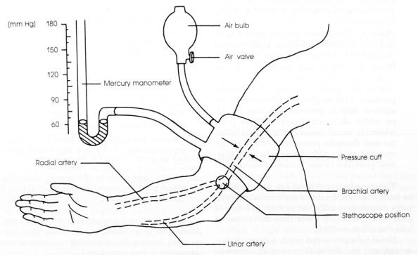

Slide 15
Suppose the BP recordings in a group of children are followed up over a period of several years, it will be observed that those individuals, whose BP was initially high would probably continue in the same ‘track’ as they grow older and those with low BP would continue in the same track as they grow older. This phenomenon of persistence of the rank order of BP has been described as ‘Tracking’ of BP. This knowledge helps to identify the ‘at-risk’ group of children and adolescents, who can develop hypertension in the future period, so that preventive care can be provided for them.

Slide 17
Clinical Manifestations
The most consistent symptom is headache.
It is early morning, sub-occipital pulsating headache.
Associated with the stiffness of the neck, awakening the patient from sleep and gives relief after vomiting.
Other features are dizziness, palpitation, easy fatigability, epistaxis, blurring of vision, breathlessness and personality changes.
Complications are angina pectoris, myocardial infarction, stroke (cerebral thrombosis and hemiplegia, cerebral hemorrhage) and renal failure.
Ocular manifestations are blurring vision, scotoma, (unilateral or bilateral,) papilledema and exudates on the retina.

Slide 18
Hypertensive patients are grouped into three groups:
Those who do not have any symptoms, but are detected during the routine check-up
Those who come with specific complaints as explained above
Those who come with complications.

Slide 22
On nutrition
The dietary changes should be:
• Average consumption of the salt to be reduced to less than 5 g per day per caput (To avoid pickles, salted nuts, etc.).
• Moderate fat intake (avoiding fats of animal origin, except fish as well as coconut oil and vanaspathi).
• Prudent diet (rich in fruits and vegetables) to be encouraged.
• Consumption of alcohol to be discouraged.
• Energy intake to be restricted to body needs.
• The DASH diet.

Slide 23
The DASH diet
It is a dietary approach to stop hypertension (DASH), now recommended as an important step in controlling blood pressure. This diet is not only rich in important nutrients and fiber but also includes foods that contain two and half times the amounts of electrolytes, potassium, calcium and magnesium. It makes the following recommendations.
• To avoid saturated fats.
• To include monounsaturated fatty acids (MUFA, e.g. Omega 9 MUFA) such as olive or canola oils.
To include polyunsaturated fatty acids (PUFA) also (e.g. Omega 3 and 6 PUFA) present in safflower, sunflower, cottonseed and fish oils, which have anti-inflammatory and antiblood clotting effects and is significantly beneficial to heart. Omega 3 is further categorized as alpha linoleic acid and docosahexaenoic acid (DHA). DHA appears to have specific benefits on blood pressure.
To choose whole grains over white flour.
To include fresh fruits and vegetables daily, specially potassium rich fruits like bananas, oranges, and vegetables like carrot, spinach, mushrooms, beans and potatoes (Grape fruits boosts the effect of calcium channel blocking drugs used for hypertension).
To include nuts, seeds or legumes (dried beans or peas daily).
To choose moderate amount of protein preferably fish or poultry. Oily fish may be particularly beneficial. A combination of DASH diet and salt restriction is very effective in reducing blood pressure.

Slide 24
On weight: Weight reduction is done by diet control and promotion of physical activities, specially by the obese people. Regular physical activity leads to fall in body weight, blood lipid and blood pressure. Maintain normal body weight.
On behavioral changes: Modification in the personal lifestyle, reduction in the stress, practicing yoga and meditation goes a longway in controlling BP. Abstain from alcohol and smoking.
Health education: People are made health conscious about HTN and its consequences and encouraged to practice health promotive measures, as explained above.
Self care: All hypertensive patients are educated to take self care by maintaining a log-book of the BP readings, which will be helpful for follow-up.
Recreation: The establishment of recreation clubs, involving in hobbies like gardening, music, periodic excursions, cultural shows and the like will help to relieve the stress.

Slide 26
TERITIARY PREVENTION
Disability limitation: If the patient comes with very high BP, treatment is given intensively to limit the development of disability.
Rehabilitation: This is given for those who have become handicapped due to complications of HTN such as hemiplegia (following stroke), blindness (due to retinopathy),

