Slide 1
INFLAMMATORY BOWEL DISEASE
Dr.Gopika.R.S
Prof & Head Dept of Pathology
SKHMC

Slide 2
INFLAMMATORY BOWEL DISEASE
Due to abnormal local immune response against the normal flora of the gut.
(1) Crohn’s disease
(2) Ulcerative colitis
based on clinical, endoscopic and pathological features
Chrons ds - occurs in any part of GIT
Ulcerative colitis – seen in colon ,non
granulomatous ds.

Slide 3
Chrons disease
Relapsing discontinuous ,transmural granulomatous disease involves any part of GIT but commonly seen in terminal ileum & colon.
Occurs in any age – peak- 6 & 7 decades
Females more common

Slide 4
Crohn’s disease
- Granulomatous inflammation
- Discontinuous: ‘skip lesions’ typically with rectal sparing
Seen as- Aphthous ulcers early,
- linear ulcers later
- Transmural inflammation
- Wall thickening/strictures with luminal narrowing
- Deep fissures/fistulas
- Extra-intestinal disease
- Probable small risk of colorectal carcinoma

Slide 5
Pathology
trans mural involvement,
non caeseating granuloma formation with fissuring,
lumen narrowed,
serosa granular ,mesentric fat wraped around bowel –string sign,
sharp demarcation between diseased part & normal – skip lesion.
Narrow fissure develop between the folds of mucosa

Slide 6
MICROSCOPICAL
Neutrophil infiltration in epithelium early
Crypt abscesses - inflmmatory infiltration with in crypts
Superficial or deep Ulceration,oedema
chronic mucosal damage
C/F
Recurrent attacks of diarrhoea, crampy abdominal pain. fever lasting for days ,insidious onset

Slide 7
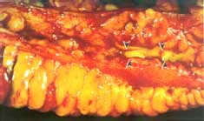
Crohn disease of ileum, showing narrowing of the lumen, bowel wall thickening, serosal extension of mesenteric fat ("creeping fat"), and linear ulceration of the mucosal surface (arrowheads).

Slide 8
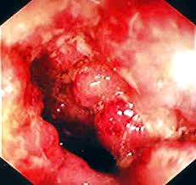
a deep fissure extending into the muscle wall,
Abundant lymphocyte aggregates are present, evident as dense blue patches of cells at the interface between mucosa and submucosa. shallow ulcer

Slide 9
Complications:
Strictures: leads to obstruction
Fissures: abscesses
Fistulas: bladder, vagina, skin, entero-enteric
Peri-anal disease
Malabsorption (terminal ileal disease, blind loops)

Slide 10
Ulcerative colitis
Ulcero inflammatory ds affecting colon limited to mucosa & submucosa.
Peak b/w 20-25 yrs
HLA B1 allele
Well formed granuloma absent
No skip lession
Mucosal lesions rarely extend to submucosa
Rarely affects mucularis propria- exposure of mucularis propria & neural plexus caueses shut down of neuromuscular function ,colon swells leading to toxic mega colon
High risk to develop Cancer

Slide 11
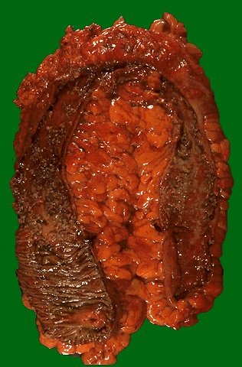
Ulcerative colitis. Ulcerated haemorrhagic surface with knobby pseudopolyps.
marked chronic inflammation of the mucosa with atrophy of colonic glands, moderate submucosal fibrosis, and a normal muscle wall.

Slide 12
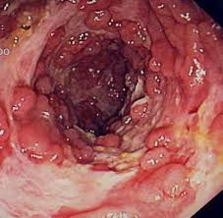
Microscopic view of the mucosa, showing diffuse active inflammation with crypt abscess and glandular architectural distortion.
Gross -pseudopolyp

Slide 14
Distinctive Features of Crohn Disease and Ulcerative Colitis
Feature Crohn Disease Ulcerative Colitis
Macroscopic
Distribution any part of GIT ileum ,Colon only
lesion Skip lesions Diffuse lesion
Stricture Early Late/rare
Wall Thickened Thin

Slide 15
Histolgical features
Chrons ds ulcerative colitis
Inflammation Transmural Limited in mucosa
Pseudopolyps No Marked
Ulcers Deep linear Superficial
Lymphoid reaction Marked Mild
Fibrosis Marked Mild
Serositis Marked Mild to none
Granulomas Yes (50%) No
Fistulae/sinuses Yes No
Clinical
Fat/vit malabsorption Yes No
Malignant potential Yes yes

