Slide 1

Inflammation
Dr. R.S.GOPIKA
Professor
DEPT OF PATHOLOGY
SKHMC

Slide 2
Inflammation is a complex reaction to injurious agents such as microbes & damaged usually necrotic cells , that consists of vascular responses ,migration, & activation of leucocytes & systemic reactions.

Slide 3
Inflammation
The response of living tissue to injury.
Injurious stimuli a protective vascular connective tissue reaction.
  Dilute
  Destroy
  Isolate
  Initiate repair
Acute and chronic forms

Slide 4
Cardinal signs -external manifestations of inflammation
result from the vascular changes and cell recruitment
Main clinical signs:
  RUBOR
  TUMOR
  CALOR
  DOLOR
    & Functio laesa
Also described in terms of the ‘triple response’: brief blanching, followed by REDDENING, FLARE and WHEAL.

Slide 5
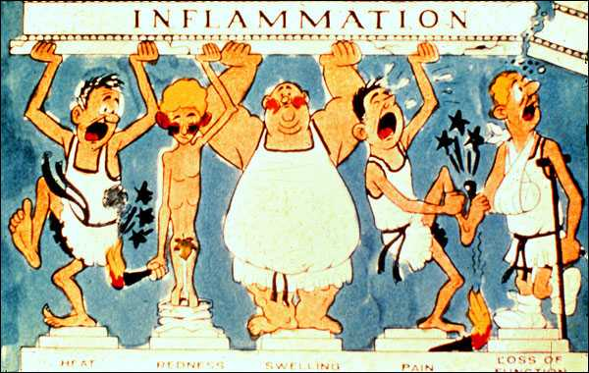
CARDINAL SIGNS OF ACUTE INFLAMMATION
Heat Redness Swelling Pain Loss of function
Celsius (30 BC) Virchow (1902)

Slide 6
types
Acute inflammation is rapid in onset and of short duration, lasting from a few minutes to as long as a few days, and is characterized by fluid and plasma protein exudation and a predominantly neutrophilic leukocyte accumulation.
Chronic inflammation may be more insidious, is of longer duration (days to years), and is characterized by influx of lymphocytes and macrophages with associated vascular proliferation and fibrosis (scarring).

Slide 7
Stimuli for Acute Inflammation
Infections (bacterial, viral, fungal, parasitic)
Trauma (blunt and penetrating)
Physical and chemical agents (thermal injury; irradiation, environmental chemicals)
Tissue necrosis (from any cause
Foreign bodies (splinters, dirt, sutures)
Immune reactions (hypersensitivity reactions)

Slide 8
Acute inflammation has two major components
Vascular changes:
alterations in vessel caliber resulting in increased blood flow (vasodilation) and structural changes that permit plasma proteins to leave the circulation (increased vascular permeability).
Cellular events:
emigration of the leukocytes from the microcirculation and accumulation in the focus of injury (cellular recruitment and activation). The principal leukocytes in acute inflammation are neutrophils

Slide 9
Vascular Changes
Changes in Vascular Caliber and Flow
depending on the nature and severity of the original inflammatory stimulus.
transient vasoconstriction arteriolar vasodilation locally increased blood flow redness and warmth microvasculature permeablity protein-rich fluid moves into the extravascular tissues red blood cells to become more concentrated increasing blood viscosity slowing the circulation
stasis leukocytes begin to accumulate along the vascular endothelial surface margination

Slide 10
arteriolar VD & volume of blood flow
intravascular hydrostatic pr movement of fluid from capillaries into the (transudate- ultrafiltrate of bl plasma contains little protein)
increasing vascular permeability movement of protein-rich fluid & even cells (exudate) into the interstitium.
The loss of protein-rich fluid intravascular osmotic pressure and increases the osmotic pr of the interstitial fluid outflow of water and ions into the extravascular tissues.
Fluid accumulation in extravascular spaces is called edema; the fluid may be a transudate or exudate

Slide 11
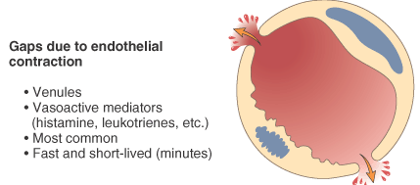
Diagrammatic representation of five mechanisms of increased vascular permeability in inflammation

Slide 12
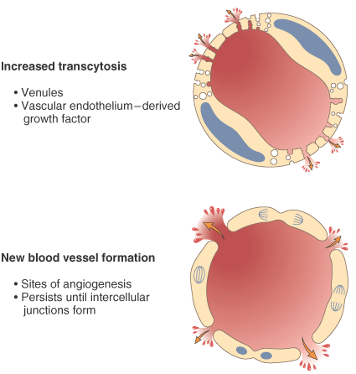

Slide 13
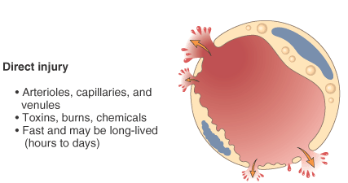
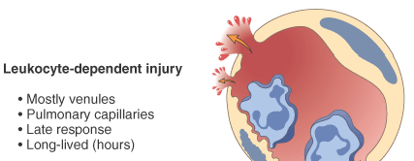


Slide 14
Vasodilation is induced by histamine
Increased vascular permeability is induced by histamine, kinins.

Slide 15
Cellular Events:
The recruitment of leukocytes to sites of injury and infection &
activate leukocytes to perform their normal functions in host defence

Slide 16
The Sequence of Cellular Events
events in the recruitment of leukocytes from the vascular lumen to the extravascular space consists of
In the lumen
(1) margination and rolling along the vessel wall;
(2) firm adhesion to the endothelium;
Transmigration between endothelial cells; and
Migration in interstitial tissues toward a chemotactic stimulus.

Slide 17
Margination and Rolling
Margination is a consequence of blood flow characteristics in small vessels
Marginated leukocytes begin to roll on the endothelial surface by forming transient adhesions via the selectin family of proteins:
–E-selectin on endothelial cells
–P-selectin on endothelial cells and platelets
–L-selectin on most leukocytes

Slide 18
Rolling, adhesion, and transmigration are mediated by the binding of complementary adhesion molecules on leukocytes and endothelial surfaces

Slide 19
Endothelial and Leukocyte Adhesion Molecules
endothelial leu receptors major role
Molecules
P selectin Sialyl –Lewis X rolling [N,M,L]
E- selectin Sialyl –Lewis X rolling, adhesion to activated
Endothelium[N,M,Tcells]
ICAM-1 CD11,18[integrins] adhesion,arrest,transmigration
VCAM-1 VLA4 [integrins] adhesion[E,M,L]
GlyCam 1 L –selectin L homing to endothelium
CD 31 CD 31 transmigration

Slide 20
Transmigration (diapedesis)
Occurs after firm adhesion within the systemic venules and pulmonary capillaries via PECAM –1 (CD31)
Must then cross basement membrane
  Collagenases
  Integrins

Slide 21
Leukocyte Activation
Once leukocytes have been recruited to the site of infection or tissue necrosis, they must be activated to perform their functions.
Stimuli for activation include
- microbes,
- products of necrotic cells, and
- several mediators.

Slide 22
Phagocytosis
Process by which Phagocytic cell (microphages and macrophages) engulf and kill foreign particles (bacteria)
Two main types of phagocytes:
1- Motile phagocytes found in the blood stream and migrate to the inflamed area (microphages)
2- Histocytes (macrophages) of the reticuloendothelial system (RES) which remove bacteria that escapes from the inflamed area.

Slide 23
Phagocytosis
three distinct but interrelated steps :
(1) recognition and attachment of the particle to the ingesting leukocyte;
(2) engulfment, with subsequent formation of a phagocytic vacuole; and
(3) killing and degradation of the ingested material

Slide 24
Leukocytes bind and ingest most microorganisms and dead cells via specific surface receptors opsonins.
The most important opsonins are
antibodies of IgG class that bind to microbial surface antigens,
breakdown products of the complement protein C3 and
plasma carbohydrate-binding lectins called collectins, which bind to microbial cell-wall sugar groups.

Slide 25
Leukocytes express receptors for opsonins that facilitate rapid phagocytosis.
These receptors include
the Fc receptor for IgG
complement receptors 1 and 3 (CR1 and 3) for complement fragments, and
C1q for the collectins.

Slide 26
Phagocytosis
Triggers an oxidative burst engulfment and formation of vacuole which fuses with lysosomal granule membrane (phagolysosome)
Granules discharge within phagolysosome and extracellularly (degranulation).
The most important microbicidal substances are reactive oxygen species (ROS) and lysosomal enzymes.

Slide 27
O₂ dependent killing
  NADPH oxidase activated; produces superoxide ion. This converts to hydrogen peroxide.
  H₂O₂-Myeloperoxidase-halide system: produces HOCl.
  Myeloperoxidase independent:
  Uses superoxide and hydroxyl radicals. Less efficient

Slide 28
Oxidative burst - sudden increase in oxygen consumption, glycogenolysis, increased glucose oxidation, and production of ROS.
2O₂ + NADPH → 2 ( O₂ֺ־) + NADP⁺ + H⁺ (NADPH oxidase)
    superoxide ion ( O₂ֺ־), + 2H⁺ → H₂O₂ (dismutase)
These ROS act as free radicals and destroy microbes

Slide 29
H₂O₂ -MPO-halide system
myeloperoxidase
H₂O₂ + Cl / I ions HOCl• + OH
HOCl• - is a powerful oxidant and antimicrobial agent
The H₂O₂ -MPO-halide system is the most efficient bactericidal system in neutrophils.
MPO-deficient leukocytes are capable of killing bacteria by virtue of the formation of superoxide, hydroxyl radicals, and singlet-oxygen.

Slide 30
oxygen-independent mechanisms
Through the action of substances in leukocyte granules
Bactericidal permeability increasing protein (BPI)- causes phospholipase activation, phospholipid degradation, and increased permeability in the outer membrane of the microorganisms.
Lysozyme - hydrolyzes glycopeptide coat of bacteria.

Slide 31
Lactoferrin - an iron-binding protein present in specific granules – cytotoxic
Major basic protein - a protein of eosinophils, is cytotoxic to many parasites
Defensins- cytotoxic to microbes
Elastase - microbial killing

Slide 32
After killing, acid hydrolases, which are normally stored in lysosomes, degrade the microbes within phagolysosomes.
The pH of the phagolysosome drops to between 4 and 5 after phagocytosis, this being the optimal pH for the action of these enzymes.

Slide 33
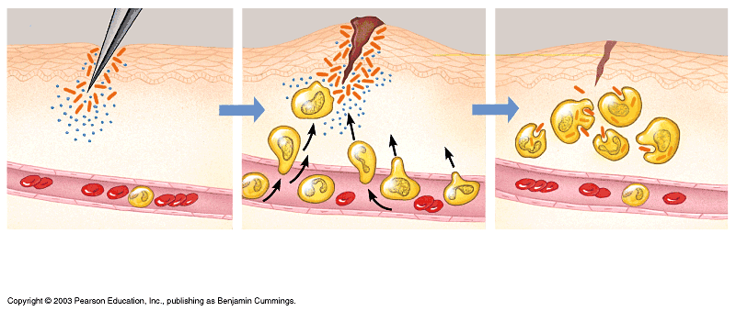
Tissue damage triggers the inflammatory response
Skin surface
Swelling
Pin
Phagocytes
Bacteria
Phagocytes and
fluid move
into area
Chemical
signals
White
blood cell
1
Tissue injury; release of
chemical signals such as
histamine
2
Dilation and increased leakiness
of local blood vessels; migration
of phagocytes to the area
3
Phagocytes (macrophages and
neutrophils) consume bacteria
and cell debris; tissue heals
Figure 24.2

Slide 34
Chemical mediators of inflammation

Slide 35
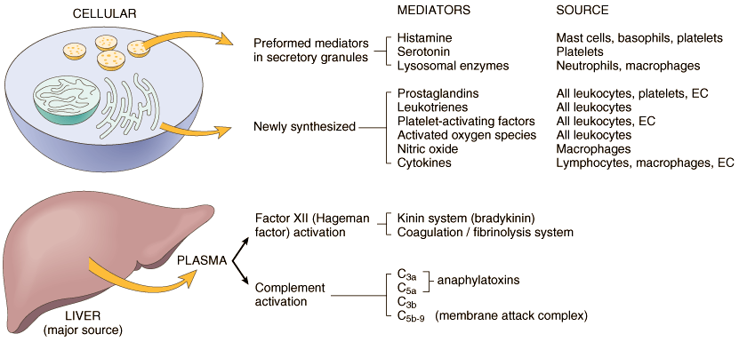

Slide 36
Cell-derived
Vasoactive amines
  Histamine:
  released by mast cells, basophils, platelets
  in response to injury, immune reactions, anaphylatoxins (C3a, C5a), cytokines (IL-1, IL-8), neuropeptides, leukocyte-derived histamine-releasing peptides
  Vasodilation, increased vascular permeability, endothelial activation
  VC in large arteries.

Slide 37
Vasoactive amines
  Serotonin:
  - platelet
  release triggered by platelet aggregation
  - Vasodilation, increased vascular permeability

Slide 38
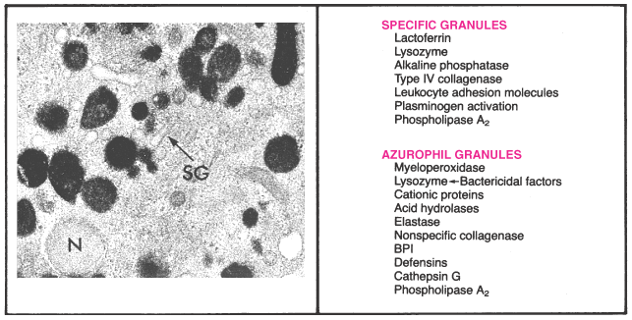
Lysozomal contents

Slide 39
Arachidonic Acid (AA) Metabolites
It is released from these phospholipids via cellular phospholipases which is activated by mechanical, chemical, or physical stimuli, or by inflammatory mediators such as C5a
Two enzymatic pathways:
Cyclooxygenase stimulates the synthesis of prostaglandins and thromboxanes, and
lipoxygenase is responsible for production of leukotrienes and lipoxins

Slide 40
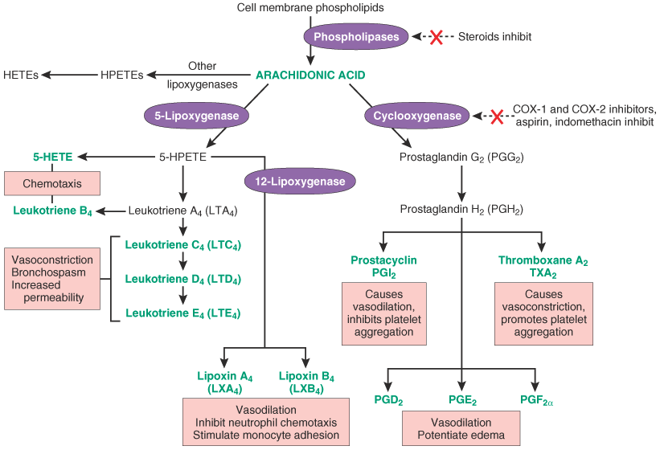
T lym,M,E
T lym,E
VC

Slide 41
Platelet-activating factor
Leukocytes, endothelial cells
Vasodilation, increased vascular permeability, leukocyte adhesion, chemotaxis, degranulation, oxidative burst

Slide 42
Cytokines (TNF, IL-1)
Macrophages, lymphocytes, endothelial cells, mast cells.

Slide 43
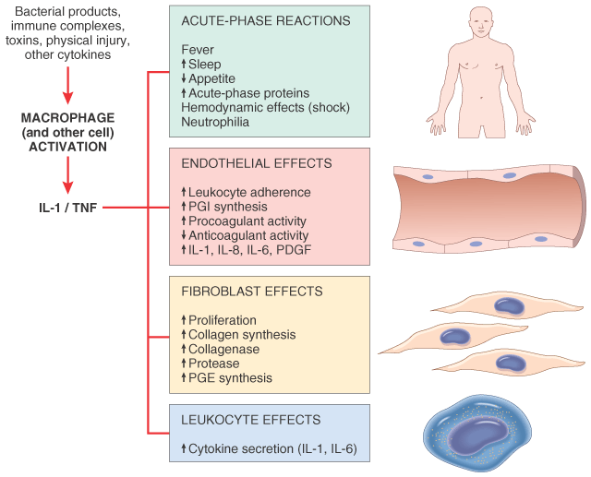

Slide 44
Chemokines
chemoattractants for leukocytes.
The two main functions of chemokines -leukocyte recruitment in inflammation and in the normal anatomic organization of cells in lymphoid and other tissues
Chemokines are classified into four groups
2 are imp in inflammation

Slide 45
CXC / Alpha chemokines –
- IL-8 act primarily on neutrophils
-produced by activated macrophages, endothelial cells, mast cells, and fibroblasts
- in response to microbial products and other cytokines such as IL-1 and TNF.
-activation and chemotaxis of N

Slide 46
CC/ Beta chemokines
Attract all leukocytes except N
MCP-1- monocyte chemoattractant protein 1 chemotactic for monocytes,
RANTES (regulated and normal T cell expressed and secreted)
chemotactic for memory CD4+ T cells and monocytes), and
EOTAXIN - chemotactic for eosinophils.

Slide 47
NITRIC OXIDE
Endothelial cells and macrophages, in presence of NO synthase enzymes.
VD, VP, sm relaxation, inhibit platelet aggregation
NO free radicals are toxic to microbial and mammalian cells

Slide 48
Plasma derived mediators
Many in “pro-form” requiring activation (enzymatic cleavage)
They gain entry to damaged area through inflammatory exudate.activated by proteolytic enzymes. short half life peroid .

Slide 49
Kinin system
Leads to formation of bradykinin from cleavage of precursor (HMWK)
  Vascular permeability
  Arteriolar dilation
  Non-vascular smooth muscle contraction (e.g., bronchial smooth muscle)
  Causes pain
  Rapidly inactivated (kininases)

Slide 50
Clotting cascade
Cascade of plasma proteases
  Hageman factor (factor XII)
  Collagen, basement membrane, activated platelets converts XII to XIIa
  Ultimately converts soluble fibrinogen to insoluble fibrin clot
  Factor XIIa simultaneously activates the “brakes” through the fibrinolytic system to prevent continuous clot propagation

Slide 51
Fibrinolytic system
Fibrin to fibrin split products by the action of plasmin .
Increases vascular permiability.

Slide 52
Complement system
Components C1-C9 present in inactive form
  Activated via classic (C1) or alternative (C3) pathways to generate MAC (C5 – C9) that produce holes in microbe membranes
  In acute inflammation
    Vasodilation, vascular permeability, mast cell degranulation (C3a, C5a)
    Leukocyte chemotaxis, activation (C5a)
    As an opsonin, increases phagocytosis (C3b, )

Slide 53
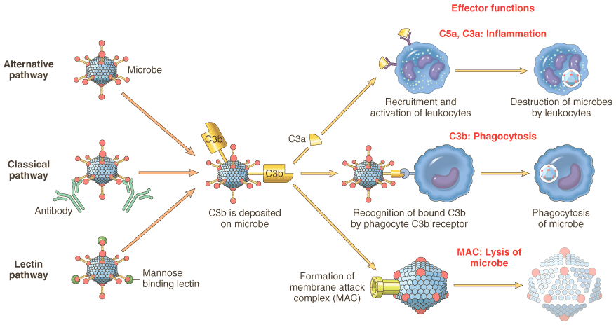
& tumour cells
Ag,Ab,immune complex
microbes

Slide 54
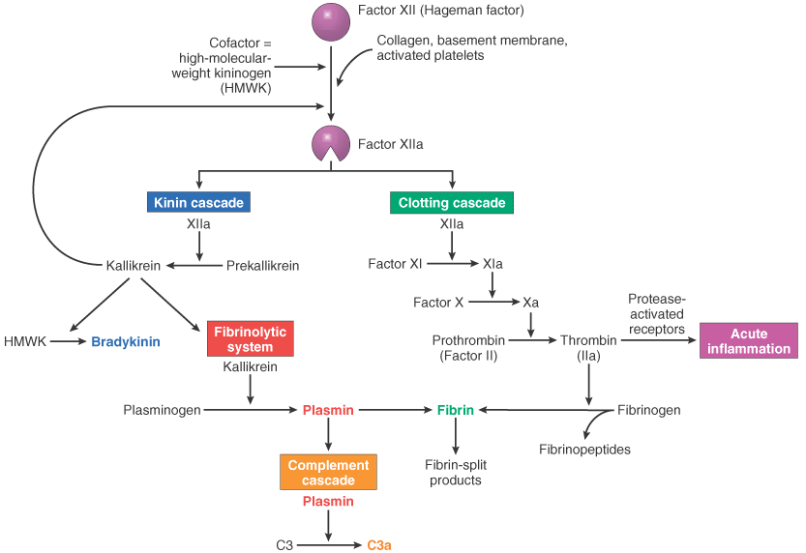
Bind to P,SM,EC
Mobilization of P selectin,
COX-2.PG,PAF,NO,
leucocyte recruitment
Chemotactic ,C5 – C5a
VP,VD, sm contr,pain
VP

Slide 55
SYSTEMIC EFFECTS OF ACUTE INFLAMMATION
Fever
  ‘Endogenous pyrogens’ produced: IL1 and TNFα
  IL1 - prostaglandins in hypothalamus
  hence aspirin etc reduce fever
Leukocytosis
  IL1 and TNFα produce an accelerated release from marrow
  Macrophages, T lymphocytes produce colony-stimulating factors
  Bacterial infections - neutrophils, viral - lymphocytes

Slide 56
SYSTEMIC EFFECTS OF ACUTE INFLAMMATION
Acute phase response
  Decreased appetite, altered sleep patterns and changes in plasma concentrations of:
-Acute phase proteins:
  C-reactive protein (CRP)
  α₁ antitrypsin
  Haptoglobin
  Fibrinogen
  Serum amyloid A protein

Slide 57
PROBLEMS CAUSED BY ACUTE INFLAMMATION
Local
  Swelling: Blockage of tubes, e.g. bile duct, intestine
  Exudate: Compression e.g. cardiac tamponade
  Loss of fluid e.g. burns
  Pain & loss of function - especially if prolonged
  ‘Bystander effect’ exacerbates damage, may initiate autoimmunity

Slide 58
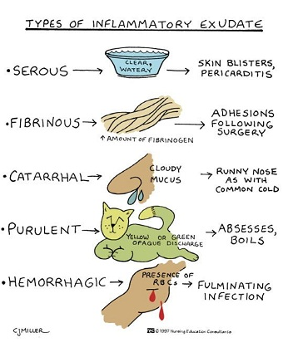
Types of acute inflammation
(based on type of exudates)
1-Catarrhal
2-Serous :
3-Fibrinous
4-Membranous
5-Hemorrhagic
6-Suppurative /
purulent

Slide 59
Name | Occur in | Characterized by
Catarrhal | Mild inflammation in mucous membrane of respiratory or alimentary tracts e.g. common cold and catarrhal appendicitis | Exudates rich in mucous
Serous | Mild inflammation in serous surface such as pleural cavity, joint cavity where no damage in endothelium ex. Tuberculosis pleurisy and Common blisters | Extensive watery low protein exudates
Fibrinous | Outpouring of exudates with high protein and less volume ex. in lobar pneumonia due to Streptococcus pneumonia & pericardium inflammation | Exudates rich in fibrinogen
Membranous | Fibrinous inflammation in which network of fibrin entangling inflammatory cells and bacteria forms pseudo-membrane. Example: Diphtheria , Bacillary dysentery. | Yellowish grey pseudo membrane rich in fibrin , polymorphs & necrotic tissues
Hemorrhagic | In blood vessels e.g. in plague | Exudates rich RBCs
Gangrenous | Acute appendicitis | Necrotic tissues resulting from thrombi or emboli
Allergic | Result to Ag – Ab reaction Hypersensitivity | Presence of edema & increase in vascularity.
Suppurative | Caused by pyogenic bacteria and is characterized by pus formation Example: Abscess. | Large amount of Pus & Purulent exudates produced

Slide 60
Suppurative or purulent inflammation
Pus: thick fluid containing viable and necrotic polymorph and necrotic tissue
Localized:
ex. Abscess:
Abscess is the localized collection of pus, commonly seen solid block of tissue - Example: dermis, liver, kidney, brain etc. Pus consists of partly or completely liquefied dead tissue mixed with dead or dying neutrophils and living or dead bacteria,
2. Diffused: Spreading of pus to adjacent areas e.g. cellulites occurring in subcutaneous tissue . Usually caused by streptococci.

Slide 61
Fate of acute inflammation
1- Resolution: exudates are reabsorbed and tissue becomes normal again.
2- Healing: by repair and regeneration.
3- Spread: through lymphatics or blood stream.
4- Chronicity

Slide 62
Chronic inflammation
inflammation of prolonged duration in which active inflammation, tissue injury, and healing proceed simultaneously.
chronic inflammation is characterized by
-Infiltration with mononuclear cells, including macrophages, lymphocytes, and plasma cells
- Tissue destruction-largely induced by the products of the inflammatory cells
- Repair- involving new vessel proliferation and fibrosis

Slide 63
Causes
Persistent infections- elicit a T lymphocyte-mediated immune response called delayed-type hypersensitivity
Immune-mediated inflammatory diseases
Prolonged exposure to potentially toxic agents.
- exogenous materials - inhaled silica
- endogenous agents such as chronically
elevated plasma lipid components

Slide 64
pathogenesis of chronic inflammatory reactions
Cellular infiltrate consists of macrophages, lymphocytes, plasma cells; fibrosis is often prominent
Mediated by cytokines produced by macrophages and T lymphocytes.
bidirectional interactions between these cells tend to amplify and prolong the inflammatory reaction

Slide 65
Cells
The roles of activated macrophages in chronic inflammation.
Macrophages are activated by cytokines from immune-activated T cells (IFN-gamma) or by nonimmunologic stimuli such as endotoxin.
The products made by activated macrophages that cause tissue injury and fibrosis are AA, PDGF, FGF, TGF- β.

Slide 66
Macrophages
Functions:
  Phagocytosis and destruction of debris & bacteria
  Processing and presentation of antigen to immune system.
  Control of other cells by cytokine release
  Synthesis; not only cytokines, but also complement components, blood clotting factors, proteases, ....

Slide 67
Lymphocytes
Sometimes called ‘chronic inflammatory cells’
Functions:
  B lymphocytes differentiate to produce antibodies.
  T lymphocytes involved in control & some cytotoxic functions.

Slide 68
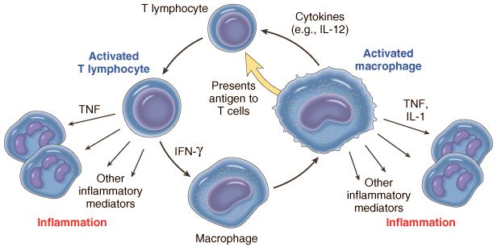
Macrophage-lymphocyte interactions in chronic inflammation

Slide 69
Macrophages from 3 sources:
1) recruitment
2) local proliferation
3) prolonged survival

Slide 70
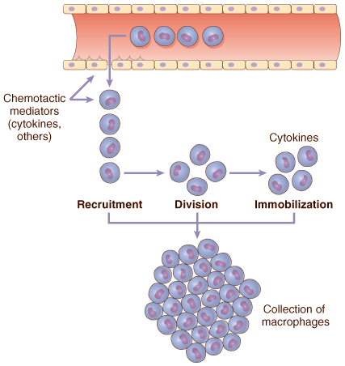
Mechanisms of macrophage accumulation in tissues
oxidized lipds
C5a,PDGF,TGF
collagen,fibronectin

Slide 71
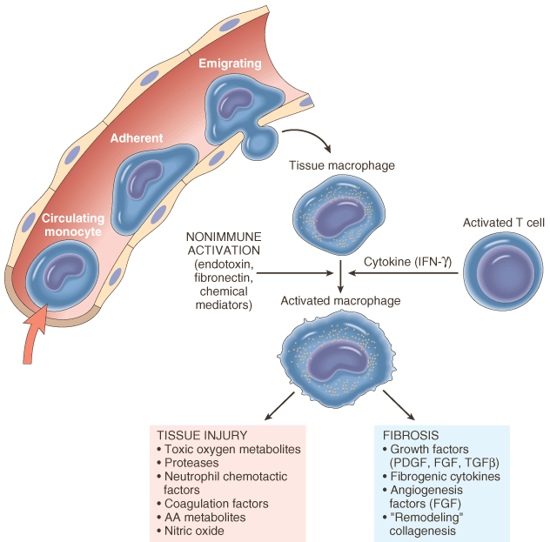

Slide 72
Other cells involved in chronic inflammation
Plasma cells:
  Differentiated antibody-producing B lymphocytes. Implies considerable chronicity.
Eosinophils:
  Allergic reactions, parasitic infestations, some tumours.
Fibroblasts / Myofibroblasts:
  Recruited by macrophages; make collagen.

Slide 73
CHRONIC NON-SPECIFIC (NON-GRANULOMATOUS) INFLAMMATION
It is the continuation of a partially successful acute inflammation & mostly reaction to persistent extracellular bacteria
Histologically - structureless unorganized diffuse infiltration of tissues by PMN’s .
Dominated by B cell immune response, with local amplification by B cell-derived plasma cells secreting specific antibodies to enhance bacterial phagocytosis and killing by WBC
Local tissue damage is caused directly by persistence of toxin producing bacteria and indirectly by release of lysosomal enzymes from host phagocytes, especially dead PMNs

Slide 74
Granulomatous inflammation
is a distinctive pattern of chronic inflammation characterized by aggregates of activated macrophages that assume an epithelioid appearance.
Immune granulomas
foreign body granulomas

Slide 75
Main causes of granulomatous inflammation:
Mildly irritant ‘foreign’ material
Mycobacteria: Tuberculosis, leprosy
Syphilis
Other rare infections e.g. some fungi
Unknown causes: Sarcoid
Wegener’s granulomatosis
Crohn’s disease

Slide 76
GRANULOMA
any small nodular delimited aggregation of mononuclear inflammatory cells, or such a collection of modified macrophages resembling epithelial cells (epitheloid cells) usually surrounded by a rim of lymphocytes, often with multinucleated giant cells.
Some granulomas contain eosinophils and plasma cells, and fibrosis is commonly seen around the lesion.

Slide 78
Older granulomas may have a rim of fibroblasts and connective tissue.
multinucleated giant cells 40 to 50 μm are found in granulomas.
In granulomas associated with certain infectious organisms a central zone of necrosis.

Slide 79
tb - GRANULOMA
Grossly- has a granular, cheesy appearance caseous necrosis
Microscopically-
necrotic material appears as amorphous, structureless, granular debris, with complete loss of cellular details.

Slide 80
‘Giant’ Cells
Multinucleate cells made by fusion of macrophages. Several types.
Morphology of most chronic inflammatory reactions is non-specific
For example:
  Rheumatoid arthritis: Mainly plasma cells.
  Chronic gastritis: Mainly lymphocytes.
  Leishmaniasis :Mainly macrophages.
  Giant cell type may be a help to diagnosis.

Slide 81
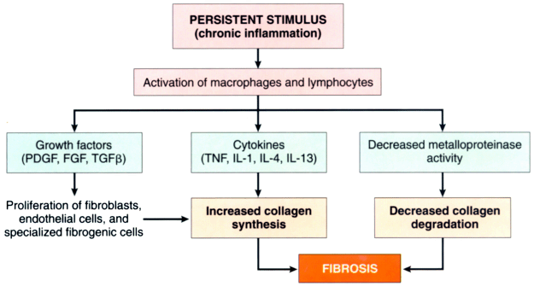
Development of fibrosis in chronic inflammation

