Slide 1
INTRAUTERINE FETAL DEATH
Dr. SHEEBA. S.,
ASSISTANT PROFESSOR,
DEPT OF OBG.

Slide 2
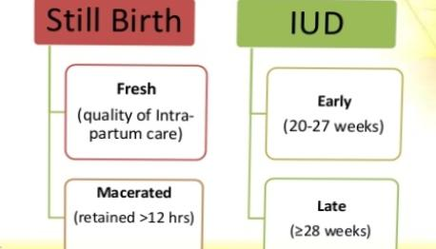
DEFINITION
It is a Fetal demise after 20 weeks gestation and before the onset of labour

Slide 6
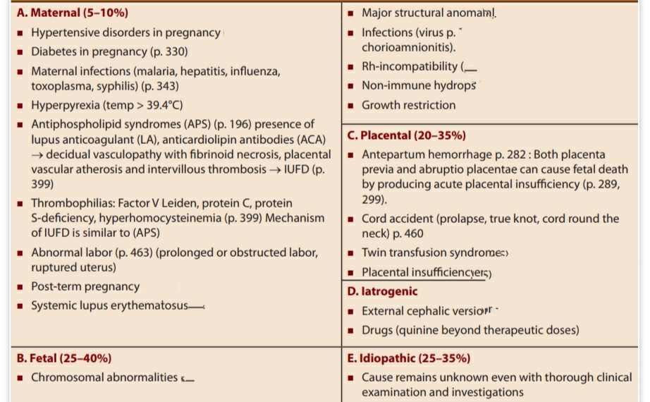
CAUSES OF INTRAUTERINE FETAL DEATH

Slide 7
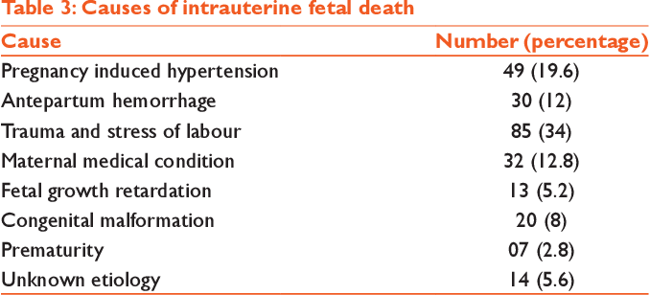
ETIOLOGY

Slide 9
CAUSES OF INTRAUTERINE FETAL DEATH Maternal (5–10%)
Antiphospholipidsyndromes
Hypertensive disorders in pregnancy
Thrombophilias: Factor V
Maternal infections (malaria, hepatitis,
Abnormal labour
Diabetes in pregnancy
Post-term pregnancy
Hyperpyrexia
toxoplasma, syphilis)
infuenza,

Slide 11
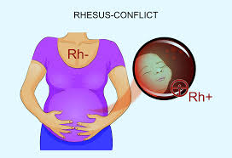
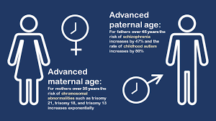
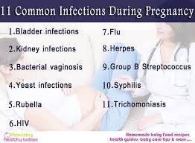
MATERNAL CAUSES

Slide 13
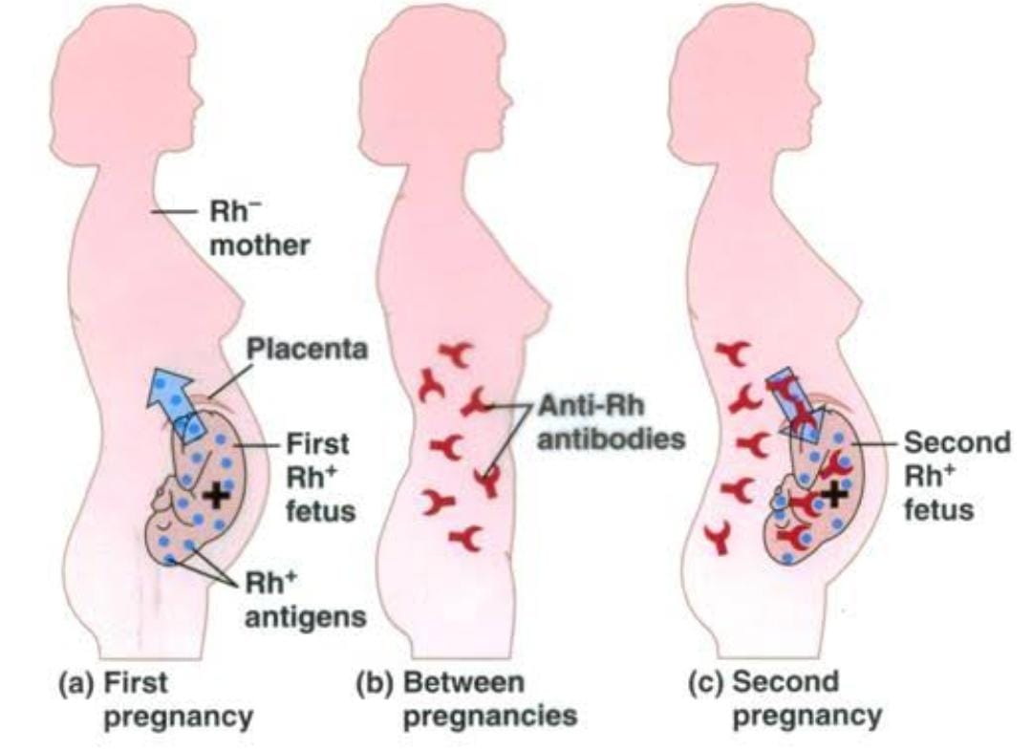
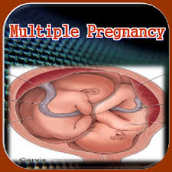
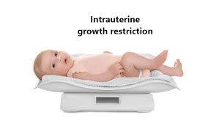
FETAL CHANGES
G6PD DEFICIENCY
BIRTH DEFECTS

Slide 14
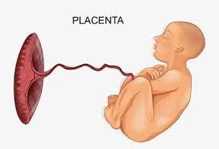
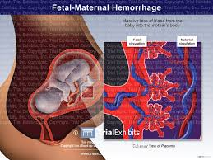

Slide 15
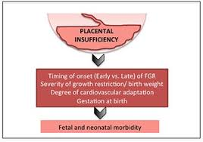
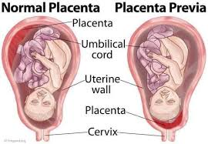
PLACENTAL CAUSES

Slide 17
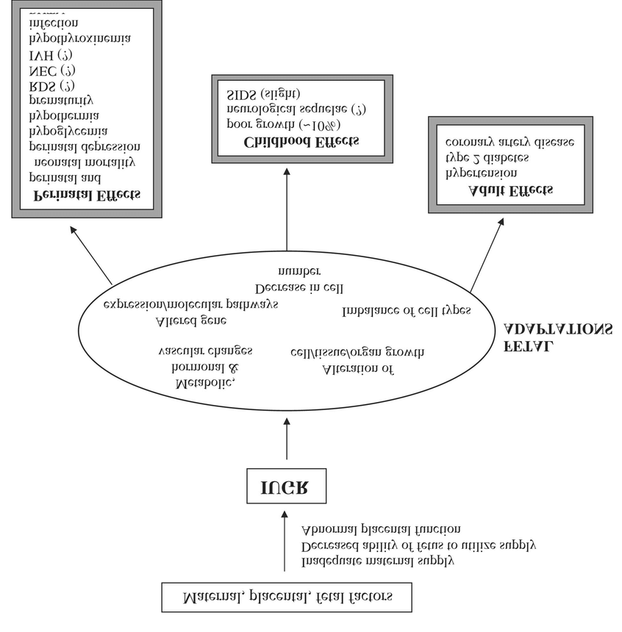

Slide 18
SIGNS
Uterine tone is diminished
Foetal movements are not felt during palpation
Foetal heart sound is not heard
Retrogression of theheight of the uterus
Retrogression of positive brest changes per abdomen

Slide 20
DIAGNOSIS -SYMPTOMS
Bleeding
Cramping
Loss of fetal movements

Slide 24
PER ABDOMEN
Gradual retrogression of the fundal height and it becomes smaller than the period of gestation
Uterine tone is diminished and the uterus feels flaccid
Fetal movements are not felt during palpation.
Fetal heart sound is absent
Cardiotocography (CTG): Flat trace
Egg-shell crackling feel of the fetal head is a late feature

Slide 25
INVESTIGATIONS
USG
Straight -x-ray abdomen
Roberts sign
Spalding sign
ball sign
Helix sign
Crowding of the ribs shadow

Slide 26
History
Gross examination
SU Infant
Umbilical coed
Placental
Aminiotic fluid
Foetal autopsy
Placental investigations
Maternal investigations

Slide 27
I. HISTORY

Slide 28
I. HISTORY
Past Obstetrical
• Baby with congenital anomaly /
hereditary condition
• IUGR
• Gestational HPT with adverse
sequele
• Placental abruption
• IUFD
• Recurrent abortions
Family
• Recurrent abortions
• Congenital anomalies
• Abnormal karyotype
• Hereditary conditions
• Developmental delay
Maternal
• DM
• HPT
• Thrombophilias
• Autoimmune disease
• Severe Anemia
• Epilepsy
• Consanguinity
• Heart disease

Slide 29
II. GROSS DESCRIPTION

Slide 30
II. GROSS DESCRIPTION
Membranes
•Stained
•Thickening
Infant description
• Malformation
• Skin staining
• Degree of maceration
• Color-pale , plethoric
Umbilical cord
• Prolapse
• Entanglement-neck, arms,legs
• Hematoma or stricture
• Number of vessels
• Length
Amniotic fluid
• Color-meconium, blood
• Volume
Placenta
• Weight
• Staining
• Adherent clots
• Structural abnormality
• Velamentous insertion
• Edema/ hydropic changes

Slide 31
III. FETAL AUTOPSY & KARYOTYPING
Radiograph - skeletal abnormalities
Fetal karyotyping
Dysmorphic fetus
Hydropic
Signs of chromosomal anomalies

Slide 32
III. FETAL AUTOPSY & KARYOTYPING
• These 2 are important tests in SB evaluation
(Pinar, 2014)
• Crucial for future pregnancy
• Appropriate consent req to take fetal tissue,Autopsy
• Ideally should be done by perinatal pathologist
• If denied, post mortem MRI should be considered
• Radiographs if indicated for skeletal abnormalities

Slide 33
IV. PLACENTAL INVESTIGATIONS
Chorioncity
Thrombosis
Vascular malformations
Placental blocks
Placental swabs for infections
Uacterial cultures for E. Coli, Listeria

Slide 34
V. MATERNAL EVALUATION
CUC
Electrophoresis
Diabetes testing
TFT

Slide 35
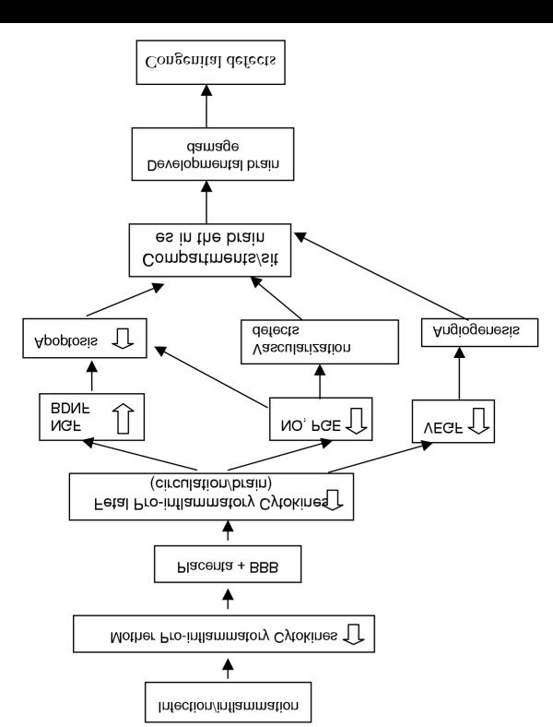

Slide 36
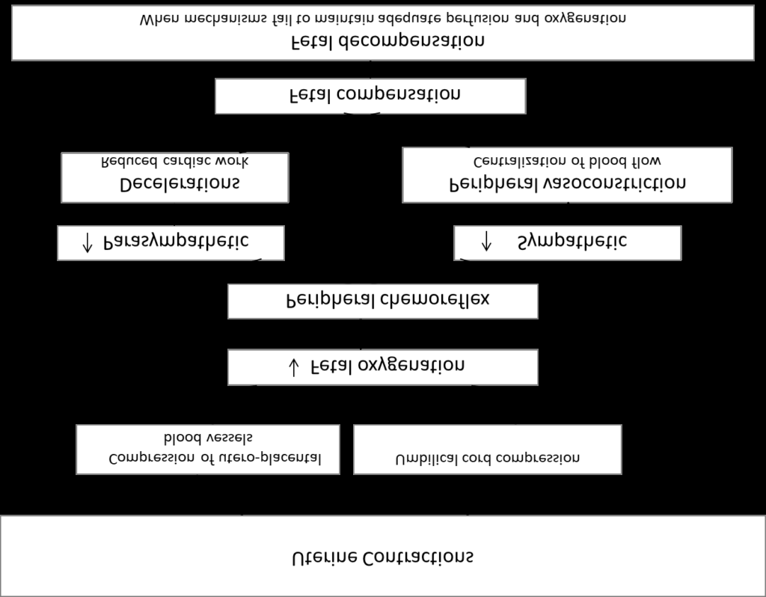

Slide 37
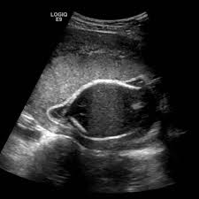
DIAGNOSIS
SYMPTOMS
Absence of fetal movements which were previously noted by the patient.
SIGNS:
Retrogression of the positive breast changes that occur during pregnancy is evident after variable period following death of the fetus.
INVESTIGATIONS:-
SONOGRAPHY
Earliest diagnosis is possible with sonography
X-ray abdomen (SPALDING SIGN)
The irregular overlapping of the cranial bones on one another is due to liquefaction of the brain matter and softening of the ligamentous structures supporting the vault. It usually appears 7 days after death, Hyperflexion of the spine
BLOOD
To estimate the blood fibrinogen level and partial thromboplastin

Slide 38
INVESTIGATIONS
SONOGRAPHY
Early diagnosis can be done :
Lack of all fetal movements during a 10 minute period observation with real time sonar is a strong presumptive evidence of fetal death.
Oligohydramnios and collapsed cranial bones are evident
STRAIGHT X- RAY ABDOMEN
Spalding signs: irregular overlapping of the cranial bones due to liquefaction of the brain matter and softening of ligamentous structures supporting the vault. Seen after 7 days of death.
Hyperflexion of the spine- common and some times hyperextension of neck is seen.

Slide 39
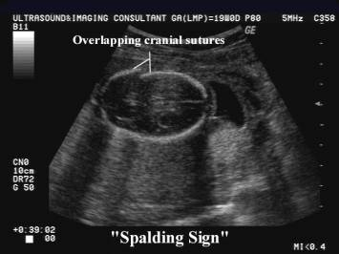
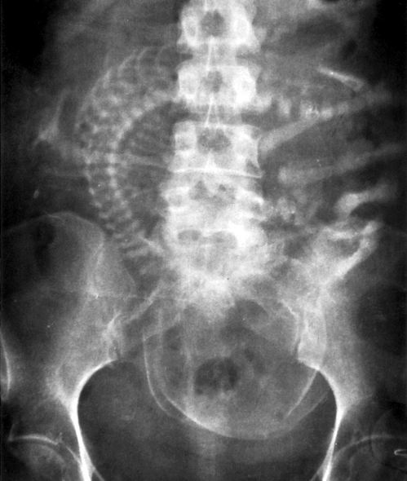
 | Appearance of gas shadow in chambers of heart and great vessels – appears as early as 12 hours .

Slide 40
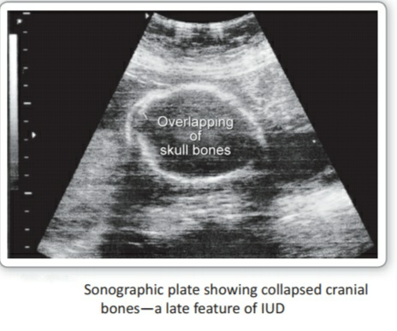
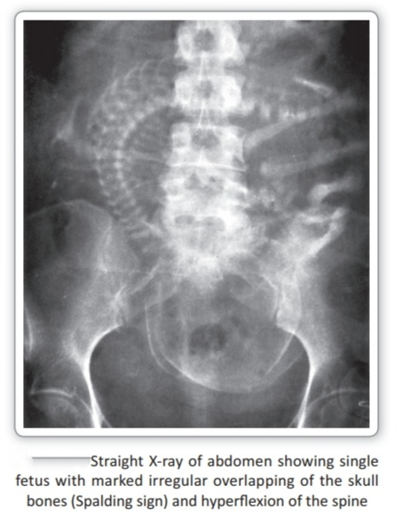
INVESTIGATION
2. STRAIGHTXRAY ABDOMEN
1.SONOGRAPHY

Slide 41
MANAGEMENT
PREVENTION
PRECONCEPTIONAL COUNSELING
CARE
SCREENING FOR “RISK MOTHERS”
PRENATAL DIAGNOSIS

Slide 42
MANAGEMENT

Slide 44
MANAGEMENT:-

Slide 47
COMPLICATIONS
Infections
PPH
Retained placenta
Abruption
DIC
Shock,renal failure
Sepsis
Maternal death

Slide 48
COMPLICATION
Psychological upset
A traumatic event
Post – partum depression
Infection
Infection by CL Welchi may occur if there is rupture of membranes
Blood coagulation disorders
If the fetus is retained for more than 4 weeks can lead to DIC
Retained placenta, PPH
During labor

Slide 49
Analysis
ANALYSIS

Slide 50
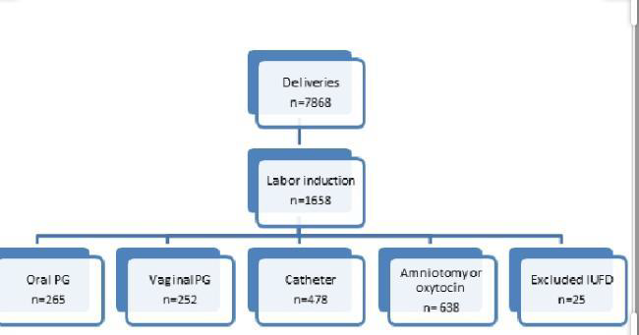

Slide 51
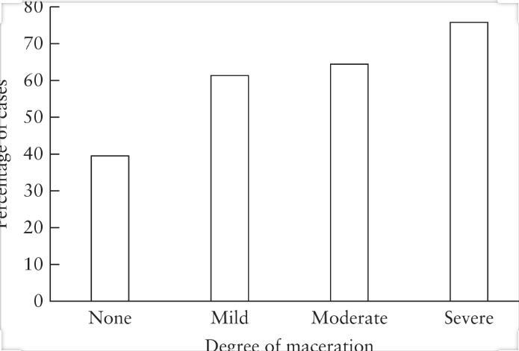
STATISTICS

Slide 52
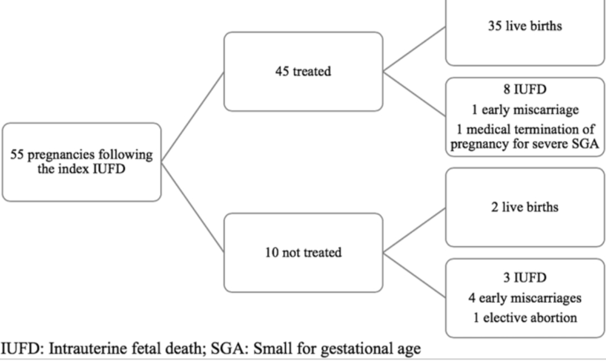

Slide 53
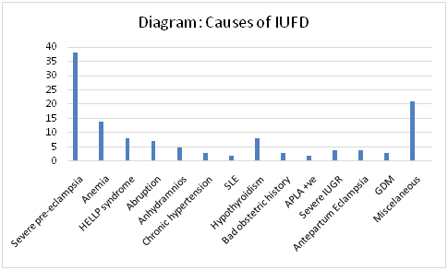

Slide 54
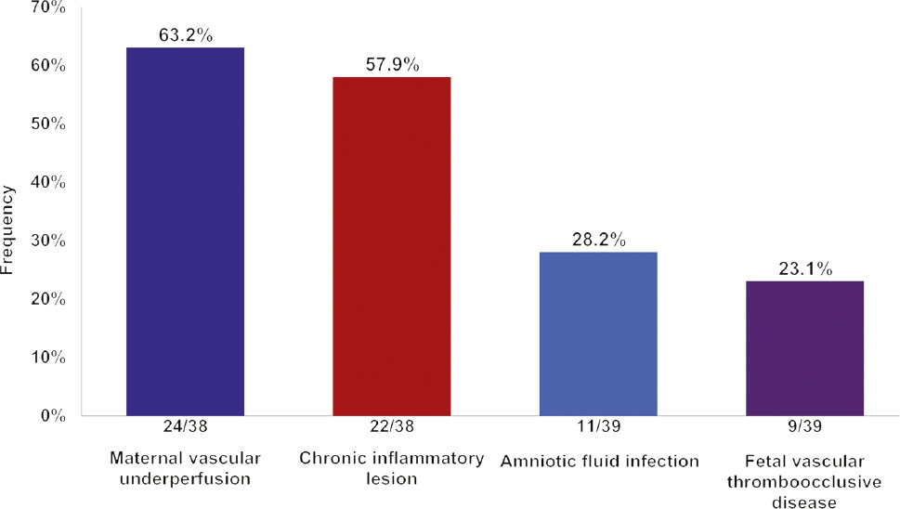
COMPLICATIONS

Slide 55
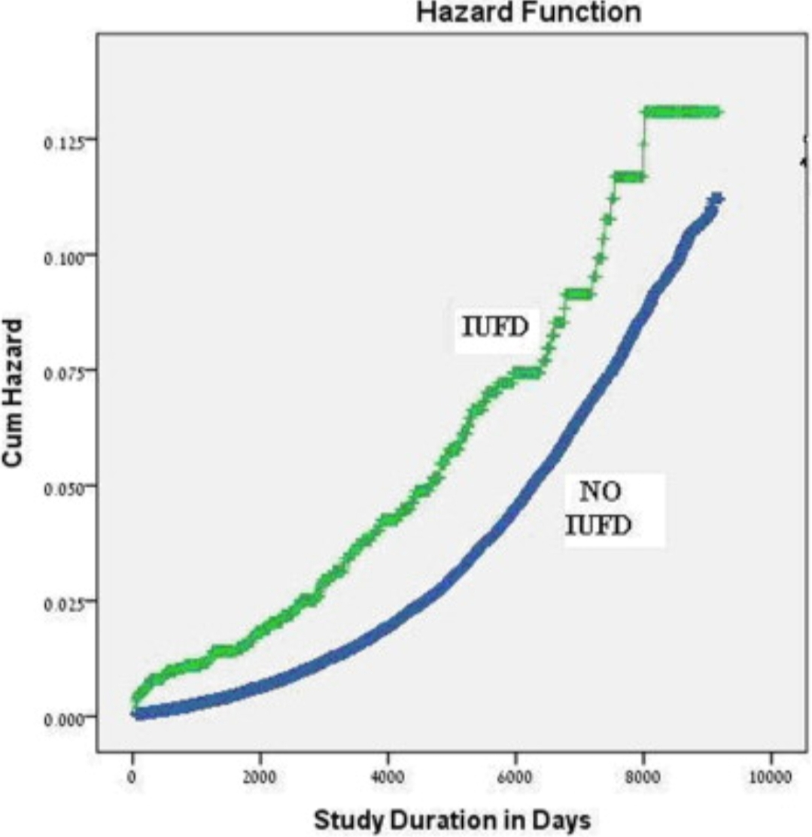
Graph..

Slide 56
2015- FETAL DEATH GRAPH

Slide 57
POINTS TO REMEMBER

