Slide 1
KIDNEYS
By
Dr.Leena. N
Associate Professor
Department of Anatomy

Slide 2
KIDNEYS
Kidneys are a pair of excretory organs situated on the posterior abdominal wall, one on each side of the vertebral column, behind the peritoneum

Slide 3
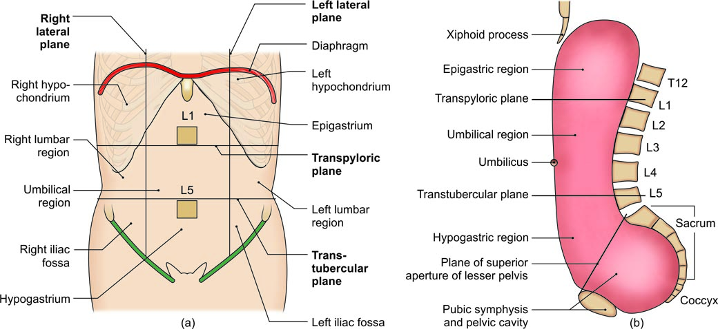
NINE REGIONS OF ABDOMEN
(a) Regions of the abdomen, and (b) sagittal section of regions of abdomen and pelvic cavity

Slide 4
EXTERNAL FEATURES
Two Poles
Two Surfaces
Two Borders
Hilum
1. The renal vein
2. The renal artery
3. The renal pelvis, which is the expanded upper end of the ureter.

Slide 5
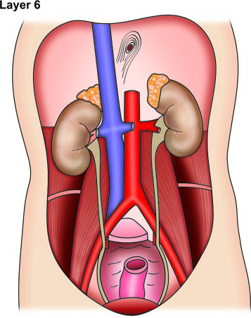
Muscles of posterior abdominal wall

Slide 6
RELATIONS OF THE KIDNEYS
Relations Common to the Two Kidneys
1. The upper pole of each kidney is related to the corresponding suprarenal gland. The lower poles lie about 2.5 cm above the iliac crests.
2. The medial border of each kidney is related to:
a. The suprarenal gland, above the hilus, and
b. To the ureter below the hilus.

Slide 7
Anterior Relations of Right Kidney
1. Right suprarenal gland
2. Liver
3. Second part of duodenum
4. Hepatic flexure of colon
5. Small intestine.

Slide 8
Anterior Relations of the Left Kidney
1. Left suprarenal gland
2. Spleen
3. Stomach
4. Pancreas
5. Splenic vessels
6. Splenic flexure and descending colon
7. Jejunum.

Slide 9
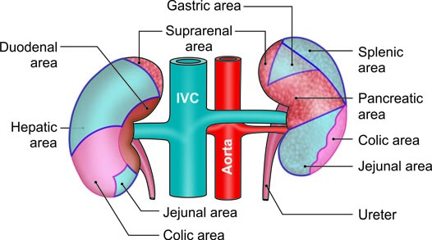
Anterior relations of the kidneys. Areas covered by peritoneum are shaded

Slide 10
Posterior relations: The posterior surfaces of both kidneys are related to the following.
a. Diaphragm
b. Medial and lateral arcuate ligaments
c. Psoas major
d. Quadratus lumborum
e. Transversus abdominis
f. Subcostal vessels
g. Subcostal, iliohypogastric and ilioinguinal nerves.
In addition, the right kidney is related to twelfth rib, and the left kidney to eleventh and twelfth ribs.

Slide 11
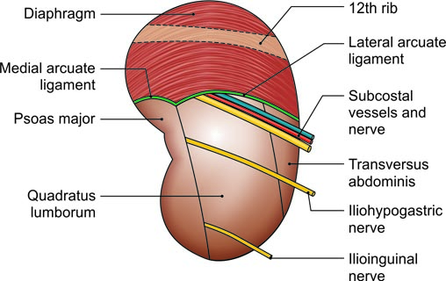
Posterior relations of the right kidney

Slide 12
Capsules or Coverings of Kidney (From within outside)
The Fibrous Capsule
Perirenal or Perinephric Fat
Renal Fascia
Pararenal or Paranephric Body (Fat)
.

Slide 13
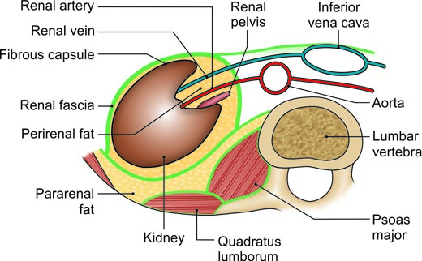
Transverse section through the lumbar region showing the capsules of the kidney

Slide 14
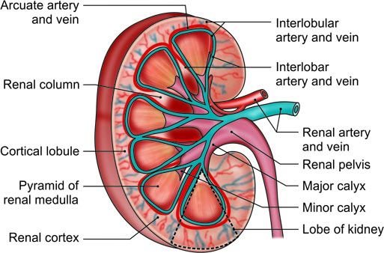
A coronal section through the kidney showing the naked eye structure including the blood supply of the kidney

Slide 15
VASCULAR SEGMENTS
The segments are apical, upper, middle and lower on anterior aspect. On posterior aspect segments seen are posterior and parts of apical and lower segments.

Slide 16
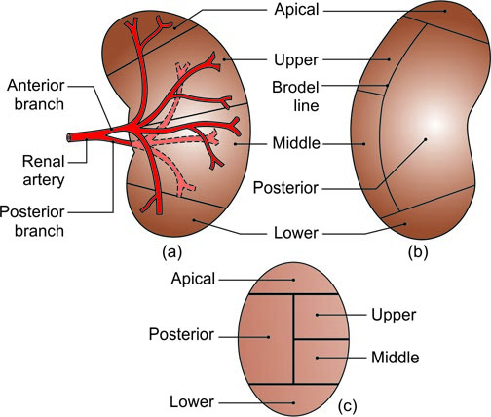
(a and b) Vascular segments of the kidney as seen in a sagittal section. Big anterior branch supplies four segments and posterior branch supplies only one segment, and (c) vascular segments of kidney as seen in sagittal section

Slide 17
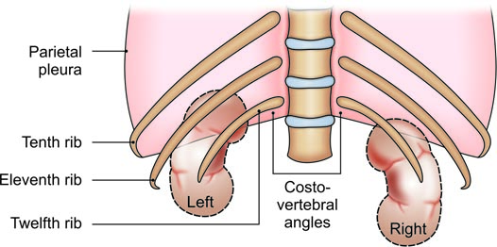
Relation of twelfth rib to pleural cavity and kidney

