Slide 1
LEPROSY
Dr. Reshma Reghu

Slide 7
INDIA
Leprosy is widely prevalent in India.
After introduction of MDT in the country, the recorded leprosy case load has come down from 57.6 cases per 10,000 population in 1981 to less than one case per 10,000 population at national level in December 2005.
Poor performing states are Tripura (74.63), Meghalaya (67.73), Rajasthan (81.23) and Delhi (76.83).

Slide 11
THE PREVALENCE POOL
The prevalence pool of leprosy in a population in general is in a constant flux resulting from inflow and outflow.
The inflow is contributed by the occurrence of new cases, relapse of cured cases, and immigration of cases.
The outflow is mainly through cure or inactivation of cases, death of cases, and emigration of cases.
Of the various factors that influence the prevalence pool, the importance of inactivation of disease and mortality are less well recognized.

Slide 12
INACTIVATION OF DISEASE
Where leprosy treatment facilities exist, inactivation or cure due to specific treatment is an important mode of elimination of cases from the prevalence pool.
Even in the absence of specific treatment, a majority of· patients, particularly of the tuberculoid and indeterminate types, tend to get cured spontaneously.

Slide 13
IMMUNITY
It is a well-established fact that only a few persons exposed to infection develop the disease.
A large proportion of early lesions that occur in leprosy heal spontaneously.
Such abortive and self-healing lesions suggest immunity acquired through such lesions.
Subclinical infections are believed to contribute to active immunity.
Cell-mediated immunity (CMI) is responsible for resistance to infection with M. leprae.

Slide 14
GENETIC FACTORS
Human lymphocyte antigen (HLA) linked genes influence the type of immune response that develops.

Slide 24
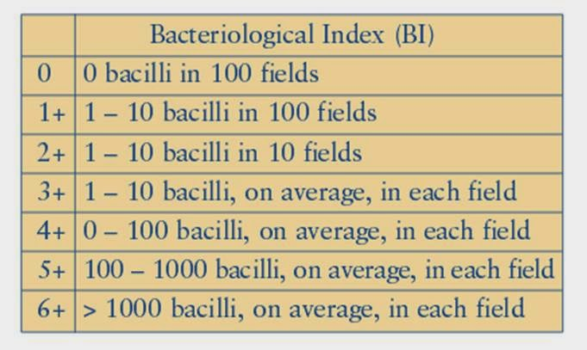

Slide 31
Value of Lepromine test
useful tool in evaluating the immune status (CMI) of leprosy patients.
Aid to classify the type of disease.
The test is also of great value in estimating the prognosis in cases of leprosy of all types.

Slide 35
Objectives of Leprosy Control
To interrupt transmission of the infection, thereby reduce the incidence of the disease so that it no longer constitutes a public health problem
to treat patients in order to achieve their cure and where possible, complete rehabilitation
to prevent the development of associated deformities.

Slide 36
Estimation of the problem
The first step in a leprosy control programme is to define the size of the problem by means of epidemiological surveys.
Random sample surveys are good enough to collect baseline data.
The survey should bring out not merely the prevalence of leprosy, but also the age and sex distribution of cases, the various forms of leprosy and the facilities available for providing the needed health care.
Estimates of the prevalence of leprosy are essential for planning and implementing an anti-leprosy programme and also for evaluating the results of the programme.

Slide 37
Early case Detection
The aim of case detection is to identify and to register all cases of leprosy .
The current trend is to involve the primary health care workers in case detection with the active participation of the community .
These workers need to be adequately trained to make a tentative diagnosis of leprosy.

Slide 38
Case Finding methods
CONTACT SURVEYS
GROUP SURVEYS
MASS SURVEYS
Records : The case information should be collected for all patients in a standardized manner.
Leprosy is an "iceberg" disease.

Slide 39
MDT
Rifampicin
Dapsone
Clofazimine
Ethionamide and protionamide
Quinolones
Minocycline
Clarithromycin

Slide 41
Duration of treatment
Multibacillary leprosy - MB blisterpacks for 12 months, within 18 months
Paucibacillary leprosy - PB blisterpacks for 6 months, within 9 month

Slide 42
Lepra reaction
During the course of leprosy, immunologically mediated episodes of acute or subacute inflammation known as reactions may occur.
Because peripheral nerve trunks are often involved, unless reactions are promptly and adequately treated, such episodes can result in permanent deformities.
Lepra reactions are usually diagnosed by clinical
examination only.

Slide 49
Deformities
Approximately 25 per cent of the patients who are not treated at an early stage of disease develop anaesthesia and/or deformities of the hands and feet.
As a single disease entity, leprosy is one of the foremost causes of deformities and crippling.
The deformities may result due to the disease process (e.g. loss of eye brows, other facial deformities), or those resulting from paralysis of some muscles due to damage to peripheral nerve trunk (e.g. claw-hand, foot-drop, lagophthalmos), or those resulting from injuries or infections to hands and feet (e.g. scar contractures of fingers, mutilation of hands and feet, corneal ulceration).

Slide 50
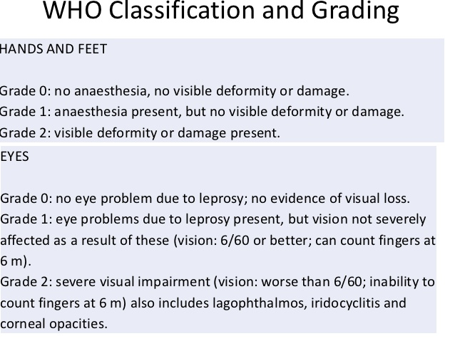

Slide 51
DEFORMITIES OF LEG
Plantar Ulcers
Foot-drop
Inversion of the Foot
Clawing of the toes
Absorption of the toes,
Collapsed Foot
Swollen Foot
Callosities.

Slide 52
REHABILITATION
The WHO Expert Committee on Leprosy in its Second Report defined rehabilitation as :
"the physical and mental restoration, as far as possible, of all treated patients to normal activity, so that they may be able to resume their place in the home, society and industry".
The cheapest and surest rehabilitation is to prevent physical deformities and social and vocational disruption by early diagnosis and adequate treatment

Slide 53
Community-based rehabilitation defined by WHO and major NGOs is as follows :
"Community-based rehabilitation is a strategy within general community development for the rehabilitation, equalization of opportunities and social inclusion of all people with disabilities.
Community-based rehabilitation is implemented through the combined efforts of the people with disabilities themselves, their families, organizations and communities, and the relevant governmental and non-governmental health, education, vocational, social and other services".

Slide 55
PROGRAMME MANAGEMENT
Adequate Infrastructure,
Trained Health Personnel,
Adequate Supply of Drugs and Vehicles
Financial Allocation.

