Slide 1
LEPTOSPIROSIS

Slide 2
Overview
Leptospirosis is an acute anthropo-zoonotic infection
Most common, underdiagnosed zoonosis
It occurs in tropical, subtropical and temperate zones
India - cases are reported from Kerala, Tamil Nadu, AP, Karnataka, Maharashtra, Gujarat & Andamans.
Source - Animals (rodents and domestic animals)
Also called Mud/Swamp Fever, Japanese 7 day fever, Rice Field Fever,Spirichote Jaundice,Canicola Fever,Leptospiral Fever, Autumn Fever and Swineherd’s Disease

Slide 3
Epidemiological Factors
Contaminated environment, Rainfall
High risk groups, endemic in all states of India
First description by Weil in 1886
Rural > Urban
Male > Female (10 : 1)
Clinical Features –mild to severe life threatening
Mimics many common febrile illnesses
Diagnosis - difficult to confirm
Treatment – effective, if started early (<5 days)
Not to be confused with rat bite fever (SM)

Slide 4
The Causative Bacterium
Order Spirochaetales – Treponema, Borrelia, Leptospira
Family – Leptospiraceae, susceptible to heat, cl, acid
Genus – Leptospira, 26 serogroups, 250 serovars
interrogans, biflex, ictero hemorrhagica, hebdomidis
Corkscrew shaped, delicate, flexible spirochete, Gram -ve
6 to 20  long & 0.1  thick, coiled, flagellate, actively motile

Slide 5
Epidemiology
Rainfall; Contaminated environment
Poor Sanitation; Inadequate drainage facilities
Presence of rodents, cattle & stray dogs
Walking/ working bare foot poses high risk
Difficult to pinpoint the source of infection
Any person can get infected, if exposed to contaminated and environment

Slide 6
Risk Groups
Occupational exposure
Farmers – Rice, Sugarcane, Vegetables, Cattle, Pigs
Sewerage workers; Abattoirs, Butchers
Vetenarians, Lab staff, Miners, Soldiers
Fishermen – Inland (not on the sea)
Recreational activities
Swimming, Sailing, Marathon runners, Gardening

Slide 7
Reservoirs of Infection
Rodents
(Rattus rattus, Rattus norvegicus, Mus musculus)
Dogs
Wild animals
Domesticated animals
Caged game animals
Leptospira are excreted in the urine

Slide 8
Modes of Transmission
1. Direct contact with urine or tissue of infected animal
Through skin abrasions, intact mucus membrane
2. Indirect contact
Broken skin with infected soil, water or vegetation
Ingestion of contaminated food & water
3. Droplet infection
Inhalation of droplets of infected urine

Slide 9
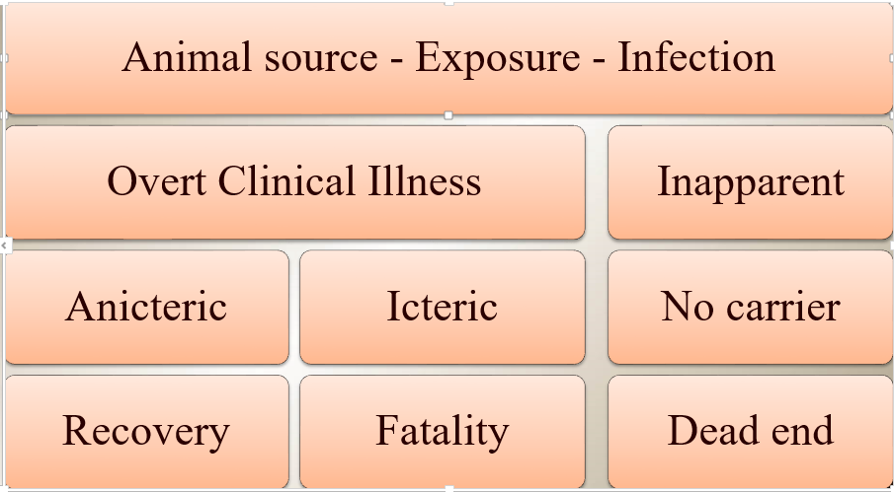
Natural History

Slide 10
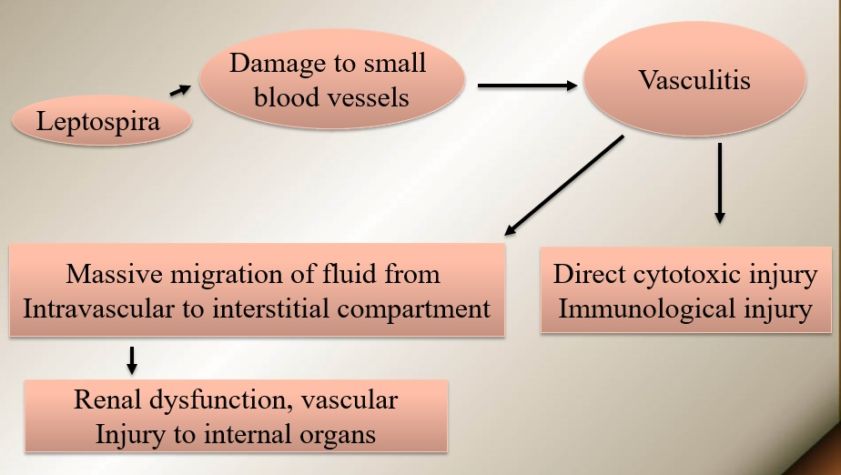
Pathogenesis of Severe Disease

Slide 11
Clinical Illnesses
Types
Anicteric (common 95% recover)
Icteric ( Weil’s Syndrome) (rare, fatal)
Hepato-renal syndrome
Hemorrhagic syndrome with ARF
Atypical pneumonia syndrome
Aseptic meningo-encephalitis
Myocarditis, Chronic uveitis

Slide 12
Clinical Presentation
Anicteric-Common, mild < 2% Mortality 90% of Cases
Icteric- Rare, Severe 15% Mortality 10% of Cases

Slide 13
Anicteric Presentation
Leptospiremic Phase | Immune Phase
initial | subsequent
Fever, Myalgia | Mild fever
Severe head ache | Meningism
Conjunctival suffusion | Uveitis
Abd. pain, Epistaxis | I.P: 5 to 14 days (21days)

Slide 14
Icteric Leptospirosis
Liver
Jaundice-Occurs in 4-6 days (2-9 days)
Serum Bilirubin- Markedly (20-40 mg/dl)
SGOT/SGPT- Mild elevation
Hepatocellular necrosis/ intra hepatic cholestasis
Death-not due to liver disease

Slide 15
KIDNEYS – Mild to Severe
Urinalysis : Hematuria / Pyuria / Proteinuria
Renal Failure: Pre renal azotemia, ATN / AIN
Oliguric / Non Oliguric
Mechanism
Nephrotoxicity – Endotoxin, (Direct ) Bacterial migration, Toxic Metabolites
Hypoperfusion – Hypotension, Fluid loss/ Fluid shift
G.I. Bleed, Myocarditis

Slide 16
Hemorrhagic Manifestations
Hemorrhagic Fever - Vascular injury
Respiratory, Alimentary, Renal & Genital tracts
More common in Icteric & with Renal Failure
Reported in Korea, Andaman’s & Brazil
Hemorrhagic Pneumonitis
Hemoptysis / Respiratory failure
CXR : Single/ Multiple ill defined opacities
Occurs in 2nd week (as early as 24-48 hours)
Reported in Korea, Andaman’s & Nicaragu

Slide 17
Cardiac Form
Cardiac manifestations
Hemorrhagic Myocarditis
Cardiomyopathy / Cardiac failure
Arrhythmias, Hypotension / Death
Atrial fibrillation / Conduction defects
ECG changes
Non Specific ST-T changes
Low voltage complexes
Reported in Srilanka,Barbados and Portugal

Slide 18
Other Manifestations
Aseptic Meningo-encephalitis
It is rare; It occurs in the Immune phase
CSF –­ proteins ⇑, ­lymphocytes ⇑
Convulsions, Encephalitis, Myelitis & Polyneuropathy
Ocular manifestations
Late complication; Conjunctival suffusion/hemorrhage
Anterior uveitis, Iritis, Iridocyclitis, chorioretinitis
Occurs in 2 weeks to 1 yr. (average 6 months)

Slide 19
Differential Diagnosis
Fever- Viral fever, Malaria, Typhus
Jaundice-Malaria, Viral hepatitis, Sepsis
Renal Failure- Malaria, Hanta virus, Sepsis
Menigitis-Bacterial / Viral causes
Hemorrhagic Fever-Dengue, Hanta virus, Typhus

Slide 20
Laboratory Tests
TC / DC / ESR / Hb / Platelet count
Serum Bilirubin / SGOT/ SGPT
Blood Urea, Creatinine & Electrolytes
Chest X-Ray; ECG
Tests for diagnosis of Leptospirosis
Culture for Leptospira: Positive
MAT; Sero conversion or 4 fold rise/ high titer
ELISA / MSAT : positive
MAT: Microscopic agglutination test
(M)SAT: Microscopic slide agglutination Test

Slide 21
Problems in Diagnosis
Early Diagnosis (1st Week) | Serological Tests (2 week)
No reliable test | Serovar specific - MAT
Delay in culture(>1 mon) | Reliable, Current infection
PCR valuable but costly | Gold Standard, Epid studies
SAT / ELISA (> 5 days) | Complicated, DFM required
Genus Specific | Occur late, persist longer

Slide 22
Interpretation of Tests
MAT
Antibody IgM titers of >1/80 or IgG 1/400
⇑ titers indicate current infection
Declining titers indicate past infection
To confirm, second sample is essential
ELISA SAT
Valuable for Dx of current infection
IgM antibodies alone are useful

Slide 23
Interpretation of Tests
ELISA/SAT | MAT | Interpretation
Positive | Positive | Current Infection
Positive | Negative | Current Infection
Negative | Positive | Past Infection
Negative | Negative | R/o Leptospirosis
Not available | Rising titers | Current Infection

Slide 24
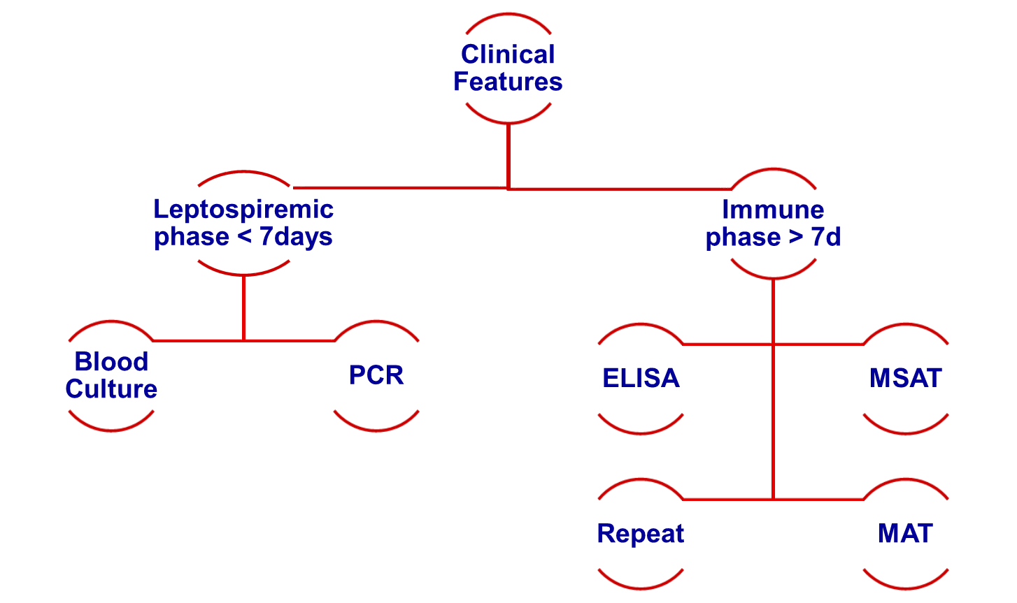
Approach to Diagnosis

Slide 25
Treatment
Mild-start Rx. early | Severe-start intensive Rx.
Oral Treatment 7 to 10 day | IV Treatment 5 to 7 days
Doxycycline 100 mg b.i.d | Benzyl Penicillin 20L q.i.d
Amoxicillin 500 mg q.i.d | Ampicillin 1G q.i.d
Ampicillin 500 mg q.i.d | 3rd gen Ceftriaxone 1G od
Supportive treatment | Cefotaxime 1G t.i.d

Slide 26
Special Measures
Intensive care, monitor
Cardiac, hepatic care
Fluid balance, bleeding
Platelets, transfusions
Renal function - dialysis
CNS complications

Slide 27
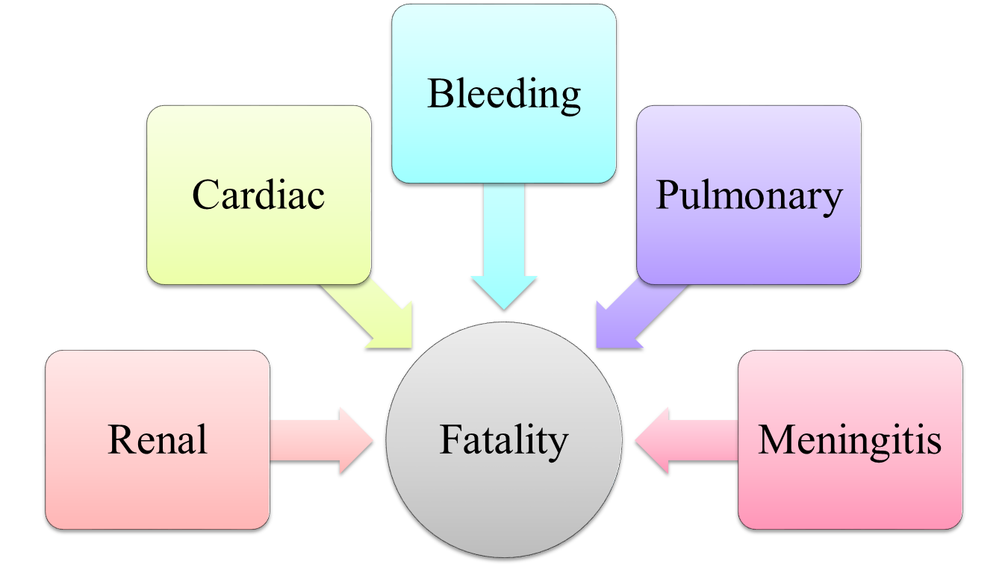
Prognosis and Mortality

Slide 28
Prevention
Prevention is difficult due to wild animal infection
Good sanitation, Immunization of live stock
Personal hygiene, PPE, Water treatment
No useful human vaccines – multiple serovars

