Slide 1
LIPIDS
Dr RESHMY K.R PROFESSOR DEPARTMENT OF PHYSIOLOGY SKHMC

Slide 2
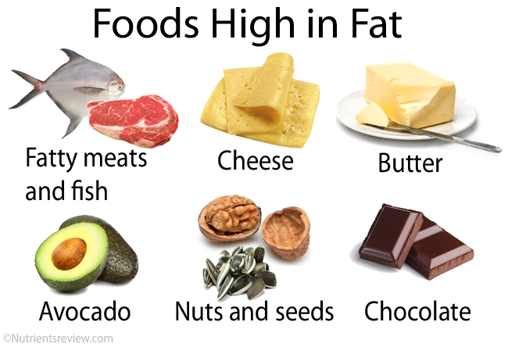
Foods rich in fats

Slide 3
LIPIDS
Organic substances relatively insoluble in water but soluble in organic solvents like chloroform, ether and benzene

Slide 4
Group of naturally occurring substances
Consists of higher fatty acids
Insoluble in water
Soluble in: Ether, chloroform, benzene and acetone (organic solvents)

Slide 5
LIPIDS
Fatty acids, Triacylglycerols, Ketone bodies, Cholesterol, Phospholipids & Sphingolipids
“Fats” and “Oils” – crude lipid mixtures from natural sources.
Fats (solid) & Oil (liquid) at room temperature

Slide 6
Fat depots (large amount of fats):
Subcutaneous tissues
Mesenteric tissues
Fatty tissues around the kidney
Yellow bone marrow
Food sources:
Milk, Egg, Meat, Liver
Fish oils, nuts, seeds and oils

Slide 7
Significance of Fats
Acts as fuel in the body. (caloric value: 9 Kcals/gm)
Deposits of fats underneath the skin - exert insulating effects.
The mesenteric fat around organs (kidney) - padding and protecting internal organs.
Building materials. (cholesterol – hormone synthesis)

Slide 8
Lipids supply the essential fatty acids which cannot be synthesized in the body.
Nervous system is particularly rich in lipids.
Vitamins A, D, E and K are fat soluble.
( lipid/fat is needed for absorbing these vitamins)
Lipoproteins and phospholipids are important constituents of cell wall & mitochondria.

Slide 9
Adult: ingests 60-150g of lipids per day of which 90% is triacylglycerol (TAG)
cholesterol, cholestryl esters, phospholipids and free fatty acids (FFA)

Slide 10
Physical Properties of Lipids
Greasy to touch and leaves an oily impression on paper.
Are insoluble in water but soluble in organic solvents.
Have less specific gravity than water (solid fat- 0.86), (liquid fat -0.95)
Pure glycerides are tasteless, odorless, colorless and neutral in reaction (acidic-yellow color (hydrolysis & oxidation)

Slide 11
Flavor of butter is due to the presence of bacterial flora; color of butter, human fat and egg yolk (due to presence of carotene & xanthophil).
Hardness and consistency depends on the amount of saturated and unsaturated fatty acids present. Saturated fatty acids are solid (room temperature) while Unsaturated fatty acids are liquid (room temperature) (e.g. oils)

Slide 12
Fats have definite melting points.
When liquid fat is placed on water- it spreads uniformly over the surface of water. If the quantity is small – it forms a layer of 1 molecule thickness (effect: to lower surface tension- help transport fat)
Though fat is insoluble in water- can be broken down into minute droplets and dispersed in water (emulsification)

Slide 13
Chemical Properties of Lipids
Acrolein Formation – glycerol → heat + potassium bisulphate
Hydrogenation – unsaturated fats (+nickel-catalyst) – saturated fats (“hardening”) e.g vegetable oil – commercial cooking oil
Saponification – hydrolysis of fat by alkali (glycerol + alkali salts = soap)
Rancidity – chemical change resulting in unpleasant odor and taste on storage when fats are exposed to light, heat, air and moisture.
E.g. Ascorbic acid (Vitamin C) and Vitamin E are antioxidants (prevents rancidity)

Slide 14
Classification of Lipids
Simple Lipids
Compound Lipids
Derived Lipids
Substances Associated with Lipids

Slide 15
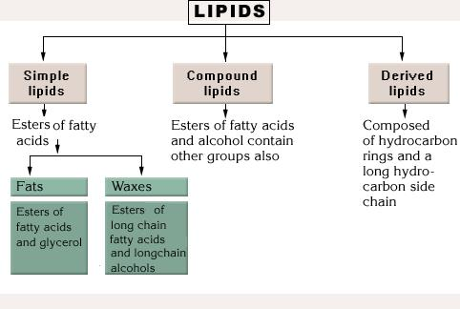
Simple Lipids
Classification | Definition | Examples
Simple Lipids | Esters of fatty acids with various alcohols | * Neutral fats (F.A. + alcohol) * Glycerol (alcohol in fats) * Anything other than glycerol (alcohol in waxes)

Slide 16
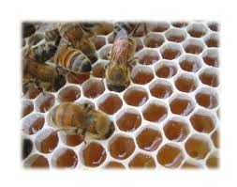
WAXES
When hydrolysis of waxes gives : one fatty acid + alcohol
Eg; Beewax

Slide 17
Compound Lipids
Classification | Description | 4 Sub-Divisions
Compound Lipids | Contains other chemical groups in addition to alcohol and fatty acids | Phospholipids Glycolipids Sulpholipids Lipoprotein
Phospholipids Glycolipids Sulpholipids Lipoprotein | Contains fatty acids, glycerol, phosphoric acid & nitrogenous compound (lecithin, cephalin) Lipids + carbohydrate + nitrogen but no phosphoric acid & glycerol Lipids containing sulphate groups Attached to proteins (present in plasma & tissues)

Slide 18
Complex lipids
Result of hydrolysis gives FA with alcohol and containing additional[prosthetic] groups.
Subclassified according to the type of prosthetic group
Phospholipids
Glycolipids
Lipoproteins

Slide 19
Derived Lipids
Classification | Description
Derived Lipids | Substances derived from simple & compound by hydrolysis.
 | Examples
Derived Lipids | Fatty acids Alcohols other than glycerol Glycerides Bases (choline, serine)

Slide 20
Derived lipids
Derived from lipids (simple or complex)or precursors of lipids
Example
Fatty acids
Steroids
Cholesterol
Vitamin A and D

Slide 21
Substances associated with Lipids
Classification | Examples
Substances Associated with Lipids | Carotenoids Tocopherols Vitamins A, D, E and K Steroids (Cholesterol)

Slide 22
Composition of Lipids
ANIMALS AND VEGETABLE FATS
Complex mixtures of glycerides
Triglycerides
(TAG)-
Neutral fats
Esters of glycerol & fatty acids
3 molecules of fatty acids - glycerol
Triglycerides
One molecule of glycerol + 3 molecules
of fatty acids (condensation)

Slide 23
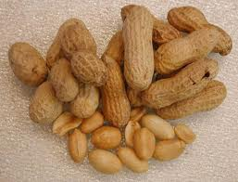
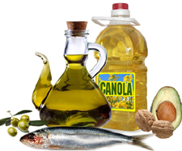
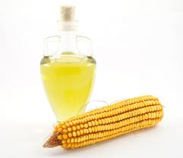
Essential Fatty Acids (Polyunsaturated Fatty Acids)
Lipids | Examples | Sources
Polyunsaturated Fatty Acids | Linoleic acid Linolenic acid Arachidonic acid (not synthesized by the body- must be taken in the diet) | Linseed Cotton seeds Peanuts Corn oils
 | Linoleic acid – the only fatty acid which is absolutely indispensable.

Slide 24
Fatty Acids
Long-chain carboxylic acids, typically 12-18 carbon atoms, insoluble in water& saturated or unsaturated.

Slide 25
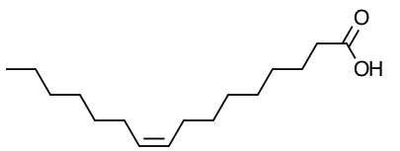
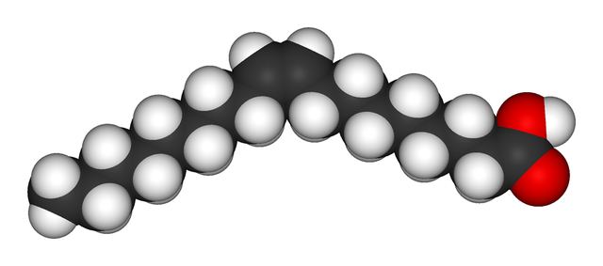
Fatty acids are
saturated with all single C–C bonds.
unsaturated with one or more double C=C bonds.
are solids at room temperature
are liquids at room temperature.

Slide 26
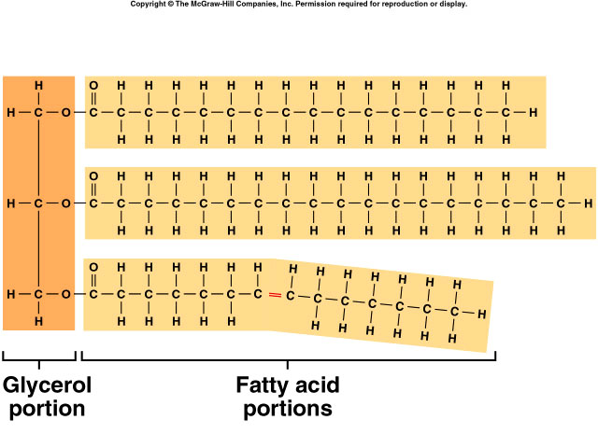
Triglycerides
Neutral fat
Concentrated source of energy
used primarily for energy; most common lipid in the body
contain C, H, and O but less O than carbohydrates (C₅₇H₁₁₀O₆)
building blocks are 1 glycerol and 3 fatty acids per molecule saturated and unsaturated

Slide 27
https://www.lipidmaps.org › images › tutorials › L...
https://www.slideshare.net/vivekaiden/lipids-classification-and-types
THANK YOU

