Slide 1
LIPOPROTEINS,KETOGENESIS
Dr.Deepa.G.S
Associate Professor
Dept.of Physiology

Slide 2
Lipoproteins
Molecular complexes that consists of lipids and proteins
They function as transport vehicles for lipids in plasma

Slide 3
Lipoproteins-Structure
1.Neutral core
Triacylglycerol
Cholesteryl ester
2.Shell
Phospholipids
Apoproteins
cholesterol

Slide 4
https://www.slideshare.net/namarta28/lipoproteins-structure-classification-metabolism-and-clinical-significance

Slide 5
Lipoproteins-Classification
Based on Density five major classes of lipoproteins
1.Chylomicrons
Synthesis:in intestinal mucosal cells
Lipid-99% (highest)
Protein-1% (Lowest)
Density-Least
Size-largest
Function:
Transport exogenous triacylglycerol from intestine
to various tissue

Slide 6
https://www.slideshare.net/namarta28/lipoproteins-structure-classification-metabolism-and-clinical-significance

Slide 7
https://www.slideshare.net/namarta28/lipoproteins-structure-classification-metabolism-and-clinical-significance

Slide 8
Lipoproteins-Classification
2.Very low density lipoprotein-VLDL
Synthesis- in Liver
Function: Transport endogenous triacylglycerol to various tissue
3.Low density lipoprotein-LDL
Formed from VLDL in blood
Function: Transport cholesterol from liver to other tissues

Slide 9
Lipoproteins-Classification
Clinical significance-(Lethally dangerous-Bad Cholesterol)
Chlolesterol (75% plasma cholesterol) rich lipoprotein
Concentration in blood has positive corelation with cardiovascular diseases(Atherosclerosis)
Lp(a)-Seen in high levels (<30mg/dl) in some persons associated with LDL-Strongly associated with MI(impairs fibrinolysis)

Slide 10
Lipoproteins-Classification
4.High density lipoprotein-HDL
Synthesis: mostly in liver
Three fractions-HDL 1,2 and 3
Function:
Transport cholesterol from peripheral tissues to
Liver (Reverse cholesterol transport)
Cholesterol from liver is excreted through bile
which is the only excretory route for cholesterol

Slide 11
Lipoproteins-Classification
Clinical significance:
Level of HDL is inversely related to MI
Above 60 mg/dl protects ,below 35mg/dl increases the risk
Highly desirable lipoprotein or Good Cholesterol
5.Freefatty acids-albumin
Fattyacids bound to albumin
I molecule of albumin can hold 20-30 molecules of free fatty acids
FFA are either oxidised to supply energy or
incorporated to tissue lipid by esterification

Slide 12
Apolipoprotein
The protein component of lipoproteins are
known as apolipoproteins or apoproteins
Functions:
Structural component of lipoprotein
Recognize cell membrane surface receptor

Slide 13
Plasma Lipid profile
Total Cholesterol-150-200mg/dl
HDL-Cholesterol-30- 60mg/dl(male)
35-75mg/dl(females)
LDL-Cholesterol- 80-130mg/dl
Triglycerides - 50-150mg/dl(males)
40-150mg/dl(females)

Slide 14
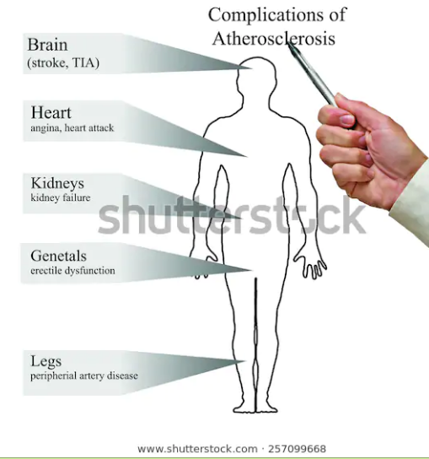
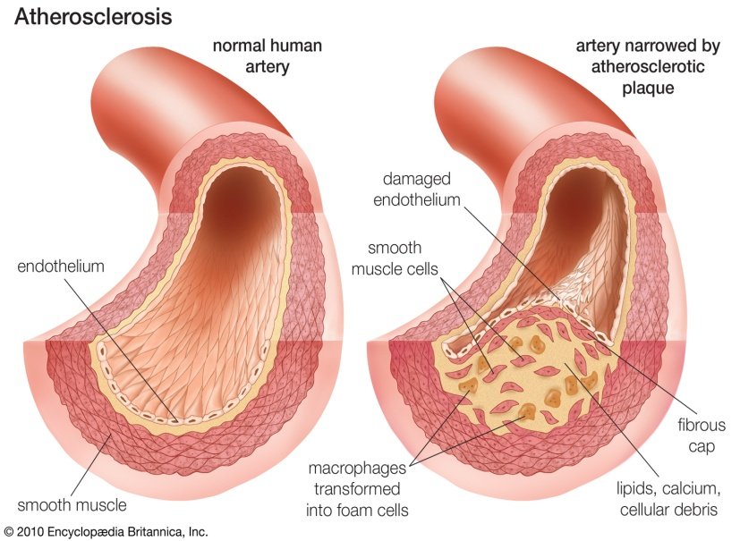
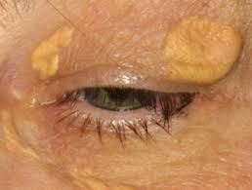
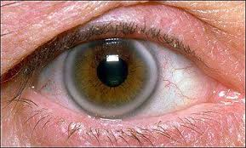
Hyperlipidemia-Complications
XANTHOMA
ARCUS

Slide 15
Phospholipids
Phospholipids are complex lipids which contain phosphoric acid and a nitrogenous base in addition with alcohol and fattyacids
Glycerophospholipids-theses contain glycerol as alcohol
eg:lecithin,cephalin,cardiolipn,Phosphotidyl inositol
Sphingophospholipids-Sphongisine is the alcohol in this group
eg:sphingomyelin-imnportant constituent of myelin

Slide 16
Phospholipids-function
Structural component of membrane and membrane permeabilitty
Lecithin,cephalin,cardiolipin-maintain conformation of ETC
Absorption of fat from intestine
Synthesis of lipoproteins
Avoid faftty liver
Synthesis of eicasanoids
Acts as surfactant
Cpehalins-blood clotting
Phosphotidyl inositol-second messenger

Slide 17
Essential fatty acids
Linolic acids
Linoleic acid
Aracidonic acids
Functions
Membrane structure and function
Transport of cholesterol
Lipoprotein formation
Prevents fatty liver
Synthesis of eicosanoids (Prostaglandins,leukotrienes)
Deficiency
Phrynoderma (Toad skin)

Slide 18
Ketone bodies
Acetone
Acetoacetate
Beta-hydroxybutyrate

Slide 19
Ketogenesis
Site:Liver
Enzymes located in mitochondrial matrix
Precursor-Acetyl-coA

Slide 20
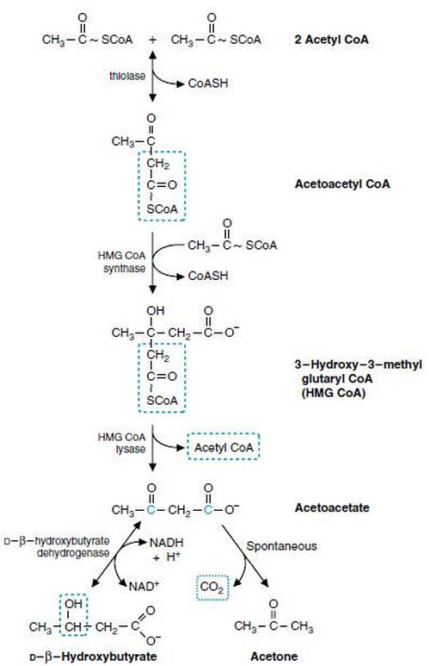
Ketogenesis
https://www.checkdiabetes.org/ketogenesis/

Slide 21
Ketone bodies-utilization
Acetoacetate and beta hydroxybutyrate are the important source of energy for peripheral tissue
More significant in starvation and DM
Major fuel source of brain during starvation,
meet 50-70% of energy needs by brain

Slide 22
Ketone bodies
Normal-1mg/dl
Excretion in urine-undetectable(Rothera’s test)
Ketonemia-Increased concentration of ketone bodies in blood
Ketonuria- excretion of ketone bodies in urine
Ketosis-ketonemia and ketnuria
Acetone smell in breath
Common conditions-DM ,starvation

Slide 23
Ketoacidosis
Acetoacetate and beta hydroxybutyrate are acids,when increased leads to ketoacidosis
Common condition-DM –leads to coma and death

Slide 24
Reference:
1.Biochemistry,U satyanarayanan, U.Chakrapani,3rd edition.
2.Text book of Biochemistry for medical students
DM Vasudevan,Sreekumari S 5Th edition

Slide 25
Thank you

