Slide 1
MEASLES
DR.T.AJAYAN
PROF. & H.O.D.
PRACTICE OF MEDICINE

Slide 2
DEFINITION
Acute, highly contageous viral infection of man spread by aerolized droplets.

Slide 3
Etiologic agent:
Paramyxovirus

Slide 4
Epidemiology
Commonly seen in children 2-6 years age.
Incidence-increased in winter and spring.
Spread by droplet infection.
Communicability is increased in Pre eruptive and Catarrhal stage.

Slide 5
CLINICAL FEATURES
Typical
Atypical
Pre eruptive and catarrhal stage
Eruptive/exanthematous stage

Slide 6
Typical measles
A)Pre eruptive and catarrhal stage:
Fever
Malaise
Rhinorrhoea
Cough
Conjunctivitis with increased lachrymation
KOPLIK’S SPOTS

Slide 7
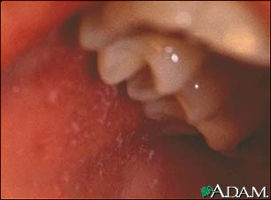
Koplik’s spots

Slide 8
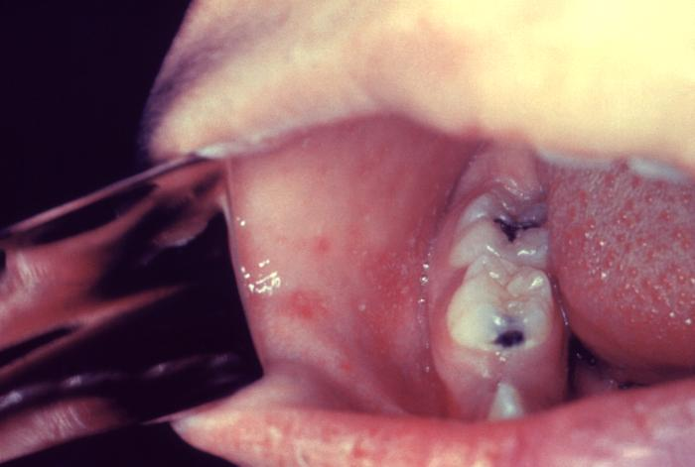

Slide 9
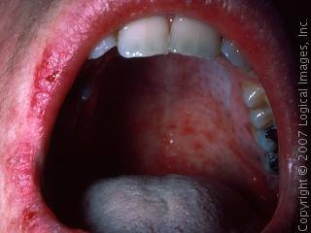

Slide 10
ERUPTIVE STAGE
Maculo papular rash.
Initially starts in face forehead- trunk- extrimities-palms and soles
Disappear in the order of appearance
General symptoms disappear 1-2 days after the appearance of skin rash

Slide 12
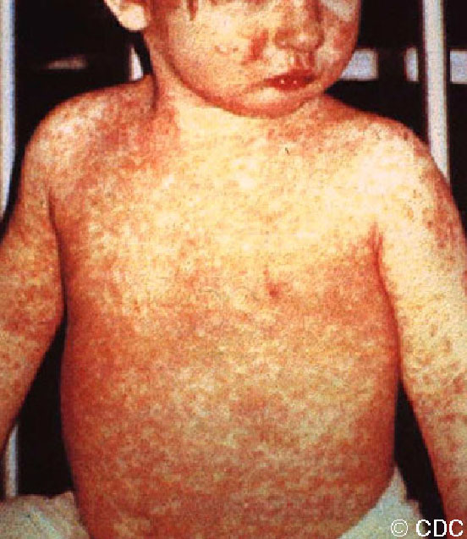

Slide 13
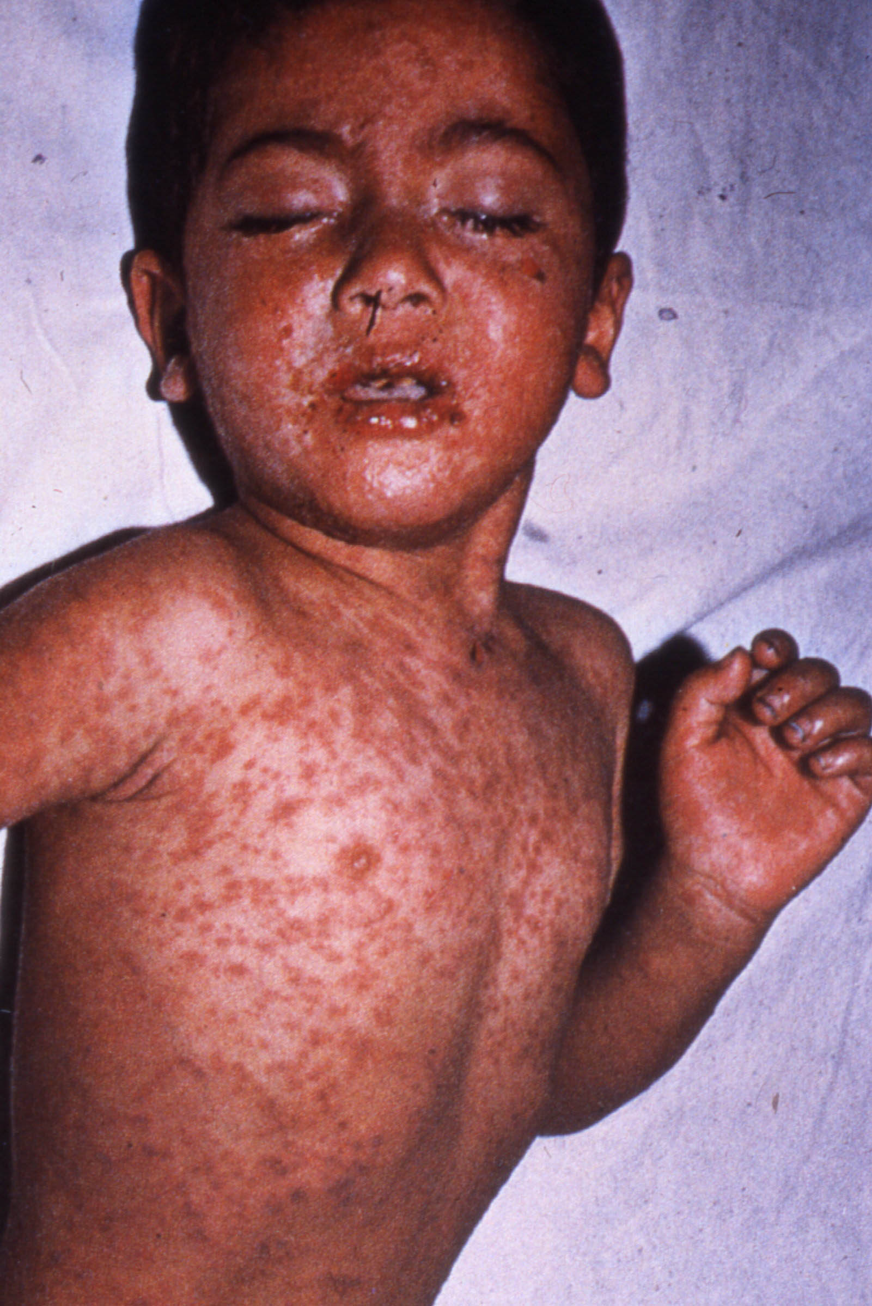

Slide 14
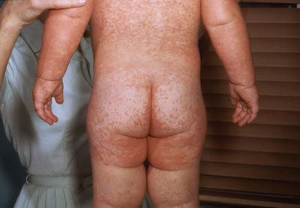

Slide 15
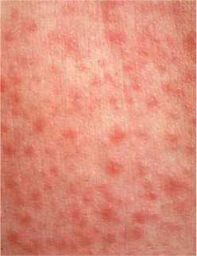

Slide 16
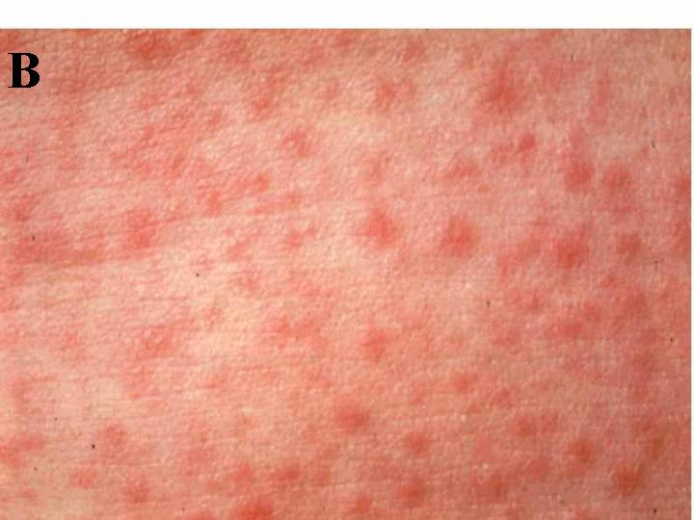

Slide 17
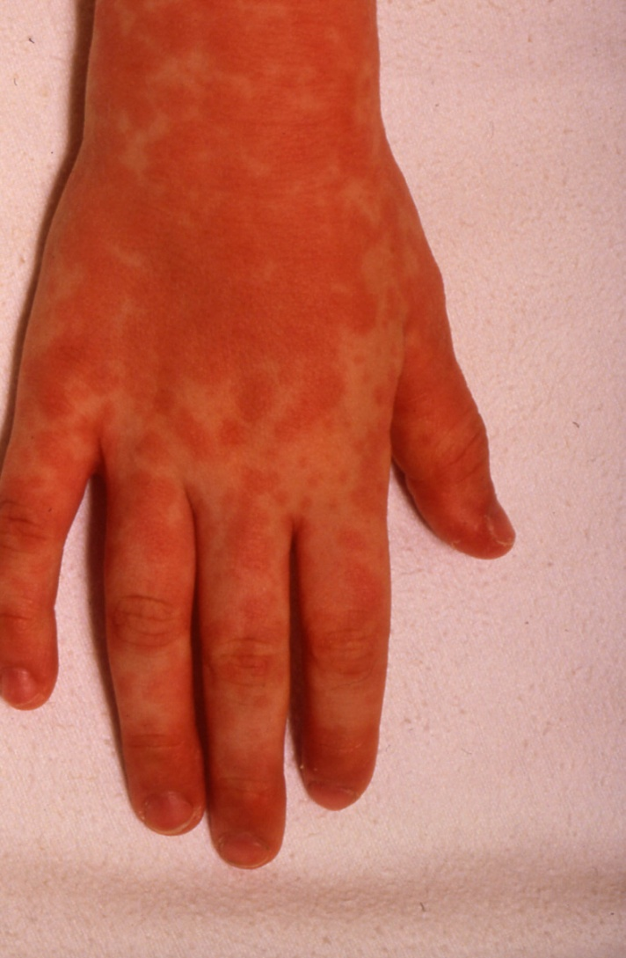

Slide 18
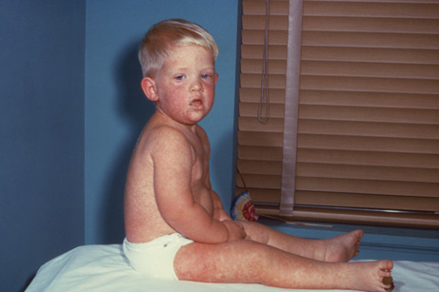

Slide 19
Atypical measles
Syndrome in adults who received live measles vaccine before 12 months age who develop hypersensitivity.
When infected later with mild measles virus develo potentially fatal illness.

Slide 20
Complications
CNS;
Encephalitis
Convulsions
Coma
Seizures

Slide 21
R.S.:
Bronchitis
Bronchopneumonia
Laryngitis

Slide 22
GIT:
Gasteroenteritis
Hepatitis
Appendicitis
Ileocolitis
Mesenteric adenitis

Slide 23
Other rare complications
Myocarditis
Glomerulo nephritis
Post infectious thrombocytic perpura

Slide 24
Lab diagnosis
Blood:-Lymphopenia
Neutropenia
proteinuria
Fourfold rise in s.hemagglutination inhibition ab supports diagnosis.
Specific-immunoflurosent staining for ag.

Slide 25
MANAGEMENT
GENERAL;
Isolation
Bed rest

Slide 26
Homoeopathic
Aconite
Bell
Bry
Ferr.phos
Gels
Phos
Puls
Sulph
Ver.vir

