Slide 1
MEDIASTINUM
By
Dr.Berlina Terrence Mary
Assistant Professor
Department of Anatomy

Slide 2
Mediastinum is the middle space left in the thoracic cavity in between the lungs.
Boundaries
Anteriorly: Sternum
Posteriorly: Vertebral column
Superiorly: Thoracic inlet
Inferiorly: Diaphragm
On each side: Mediastinal pleura.

Slide 3
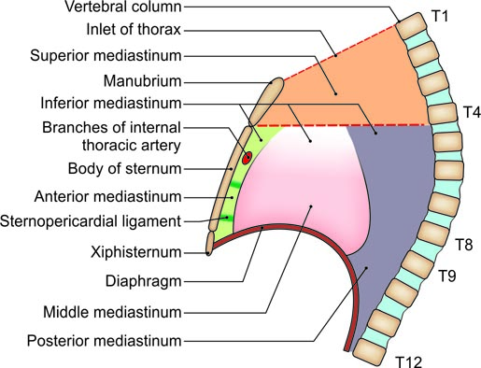
Subdivisions of the mediastinum

Slide 4
SUPERIOR MEDIASTINUM
Boundaries
Anteriorly: Manubrium sterni
Posteriorly: Upper four thoracic vertebrae
Superiorly: Plane of the thoracic inlet
Inferiorly: An imaginary plane passing through the sternal angle in front, and the lower border of the body of the fourth thoracic vertebra behind.
On each side: Mediastinal pleura.

Slide 5
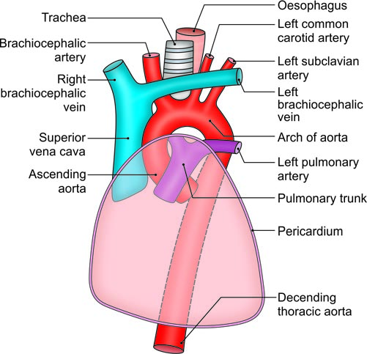
Arrangement of the large structures in the superior mediastinum. Note the relationship of superior vena cava, ascending aorta and pulmonary trunk to each other in the middle mediastinum, i.e. within the pericardium. The bronchi are not shown

Slide 6
Inferior Mediastinum
Anterior Mediastinum
Anterior mediastinum is a very narrow space in front of the pericardium.
Middle Mediastinum
Middle mediastinum is occupied by the pericardium and its contents, along with the phrenic nerves and the pericardiacophrenic vessels.

Slide 7
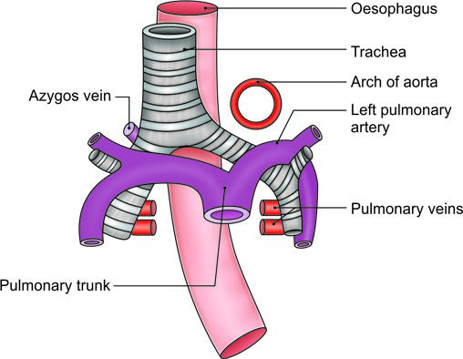
Some structures present in superior, middle and posterior mediastina

Slide 8
Posterior Mediastinum
Contents
Oesophagus
Arteries: Descending thoracic aorta
Veins: (i) Azygos vein, (ii) hemiazygos vein, and (iii) accessory hemiazygos vein.
Nerves: (i) Vagi (ii) splanchnic nerves, greater, lesser and least
Lymph nodes and lymphatics:
Posterior mediastinal lymph nodes lying alongside the aorta.
The thoracic duct.

Slide 9
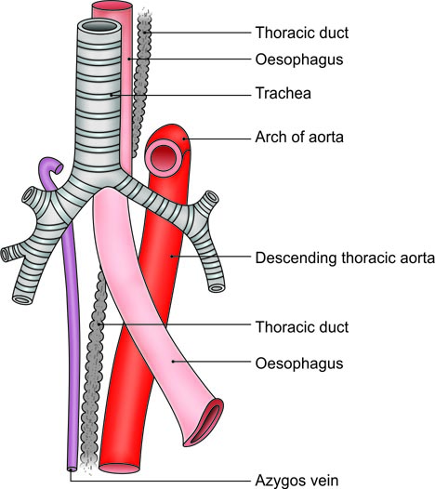
Large vessels in relation to heart

Slide 10
Clinical Anatomy
Mediastinitis result from infections in the neck.
Dead space on the right side.
Mediastinal syndrome.

