Slide 1
Micturition
Dr Reshmy K.R
Professor
Dept. of Physiology
SKHMC

Slide 2
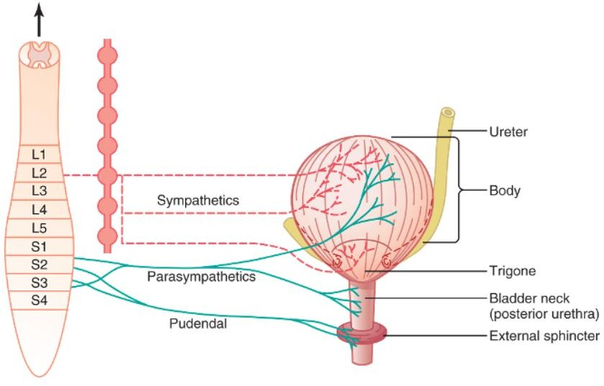
Innervation of the Bladder
The principal nerve supply of the bladder is by way of the pelvic nerves, which connect with the spinal cord through the sacral plexus, mainly connecting with cord segments S2 and S3 Coursing through the pelvic nerves are both sensory nerve fibers and motor nerve fibers.
The sensory fibers detect the degree of stretch in the bladder wall.
Stretch signals from the posterior urethra are especially strong and are mainly responsible for initiating the reflexes that cause bladder emptying.

Slide 3
Innervation of the Bladder
The motor nerves transmitted in the pelvic nerves are parasympathetic fibers.
These terminate on ganglion cells located in the wall of the bladder.
Short postganglionic nerves then innervate the detrusor muscle.
In addition to the pelvic nerves, two other types of innervation are important in bladder function.
Most important are the skeletal motor fibers transmitted through the pudendal nerve to the external bladder sphincter.

Slide 4
Innervation of the Bladder
These are somatic nerve fibers that innervate and control the voluntary skeletal muscle of the sphincter.
Also, the bladder receives sympathetic innervation from the sympathetic chain through the hypogastric nerves, connecting mainly with the L2 segment of the spinal cord.
These sympathetic fibers stimulate mainly the blood vessels and have little to do with bladder contraction. Some sensory nerve fibers also pass by way of the sympathetic nerves and may be important in the sensation of fullness and, in some instances, pain.

Slide 5
Nerve | Afferent supply | Afferent supply | Function
Hypogastric nerve “sympathetic” | It transmit impulses from the pain receptors to the upper lumbar segment. Detect bladder fullness resulting pain sensation from the urethra & bladder.e.g. severe bladder distension & inflammation. | Inhibitory to the bladder wall (detrusor muscle). Motor to the internal urethral sphincter Motor to the seminal vesicle, ejaculatory duct & prostatic musculature. | Stimulate mainly the blood vessels and have little to do with bladder contraction. Sensory nerve fibers of the sympathetic nerves also mediate the sensation of fullness and pain.
Pelvic nerve “Parasympathetic” | Carry input from stretch receptorsin the bladder neck. transmit impulses from the tension & pain receptors in the wall of U.B. to the sacral region of spinal cord. Resulting in both reflex micturition, sensation of bladder fullness and temperature sensation | Motor to the bladder wall(detrusor muscle). Inhibitory to the internalurethral sphincter“ inhibitory = relaxation” | Contraction of bladder The sensory fibers detect the degree of stretch in thebladder wall
Pudendal nerve “Somatic Nerve” | It transmit impulses for the sensation of Distension of the urethra and Passage of urine through the urethra. | Motor to the external urethral sphincter | Fibers that innervate and control the voluntary skeletal muscle of the sphincter
Autonomic Innervation of

Slide 6
Innervation of the Bladder
Sympathetic supply to the bladder cause storage of urine.
Parasympathetic supply leads to the Passage of urine.
 | Parasympathetic | Sympathetic
Nerve | Pelvic nerve | Hypogastric nerve
Origin | LHCs of the S2,S3, S4 | LHCs of the L1,L2, L3.
Supply | Body and neck of the bladder | Bladder neck

Slide 7
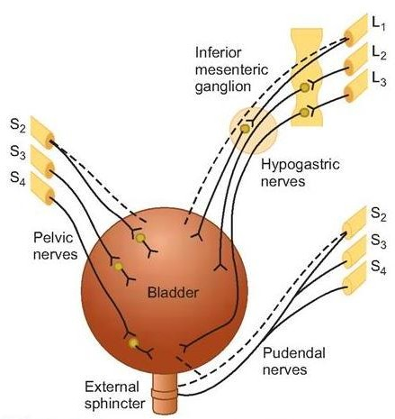
Innervation of the Bladder
The Pudendal nerves--Origin: Anterior horn cells (AHCs) of S2,S3,S4
Its efferent fibers arise as the parasympathetic nerves from the 2nd, 3rd and 4th sacral segments of the spinal cord
They supply and control the activity of the External urethral sphincter

Slide 8
Urinary bladder-function
Urine will enters the urinary bladder without producing much increase in Intravesical pressure till the bladder becomes well-filled.
“The pressure exerted on the contents of the urinary bladder, being the sum of the intraabdominal pressure from outside
The bladder and the detrusor pressure exerted by the bladder wall musculature itself. Also called bladder pressure, vesical pressure”.

Slide 9
Cystometry
Study the relationship between intravesical volume and pressure.
Done by inserting catheter and emptying the bladder, then recording the pressure while bladder filled at 50 ml increment of water.
The plot of I.V.P. against the volume is called “Cystometrogram”.

Slide 10
Cystometrogram
Assess how your bladder and sphincter behave while you store urine and when you pass urine.
This test is done for people with urinary incontinence, people who have difficulty with urination, and in people with neurologic diseases that can affect bladder function.
This test will measure your bladder capacity and pressure.
By doing this we can identify problems such as a small capacity bladder, overactive bladder or high pressure bladder.

Slide 11
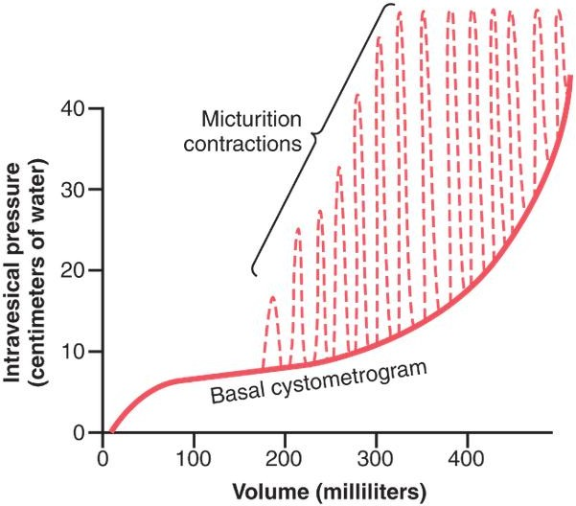
Approximate changes in intravesicular pressure as the bladder fills with urine
When there is no urine in the bladder, the intravesicular pressure is about 0, but by the time 30 to 50 milliliters of urine have collected, the pressure rises to 5 to 10 centimeters of water.
Additional urine—200 to 300 milliliters—can collect with only a small additional rise in pressure; this constant level of pressure is caused by intrinsic tone of the bladder wall itself.
Beyond 300 to 400 milliliters, collection of more urine in the bladder causes the pressure to rise rapidly.
Superimposed on the tonic pressure changes during filling of the bladder are periodic acute increases in pressure that last from a few seconds to more than a minute.
The pressure peaks may rise only a few centimeters of water or may rise to more than 100 centimeters of water.
These pressure peaks are called micturition waves in the cystometrogram and are caused by the micturition reflex

Slide 12
Cystometrogram
Graph that studies the relation between the pressure and urine volume, in order to study these 2 factors we should first empty the bladder and then in the lab they put 2 catheters.
The 1st catheter fills the bladder gradually and the other one measures the pressure , as they increase the volume of urine the pressure increases.
When the volume reaches to 50 ml the pressure increases to be 5 but they noticed that when the volume contuses increasing between 100 to 200 ml the pressure remains constant this is due to the bladder has feature called “receptive relaxation “
i.e. : as it receives more urine it dilate more and more so the pressure remains constant and this dilation is due to presence of transitional epithelium “ this called Laplace law .
The pressure will remain constant within limit but when it reaches 400 ml any further increase will increase the pressure and it won’t be constant anymore.

Slide 13
Stage I
Represent initial rise in I.V.P. (when the first increment in volume are produced ) by about 10 cm H2O when the first volume is produced by about 50 ml.
Stage II
It is a long, nearly flat segment produced by further  in filling up to nearly 150 ml.
Stage III
A sudden, sharp rise in pressure as the micturition reflex is triggere(sense of fullness and urge to void )
This segment is produced by further increment of volume(150 – 400 ml)

Slide 14
The flatness of segment II is a manifestation of the Laplace Law which states that the pressure in the spherical viscus equal to twice the wall tension divided the radius { P = 2T / r }.

Slide 15
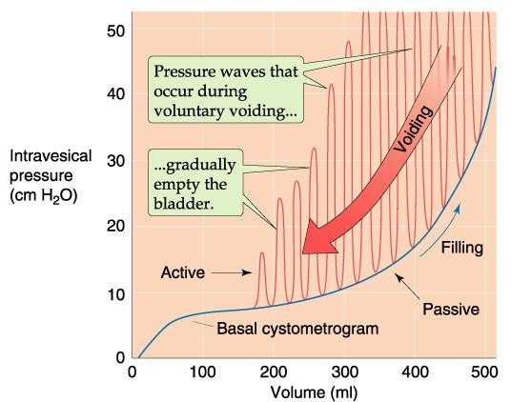
The tension on the wall increases as the volume increases & also the Radius increases, so there is little change in pressure until the organ is filled. (  tension =  Volume =  Radius )
Any increase in volume after this will NOT be accommodated & is reflected by rapid rise of pressure.
Superimposed on this curve, periodic acute increase in pressure which lasts very few seconds, & called “micturition waves” & are caused by micturition reflex.

Slide 16
Sensations from the U.B at different urine volumes
Stage 1 : U.V 150-300 ml 1ST urge to void urine
Stage 2 : U.V 300-400 ml sense of fullness of U.B
Stage 3 : U.V 400-600 ml sense of discomfort
Stage 4 : U.V 600-700 ml sense of pain
Break point : U.V 700 ml micturition can’t be suppressed
Micturition reflexes start to appear at this stage.
Sometimes when you don’t want to urinate and your bladder is extremely filled it will inhibit the pudendal nerve which result in opening of external sphincter .

Slide 17
The flatness of segment Ib is a manifestation of the Laplace Law which states that the pressure in the spherical viscus equal to twice the wall tension divided the radius { P = 2T / r }.
At the stages from ( 1 to 4 )Micturition reflexes can be voluntarily suppressed.

Slide 18
Control of micturition
It is a complete autonomic spinal reflex to get urine outside the body, that is facilitated or inhibited by higher brain centers.
Infants as they born they don’t have this control they develop control after 2 years that’s why moms always need to change their diapers .

Slide 19
Micturition
Unconditioned (Automatic)
Conditioned(Voluntary)
In Infants
In infants --urination occurs through a series of spinal reflexes called “the micturition reflexes” which are automatic (not under voluntary control) because the nerve tracts are not yet myelinated in infants.
The stimulus that initiates these reflexes is rise of the IVP (which stimulates stretch receptors in the bladder wall)
In adult
In adults -- the act of micturition occurs also through the micturition reflexes, but however, it can be voluntarily controlled by certain higher (or supra-spinal) centers in the brain, which include the following:
Facilitatory
-In pontine area.
-Posterior hypothalamus.
-Other cortical centers
Inhibitory
- In the midbrain

Slide 20
The micturition reflexes
Distention of the U.B. (as a result of  I.V.P. & not by an  in the bladder volume) produces reflex contraction of its wall & relaxation of the internal urethral sphincter & external urethral sphincter.
The flow of urine in urethra will produce contraction of the U.B. wall & relaxation of both internal & external urethral sphincters.
Higher Centers Control Micturition :
1)Cerebral cortex:
Motor cortex exerts a voluntary control of micturition either stimulation or inhibition.
2)Hypothalamus:
There is facilitatory area in the hypothalamus.
3)Midbrain: Inhibition.
4)Pons: Facilitation

Slide 21
Mechanism of voluntary control of micturition
Filling of the bladder beyond 300 -400 ml
Stretching of sensory stretch receptors
These sensory signals stimulate sacral segmentwhich is consciously appreciated by higher centers

Slide 22
Condition is Favorable- The cortical centers facilitate micturition by discharging signals that leads to:
Stimulation (+) of sacral micturition center.
Inhibition (-) of pudendal nerves
relaxation of external urethral sphincter.
Contraction of anterior abdominal muscle & diaphragm to increase intra-abdominal pressure
the intra-vesical pressure is increased.This intensifies the micturition reflex.
RESULTS IN :
Intensifies the micturition reflex
Condition is Unfavorable
Higher centers will inhibit the micturition reflex
Inhibition (-) of sacral micturition center
Stimulation (+) of pudendal nerves
Contraction of external urethral sphincter
RESULTS IN :
Inhibit the micturition reflex - No urination

Slide 23
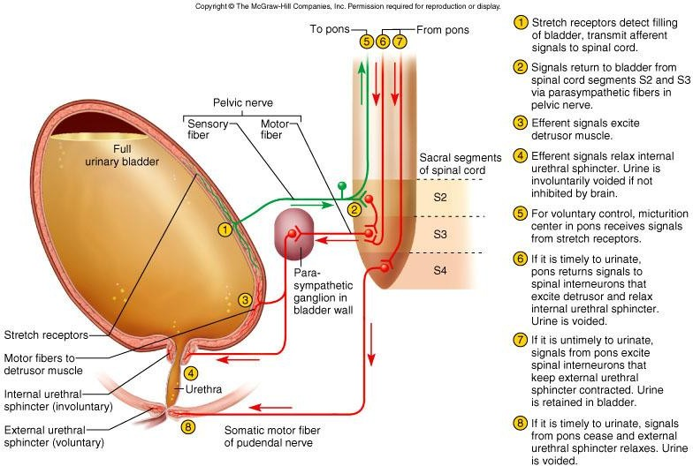
Mechanism of voluntary control of micturition
1)APs generated by stretch receptors
2)reflex arc generates APs that
3)stimulate smooth muscle lining bladder
4)relax internal urethral sphincter (IUS)
5)stretch receptors also send APs to Pons
6)if it is o.k. to urinate
–APs from Pons excite smooth muscle of bladder and relax IUS
–relax external urethral sphincter
7)if not o.k. :
–APs from Pons keep external urethral sphincter contracted

Slide 24
As the impulses flow through the afferent part of pelvic nerve other impulses travel to pons in the brain.
If you want to urinate, pons will stimulate parasympathetic and inhibit pudendal nerve to open external sphincter. in the other hand,
If you don’t want to urinate pons will inhibit parasympathetic and stimulate pudendal nerve .

Slide 25
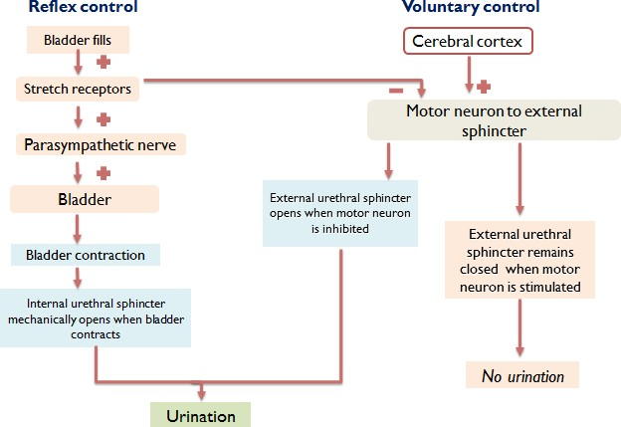
Reflex & voluntary control of micturition

Slide 26
Disturbances (Abnormalities) of Micturition
Denervation of the afferent supply only suchas in :Tabes Dorsalis (tabetic bladder)
Loss of the U.B sensations and reflexmicturition
Some intrinsic responses of the smoothmuscle are retained
The bladder becomes distended, thin walled & hypotonic(atonic bladder)
There is retention with overflow. i.e. dribbling of urine when the bladder becomes over filled.
Denervation of both afferent and efferent nerve supply such as intumor or injury to cauda equina
Abolished (canceled ) reflexes
Increase in the intrinsic responses of the smooth muscles
Hypertonic bladder due to denervation hypersensitivity because : à Decreased degradation of Ach by process of reuptake. à Decreased cholinesterase in the tissue à Increased number of cholinergic receptors
This condition is associated with uncontrolled periodic micturition about 25 – 100 ml at a time

Slide 27
Disturbances (Abnormalities) of Micturition
Tabes dorsalis is a late manifestation of untreated syphilis and is characterized by a triad of clinical symptoms namely gait unsteadiness, lightning pains and urinary incontinence.
It occurs due to a slow and progressive degeneration of nerve cells and fibers in spinal cord.
It is one of the forms of tertiary syphilis or neurosyphilis.

Slide 28
 | ABNORMALITIES OF MICTURITION
 | ATONIC BLADDER | AUTOMATIC BLADDER
Lesion | Sensory nerve fibers from the bladder to the spinal cord are destroyed Crush injury to the sacral region of the spinal cord and tabes dorsalis | Spinal Cord Damage Above the Sacral Region resulting in Spinal shock
Feature | Bladder fills to capacity and overflows a few drops at a time through the urethra. This is called overflow incontinence. | return of excitability of micturition reflex until typical micturition reflexes returns & then, periodic (but unannounced) bladder emptying occurs which may be controlled by scratching or tickling

Slide 29
THANK YOU
https://teachmephysiology.com/urinary-system/micturition/storage-phase/
https://www.toppr.com/guides/biology/excretory-products/micturition/

