Slide 1
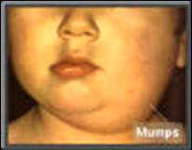
MUMPS
DR.T.AJAYAN
PROF. & H.O.D
PRACTICE OF MEDICINE

Slide 2
DEFINITION
An acute ,systemic, communicable viral infection .
Most distinctive feature is swelling of one or both parotid glands.
Involvement of other salivary glands, meninges,pancreas and gonads is also common.

Slide 3
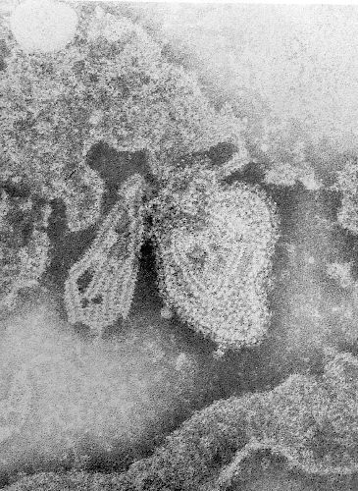
Etiologic agent
Paramyxo virus

Slide 4
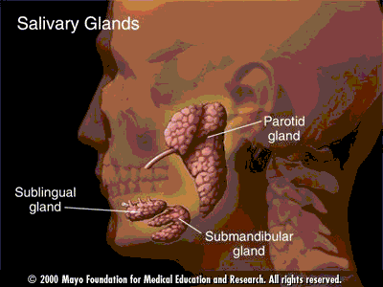
Salivary glands

Slide 5
Epidemiology
Reservoir Human Asymptomatic infections may transmit
Transmission Respiratory drop nuclei
Temporal pattern Peak in late winter and spring

Slide 6
Communicability Three days before to four days after onset of active disease
Commonly seen in children
Source of infection is saliva

Slide 7
Clinical features
Prodromal symptoms- fever
malaise
myalgia
anorexia
I.P. – 14- 21 days.(average-18 days

Slide 8
Parotitis:
Parotid tenderness
Pain near angle of mandible
Obliteration of space between earlobe and angle of mandible.

Slide 9
Patient frequently complains- earache, difficulty to eat, swallow or talk.
At times only one side is affected.
Distoration of face.
Swelling increases for few days and gradually subsides disappearing in one week

Slide 10
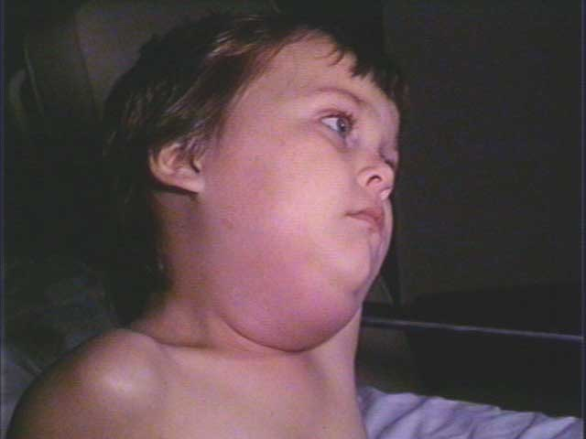

Slide 11
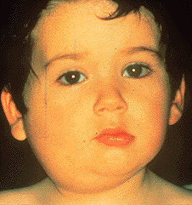

Slide 12
Complications
Common
Meningitis – 5-15% of cases
Orchitis – 20%-30% of cases in post-pubertal males (rarely sterility)
Oophoritis, mastitis

Slide 13
Uncommon
Pancreatitis
Encephalitis
Deafness
Death

Slide 14
Prognosis
Rarely exceeds 2 weeks.

Slide 15
Lab Diagnosis
Blood:-Relative lymphocytosis
S.amylase- elevated.
CSF:- Lymphocytic pleocytosis- meningitis

Slide 16
Diagnosis:-confirmed by
Isolation of virus from saliva or CSF or demonstrating a fourfold rise in compliment fixing antibodies in paired sera.

Slide 17
MANAGEMENT
GENERAL:-
Isolation until swelling subsides .
Bed rest –Febrile period.

Slide 18
Management of Complications
Meningitis :-Purely symptomatic
Encephelitis :- Attention to cerebral oedema,airway and vital functions.

Slide 19
Orchitis :- Scrotum- suspended in a suspensory or toweling bridge and ice bags are applied.
Pancreatitis:- Symptomatic treatment.

Slide 20
HOMOEOPATHIC MANAGEMENT
BELL
PULS
MERC
PILOCARPUS/JABORANDI
RHUS TOX

Slide 21
PREVENTION AND CONTROL
Mumps live virus vaccine – safe and highly effective.
Routine immunization –
MMR or alone .

Slide 22
Should not be given in
Pregnant woman
Patient receiving glucocorticoids.
Immunocompromised individuals.

Slide 23
THANK YOU

