Slide 1
MYCOBACTERIUM
Dr. R.S. Gopika M.D. (Hom.)
Professor & Head
Department of Pathology

Slide 2
MYCOBACTERIUM TUBERCULOSIS
Tubercle bacilli / Koch’s bacilli
rod shaped,
non spore forming,
Slow-growing -generation time of 12 to 18 hours
3 X .5 micro.m,
In pairs ,clumps.

Slide 3
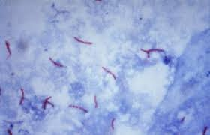
Mycobacterium tuberculosis Ziehl Neelsons staining

Slide 4
Facultative intracellular pathogens
usually infecting mononuclear phagocytes
tend to clump together
they are impermeable to the usual stains
once stained, the bacilli cannot be decolorized by acid alcohol
Acid fastness is due to organism's high content of mycolic acid, long-chain cross linking fatty acids, and other lipids

Slide 5
Culture
obligate aerobes
optimum temperature- 37 ºC
pH- 6.4-7, CO₂- 5 -10 %
Colonies appear in 2 weeks

Slide 6
Liquid medias
Dubo’s medium
virulent type- long serpentine cords
avirulent type- dispersed
Solid medias
L J media
Middle brook’s media

Slide 7
Middlebrook's medium
Media is clear, thus allows easier colony observation and quantification
Available as plate or slant
Incubate medium in a 5-10% CO₂ atmosphere at 35 +/- 2ºC., for up to eight weeks.
Cultures should be read within 5–7 days after inoculation and once a week thereafter for up to 8 weeks.

Slide 8
Middlebrook's medium
Turbidity in the bottom layer of the medium or throughout the tube indicates growth

Slide 9
Lowenstein-Jensen medium
-is an egg based medium.
It takes 6-8 weeks to get visual colonies
Colonies are non-pigmented, dry, rough, raised, irregular with wrinkled surface
creamy white initially, becoming yellowish or buff colored on further incubation
Rough,tough and buff

Slide 10
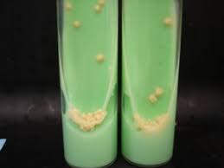
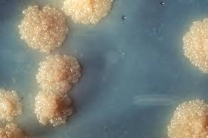
Colonies on Lowenstein-Jensen medium

Slide 11
Resistence
milk –pasturization
60 ºC in 15- 20 min
80% ethanol, glutraldehyde, formaldehyde –2-10 min
sputum-20-30 hrs
droplet- 8-10 days

Slide 12
Antigenic structure
Cell wall antigens-
insoluble Ag, acid fastness, attachment
Cytoplasmic antigens
soluble Ag , Ag-5,6,60, serodiagnosis

Slide 13
VIRULENCE
Due to mycoside –
toxic to macrophages
Sulphatides- inhibits phagosome lysosome
fusion,-intracellular survival-
tissue destruction.

Slide 14
PATHOGENESIS
Source of infection :
- Human
- Bovine
Mode of transmission- :
- inhalation of droplet
- ingestion
- inoculation

Slide 15
PATHOGENESIS OF TB
Pulmonary TB
Extrapulmonary TB
Pulmonary tuberculosis
2 forms
Primary TB / invasive LN involvement
Post primary TB [sec. TB]

Slide 16
PATHOGENESIS
AFB that reach alveoli ingested by activated macrophages.
If the bacilli are not killed, they multiply, lyse the macrophages spread to non activated monocytes.
transport bacilli to regional lymph nodes
disseminated throughout the body

Slide 17
Events following entry of bacilli
Stage1:
Phagocytosis of M.Tb by Alveolar macrophage Destruction of M.Tb ,but some evade destruction & continue to multiply inside them & infect other macrophages
Stage 2:
Influx of PMN’s ,recruitment of Monocytes, differentiate into Macrophage ,but fail to eliminate completely
Logarithmic growth of bacilli, little tissue destruction

Slide 18
Stage 3:
Ag specific T-cells are recruited to the site that activate monocytoid cells & differentiate into two types of Giant cells -Epithelioid, langhans’ giant cell
Walling off infection from rest of the body & prevent dissemination of bacilli.
Stage 4:
Stage of Latency (Granuloma) disrupts under conditions of failing immune surveillance & leads to Endogenous re activation of dormant foci
Characterised by Caseation necrosis

Slide 19
Tubercle
Hard tubercle :
intitial stage ,central zone activated macrophages,perpheral zone of L,Fibroblast
Soft tubercle:
central caseous necrosis.

Slide 20
PRIMARY INFECTION
Child hood TB
inhaled bacilli
Ghons lesion

Slide 21
Droplets alveolar spaces.
If the defense system fails to eliminate the infection
bacilli proliferate inside alveolar macrophages
and kill the cells
infected macrophages produce cytokines and CK attract – m,n,alveolar macrophages
nodular granulomatous structure called the tubercle

Slide 22
If the bacterial replication is not controlled
the tubercle enlarges
the bacilli enter local draining lymph nodes.
lymphadenopathy, a characteristic clinical manifestation of primary tuberculosis (TB).
The lesion produced by the expansion of the tubercle into the lung parenchyma and lymph node - Ghons complex.
Bacteremia may accompany initial infection.

Slide 23
Primary pulmonary infection
initial infection with TB
middle or lower lung zones
2 type of host response
a) Macrophage activated response
IFNγ – activates macrophages- tubercle
b) Tissue damage response - due to delayed
hypersensitivity
granulomatous inflammation, caseous necrosis, spread .

Slide 24
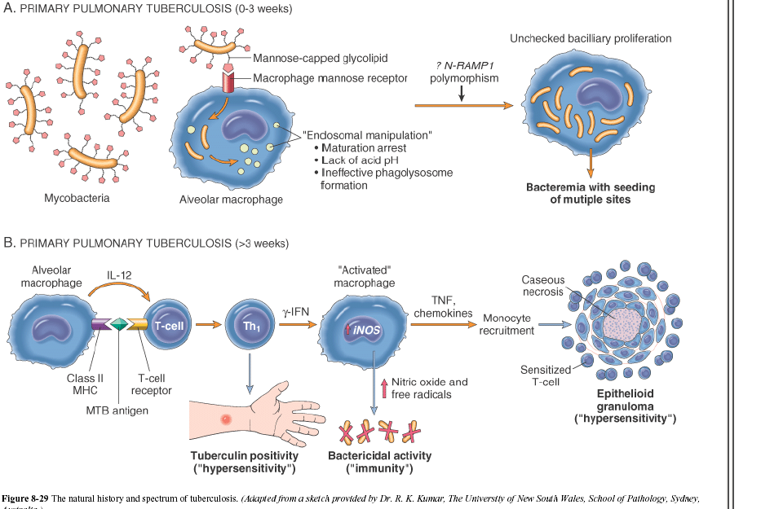

Slide 25
GHONS LESION
Time of development - 8-10 weeks
Rounded, 0.5-2cm dia.
Grey white inflammatory consolidation, center caseous necrosis
It heals by- fibrosis, calcification, ossification
a fibrosus capsule developed around it.

Slide 26
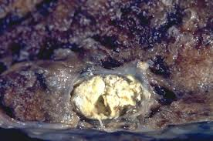
GHONS LESION

Slide 27
Ranke complex
Ghons complex after undergoing progressive fibrosis produces radiologically detectable calcification called as Ranke complex

Slide 28
Fate of primary pul TB
Fibrosis, calcification
Progressive primary TB
Primary millary TB
Progressive secondary TB

Slide 29
Spread of Primary complex ie
Progressive Primary TB
3 routes of spread
Bronchogenic spread
Haematogenous spread
Spread along mucous &serous surface
Extra pulmonary Primary TB
Abdominal organs-ulcers in s.intestine & enlarged mesentric LN
Tonsils-with enlarged cervical LN

Slide 30
Secondary tuberculosis
Seen in older children & adults
Due to reinfection or reactivation of healed
primary focus
Initial lesion is small patch of broncho pneumonia heals by fibrosis in sub apical
scar→ formation of TB cavity.

Slide 31
Secondary tuberculosis
The initial lesion is the apical nodule
presents as a uni- or bilateral, small-sized (max. 3 cm),
yellow-grey, low consistency (caseous necrosis) solid nodular mass.
After treatment, the apical nodule cures by fibrosis and calcification

Slide 32
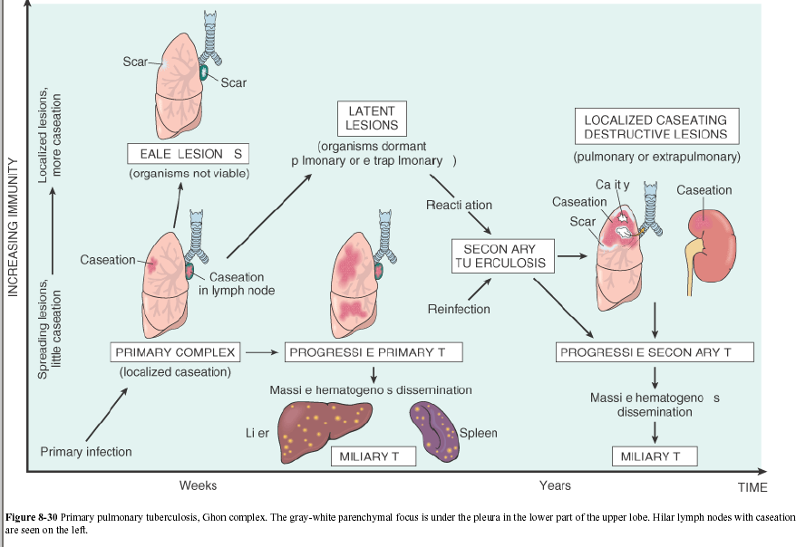

Slide 33
Left untreated, chronic lesions evolve accompanied by an intense process of perilesional and pleural fibrosis.
Leading to secondary progressive tuberculosis which includes
-Apical cavitary fibrocaseous tuberculosis
- Advanced cavitary fibrocaseous tuberculosis
- Tuberculous bronchopneumonia
- Milliary tuberculosis
- Caseous pneumonia

Slide 34
Apical cavitary/open fibrocaseous TB
occurs by the draining of the apical nodule through the bronchial wall resulting thin multiple cavities, lined with caseous debris .
thicker walls, perilesional fibrosis and smooth internal surface.

Slide 35
Advanced cavitary fibrocaseous tuberculosis
presents large lesions extended to one or more pulmonary lobes.
large areas of caseous necrosis, multiple chronic cavities, fibrosis and thickened pleura with multiple adhesions.

Slide 36
Tuberculous bronchopneumonia
occurs as an acute complication of secondary tuberculosis
patchy circumscribed condensated foci with a diameter of 0.5-1 cm,
white to yellowish, centered by a bronchi, separated by normal lung parenchyma (polycyclic tubercles)

Slide 37
Milliary tuberculosis
appears by
-lymphatic dissemination exclusively in lung, - blood dissemination
resulting in systemic Milliary tuberculosis, affecting the spine, spleen, liver, adrenal.
Lesions are small (1- to 2-mm)

Slide 38
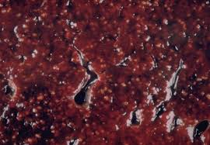
Milliary TB

Slide 39
Caseous pneumonia
acute complication of tuberculosis,
presents as a diffuse yellowish area of consolidation accompanied by multiple small sized cavities with irregular walls and caseous debris,
can be identified also in the bronchioles

Slide 40
C/ F Pulmonary TB
Primary disease:
The initial infection is frequently located in the middle and lower lobes.
The primary lesion usually heals spontaneously, and a calcified nodule (ranke lesion) remains.
Hilar and paratracheal lymphadenopathy are common.
In immunosuppressed pts and children, primary disease may progress rapidly to clinical disease, with cavitation, pleural effusions, and hematogenous dissemination.

Slide 41
Primary TB
Most individuals are asymptomatic or have flu-like symptoms along with fever and chest pain
Around 3 weeks after infection skin test will be positive
Dormant lesions that still contain bacteria

Slide 42
Postprimary :
Usually localized to the apical and posterior segments of the upper lobes and the superior segments of the lower lobes.
Early symptoms of fever, night sweats, weight loss, anorexia, malaise, and weakness.
Cough and purulent sputum production, often with blood streaking,
Occasionally, massive haemoptysis follows erosion of a vessel located in the wall of a cavity.
Disease can be limited, or extensive cavitation may develop.
Extensive disease may cause dyspnoea and respiratory distress.

Slide 43
Extrapulmonary TB
Any site in the body can be involved.
Up to two thirds of HIV-infected pts with TB have extrapulmonary disease.

Slide 44
Lymphadenitis
Painless swelling of cervical and supraclavicular
nodes.
Early nodes are discrete but later matted, can be with a fistulous tract.

Slide 45
Genitourinary
common among women than among men.
frequency and dysuria
Later - Hydronephrosis, Calcifications and ureteral strictures
urinalysis - pyuria and haematuria
culture of three morning urine specimens is diagnostic.
urethral stricture.
Fallopian tube and uterine disease can cause infertility.

Slide 46
CUTANEOUS TB
Lupus vulgaris
reddish brown, well demarcated plaques.
When pressed with glass slide, small translucent nodules are seen [apple jelly]

Slide 47
Scrofuloderma
Skin lesions result from direct extension of underlying TB infection of lymph nodes, bone or joints
Firm, painless lesions that eventually ulcerate with a granular base

Slide 48
TB verrucosa cutis
Occurs after direct inoculation of TB into the skin in someone who has been previously infected with mycobacteria
Presents as a purplish or brownish-red warty growth
Lesions most often occur on the knees, elbows, hands, feet and buttocks

Slide 49
CNS
Meningitis occurs in young children and HIV-sero positive pts.
Cranial nerve involvement (particularly of the ocular nerve) and hydrocephalus, cerebral oedema are common.
The CSF has a high lymphocyte count, an elevated protein level, and a low glucose concentration.
Tuberculoma.

Slide 50
Gastrointestinal TB
affects the terminal ileum and ceacum.
abdominal pain and diarrhea.
A palpable mass and bowel obstruction may
occur.
peritonitis presents with fever, abdominal pain, and ascites

Slide 51
Tuberculous pericarditis
is characterized by an acute or subacute onset of fever, dull retrosternal pain, and sometimes a friction rub.
Effusion is common.
Chronic constrictive pericarditis is a potentially fatal complication.

Slide 52
SKELETAL :
The spine, hips, and knees are the most common sites.
Spinal TB (Pott’s disease) often involves three or more adjacent vertebral bodies; in adults, lower thoracic /upper lumbar vertebrae are usually affected
Disease spreads to adjacent vertebral bodies, destroying the intervertebral disc and causing collapse of vertebral bodies in advanced disease
Paravertebral cold/ psoas abscesses may form.
TB osteomyelitis of long bones-[spine, femur, tibia, fibula]
TB arthritis-monoarticular

Slide 53
Potts spine-pathology
Hameatogenous spread
Infection begins in cancellous area of vertebral body.
Advances & destroys the cortex, intervertebral disc & adjacent vertebrae
Granuloma formation Tissue necrosis & inflammatory response
Progressive bone destruction leads to vertebral collapse, kyphosis & neurological involvement.

Slide 54
Psoas abscess
An abscess originating in tuberculous spondylitis and extending through the iliopsoas muscle to the inguinal region
classical clinical triad - fever, back pain, and limp
pain can radiate to hip and thigh.
Other symptoms are vague abdominal pain, malaise, nausea, and weight loss

Slide 55
LAB DIAGNOSIS
Microscopy
Culture
Serological test-ELISA
Nueclic acid probes
PCR
Tuberculin test [Mantoux]
CSF, Body fluid examination

Slide 56
Tuberculin test
Delayed hypersensitivity
Mantoux /PPD test

Slide 57
Immunologic basis for the tuberculin reaction
The reaction – delayed hypersensitivity reaction.
Reaction in the skin to tuberculin PPD begins when
specialized immune cells-T cells, sensitized by prior infection, are attracted by the immune system to the skin site where they release lymphokines.
Which induce induration (a hard, raised area with clearly defined margins at and around the injection site) through local vasodilation , edema, fibrin deposition, and attraction of other types of inflammatory cells to the area.

Slide 58
The standard recommended tuberculin test is the Mantoux test,
Procedure :
injecting a 0.1 mL of liquid containing 5 TU (tuberculin units) PPD (purified protein derivative) into the top layers of skin of the forearm.
Read taken - 48-72 hours after the injection.
The basis of the reading of the skin test is the presence or absence and the amount of induration (localized swelling)

Slide 59
Features of the reaction include
(1) its delayed course, reaching a peak more than 24 h after injection of the antigen;
(2) indurated
(3) occasional vesiculation and necrosis

Slide 60
+ve reaction-
A discrete, pale elevation of the skin (a wheal) of more than10mm in dia.
A positive tuberculin skin test means that body has come into contact with the TB bacteria at least once, and further testing will be done to make sure about active TB.

Slide 61
Non tuberculous mycobacterias
Nontuberculous mycobacteria (NTM) represent a large group of bacteria that have been isolated from environmental sources.
Mycobacteria other than tuberculosis (MOTT)
Atypical
Environmental
Opportunistic
40% cause diseases in human
Immunosuppressed host

Slide 62
NTM
Water, soil, food and animals
Does not spread from person to another
Relatively resistant to chlorination and ozonization
Outbreak and Pseudo-outbreak in the hospital
HIV and dialysis patients

Slide 63
Pulmonary disease
M. avium complex(MAC)
M. kansasii
M. abscessus
M. xenopi

Slide 64
Skin/soft tissue/bone/joint and tendons
M. marinum
M. fortuitum/peregrinum
M. abscessus/chelonae
M. ulcerans

Slide 65
Mycobacterium kansasii
lung disease have upper lobe fibro-cavitary abnormalities similar to TB
particularly in HIV-infected patients

Slide 66
M. xenopi
pulmonary disease are variable but most often include upper lobe cavitary changes compatible with TB. M

Slide 67
M.marinum
Water ,fish
Lake, bay,ocean,pool,aquarium
1-2 month IP → granulomatous nodular – ulcerative lesions (hands)
Bx for diagnosis

Slide 68
Buruli ulcer /M.ulcerans
Chronic cutanous ulcer
Africa mostly
Debridment

Slide 69
https://commons.wikimedia.org
Robbin’s &Cotran Pathologic Basis Of Disease -8th Edition

