Slide 1
MENINGITIS

Slide 2
Meningitis is an inflammation of the arachnoid membrane, the pia mater, and the intervening cerebrospinal fluid (CSF).
The inflammatory process extends throughout the subarachnoid space around the brain and spinal cord and involves the ventricles.
EPIDEMIOLOGY
The incidence of bacterial meningitis has dropped dramatically in developed countries since the introduction of vaccines against bacterial pathogens.
Worldwide, bacterial meningitis remains a major cause of mortality and morbidity.
Although all human microbes have the potential to cause meningitis, only a few organisms account for most cases of bacterial meningitis.

Slide 3
Haemophilus influenzae affects primarily children,whereas Streptococcus pneumonia causes meningitis in adults, especially those older than 50 years with comorbid conditions. Meningococcal meningitis most often occurs in outbreaks.
Listeria monocytogenes is emerging as the most common cause of bacterial meningitis, with peak frequencies in the neonatal period and in persons 60 years of age and older.
Meningococcal disease, including meningitis, may occur sporadically and in cyclic outbreaks.
High-risk groups include individuals who live in close quarters such as crowded classrooms, college dormitories, military barracks, or jails. In children the greatest risk is in the first year of life.

Slide 4
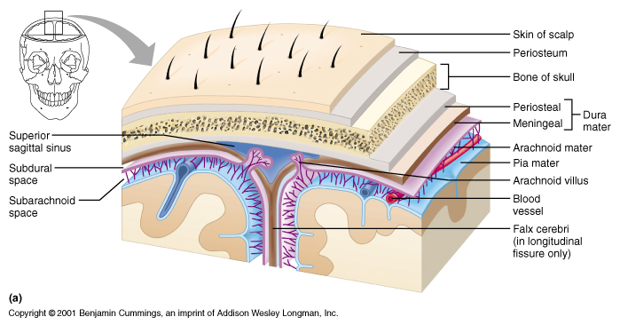

Slide 5
PATHOBIOLOGY
On gross examination, purulent exudate in the subarachnoid space is most abundant in the cisterns at the base of the brain and over the convexities of the rolandic and sylvian sulci, which are expansions of the subarachnoid space.
Although neither the infecting organism nor the inflammatory exudate directly invades cerebral tissue, the subjacent brain becomes congested and edematous.
The effectiveness of the pial barrier generally prevents bacterial meningitis from causing a cerebral abscess; when these two processes coexist, the sequence is usually that an initial abscess leaks its contents into the ventricular system and produces secondary ventriculitis and meningitis.

Slide 6
The inflammatory exudate can extend around the perivascular spaces to adjacent structures, especially the arteries and veins that carry a layer of pia mater and arachnoid membrane as they enter the brain from the cortical surface.
Cortical thrombophlebitis results from venous stasis and adjacent
meningeal inflammation.
Infarction of cerebral tissue may follow.
Rarely, temporal lobe herniation through the tentorium develops in such patients and compresses the midbrain, thereby leading to ipsilateral third nerve palsy and contralateral hemiparesis or cerebellar herniation through the foramen magnum with compression of the medulla, which results in apnea, hemodynamic instability, and coma.

Slide 7
Damage to cranial nerves occurs in areas where dense exudate
accumulates around the nerves; the third and sixth cranial nerves are also vulnerable to damage by increased intracranial pressure. Ventriculitis accompanies most cases of bacterial meningitis and may rarely progress to ventricular empyema.
As the exudates continue to accumulate, obstruction of the flow of CSF may result in hydrocephalus.
Obstruction of the foramina of Magendie and Luschka at the base of the fourth ventricle results in noncommunicating or obstructive hydrocephalus, whereas obstruction at the level of the arachnoid granulations in the venous sinuses results in communicating hydrocephalus.

Slide 8
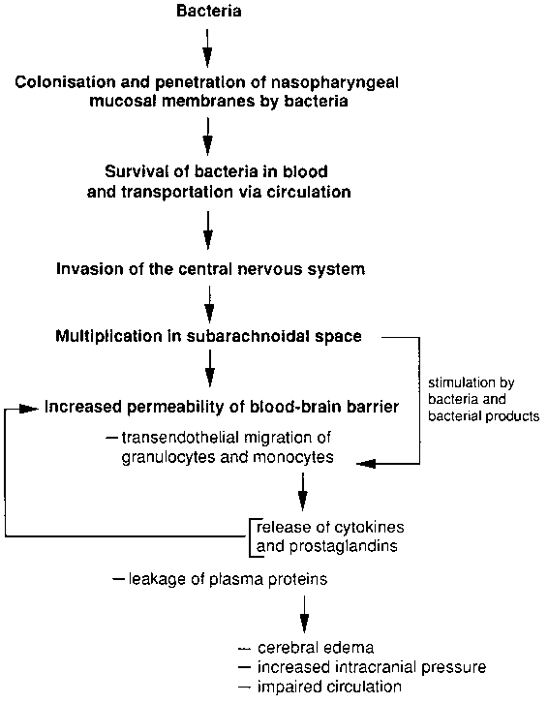
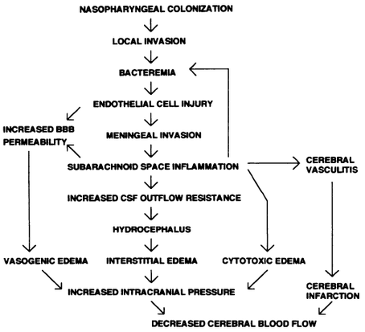

Slide 9
Pathogenesis
Bacteria may gain access to the meninges by several routes:
Hematogenous spread from a distant site,
direct ingress from the upper respiratory tract or skin through an anatomic defect (e.g., skull fracture, meningocele,sequela of surgery),
passage intracranially through venules in the nasopharynx,
or
(4) spread from a contiguous focus of infection (infection of the paranasal sinuses, leakage of a brain abscess).
Pathogens gain access to the blood stream, their intravascular survival is aided by the presence of polysaccharide capsules that inhibit phagocytosis

Slide 10
Bacteria also may travel along nerve tracts to invade the brain.
For example, L. monocytogenes invades the intestine, and animal models suggest that these bacteria can travel along the vagus nerve to the brain stem, from where they also may invade the meninges in the posterior fossa.
The mechanism by which bacteria gain access to the subarachnoid spaces from blood appears to be related to specific adhesion molecules on brain endothelial cells.
Once established in any part of the meninges, infection quickly extends throughout the subarachnoid space.
Bacterial replication proceeds relatively unhindered because the low CSF levels of immunoglobulin and complement early in meningeal inflammation result in minimal or no opsonic or bactericidal activity and because surface phagocytosis of unopsonized organisms is meager in such a fluid environment.

Slide 11
During meningitis, the concentrations of immunoglobulins in CSF increase but still remain relatively low.
Secondary bacteremia may follow meningeal infection and may itself contribute to continuing further inoculation of CSF.
Bacterial meningitis following head trauma occurs because of a dural fistula from the nasal cavity, paranasal sinuses, or middle ear to the subarachnoid space.
The most frequent site is at the cribriform plate, where the bone is thin and the dura is tightly adherent to the bone.
Leakage of CSF results in CSF rhinorrhea and loss of smell.

Slide 12
Bacterial components are major elicitors of meningeal inflammation by causing release into the subarachnoid space of various proinflammatory cytokines such as interleukin-1 and tumor necrosis factor (TNF) from endothelial and meningeal cells, macrophages, and microglia.
Cytokines appear to enhance the passage of leukocytes by inducing several families of adhesion molecules that interact with the corresponding receptors on leukocytes.
Cytokines also can increase the binding affinity of a leukocyte selectin, leukocyte adhesion molecule, for its endothelial cell receptor and may thereby further contribute to trafficking of neutrophils into the subarachnoid space.

Slide 13
In bacterial meningitis, neutrophils move into the subarachnoid space but are not able to control the bacterial infection because their phagocytic properties are inefficient as a result of a lack of opsonic and bactericidal activity.
Within the subarachnoid space, neutrophils release prostaglandins, matrix metalloproteinases, and free radicals that disrupt the endothelial intercellular tight junctions and the subendothelial basal lamina.
The increased local vascular permeability of the blood-brain barrier may cause cerebral edema, which also can be caused by increased CSF pressure as a result of obstruction of CSF outflow because of interstitial inflammation at the level of the arachnoidal villi.

Slide 14
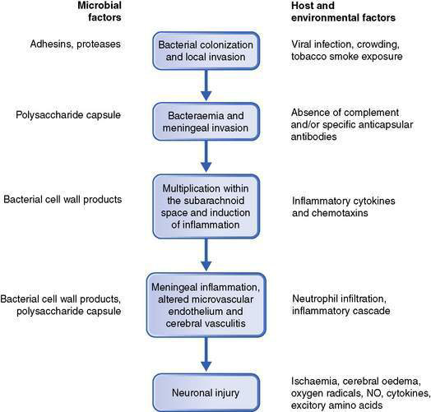
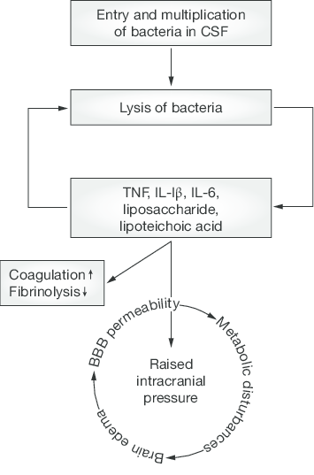

Slide 15
Clinical features
1.The meningitic syndrome
Triad: headache, neck stiffness and fever.
Photophobia and vomiting are often present.
In acute bacterial infection there is usually intense malaise, fever, rigors, severe headache, photophobia and vomiting, developing within hours or minutes.
The patient is irritable and often prefers to lie still.
Neck stiffness and positive Kernig’s sign usually appear within hours.

Slide 16
In uncomplicated meningitis, consciousness remains intact, although anyone with high fever may be delirious.
Progressive drowsiness, lateralizing signs and cranial nerve lesions indicate complications such as venous sinus thrombosis, severe cerebral oedema, hydrocephalus, or an alternative diagnosis such as cerebral abscess or encephalitis.

Slide 17
Specific varieties of meningitis
Acute bacterial meningitis
Onset is typically sudden, with rigors and high fever.
Meningococcal meningitis is often heralded by a petechial or other rash, sometimes sparse.
The meningitis may be part of a generalized meningococcal septicaemia.
Acute septicaemic shock may develop in any bacterial meningitis.
Viral meningitis
This is almost always a benign, self-limiting condition lasting 4–10 days.
Headache may follow for some months.
There are no serious sequelae, unless an encephalitis is present.

Slide 18
General Physical Findings
Evidence of meningeal irritation is usually present, as evidenced by a stiff neck, Kernig sign (inability to straighten the leg when the hip is flexed to 90 degrees), and Brudzinski sign (involuntary flexion of the hip and knee when the neck is passively flexed).
Although the classic triad of fever, stiff neck, and change in mental status is initially present in only 44% of episodes, a combination of two of four symptoms (headache, fever, stiff neck, and altered mental status) is found in 95% of patients.
In elderly patients, neck stiffness may be difficult to evaluate because of osteoarthritis in the neck or stiffness of neck muscles secondary to basal ganglia disorders.
When neck stiffness is caused by meningitis, the neck resists flexion but can be rotated passively from side to side; with cervical spine disease, however, resistance is present in all directions of neck movement. Neck stiffness disappears during coma.

Slide 19
Clinical clues in meningitis
Petechial rashes- meningococcal infections.
Skull Fracture, Ear Diseases, congenital lesions- pneumococcal infections.
Rashes, Pleuritic Pain- Enterovirus
International traval – Malarial
occupational- (water linked)- Leptospirosis
Fulminant meningococcal septicemia may cause hemorrhages within the adrenal glands and result in Waterhouse-Friderichsen syndrome a condition characterized by the sudden onset of a febrile illness, large petechial hemorrhages in the mucous membranes and skin, cardiovascular collapse, and disseminated intravascular coagulation.

Slide 20
Neurologic Findings and Complications
Cranial nerve abnormalities, involving principally the third, fourth, sixth, or seventh nerve and usually disappear shortly after recovery. Persistent sensorineural hearing loss occurs in children with bacterial meningitis, and another have transient conductive hearing loss.
The most likely sites of involvement in patients with persistent sensorineural deafness appear to be the inner ear and the acoustic nerve.
In children, permanent hearing impairment is more common after meningitis caused by S. pneumoniae than by H. influenzae or N. meningitidis.
Seizures- Seizures can occur during the first few days or can appear with associated focal neurologic deficits caused by vascular inflammation some days after onset of the meningitis.

Slide 21
Increased CSF pressure, (brain swelling or hydrocephalus) is associated with seizures, vomiting, sixth and third nerve dysfunction, abnormal reflexes, reduced consciousness or coma, dilated and poorly reactive pupils, and the Cushing response of decerebrate posturing, hypertension, bradycardia, and irregular respirations.
Focal cerebral signs (principally hemiparesis, dysphasia, visual field defects, and gaze preference) occur in community-acquired bacterial meningitis.

Slide 22
Laboratory Tests
Evaluation of a patient with suspected meningitis includes a blood count, blood culture, lumbar puncture followed by careful study and culture of the cerebrospinal fluid, and a chest film.
The fluid must be examined for cell count, glucose, and protein, and a smear stained for bacteria and cultured for pyogenic organisms and for mycobacteria and fungi when indicated.
Polymerase chain reaction (PCR) testing of cerebrospinal fluid has been used to detect bacteria and viruses in patients with meningitis.

