Slide 1
Neuroglia
Dr RESHMY K.R
PROFESSOR
DEPT.OF PHYSIOLOGY
SKHMC

Slide 2
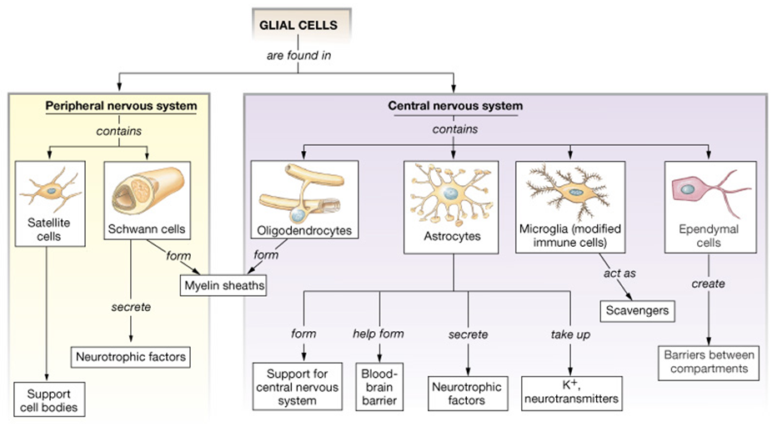

Slide 3
Neuroglia / Glia
Supporting cell of the Nervous system.
Nonexcitable- non neural cells/ glial cells
Number of glial cells is many times greater to the number of neurons
Important role in the reaction of nerve during infection
Constitute the site of tumors in the nervous system

Slide 4
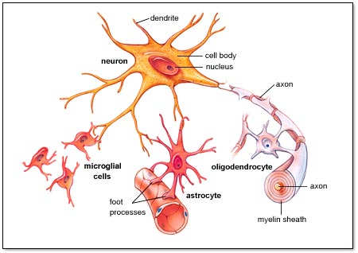
Types of Neuroglial cells
3 types
I. Astrocytes
II.Microglia
III.Oligodendrocytes

Slide 5
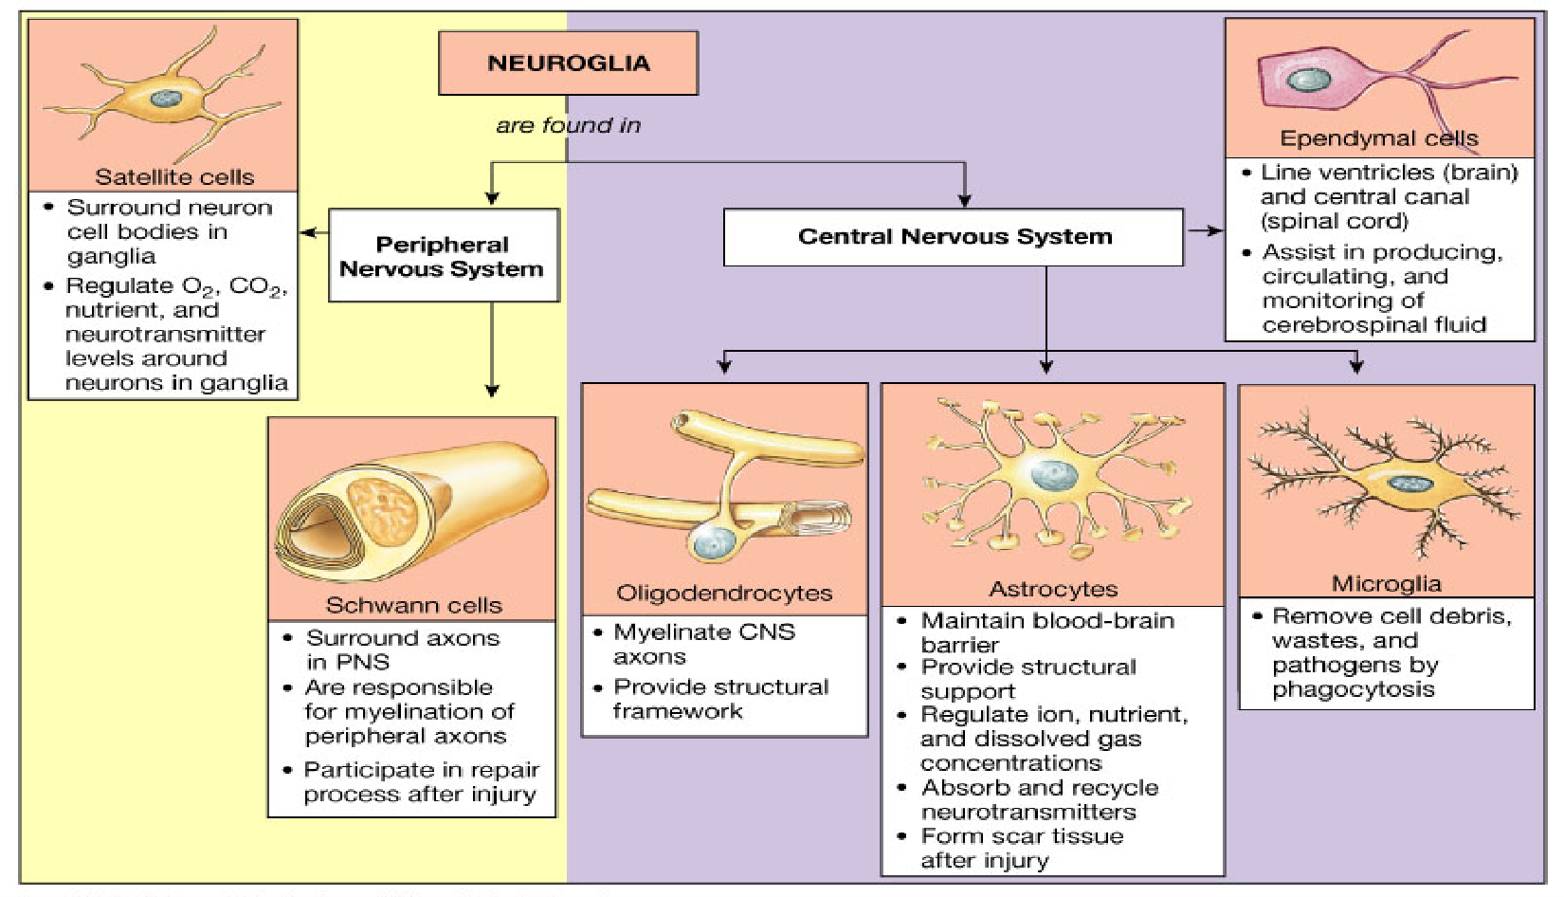
Neuroglia

Slide 6
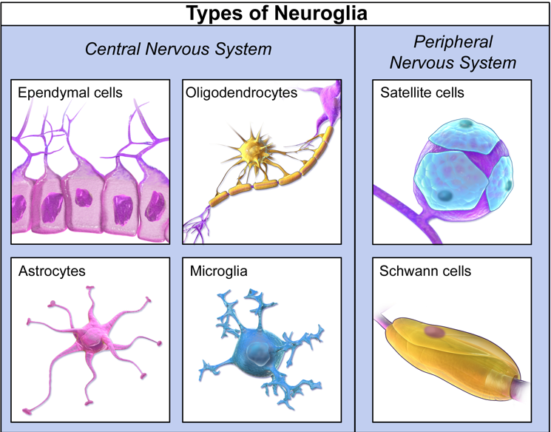

Slide 7
Astrocytes
-Star shaped cells present in all the parts of the brain.
  Found between neurons and blood vessels
  Provide structural support, help regulate nutrients and ions in tissues
  Form scar tissue to fill spaces after CNS injuries

Slide 8
Fibrous Astrocytes
Occupy mainly the white matter
Process of these cells cover the nerve cells and synapses.
Important role in the formation of blood- brain barrier by sending processes to the blood vessels of brain,particully the capillaries, forming tight junction with capillary membrane.
Tight junction in turn forms the blood -brain barrier

Slide 9
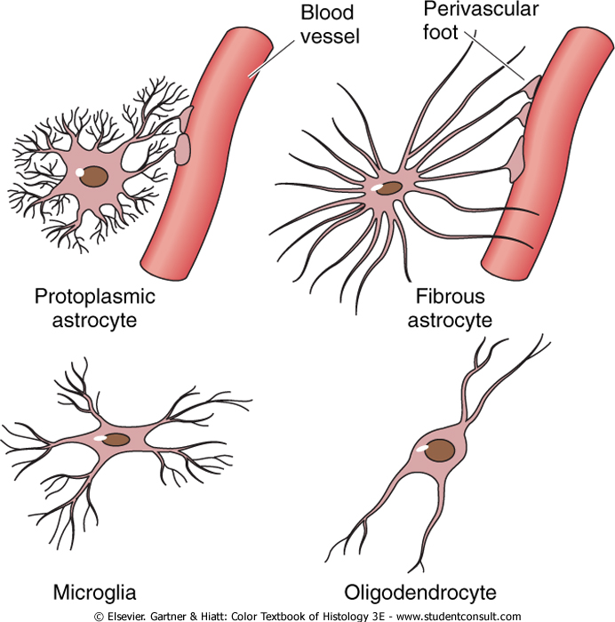
Protoplasmic Astrocytes
present mainly in gray matter
processe of the neuroglia run between the nerve cell bodies.

Slide 10
2.Microglial cells
  -Scattered throughout CNS
  -smaller in size , derived from monocys and enter the tissues of N.S from blood
  Support neurons and phagocytize bacterial cells and cellular debris
  migrate to the site of infection or injury -Macropgages of central N.S

Slide 11
3.Oligodendrocytes
  Occur in rows along nerve fibers
  Provide layers of myelin sheath around axons within brain and spinal cord
  have only few processes which are short
  Schwann cells are absent
  provide support by forming a semi stiff connective tissue between the nerve.

Slide 12
Ependymal cells
  Form epithelial-like membrane in parts of the brain (choroid plexuses)
  Form inner linings that enclose ventricles in the brain and central canal in the spinal cord

Slide 13
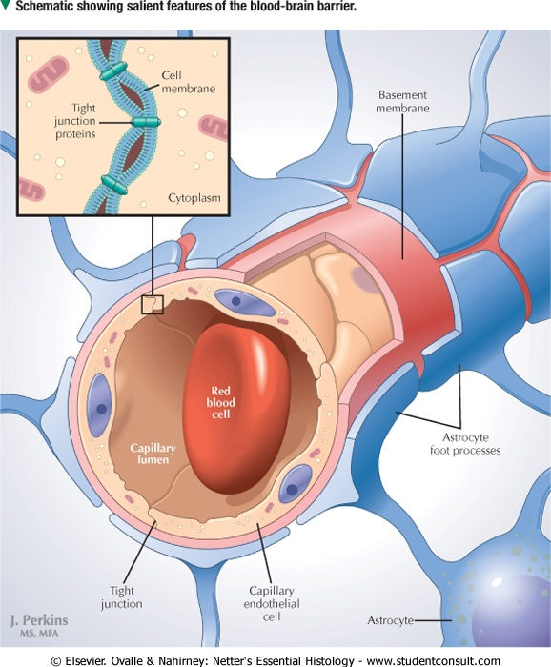
Functions of Neuroglial cells
They twist around the nerve cells and form the supporting network in brain and spinal cord.
Forms the basis of blood -brain barrier
Regulate the entry of substances from blood into brain tissues

Slide 14
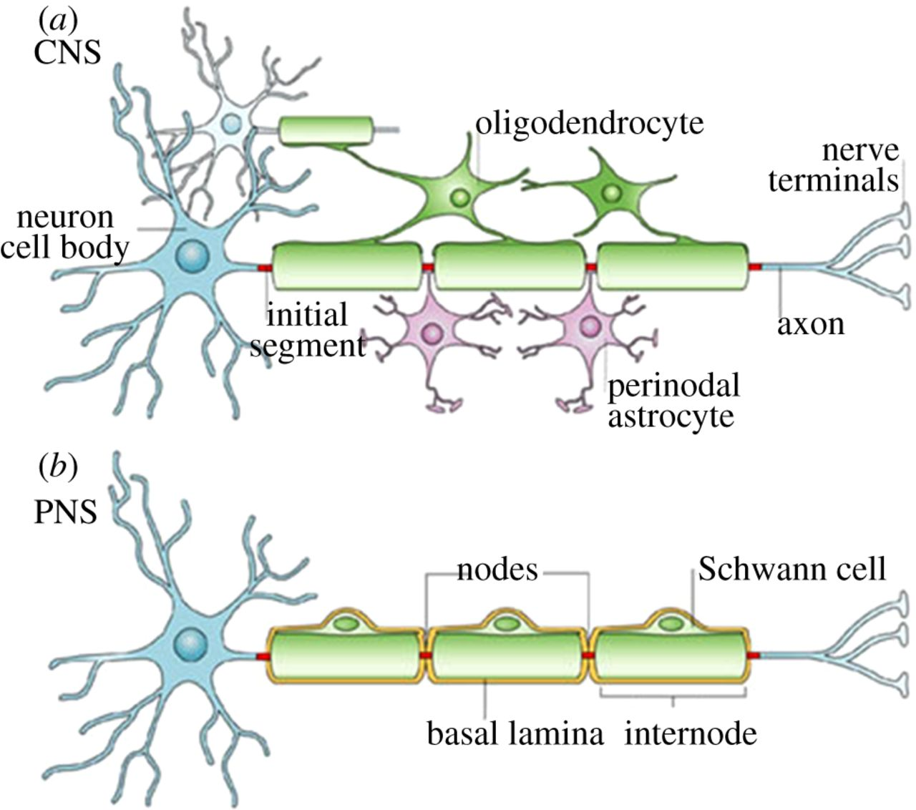
SCHWANN CELLS AND MYELIN SHEATH
Axons in the peripheral nervous system - myelinated or unmyelinated
The myelinated axons are surrounded by a lipid-rich layer called the myelin sheath
The myelin sheath is composed of multiple layers of Schwann cell plasma membrane wrapped concentrically around the axon
Node of Ranvier, devoid of myelin – is junctional zone, where two adjacent Schwann cells meet
Internodal segment – the myelin sheath between two sequential nodes of Ranvier

Slide 15
reference
https://en.wikipedia.org/wiki/Glia
https://ib.bioninja.com.au/options/option-a-neurobiology-and/a1-neural-development/types-of-neuroglia.html
THANK YOU

