Slide 1
OCCUPATIONAL DISEASE
Dr. Reshma Reghu,
Lecturer,
Dept of Community Medicine

Slide 2
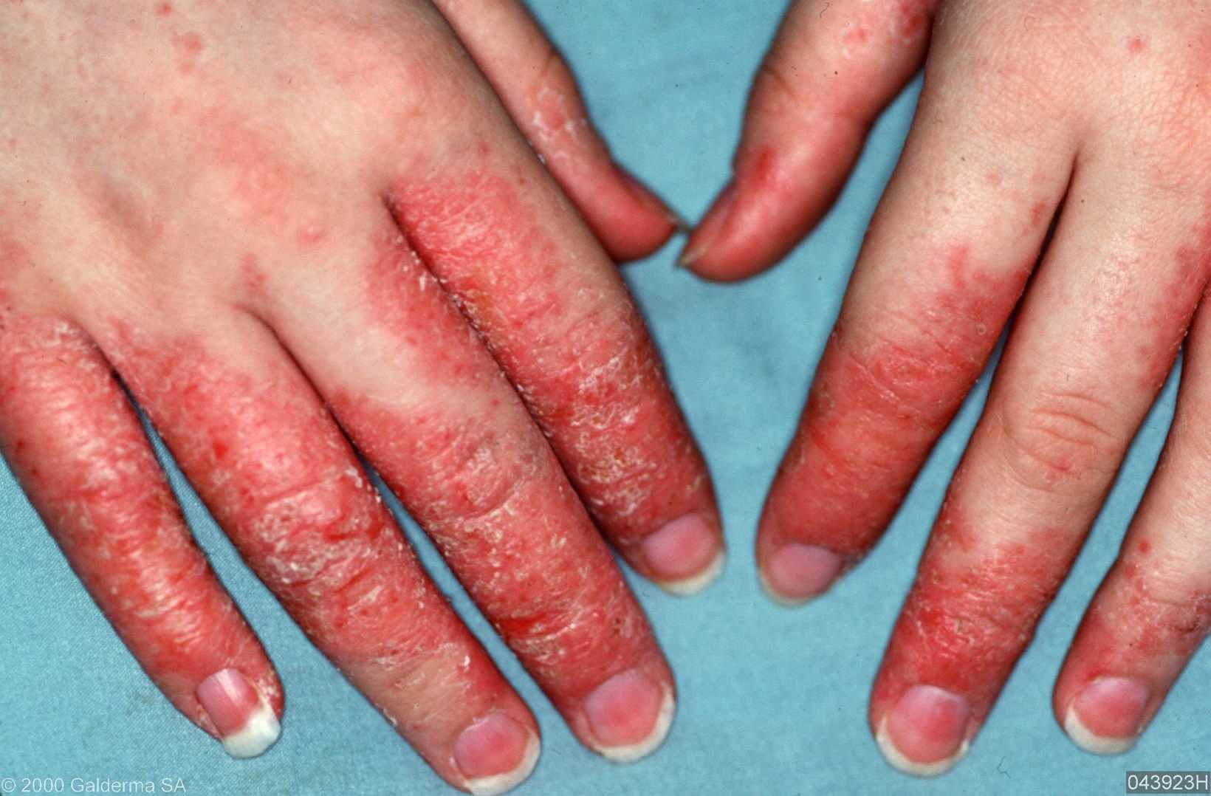
OCCUPATIONAL DERMATITIS
CAUSES
Physical- heat, cold, moisture,
friction, pressure, X-rays etc…
2. Chemical- acids, alkalies, dye,
solvents, grease, tar etc…
3. Biological- bacteria, virus, fungi,
parasites
4. Plant products- leaves, vegetables,
fruits, flowers etc…

Slide 3
AGENTS
Primary Irritants
Sufficient concentration
Long period of time
Sensitizing agents
Sensitization of skin

Slide 4
PREVENTION
PRE-SELECTION
- Medically examined before employment
PROTECTION
Against direct contact
Barrier creams
PERSONAL HYGIENE
- Adequate washing
PERIODIC INSPECTION
-Periodic medical check up

Slide 5
RADIATION HAZARD
X-RAYS
RADIO-ACTIVE SUBSTANCES
UV RAYS
IR RAYS

Slide 6
EFFECTS OF RADIATION
Acute
Burns
Dermatitis
Blood Dyscrasia
Chronic
Malignancies (Lung CA- Uranium mines)
Genetic disorders

Slide 7
PREVENTION
Avoid direct contact, inhalation & swallowing
Shielding of certain thickness to avid exposure
Suitable protective clothing
Monitor the employees not more than 6 months
Adequate ventilation
Replacement & periodic examination
Pregnant women shouldnot be allowed

Slide 8
Occupational Hazards of Agricultural workers
Zoonotic diseases
Anthrax, Leptospirosis, Tetanus, Tuberculosis
Accidents
Agricultural machineries
In India, Snake bite & insect bite are common
Toxic Hazards
Fertilizers, Insecticides, Chemicals
Malnutrition & Parasitic infestation
Physical Hazards
Respiratory diseases

Slide 9
Accidents in Industry
3 million mandays lost yearly in India
To the worker:
Loss of wages
Industry:
Compensation cost
Provision of medical care
Lowered morale
Lowered production

Slide 10
CAUSES
HUMAN- 85%
PHYSICAL
PHYSIOLOGICAL
PSYCHOLOGICAL
ENVIRONMENT- 10 to 20%

Slide 11
HUMAN
PHYSICAL-
decreased capability
PHYSIOLOGICAL
Sex
Age
Time
Experience
Working hours
PSYCHOLOGICAL-
Careless, Inattention, Inexperience

Slide 12
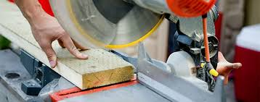
ENVIRONMENT
10 20%
Temperature
Poor illumination
Unsafe machine

Slide 13
PREVENTION
Adequate pre-placement Examination
Adequate job training
Continuing Education
Ensure safe working
Safety department in the organisation
Periodic survey for finding
Careful reporting

Slide 14
SICKNESS ABSENTEEISM
Useful index to assess the state of health workers and their physical, mental & social well being
INCIDENCE
15 – 20% or more in recent years
Rate of absenteeism was reported to be 8- 10 days / head per year

Slide 15
CAUSES
Economic
Social
Medical
Non-occupational

Slide 16
PREVENTION
Good factory management
Adequate pre placement examination
Good human relation
Application of Ergonomics

Slide 17
HEALTH PROBLEMS DUE TO INDUSTRIALIZATION
Environmental Sanitation
Communicable diseases
Food Sanitation
Mental Health
Accidents
Social problems
Morbidity &Mortality

Slide 18
Environmental Sanitation
Housing
Water Pollution
Air Pollution
Sewage disposal

Slide 19
MEASURES FOR WORKERS
NUTRITION
COMMUNICABLE DISEASE CONTROL
ENVIRONMENTAL SANITATION
MENTAL HEALTH
MEASRE FOR WOMEN & CHILDREN
HEALTH EDUCATION
FAMILY PLANNING

Slide 20
ENVIRONMENTAL SANITATION
Water Supply
Food
Toilet
General Plant Cleanliness
Sufficient space
Lighting
Ventilation & Temperature
Protection against hazards
Housing

Slide 21
MENTAL HEALTH
Health & happiness to workers
To detect the signs of emotional stress & signs and to secure the relief of them
Treatment of employees suffering from mental illness
Rehabilitation

Slide 22
MEASURES FOR WOMEN & CHILDREN
Special protection to women workers
Developing embryo is susceptible
Less suited for some work
Tend to feed less
Infant mortality is high

Slide 23
PROTECTION FOR WOMEN WORKERS
Expected mother- maternity leave for 12 weeks (6 weeks- precede the EDD), Maternity benefit under ESI Act 1948
Provision of ante natal, prenatal & post natal services
Prohibit night works & heavy works
Prohibit underground work
Creches in factories > 30 women workers

Slide 24
PREVENTION OF OCCUPATIONAL DISEASE
Medical
Engineering
Legislative

Slide 25
MEDICAL MEASURES
Pre- placement examination
Periodic examination
Medical and health care services
Notification
Supervision & working environment
Maintenance & Analysis of records
Health Education & Counseling

Slide 26
ENGINEERING MEASURES
Design of building
Good House keeping
General ventilation
Mechanization
Substitution
Dusts
Enclosure
Isolation
Local exhaust ventilation
Protective devices
Environmental monitoring
Statistical monitoring
Research

