Slide 1
edema
Dr. R. S. Gopika M.D. (Hom)
Prof. & HoD
Department of Pathology

Slide 2
Definition
Edema is an abnormal accumulation of fluid in the cavities and intercellular spaces of the body.

Slide 3
Oedema
. Primary factors favoring edema are increased capillary hydrostatic pressure (increased venous pressure), decreased osmotic pressure of plasma (hypoproteinemia), decreased tissue tension and lymphatic drainage, increased osmotic pressure of tissue fluids, and increased capillary permeability.
Additional renal and hormonal factors are important.
Clinical manifestations may consist of a steady weight gain or localized or generalized swelling.

Slide 7
Oedema ….cont
Two forces are responsible for maintaining the fluid in specific areas or ‘pulling’ and ‘pushing’ fluid into other areas.
These forces are known as hydrostatic pressure and osmotic pressure.
Hydrostatic pressure is the force that pushes fluid from an area of high pressure to low pressure.
Osmotic pressure is the force that draws fluid from an area of low electrolyte concentration to one of a higher electrolyte concentration.

Slide 9
Other mechanism which influence the movement of fluid with in the body.

Slide 10
Other factors …cont

Slide 11
PATHOPHYSIOLOGY OF EDEMA FORMATION
There are two basic steps involved in edema formation:
An alteration in capillary hemodynamics that favors the movement of fluid from the vascular space into the interstitium.
The retention of dietary or intravenously administered sodium and water by the kidneys

Slide 12
Causes of Edema
Edema will occur under these circumstances :
Increased hydrostatic pressure will push fluid out of the vessels into tissue spaces. This results in edema.
Reduced osmotic pressure within the vessels will not pull fluid from the tissue spaces into the vessel. The fluid accumulates within the tissue space and results in edema.
Fluid retention (water retention) where there is excessive fluid within the blood vessel and tissue spaces. If the body is not able to pass out this excess fluid, it will be retained within the tissue spaces thereby resulting in edema.

Slide 13
Increased vascular permeability is when blood vessel wall allows fluid to pass out of the blood vessel unabated. Fluid from the tissue spaces are not drawn into the blood vessel fast enough and fluid remains in the tissue space thereby resulting in edema.
Lymphatic obstruction is where the lymph vessels are blocked at some point and the interstitial fluid cannot be drained from the tissue spaces. Fluid accumulates in the tissue space and the result is edema.

Slide 14
Increased Hydrostatic Pressure
Impaired venous return
Congestive heart failure
Constrictive pericarditis
Ascites (liver cirrhosis)
Venous obstruction or compression
Thrombosis
External pressure (e.g., mass)
Lower extremity inactivity with prolonged dependency Arteriolar dilation Heat
Neurohumoral dysregulation

Slide 16
Reduced Plasma Osmotic Pressure/ Hypoproteinemia
Protein-losing glomerulopathies (nephrotic syndrome)
Liver cirrhosis (ascites)
Malnutrition
Protein-losing gastroenteropathy

Slide 17
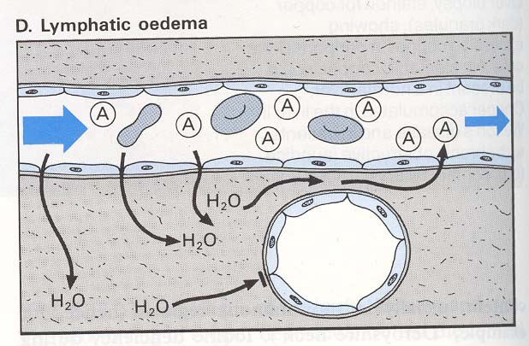
Lymphatic Obstruction
Inflammatory
Neoplastic
Postsurgical
Postirradiation

Slide 18
Sodium Retention
Excessive salt intake with renal insufficiency
Increased tubular reabsorption of sodium
Renal hypoperfusion
Increased renin-angiotensin-aldosterone secretion

Slide 19
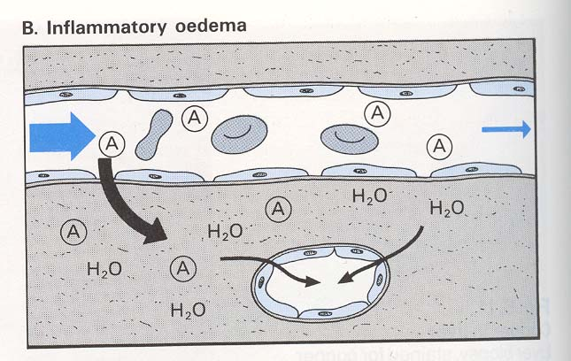
Inflammation
Acute inflammation
Chronic inflammation
Angiogenesis

Slide 20
Pathogenesis
Sequence of events leading to systemic edema due to primary heart failure,
primary renal failure, or
reduced plasma osmotic pressure (as in malnutrition, diminished hepatic protein synthesis, or loss of protein owing to the nephrotic syndrome).

Slide 22
Changes
Microscopical
tissue cells or fibers are seperated
intercellular space widened
fluid is homogenous or granular

Slide 23
Macroscopical
Tissue, organ swollen, boggy, gelatinous
On cutting exude fluid
Loss of elasticity of tissues- pitting

Slide 24
Edema Terminology
There are different medical terms for edema in specific areas or organs of the body.
Anasarca is the term for severe generalized edema.
Ascites is the term for excessive fluid accumulation within the peritoneal cavity. This is the area between the lining of the abdomen and organs within the abdominal cavity.
Pleural effusion is the term for edema in the pleural space between the outer layers of the lung. It is also known as a hydrothorax.

Slide 25
Pericardial effusion is the term for edema within the pericardial space between the outer layers of the heart. It is also known as a hydropericardium.
Pulmonary edema is the term for edema within the lungs.
Cerebral edema is the term for edema within the brain.
Lymphedema is the excessive fluid accumulation within tissues because the tissue fluid cannot be drained by the lymphatic vessels in that area.

Slide 26
Hepatic edema is the term for excessive fluid accumulation in tissues due to a liver dysfunction.
Cardiac edema is the term for excessive fluid accumulation in tissues due to heart failure.
Renal edema is the excessive fluid accumulation in they body’s tissues due to kidney disease or failure.

Slide 27
Morphology
Edema is most easily recognized grossly; microscopically, edema fluid is reflected primarily as a clearing and separation of the extracellular matrix elements with subtle cell swelling.
Although any organ or tissue in the body may be involved, edema is most commonly encountered in subcutaneous tissues, lungs, and brain.

Slide 28
Subcutaneous edema can be diffuse or more prominent in regions with high hydrostatic pressures; the ultimate distribution depends on the underlying etiology.
Even diffuse edema is usually more prominent in certain body areas as a result of the effects of gravity; a gravity-dependent distribution is referred to as dependent edema
Dependent edema is a prominent feature of cardiac failure, particularly of the right ventricle

Slide 29
Finger pressure over significantly edematous subcutaneous tissue displaces the interstitial fluid and leaves a finger-shaped depression, so-called pitting edema.

Slide 30
oedema is most commonly caused by:
Physical inactivity - edema is more prevalent among people who do not exercise at all, and walk very little.
Standing or sitting still for long - if you stand or sit still for a long time there is a much higher chance of swelling.

Slide 31
High altitudes - especially when combined with physical exertion. Acute mountain sickness can lead to high altitude pulmonary edema or high altitude cerebral edema.
Heat - especially when combined with physical exertion. During high temperatures the body is less efficient at removing fluid from tissues, especially around the ankles.
Burns - the skin reacts to a burn by retaining fluid, causing localized swelling

Slide 32
Pregnancy - during pregnancy the woman releases hormones which encourage the body to retain fluids. Pregnant women tend to retain much more sodium and water than women who are not pregnant.
When the woman is resting in a reclined position the enlarged uterus occasionally compresses the inferior vena cava, causing obstruction of both femoral veins, leading to edema
A pregnant woman's blood is hypercoaguble (clots more easily), raising the risk of deep venous thrombosis (DVT), a cause of edema

Slide 33
Menstruation and pre-menstruation - hormone levels fluctuate during the menstrual cycle. During the days before menstrual bleeding there will be a reduction in the levels of the hormone progesterone, which may cause fluid retention.
The contraceptive pill - estrogen can cause fluid retention.
Menopause - around the period of the menopause as well as after it, hormone fluctuations can cause fluid retention.

Slide 34
Malnutrition and/or bad diet -
low consumption of thiamine (vitamin B1), as well as insufficient vitamins B6 and B5 may contribute toward fluid retention.
Low levels of albumin levels may also play a part - low albumin levels can also be caused by kidney disease.

Slide 35
Edema can also be caused by the following diseases:
Kidney disease/damage -
patients with kidney disease may not be able to eliminate enough fluid and sodium from the blood. This results in more pressure on the blood vessels, which causes some of the liquid to leak out.
Kidney disease patients with edema will generally have swelling around their legs and eyes

Slide 36
Renal oedema
Damage to the capillaries in the kidneys (glomeruli) that filter waste and excess fluids from the blood can result in nephrotic syndrome.
Among the many symptoms of nephrotic syndrome is an insufficient level of blood albumin, which leads to edema.

Slide 37
Heart failure
this is when the heart cannot pump blood properly to all parts of the body.
If one or both of the lower chambers of the heart lose the ability to pump blood effectively, the blood can accumulate in the limbs, causing edema

Slide 38
Chronic lung disease -
this includes many lung diseases, such as asthma, chronic bronchitis COPD, emphysema, pulmonary fibrosis and sarcoidosis.
Some patients may experience an accumulation of fluids in the lungs - pulmonary edema.

Slide 39
Liver disease
such as cirrhosis, which causes scarring of the liver. This affects liver function, which causes the secretion of hormones and fluid-regulating chemicals to change.
People with cirrhosis of the liver also have increased pressure within the portal vein
The problems can lead to fluid retention in the legs and ascites (abdominal cavity).

Slide 40
Cardiac edema

Slide 41
Cardiac oedema
Generalised oedema
Starts in most dependent parts

Slide 42
When the heart ceases to meet the requirements of the body for oxygen, the sympathetic-adrenal system is activated.
This occurs in people with a healthy heart when the demands for oxygen are excessive—for example, in heavy muscular work—and in subjects with a failing heart when the demands are normal or small. Eventually, when the heart is unable to meet even the ordinary requirements of everyday life, the sympathetic activity becomes more or less continuous.
It may lessen during rest at night, but with a further failing of the heart its output may become inadequate even in complete rest.

Slide 43
Angioneurotic oedema
Angioedema or Quincke's edema
is the rapid swelling (edema) of the dermis, subcutaneous tissue, mucosa and submucosal tissues. It is very similar to urticaria, but urticaria, commonly known as hives, occurs in the upper dermis.
The term angioneurotic oedema was used for this condition in the belief that there was nervous system involvement but this is now thought not to be the case

Slide 45
Types
Acquired angioedema is usually caused by allergy and occurs together with other allergic symptoms and urticaria. It can also happen as a side-effect to certain medications, particularly ACE inhibitors.
Hereditary angioedema (HAE) - caused by a genetic mutation that is inherited in an autosomal dominant form.

Slide 46
Pathophysiology
Bradykinin plays a critical role in all forms of hereditary angioedema.
This peptide is a potent vasodilator and increases vascular permeability, leading to rapid accumulation of fluid in the interstitium.
This is most obvious in the face, where the skin has relatively little supporting connective tissue, and edema develops easily.
Various mechanisms that interfere with bradykinin production or degradation can lead to angioedema

Slide 47
In hereditary angioedema, bradykinin formation is caused by continuous activation of the complement system due to a deficiency in one of its prime inhibitors, C1-esterase (aka: C1-inhibitor or C1INH), and continuous production of kallikrein.
Consumption of foods which are themselves vasodilators such as alcohol or cinnamon can increase the probability of an angioedema episode in susceptible patients

Slide 48
Pulmonary edema
is fluid accumulation in the lungs.
It leads to impaired gas exchange and may cause respiratory failure.
It is due to either failure of the heart to remove fluid from the lung circulation ("cardiogenic pulmonary edema") or
a direct injury to the lung parenchyma ("noncardiogenic pulmonary edema").

Slide 49
Pulmonary edema with small pleural effusions on both sides.
which shows increased fluid in the
alveolar walls. Kerley B lines, increased
vascular filling ,pleural effusions,
upper lobe diversion (increased
blood flow to the higher parts of the lung)

Slide 50
Cardiogenic
Congestive heart failure
Severe heart attack with left ventricular failure
Severe arrhythmias (tachycardia/fast heartbeat or bradycardia/slow heartbeat)
Hypertensive crisis
Pericardial effusion with tamponade
Fluid overload, e.g., from kidney failure or intravenous therapy

Slide 51
Non-cardiogenic
May occur after upper airway obstruction, intravenous fluid overload,
neurogenic causes (seizures, head trauma, strangulation, electrocution).
Can also be seen with ARDS (acute respiratory distress syndrome).

Slide 52
Alveolar
Inhalation of toxic gases
Pulmonary contusion,
Aspiration
Reperfusion injury
Multiple blood transfusions
Severe infection

Slide 53
Acute pulmonary oedema
left vent out put
pul venous pr
fluid in alveolar walls
fluid in alveolar spaces
lung compliance
impaired gas exchange pink frothy sputum

Slide 54
Cerebral oedema

Slide 56
Thank you

