Slide 1
OPHIDIA
PRESENTED BY ,
Dept Of Materia Medica

Slide 2
As the name implies, the Ophidia group consists of medicines taken from snakes.
Ophidia comes under Class Reptilia, which comes under Phylum Chordata, under metazoa. The other Classes in Phylum Chordata includes Pisces, Amphibia, Aviens and Mammalia.
There are mainly 15 medicines in the Ophidia group.

Slide 3
The snake is one of the most ancient and most grandiose mythological characters. The snakes have been playing greater role in medical history and Hindu philosophy since ages. Snakes are a fascinating part of nature. Their colour, movement and secretive habits make them more mysterious than other animals. For people who are especially interested in wild life, snakes are a wonderful introduction to the world of nature.

Slide 4
There are more than 2,600 species of snakes in the world, of these about 216 species are found in India of which 52 are poisonous. The snakes are world wide distributed. Majority of snakes inhabit the warm parts of the world. Most of the snakes are non-poisonous and harmless, only few are poisonous. The poisonous snakes cause a major medical problem in the tropical countries like Africa, India, Brazil, Burma, Sri Lanka Pakistan and in Australia.

Slide 5
According to an estimate by WHO about 60,000 to 70,000 persons die of snakebite every year in the world. In India 18,000 to 20,000 persons die of snake bite every year. The poisonous snakes are Cobras, Vipers, Kraits, Coral snakes and Sea snakes. Aquatic snakes inhabit sea and fresh water media; terrestrial snakes are generally fossorial (living in burrows) while a few are arboreal (living on trees).

Slide 6
USES OF SNAKES
Snakes eat rats and thus prevent spoiling of the crops and grains.
Snake venom has many toxins, proteins, and enzymes. Important use of snake venom is to manufacture anti-venom serum, the remedy for snakebite.
In various cultures snakes are eaten for medicinal purposes, like, to cure gangrene, cholera, tuberculosis, meningitis and in haemorrhagic disorders.
Snakeskin has ornamental value.

Slide 7
MEMBERS OF THE FAMILY OPHIDIA
1) Lachesis [ lachesis/ lachesis muta, proved by Hering]
2) Crotalus horridus [ Bush master-proved by Hering]
3) Crotalus cascavella [ rattle snake or pit viper, proved by Mure, comes under the N.O.-Crotalidae]
4) Naja tripudiens [ naja; cobra; Elapidae]
5) Elaps corallinus [ Snake; Micru rus corallinus]
6) Bothrops lanceolatus [ viper yellow.Lach lanceolates)
7) Vipera torva (german viper)
8) Vipera communis(common viper)

Slide 8
9) Vipera redi(italian viper)
10) Cenchris contortrix [ copper head snake of south america; Ancistrodon]
11) Bungarus fasciatus [ krait]
12) Toxicophis [ snake]
13) Hydrophis cyanocinctus
14) Clotho arictans [ adder]
15) Ophiotoxinum

Slide 9
SOURCES OF DRUGS:
The poison taken from the snakes. Chemically, the snake poisons are cyan hydrates of soda and other salts.
Alcohol is a natural solvent and an antidote for these poisons.

Slide 10
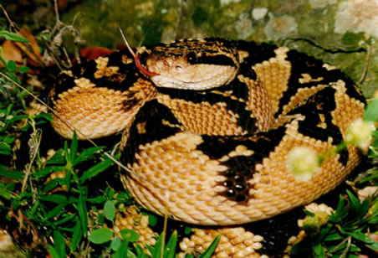
LACHESIS [ lachesis/ lachesis muta, proved by Hering]

Slide 11
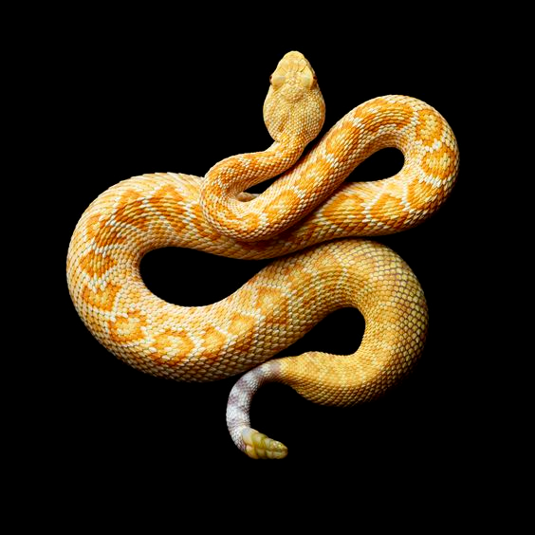
CROTALUS HORRIDUS [ Bush master-proved by Heringwith images

Slide 12
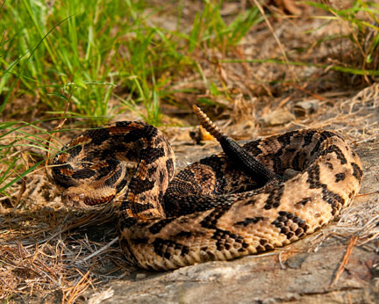
CROTALUS CASCAVELLA [ rattle snake or pit viper, proved by Mure, comes under the N.O.-Crotalidae]

Slide 13
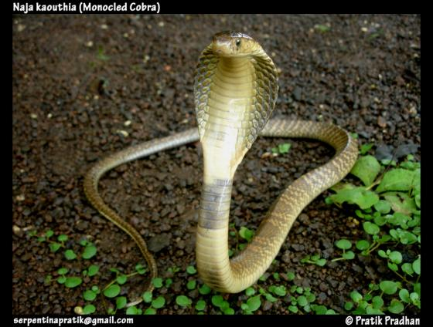
NAJA TRIPUDIENS [ naja; cobra; Elapidae]

Slide 14
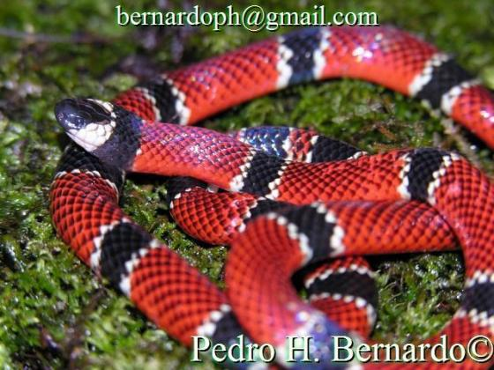
ELAPS CORALLINUS [ Snake; Micru rus corallinus]

Slide 15
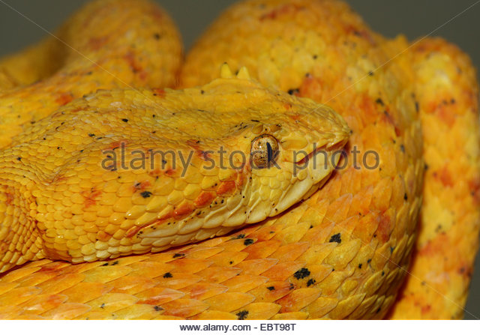
BOTHROPS LANCEOLATUS [viper yellow.Lach lanceolates]

Slide 16
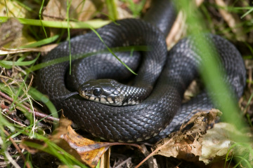
VIPERA TORVA (german viper)

Slide 17
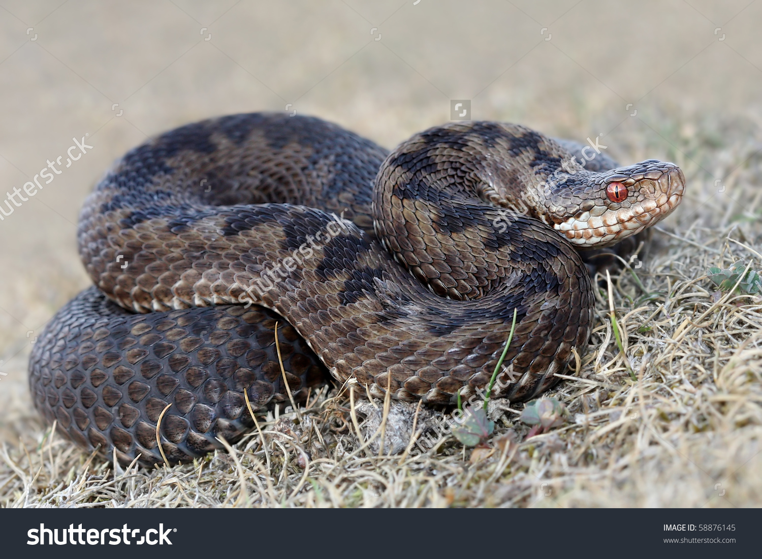
VIPERA COMMUNIS (common viper)

Slide 18
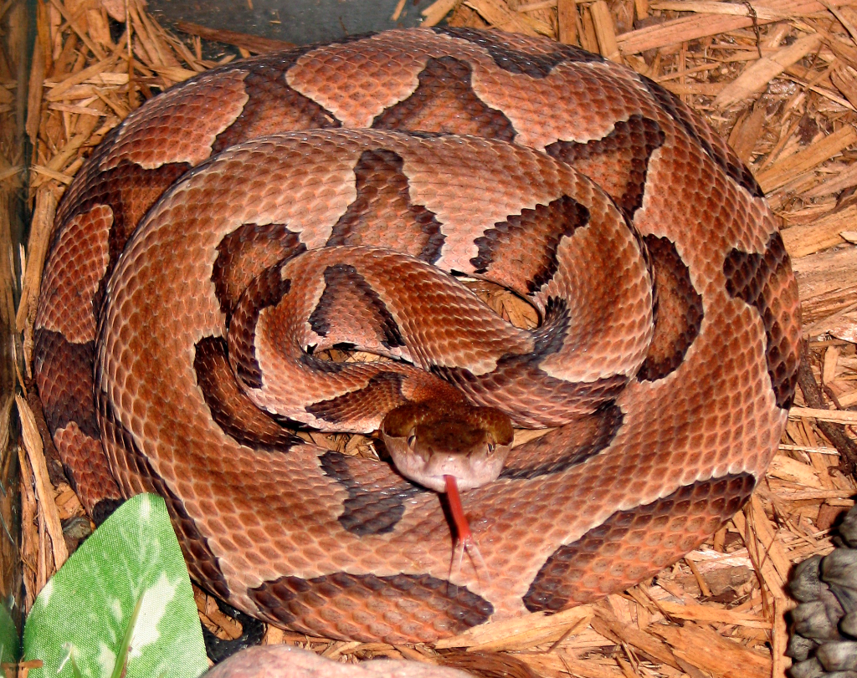
CENCHRIS CONTORTRIX [ head snake; Ancistrodon]

Slide 19
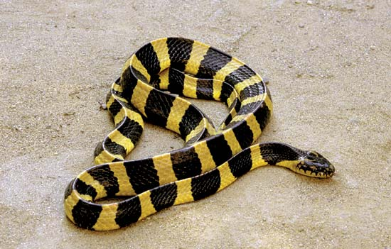
BUNGARUS FASCIATUS [ krait]

Slide 20
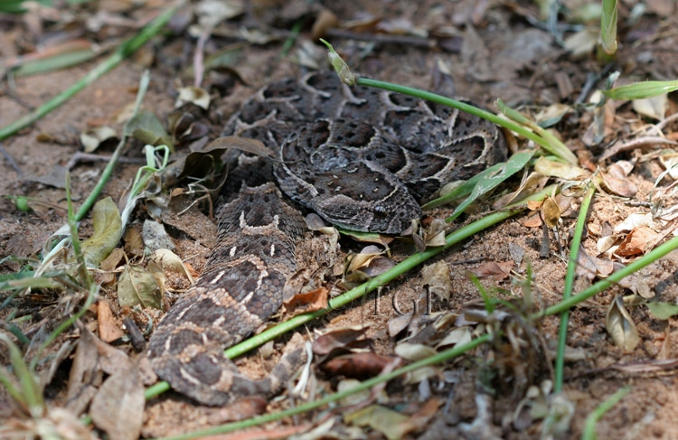
CLOTHO ARICTANS [ adder]

Slide 21
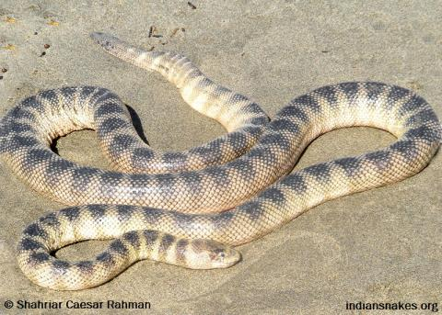
HYDROPHIS CYANOCINCTUS

Slide 22
The major poisonous snakes, the poison of which are made use of in homoeopathy are;
1) Viper [ including pit vipers of crotalidae]
2) Cobras [Naja)
3) Kraits [Bungarus)
4) Sea snakes [Hydrophis)

Slide 23
SNAKE VENOM
The Snake Venom is the modified saliva. The venom contains nine enzymes such as;
(i) Phosphatidases
(ii) Proteases
(iii) Cholinesterases
(iv) Hyaluronidases
(v) Ribonucleases
(vi) Deoxyribonucleases
(vii) Ophioxidase
(viii) Lecithinase
(ix) Crepsins

Slide 24
In addition Cobra and Krait venoms also contain highly neurotoxic non enzymatic components like basic polypeptides, which cause neuromuscular block.
Viperine venom contains hemorrhagic, necrotic, coagulant and hemolytic substances which lead to extensive necrosis.Lesions are due to intravascular coagulation, fibrinolysis, damage to vascular endothelium and extensive necrosis
Venoms of Sea snake are neurotoxic. They can also cause extensive tissue

Slide 25
SPEED OF ACTION OF VENOM:
This depends on the site of injection and the amount injected. If the venom directly enters the blood stream, effect may be rapid and lead to sudden death. In most of the cases, the absorption of venom is slower and especially in Viperine bites With extensive local reaction, considerable amount of venom may remain locally which will be absorbed into the circulation in due course.

Slide 26
PROPERTIES OF SNAKE POISON Constituents of Snake poison
Fibrinolysins
Proteolysins
Neurotoxins
Cholinesterase (Elapid viper)
Haemolysins (Viper venom)
Thromboplastin (Viper venom)
Cardiotoxin
Coagulase hyaluonidase (Helps to spread)

Slide 27
PHYSICAL PROPERTIES:
It is an odorless and tasteless, viscid fluid of pale yellow colour.
Specific gravity ranges from 1.03 to 1.07.
CHEMICAL PROPERTIES:
It contains peptides.
It is acidic to litmus paper.
It also contains inorganic phosphorous and metallicions like Na+, K+, Zn+, Ca+, Mg++, Fe++, and Co++ etc

Slide 28
MEDICINAL VALUE:
Cobra poison used to relieve pain due to neural leprosy.
In Ayurvedic medicine snake venom is used as antidote in the form of certain Rasas against Tuberculsis.
Viper venom used as hemostat. Used in hemophilia, during major surgery, to stop hemorrhages.
Poison of Rattlesnake is used as medicine for epilepsy, nerve exhaustion.
Certain snake venoms are used as a local agent to treat rheumatism, inflammation of joint and neuralgic condition.

Slide 29
Important Homoeopathic Remedies of the Snake Group
Lachesis trigonocephalus - surukuku snake
Naja tripudians - cobra venom
Elaps corrallinus - coral snake
Crotalus horridus - rattlesnake
Crotalus cascavella - brazilian snake
Cenchris contortrix - copperhead snake
Bothrops lanciolatus - yellow viper
Vipera berus - german viper
Hydrophis cyanocintus - sea snake
Toxicophis - Moccasin snake

Slide 30
Doctrine of Signature
The snake is extremely sensitive to heat, So It lives in deep burrows where it is cooler. The Patient Of Ophidia Group Is Worse From Hot Weather, By Hot Drinks, By Sun And By Warmth In General.
The snake is more ferocious and poisonous when hungry. The Patient Of Ophidia Group Is < By Fasting And > After Eating.
Snakes are poisonous, when we say the mind is poisoned, It means that there is Jealously And suspicion. Suspicion And Jealousy are the characteristic symptoms of the patients.

Slide 31
The snake coils itself from left to right. Symptoms Of The Ophidia Group are proceeded from Left to Right (Except Crotallus and Elaps as they are Right Sided).
Immediately after a snake bite the blood is let out from that site as a therapeutic measure to limit the extent of damage. General relief from bleeding and any other discharges
The snake is very sensitive to touch and vibrations. Patient is also aggravated by touch and slight sound.

Slide 32
CHARACTERISTICS OF OPHIDIA GROUP
Constitution: Haemorrhagic constitution, skin shows purple or mattled appearance. They are very much restless people. Face is sickly, pale, anxious, bloated, dark, red or bluish. Miasm: Syphilitic & Tubercular background Temperament: Melancholic Diathesis: Haemorrhagic Thermal relation: All ophidians are Hot patients (except Elaps & Naja which are chilly)

Slide 33
Ailments from: Fright, jealousy, alcoholism, Onanism, loss of vital fluids, suppressed menses, physical trauma. Bad effects of poisons, long lasting grief, disappointed love, vexation, summer and spring. Sphere of action: Nerves esp. pneumogastric and spinal accessory, cellular tissues, skin, circulation, CVS, brain, liver, glands, throat, muscles, etc

Slide 34
PATHO-PHYSIOLOGICAL ACTION
Neurotoxic venom - Muscular weakness and paralysis It acts primarily on the motor nerves. Vasculotoxic venom - Enzymatic destruction of cell walls and coagulation disorders. Myotoxic venom - Generalized muscle pains followed by myoglobinuria. Haemolytic venom - Break down of the RBC‘s separating plasma and haemoglobin

Slide 35
CHARACTERISTIC MENTAL SYMPTOMS
Anxiety, mental excitement and fear. Hallucinations are regularly seen.
Loquacity, compelled to talk continuously, jump from one topic to the other without any connection.
Suspicious, fear of being poisoned, refuse the medicines offered, suspicious because of survival instincts.
Fear, of disease and death.
Religious Insanity, religious melancholy and clairvoyance.
Delirium, muttering like when drunk.
Fastidious, hurried tendency

Slide 36
Irritable & Quarrelsome
Competitiveness & attractiveness
Double standards, ophidians are known to have two sets of rules one for themselves and the other for others because of egotism and jealousy.
Hallucinations, delusions, insanity, delirium.
Greedy, jealous, quarrelsome, malicious, always playing dirty tricks.
Active, Ophidians have an active memory and a very striking nature.

Slide 37
CHARACTERISTIC PHYSICAL SYMPTOMS
Haemorrhagic diathesis, dark red and oozes profusely from every orifice of the body.
Dark spots appear on the body and blood settles into ecchymoses. Thus a mottled, purple appearance.
All ophidians are left sided (except Crotalus & Elaps)
Pains go from left to right (except Crotalus & Elaps)
Gangrene, Decomposition of blood with death of tissue.
Ulcers bleed black blood, which soon coagulates and looks like charred straw.

Slide 38
Congestive pains are felt in the head. Gums bleed easily and blood is seen around the teeth.
Hematuria is very often seen.
Septicemia, Patient exhibits symptoms like that of septicemia.
Hypersensitiveness, especially of slight noise or touch, to motion to cover. The mere touch of a finger or hand is unbearable, cannot wear tight clothes and tight bandages around neck and waist.
Debility and prostration leads to collapse
Inflammation of cellular tissue, effusion of inner organs and septicemia
Paralysis, There is torpidity, numbness, twitching and fornications.

Slide 39
Constrictiveness, the ophidians have constrictiveness or choking sensation due to the irritation of pneumogastric.
Dryness of the skin, inability to sweat.
Discharges, The discharges of ophidians are very offensive, profuse, bloody and dark. Suppression of these discharges gives rise to the complaints.
Periodicity of complaints seen during spring, before and after menses.
Craving - alcoholic drinks, cold drinks and oysters.

Slide 40
General Modalities
AGGRAVATION: Morning, asleep, noise, jar, suppression of discharges, summer, touch, night. AMELIORATION: When awake, cold, appearance of discharges.

Slide 41
Clinical Conditions Angina, Asthma, Alcoholism, Boils, Carbuncles, Cardiac Asthma, Ciliary Neuralgia, Cough, Diphtheria, Endocarditis, Gangrene, Haemorrhage, Haemorrhoids, Heart Hypertrophy And Valvular Affections, Jaundice, Laryngitis, Lockjaw, paralysis, Puerperal Fever, Phlegmasia Alba Dolens, Polyneuritis, Purpura, Quinsy, Skin Affections, Ulcers, Varicose Veins, Vertigo.

Slide 42
EFFECT OR CLINICAL FEATURES OF SNAKE BITE:-
IMMEDIATE RESPONSE-
Seen in all snake bites. There will be severe fright and mental agitation leading to tachycardia, sweating, hypotension and even vascular collapse.
LOCAL REACTIONS:
This is seen more in Viperine bites than in others. There will be intense pain, swelling and violaceous discoloration, developing within minutes and often a sero sanguineous fluid exudes from the fang marks.
Oedema and discoloration spread proximally and in a few hours, vesicles and hemorrhagic blebs may appear.

Slide 43
GENERAL EFFECTS:
The general effects vary with the type of snake.
Cobra and sea snake venoms are pre dominantly neurotoxic Viperine venom is histotoxic and haemorrahagic.
There will be some overlapping of the effects during certain seasons.
COBRA AND KRAIT BITES:
They are neurotoxic. Soon after the bite, the patient complains of a sinking feeling, drowsiness, blurring of vision, diplopia, dysphagia and dyspnoea. There will be paralysis of palate, tongue, pharynx and respiratory muscles. There’ll be a flaccid paralysis of the limbs, associated with hypotonia and a diminution in the tendon reflexes.Coma and death can happen due to respiratory failure or shock in 6-48 hrs. Sometimes the symptoms may present as acute myasthenic crisis.

Slide 44
VIPERINE BITES:
It is histotoxic and haemorrhagic. Within 3-4 hours of bite there will occur the following features.
Haemorrhagic manifestations, which appear as extensive bruises, bleeding from the bitten parts, bleeding from gums, epistaxis, blotchy purpura haemorrhagica, haématemesis and malena. Bleeding can lead to shock.
Cardiac manifestations occur as tachycardia, myocarditis and cardiac failure.

Slide 45
Rarely, there’ll be optic neuritis lead ing to partial or complete blindness in 2-7 days.
Renal changes occur as proteinuria and haematuria. A dreaded complication due to direct nephrotoxicity is anuric renal failure, the lesions of which are acute tubulonecrosis, haemorrhagic interstitial nephritis and acute glomerulonephritis.
Death in Viperine bite occur due to shock, haemorrhages, secondary infection, renal failure or cardiac failure.
KRAIT VENOM IS NEUROTOXIC. They present with symptoms similar to co bra bite but is most lethal. Local reaction is minimal.

Slide 46
SEA SNAKES-Their venom is neurotoxic and nephrotoxic. There’ll be pain and stiffness of muscles of neck, back and proximal part of limbs. Trismus, ptosis, etc. Ophthalmoplegia and paralysis and the symptoms may lead to respiratory failure. Proteinuria and myoglobinuria occurs. Death is due to respiratory paralysis and renal failure.

Slide 47
COMMON CHARACTERISTICS OF OPHIDIA
PARALYSIS
Features of typical bulbar paralysis occur in Naja.
The paralysis of Ophidia group occur in right side as well as left side.
Right side
(1) Crotalus horridus
(2) Crotalus cascavella right sided hemiplegia.It is complementary to Lachesis as it completes the curative action.)
(3) Elaps corallinus
(4) Bothrops-hemiple gia with aphonia

Slide 48
Left Side
Lachesis has left sided paralysis especially from apoplexy.There will be extensive paralysis
Naja: Bulbar paralysis, sphincter control will be lost.
Vipera: Paraplegia of lower extremities, resembling acute ascending paralysis of Landry.
Bangarus fasciatus: Acute polioencephalitis and myelitis.

Slide 49
CONSTRICTION OF THROAT - LARYNX & SPHINCTERS
(i)Lachesis: Constriction of throat, larynx and abdomen, with intolerance to least touch or pressure, especially on neck. There’ll be constriction in rectum. Anus will feel tight. There will be dysphagia for liquids as in Bothrops.
(ii) Cenchris contortrix: There’ll be constriction as in Lachesis with the necessity for having the clothes loose. There will be vivid dreams. Like Arsenic alb, there’ll be dyspnea; Mental and physical restlessness; Thirst for small quantities of water.

Slide 50
(iii) Elaps: There’ll be constriction of pharynx. Food and drinks are suddenly arrested and “ fall heavily into stomach.”
(iv) Crotalu horridus: There’ll be spasms o The patient is not able to swallow any solid substances. There’ll be an intolerance to clothing around stomach.
(v) Vipera: Tears his clothes open due to violent congestion in chest. There’ll be “Cardiac anguish with violent, chest pains.”
(vi) Naja: Grasping throat with a sense of choking. There will be asthmatic constriction in evening.
(vii) Bothrops- There will be constriction in throat with difficulty in swallowing, especially towards liquids.

Slide 51
Haemorrhages Of Dark, Non-coagulable Decomposed Black Blood Oozing From All Orifices Of The Body With Ecchymosed.
(i) Lachesis: Oozing of dark, decomposed blood, purpura with intense prostration, epistaxis, bleeding gums. There will be haemorrhages from bowels like charred straw, black particles. There will be a general relief by menstrual flow.
(ii) Crotalus horridus: Dark non-coagulating blood; haemorrhagic diathesis; retinal haemorrhages. Blood oozes from ears. There’ll be epistaxis where the blood will be black and stringy: persistent haemorrhages; intestinal haemorrhage; bloody urine; purpura haemorrhagica; bloody sweat.

Slide 52
(iii) Elaps: Epistaxis; Haemorrhages from lungs as black ink. Watery haemorrhage with pain in the apex of right lung. There will be cough with expectoration of black blood. Menstrual bleeding is black In typhoid fevers when ulcers have eaten into tissues, there’ll be the discharge of black blood.
(iv) Bothrops: Haemcirrhages from all orifices, b leading to hemiplegia aphasia and dysarthria; conjunctival and retinal haemorrage; bloody stools.
(v) Vipera-Persistent epistaxis; affects especially the veins.
Inflammations And Fevers Of Low Destructive Type.Eg: Gangrene, Cellulitis, Malignant Ulcerations, Diphtheria And Typhoid Etc.

Slide 53
(i) Lachesis; Septic states, diphtheria and other low forms of diseases with pro found prostration. There’ll be boils, carbuncles and ulcers with bluish purple surroundings; pyaemia, dissecting wounds, bedsore with black edges. bluish or baickish swellings.
(ii) Crotalus horridus: Low septic states; carbuncles; malignant scarlatina; yellow fever, plague, cholera etc. Boils, carbuncles and eruptions are surrounded by purplish, mottled skin, and oedema; lymphangitis; septicaemia.
(iii) Bothrops: Cold, swollen skin with hemorrhagic infiltrations; gangrene; lymphatics swollen; Anthrax; m erysipelas.

Slide 54
(iv) Vipera: Lymphangioma, boils, carbuncles with burning sensation, relieved by elevating parts Skin peels off in large plaques.
NERVES, SPECIALLY AFFECTED BY SNAKE POISONS
(i) vagus nerve
(ii) Spinal accessory nerve ,So, characteristically we get symptoms of larynx, respiration and heart.

Slide 55
Ophidia medicines cause choking constrictive sensation due to pneumogastric nerve irritation.
Weak heart, cold feet and trembling.
All the medicines have dyspnoea and cardiac symptoms.
YELLOW STAINING OR COLOUR OF SKIN
Most marked in Cortalus horridus, less in Lachesis and Vipera communis and Vipera torva.
ACTION ON HEART-PRODUCE PALPITATION, DYSPNOEA AND VALVULAR LESIONS.

Slide 56
(i) Naja: Heart rhythm is regular, but the force of c3ntractio1rr indicated in remote effects of advanced valvular lesions. There’s a well marked frontal and temporal headache with the cardiac_symptoms. Patient is always gasping for breath.
(ii) Lachesis: Indicated in the of rheumatic heart diseases. Palpitation with fainting spells especially during the clirnacteric period; Cyanosis.
(iii) Crotalus horridus: Palpitation,espe cially during menses. Heart’s actions feeble.
(iv) Vipera-Cardiac dropsy

Slide 57
Appearance of face
Sickly, pale, anxious, bloated swollen, dark red or bluish, especially in Lachesis, Bothrops, Vipera. The face is yellow in Lachesis and Crotalus.
Alteration of spinal reflexes-
Dimness of vision, excitability of brain or spinal cord resulting in mental restless ness and physical sensitiveness
Torpidity, numbness twitching and formication.

Slide 58
INITIAL ANXIETY, MENTAL EXCITABILITY AND OVER SENSITIVENESS
Hallucinations and fear, followed by nervous depression which varies from debility to confusion, stupor, delirium and paralysis. PERIODICITY:
Vipera : Symptoms return anually for years
Thxicophis: Pain and fever return an nually, sometimes changing location with disappearance of the first symp toms.
Lachesis: Complaints, especially the intermittent fever, returning in every spring.

Slide 59
SWELLING
(i) Clotho arictans: Excessive swelling is the characteristic feature
(ii) Toxicophis: Oedematous swelling
(iii) Naja: No haemorrhage; only oedema.
CLIMACTERIC AILMENTS:
(1) Lachesis: Haemorrhages, haemorrhoids; hot flushes, hot per spiration; burning in vertex, headache at or after menopause.
(ii) Crotalus horridus: Intense flushings and drenching perspiration. Profound anaemia. Prolonged metrorrhagia; dark offensive fluid; faintness and sinking at stomach.

Slide 60
(iii) Vipera: Climacteric ailments.
MENTAL SYMPTOMS:
(i) Fear of rain: Elaps, Naja
(ii) Dreams of dead persons: Elaps, Cro talus horridus, Crotalus cascavella
(iii) Dreads to be left alone: Elaps, Naja

Slide 61
ACTION ON LIVER –
Hepatomegaly and Jaundice
(i) Lachesis- Liver regions sensitive. Can’t tolerate clothing around waist
(ii) Crotalus- Haemolytic jaundice; yellow conjunctiva and skin
(iii) Vipera: Violent pain. Enlarged liver with jaundice and fever pains extend to shoulder and hip

Slide 62
SLEEP AGGRAVATION
(i) Lachesis: As soon as the patient falls asleep, breathing stops
(ii) Croralus horridus: Sleeps into his symptoms
(iii) Naja: Suffocative spells after sleeping

Slide 63
DYSARTHRIA:
(i) Bothmps: Hemiplegia with aphasia; in ability to articulate without any affect tion to tongue.
(ii) Vipera: Speech is difficult
(iii) Naja: Blurred speech (bulbar paralysis)

Slide 64
THANK YOU

