Slide 1
OPHIOTOXINS
OPHIDIA = SNAKE FAMILY
TOXINS = POISONS
First medicine proved – Lachesis trigonocephalus
CN – SURU KUKU Snake
Proved by Dr. Constantine Hering
Ophidia group consists of medicines taken from snakes venoms which is modified saliva
Ophidia comes under Class Reptilia, which comes under Phylum Chordata

Slide 2
MEDICINES FROM OPHIOTOXINS
CROTALUS HORRIDUS
CROTALUS CASCAVELLA
NAJA TRIPUDIANS
ELAPS CORALLINUS
BOTHROPS LANCEOLATUS
CENCHRIS CONTORTRIX
VIPERA BERUS
HYDROPHIS CYANOCINCTUS
TOXICOPHIS

Slide 3
SNAKE POISON CONSTITUENTS
FIBRINOLYSIN
PROTEOLYSIN
NEUROTOXIN
CHOLINE ESTERASE
HEMOLYSIN
THROMBOPLASTIN
CARDIOTOXIN
COAGULASE HYALURONIDASE

Slide 4
SNAKE VENOM
The Snake Venom is the modified saliva. The venom contains nine enzymes such as
(i) Phosphatidases
(ii) Proteases
(iii) Cholinesterases
(iv) Hyaluronidases
(v) Ribonucleases
(vi) Deoxyribonucleases
(vii) Ophioxidase
(viii) Lecithinase
(ix) Crepsins

Slide 5
DOCTRINE OF SIGNATURE
Snake extremely sensitive to heat. So lives in deep burrows – Ophidia patients < warmth, hot drinks
Mind poisoned jealousy and suspicion –
Jealousy seen in ophidia patients
Snake coils from left to right – symptoms shift from left to right

Slide 6
DOCTRINE OF SIGNATURE
After snake bite blood is let out to get relief – patient > bleeding
Snake sensitive to touch and vibrations –
patient < touch and slight sound
Snake can swallow large creatures – patient can swallow solids easily than liquids
Stools of snake is black and offensive – patient discharges are dark and offensive

Slide 7
SNAKE BITE
I. Immediate response- Seen in all snake bites. There will be severe fright and mental agitation leading to tachycardia, sweating, hypotension and even vascular collapse.
II. Local reactions: This is seen more in Viperine bites than in others. There will be intense pain, swelling and violaceous discolouration, developing within minutes and often a sero sanguinous fluid exudes from the fang marks. Oedema and discolouration spread proximally and in a few hours, vesicles and haemorrhagic blebs may appear.

Slide 8
General effects: The general effects vary with the type of snake. Cobra and sea snake venoms are pre dominantly neurotoxic
Viperine venom is histotoxic and haemorrahagic. There will be some overlapping of the effects during certain seasons.

Slide 9
IV. Cobra and Krait bites: They are neurotoxic. Soon after the bite, the patient complains of a sinking feeling, drowsiness, blurring of vision, diplopia, dysphagia and dyspnoea. There will be paralysis of palate, tongue, pharynx and respiratory muscles. There’ll be a flaccid paralysis of the limbs, associated with hypotonia and a diminution in the tendon reflexes. Coma and death can happen due to respiratory failure or shock in 6-48 hrs.

Slide 10
V. Viperine bites: It is histotoxic and haemorrhagic. Within 3-4 hours of bite there will occur the following features.
(ii) Haemorrhagic manifestations, which appear as extensive bruises, bleeding from the bitten parts, bleeding from gums, epistaxis, blotchy purpura haemorrhagica, haématemesis and malena. Bleeding can lead to shock. Cardiac manifestations occur as tachycardia, myocarditis and cardiac failure.

Slide 11
(iii) Rarely, there’ll be optic neuritis lead ing to partial or complete blindness in 2-7 days. Renal changes occur as proteinuria and haematuria. A dreaded complication due to direct nephrotoxicity is anuric renal failure, the lesions of which are acute tubulonecrosis, haemorrhagic interstitial nephritis and acute glomerulonephritis. Death in Viperine bite occur due to shock, haemorrhages, secondary infection, renal failure or cardiac failure.

Slide 12
VI. Krait venom is neurotoxic. They present with symptoms similar to co bra bite but is most lethal. Local reaction is minimal.
VII. Sea Snakes- Their venom is neurotoxic and nephrotoxic. There’ll be pain and stiffness of muscles of neck, back and proximal part of limbs. Trismus, ptosis, etc. Ophthalmoplegia and paralysis and the symptoms may lead to respiratory failure. Proteinuria and myoglobinuria occurs. Death is due to respiratory paralysis and renal failure

Slide 13
PATHOPHYSIOLOGICAL ACTION
NEUROTOXIC VENOM – Muscular weakness and paralysis of muscles of face, throat, respiration. Acts on pneumogastric nerve producing constriction of throat, bronchus and heart
VASCULOTOXIC VENOM–Enzymatic destruction of cell walls, coagulation disorders, destruction of endothelium of blood vessels
MYOTOXIC VENOM – Generalised muscular pains, myoglobinuria,respiratory failure

Slide 14
BLOOD – Decomposes blood, produces non coagulable fluid blood and hemorrhage
HEMOLYTIC VENOM – Breakdown of RBC, decreased oxygen carrying capacity of blood, cyanosis and jaundice
LOCAL EFFECT – Inflammation, agonising pain, swelling at the site of injury, gangrene, cellulitis, erysepelas, foul ulcers
SYSTEMIC EFFECT – Absorption by lymphatics and veins producing septaemia

Slide 15
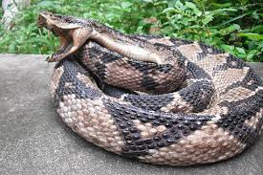
LACHESIS MUTUS (SURUKUKU)

Slide 16
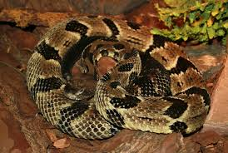
CROTALUS HORRIDUS (RATTLE SNAKE)

Slide 17
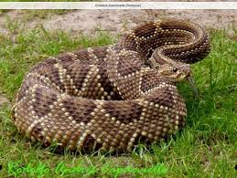
CROTALUS CASCAVELLA (BRAZILLIAN RATTLE SNAKE)

Slide 18
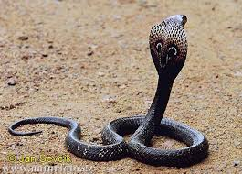
NAJA TRIPUDIANS (COBRA)

Slide 19
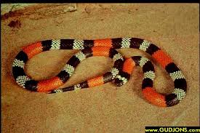
ELAPS CORALLINUS (CORAL SNAKE)

Slide 20
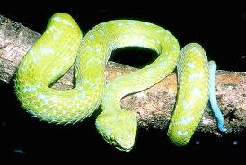
BOTHROPS LANCEOLATUS (YELLOW VIPER)

Slide 21
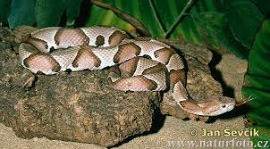
CENCHRIS CONTORTRIX (COPPER HEAD SNAKE)

Slide 22
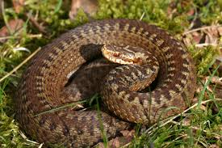
VIPERA BERUS (GERMAN VIPER)

Slide 23
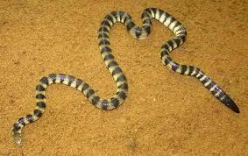
HYDROPHIS CYANOCINCTUS (SEA SNAKE)

Slide 24
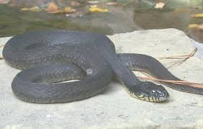
TOXICOPHIS (MOCCASIN SNAKE)

Slide 25
COMMON CHARACTERISTICS OF OPHIDIA
I. Paralysis Features of typical bulbar paralysis occur in Naja. The paralysis of Ophidia group occur in right side as well as left side.
II. Constriction of throat – larynx & sphincters
III. Haemorrhages of dark, non-coagulable decomposed black blood oozing from all orifices of the body with ecchymosed

Slide 26
IV. Inflammations and fevers of low destructive type Eg: gangrene, cellulitis, malignant ul cerations, diphtherIa and typhoid etc. v).Nerves, specially affected by snake poisons (I) Vagus nerve (ii) Spinal accessory nerve ,So, characteristically we get symptoms of larynx, respiration and heart. Ophidia medicines cause choking constrictive sensation due to pneumogastric nerve irritation. Weak heart, cold feet and trembling. All the medicines have dyspnoea and cardiac symptoms

Slide 27
VI. Yellow staining or colour of skin Most marked in Cortalus horridus, less in Lachesis and Vipera communis and Vipera torva.
VII. Action on heart-Produce palpitation, dyspnoea and valvular lesions. VIII. Appearance of face Sickly, pale, anxious, bloated swollen, dark red or bluish, especially in Lachesis, Bothrops, Vipera. The face is yellow in Lachesis and Crotalus.

Slide 28
IX . Alteration of spinal reflexes- Dimness of vision, excitability of brain or spinal cord resulting in mental restless ness and physical sensitiveness Torpidity, numbness twitching and formication.
X. Initial anxiety, mental excitability and over sensitiveness Hallucinations and fear, followed by nervous depression which varies from debility to confusion, stupor, delirium and paralysis.

Slide 29
XI. Periodicity: Vipera : Symptoms return annually for years
XII. Swelling
Naja: No haemorrhage; only oedema.
XIII Climacteric ailments: Lachesis: Haemorrhages, haemorrhoids; hot flushes, hot per spiration; burning in vertex, headache at or after menopause.

Slide 30
XIV. Mental Symptoms: (i) Fear of rain: Elaps, Naja (ii) Dreams of dead persons: Elaps, Cro talus horridus, Crotalus cascavella (iii) Dreads to be left alone: Elaps, Naja
XV. Action on liver – Hepatomegaly and Jaundice (i) Lachesis- Liver regions sensitive. Can’t tolerate clothing around waist (ii) Crotalus- Haemolytic jaundice; yellow conjunctiva and skin

Slide 31
XVI. Sleep aggravation (i) Lachesis: As soon as the patient falls asleep, breathing stops
XVII. Dysarthria: (i) Bothrops: Hemiplegia with aphasia; in ability to articulate without any affect tion to tongue.

