Slide 1
OBESITY
By
Dr.Mahadevi A.L
Dept of physiology
SKHMC

Slide 2
Overweight and obesity are defined as abnormal or excessive fat accumulation that may impair health.
Body mass index (BMI) is a simple index of weight-for-height that is commonly used to classify overweight and obesity in adults.
It is defined as a person's weight in kilograms divided by the square of his height in meters (kg/m²).

Slide 3
Overweight and obesity are major risk factors for a number of chronic diseases, including diabetes, cardiovascular diseases and cancer.
Once considered a problem only in high income countries, overweight and obesity are now dramatically on the rise in low- and middle-income countries, particularly in urban settings.

Slide 5
Adults
For adults, WHO defines overweight and obesity as follows:
overweight is a BMI greater than or equal to 25; and
obesity is a BMI greater than or equal to 30.
BMI provides the most useful population-level measure of overweight and obesity as it is the same for both sexes and for all ages of adults. However, it should be considered a rough guide because it may not correspond to the same degree of fatness in different individuals.
For children, age needs to be considered when defining overweight and obesity.

Slide 6
Children under 5 years of age
For children under 5 years of age:
overweight is weight-for-height greater than 2 standard deviations above WHO Child Growth Standards median; and
obesity is weight-for-height greater than 3 standard deviations above the WHO Child Growth Standards median.

Slide 7
Children aged between 5–19 years
Overweight and obesity are defined as follows for children aged between 5–19 years:
overweight is BMI-for-age greater than 1 standard deviation above the WHO Growth Reference median; and
obesity is greater than 2 standard deviations above the WHO Growth Reference median

Slide 8
Causes obesity and overweight:
energy imbalance between calories consumed and calories expended.
Globally, there has been:
an increased intake of energy-dense foods that are high in fat and sugars; and
an increase in physical inactivity due to the increasingly sedentary nature of many forms of work, changing modes of transportation, and increasing urbanization.
Changes in dietary and physical activity patterns are often the result of environmental and societal changes associated with development and lack of supportive policies in sectors such as health, agriculture, transport, urban planning, environment, food processing, distribution, marketing, and education.

Slide 9
Raised BMI is a major risk factor for noncommunicable diseases such as:
cardiovascular diseases (mainly heart disease and stroke), which were the leading cause of death in 2012;
diabetes;
musculoskeletal disorders (especially osteoarthritis – a highly disabling degenerative disease of the joints);
some cancers (including endometrial, breast, ovarian, prostate, liver, gallbladder, kidney, and colon).

Slide 10
not sleeping enough, which can lead to hormonal changes that make you feel hungrier and crave certain high-calorie foods
pregnancy, as weight gained during pregnancy may be difficult to lose and might eventually lead to obesity
Certain health conditions can also lead to weight gain, which may lead to obesity. These include:
polycystic ovary syndrome (PCOS), a condition that causes an imbalance of female reproductive hormones
Prader-Willi syndrome, a rare condition present at birth that causes excessive hunger
Cushing syndrome, a condition caused by having high cortisol levels (the stress hormone) in your system hypothyroidism (underactive thyroid), a condition in which the thyroid gland doesn’t produce enough of certain important hormones
osteoarthritis (OA) and other conditions that cause pain that may lead to reduced activity

Slide 11
The risk for these non communicable diseases increases, with increases in BMI.
Childhood obesity is associated with a higher chance of obesity, premature death and disability in adulthood.
But in addition to increased future risks, obese children experience breathing difficulties, increased risk of fractures, hypertension, early markers of cardiovascular disease, insulin resistance and psychological effects.

Slide 12
The following classes Trusted Source are used for adults who are at least 20 years old:
BMIClass18.5 or underunderweight18.5 to <25.0“normal” weight25.0 to <30.0overweight30.0 to <35.0class 1 obesity35.0 to <40.0class 2 obesity40.0 or over class 3 obesity (also known as morbid, extreme, or severe obesity)

Slide 13
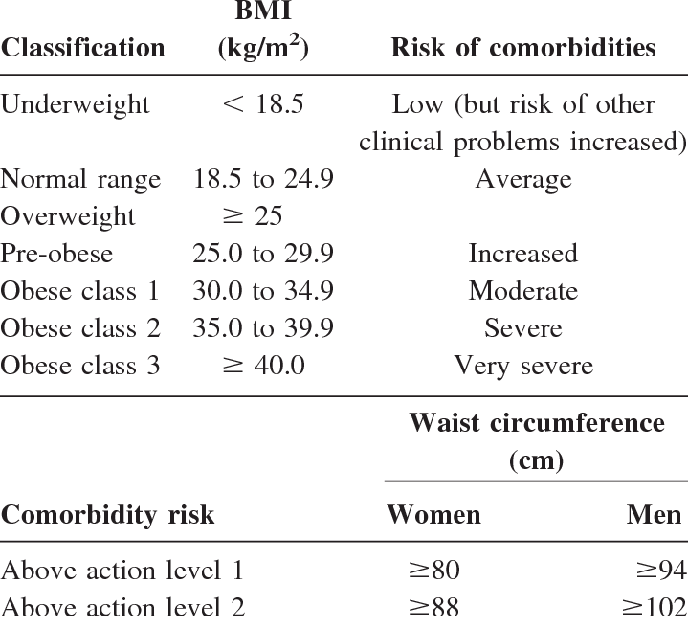

Slide 15
Diagnosis of obesity
BMI is a rough calculation of a person’s weight in relation to their height.
Other more accurate measures of body fat and body fat distribution include:
skinfold thickness tests
waist-to-hip comparisons
screening tests, such as ultrasounds, CT scans, and MRI scans
certain tests to help diagnose obesity-related health risks. These may include:

Slide 16
blood tests to examine cholesterol and glucose levels
liver function tests
a diabetes screening
thyroid tests
heart tests, such as an electrocardiogram (ECG or EKG)
A measurement of the fat around your waist is also a good predictor of your risk for obesity-related diseases.

