Slide 1
PHARMACONOMY
DR.RAMYA S.S
ASSISTANT PROFESSOR
DEPT OF HOMOEOPATHIC PHARMACY

Slide 2
Pharmaconomy
As Homoeopathy bears a speciality and originality in the field of medicine,it’s route and mode of administration also bears a speciality
DEFINITION :The subject dealing with the route or channel of administration of drugs and medicine is termed as PHARMACONOMY

Slide 3
VARIOUS ROUTES
ORAL ROUTE;(INGESTION THROUGH MOUTH)
BY OLFACTION:(INHALATION THROUGH NOSE OR MOUTH)
BY APPLICATION TO THE SKIN:
Rubbing or Friction(epidermic)
Enepidermic
OTHERS: EYE, EAR etc

Slide 4
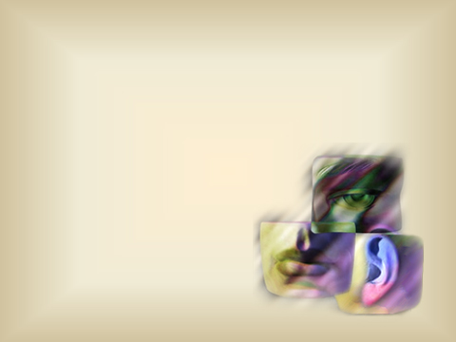
The various homoeopathic dosage
forms can be introduced into the body
through a variety of routes.
PHARMACONOMY
is the subject that
deals with the route
of administration
of medications.

Slide 5
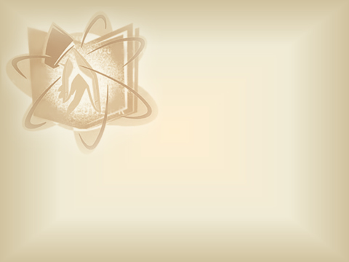
In 6th edition of
Organon of Medicine, §284, §285,
Hahnemann clarifies about the
various routes of administration of
Homoeopathic Similimum.

Slide 6
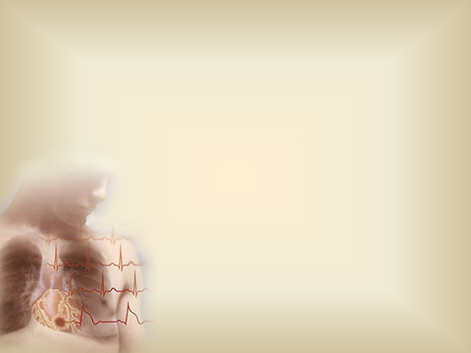
Besides the tongue, mouth and stomach which are most commonly affected by the administration of the medicine...
the nose and respiratory organs
are receptive of the action of
medicines in fluid form by means
of olfaction and inhalation
through mouth.

Slide 7
But the whole remaining skin of the body clothed with epidermis is adapted to the action of medicinal substances, especially if the inunction is connected with simultaneous internal administration.

Slide 8
In this way,
the cure of very old diseases maybe
furthered by applying externally,
rubbing it in the back, arms, extremities,
the same medicine he gives internally
and which showed itself curatively.
In doing so, he must avoid parts subject
to pain, spasm and skin eruption.

Slide 9
The nature of the dosage form must be
in consonance with the intended route of
administration for maximum effectiveness
and convenience of handling and
administration.
There are various routes or channels
through which the homoeopathic
medicine can be introduced into the
human system.

Slide 10
ORAL ROUTE
Oral route is the most important
of all the routes of administration.
Homoeopathic medicines act via oral
route on the entire human organism,
not by a process of digestion,
but via nervous syste

Slide 11
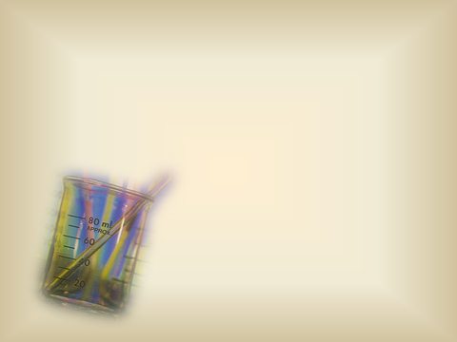
‘… A similar globule, crushed with some
sugar of milk and dissolved in a good deal of water and stirred well before every administration will produce a far more powerful medicine for the use of several days. Every dose, no matter how minute, touches, on the contrary, many nerves.’
(Aphorism 272)

Slide 12
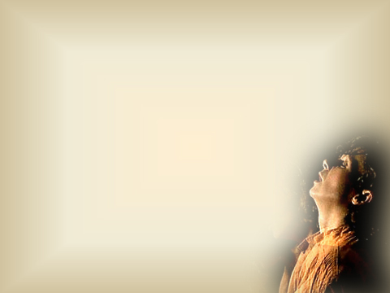
Sub-lingual administration of medicines may also be adopted.
Gurgles are aqueous solutions intended
to be used after dilution with warm
water. The gargle is kept in throat
and air from lungs is forced
through for the solution to
come in contact with the
above membranes.

Slide 13
OLFACTION AND INHALATION
The olfactory nerve is directly connected
to the brain (bypassing digestive system)
and is an interesting avenue for the
administration of dynamic remedies.
Here the remedy
reaches the brain
and higher centres
directly.

Slide 14
OLFACTION
A method of administering medicine through the nose and mouth by act of smelling.
Globule is moistened with medicinal fluid. The patient holds the open mouth of phial first in one nostril, and in the act of inspiration draw the air out of it into himself.
(Footnote to §288, 5th edition of Organon of Medicine)

Slide 15
In children it is applied close to the
nostrils while they are asleep.
This method is usually applied for
idiosyncratic patients and when it is not
possible to administer the medication
orally as in cases of epilepsy, hysteria,
lock-jaw, etc.

Slide 16
INHALATION
Inhalations are solutions of medicaments
administered by nasal or respiratory
route, intended for local or systemic
effects. Inhalations are applied in form of
vapors that are to be inhaled along with
breath from the surface of hot water.
Vehicles preferred are normal saline and
other water based liquids. 1tsp of
medicine is poured to 1 pint of hot water,
not boiling water.

Slide 17
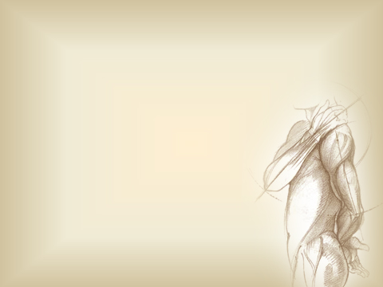
APPLICATION TO SKIN
The remedy, in its watery solution maybe
rubbed into parts of the body that are free
from skin, pain and cramps.
A small quantity of the solution
should be rubbed with the hand,
until the limb is dry. Also for this
purpose, the bottle should be
shaken five or six times.

Slide 18
The drugs applied to the skin in the
form of lotions, liniments, ointments,
poultices, plasters, are meant to
exercise local action in adynamic
diseases and expedite cure in chronic
dynamic derangement.

Slide 19
Rubbing or friction
(Inunction or Epidermic)
Friction through the whole cutaneous surface of the body, wherever the epidermis is sound as epigastrium,
inner parts of the thighs, lower part
of the abdomen, back, arms, etc.
E.g. application of lotions, ointments, liniments

Slide 20
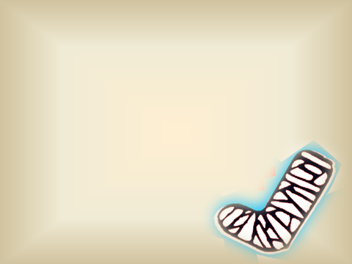
Enepidermic
In this method drugs are simply kept
in contact with the unbroken skin
without friction or rubbing.
E.g. plasters, poultices

Slide 21
OTHER ORIFICES OF THE BODY
Ear
Ear drops are often aqueous solutions,
sometimes glycerin or alcoholic,
intended for instillation into ear
e.g. Mullein oil

Slide 22
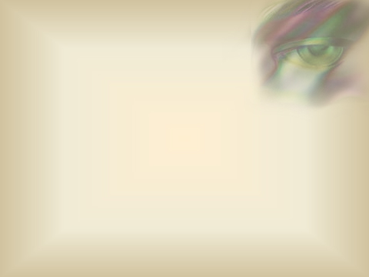
Eye
Eye drops which are aqueous or oily
solutions of drugs and eye ointments are intended for instillation into eye.
E.g. Cineraria eye drops
The ophthalmic products are generally meant for instillation into the space between the eyelids and the eyeballs.

Slide 23
Rectal route
The forms of rectal administration are
solutions, ointments and suppositories.
Consistency of rectal ointments has to be
thinner and softer than skin ointment to
easily pass through the fine holes
of rectal nozzle.
Vagina, Urethra
Medications intended to be delivered
locally may be injected into the vagina
or the urethra, as per the need.

Slide 24
PARENTERAL ROUTES
The parenteral placement of the
homoeopathic medicines into various
tissues at various depths including the
blood stream is a field that has not
been explored and studied.

Slide 25
Since all studies of the action of
homoeopathic medicines on healthy
humans is done by oral or olfactory route,
sufficient literature to lay down the
guidelines for parenteral introduction
remains unavailable.

Slide 26
PLACENTAL ROUTE AND VIA MILK OF MOTHER
The power of medicines acting upon an
infant through milk of mother or wet
nurse is helpful. Every disease in a child
yields to the rightly chosen homoeopathic
medicines given in moderate doses to the
nursing mother and so administered, is
more easily and certainly utilized than is
possible in later years.

Slide 27
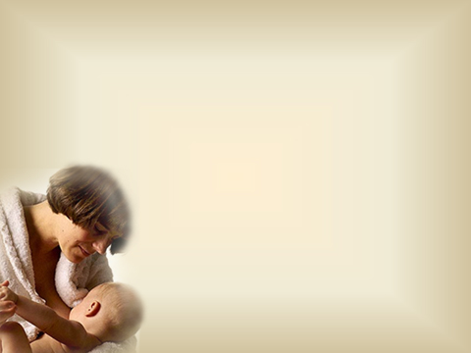
Since most infants usually have imparted
to them psora through the milk of the
nurse, if they do not already possess it
through heredity from the mother,
they may be at the same
time protected antipsorically
by means of the milk of the
nurse rendered medicinally
in this manner.

Slide 28
But the case of mothers in their pregnancy
by means of a mild antipsoric treatment,
especially with sulphur dynamizations,
prepared according to the directions (§270),
is indispensable in order to destroy the
psora - which is given them hereditarily;
destroy it both within themselves and in
the fetus, thereby protecting posterity in
advance.

Slide 29
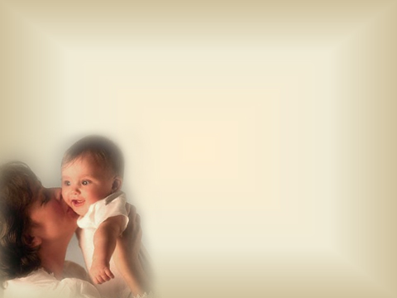
This is true of pregnant women thus
treated; they have given birth to children usually more healthy and stronger, to the astonishment of everybody.
A new confirmation of the great truth of psora theory discovered by me.
(Footnote no.164, §284)

