Slide 1
PHOSPHORUS
Inorganic Irritant poison
Dr. SALINI CHANDRAN
Dept.of Forensic Medicine & Toxicology

Slide 2
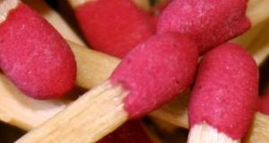
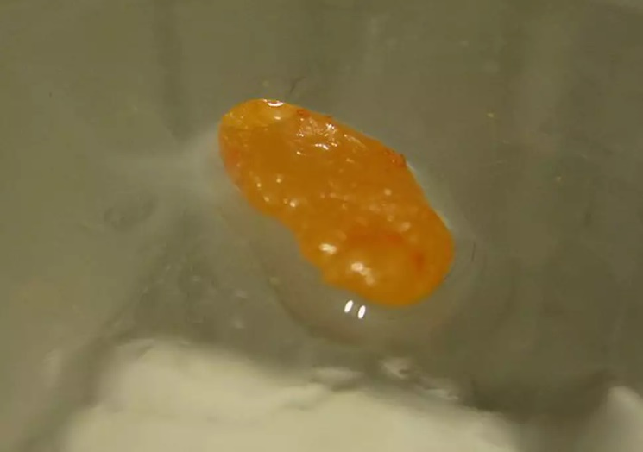
DIFFERENT FORMS OF PHOSPHOROUS
RED PHOSPHORUS
YELLOW/WHITE PHOSPHOROUS
Fertilizers
Insecticides
Rodenticides
Incendiary bombs
Smoke screens
Fireworks

Slide 3
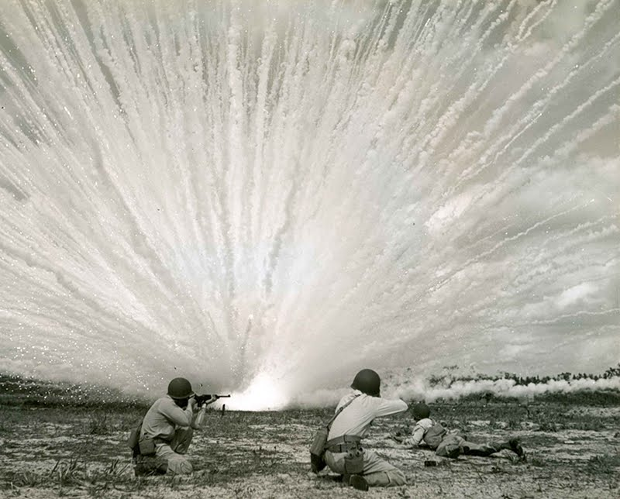

Slide 4
ACTION
Protoplasmic poison
Affects cellular oxidation

Slide 5
ACTION
Local effects
Local damage to skin,GIT ,mucous membrane ,respiratory tract
Oxidative damage
Thermal damage

Slide 6
ACTION
Systemic effects
General protoplasmic poison
Impair ribosomal function and protein synthesis
Cause free radicle injury
Impair lipoprotein synthesis
Fatty degeneration

Slide 7
CARDIOVASCULAR SYSTEM
Depress myocardial protein synthesis
Impair contractility and cause vasodilation
Common cause of early death

Slide 8
CENTRAL NERVOUS SYSTEM
Neuronal toxicity
Cerebral hypo perfusion
Hypoglycemia

Slide 9
TYPES OF POISONING
ACUTE
CHRONIC
FULMINATING

Slide 10
FULMINATING
More than 1 gm
Death within 12 hrs
Shock and Cardiovascular collapse
Those who survive
Restless delirious & maniacal
Severe nausea, vomiting and retching

Slide 11
ACUTE POISONING
STAGE 1
Last for several hours
Burning tastepain in throat and abdomen
Nausea ,vomiting ,diarrhea, abdominal pain
Mucosal burning
Breath ,stool, vomitus have garlic odor
Phosphorescent
Tachycardia ,hypotension ,shock and coma may develop
Burns (2nd and 3rd degree) - Skin Contact

Slide 12
ACUTE POISONING
STAGE 2
Quiescent stage
Last for 1-3 days
Some gastrointestinal abnormalities may present

Slide 13
ACUTE POISONING
STAGE 3
• Few days after ingestion
• End organ damage
• Nausea ,vomiting, abdominal pain , convulsions
• Liver injury
Hges intoskin mucous membrane,and viscera

Slide 14
ACUTE POISONING
STAGE 3
•Renal Damage
Oliguria , Haematuria, casts, albuminuria
Death from shock , hepatic failure CNS Damage

Slide 15
FATAL DOSE & PERIOD
FATAL DOSE- 60 to 120mg
Fatal Period - 2 to 8 days

Slide 16
DIAGNOSTIC TESTS
ULTRAVIOLET LIGHT
SERUM PHOSPHORUS LEVELS
SERUM ELECTROLYTES & CALCIUM LEVELS

Slide 17
TREATMENT
Gastric lavage with potassium permanganate (1:5000)
Activated Charcoal
Stomach wash with CuSO4 0.2gm
12 gm of CuSO4every 5 mins till vomiting occurs
Vit K
Whole bowel irrigation
Exchange transfusion
Peritoneal or haemodialysis

Slide 18
PM Appearance
GIT- Irritation
Luminous material in stomach
Jaundice
Garlicky odour
Mucous membrane of stomach- yellowish or greyish white
Softened ,thickened, lnflamed, corroded in patches

Slide 19
PM Appearance
Liver- swollen yellow, soft,easily ruptured
Kidneys- Large, greasy, yellow with hgic spots
Mucous membrane of stomach- yellowish or greyish white
Heart- Pale and flabby with fatty degeneration

Slide 20
CHRONIC POISONING
PHOSSY JAW
SYSTEMIC

Slide 21
ML IMPORTANCE
Accidental in chidren
Occasionally for homicide
Sometimed for abortion
Arson

