Slide 1
PLACEBO
DR.RAMYA S.S
ASSISTANT PROFESSOR
DEPT OF HOMOEOPATHIC PHARMACY

Slide 2
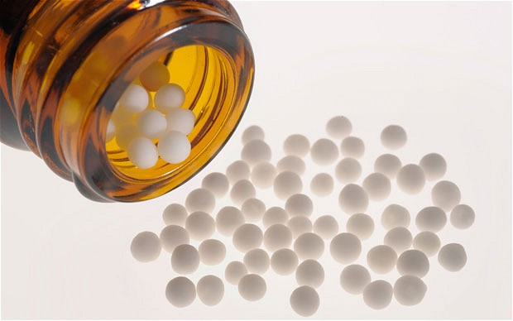
PLACEBO –THE SECOND BEST REMEDY

Slide 3
STUART CLOSE DEFINITION
Placebo is the second best remedy in the materia medica without which no good Homoeopathist could practice medicine

Slide 4
SYNONYMS
PHYTUM
NIHILINUM
RUBRUM
LACTOPEN

Slide 5
DIFFERENT FORMS OF PLACEBO
SOLID
SUGAR OF MILK
CANE SUGAR GLOBULES
TABLETS
CONES
LIQUID
ALCOHOL
PURIFIED WATER
PURIFIED WATER WITH ALCOHOL

Slide 6
UTILITY OF PLACEBO
WE HAVE TO GIVE PLACEBO TO KEEP THE ACTION OF THE MEDICINE UNDISTURBED,AT THE SAME TIME THE PATIENT ALSO BELIEVES THAT HE IS TAKING MEDICINE
DURING HOMOEOPATHIC AGGRAVATION
WHEN A PATIENT COMES TO US AFTER BEING OVER DRUGGED FROM ALLOPATHIC OR HOMOEOPATHIC SYSTEM
SOME MEDICINES START THEIR ACTION EVEN AFTER TWO OR THREE WEEKS.THEN WE HAVE TO WAIT AND DURING THIS PERIOD ,WE SHOULD GIVE PLACEBO
AS WE GIVE MINIMUM QUANTITY OF MDICINE,A NUMBER OF PLACEBO DOSES IS GIVEN ALONG WITH THE MEDICINE
PLACEBO MAY BE GIVEN TO A PATIENT WHO HAS IMAGINARY ILLNESS
SOMETIMES IT TAKES MORE TIME TO THE PHYSICIAN TO STUDY THE CASE AND SELECT A MEDICINE AND THEREBY KEEP HIS HONOUR

