Slide 1
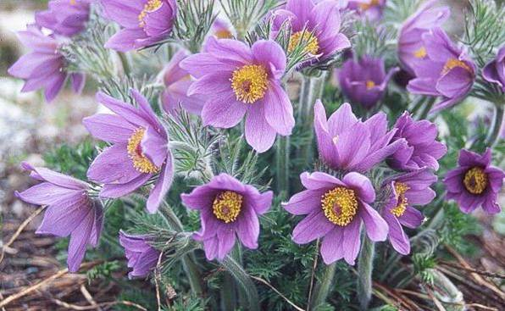
PULSATILLA
Dr. C. R KRISHNA KUMARI AMMA
HOD & PROF.
DEPT OF MATERIA MEDICA

Slide 2
PULSATILLA NIGRICANS
Common name : Wind flower
:Anemone
Family: Rannunculaceae
Prover :Hahnemann
Preparation: under class I
Authority: Materia Medica Pura

Slide 3

PULSATILLA

Slide 4
SPHERES OF ACTION
VEINS
MUCOUS MEMBRANE OF TONGUE, STOMACH, BOWELS, FEMALE GENITALS.

Slide 5
CLINICAL UTILITY
- Acne.
- Amaurosis.
- Amenorrhoea.
- Anaemia.
- Appetite, depraved.
- Bladder, catarrh of.
- Blepharespasm.
- Breasts, pain behind.
- Bronchitis.
- Cataract.

Slide 6
- Catarrh.
- Chaps.
- Chest, pains in.
- Chilblains.
- Clavus.
- Cold.
- Cough.
- Diarrhoea; of phthisis

Slide 7
Dyspepsia.
- Earache.
- Epilepsy.
- Epistaxis.
- Eyes, lachrymal sac, inflammation of; granular ophthalmia.
- Fear.
- Feet, soles painful.
- Foetus, mal-position of.
- Freckles.
- Gonorrhoea.
- Gout.

Slide 8
Haemorrhoids.
- Hands, pain in.
- Heart, palpitation of.
- Heartburn.
- Hydrocele; congenital.
- Hysteria.
- Intermittent fever.
- Joints, synovitis of.
- Labour, spurious pains of.
- Lactation, disorders of.
- Leucorrhoea.

Slide 9
Measles.
- Menstruation, abnormal; vicarious.
- Moles.
- Mumps.
- Neuralgia.
- Nymphomania.
- Ovaries, pains in; inflammation of.
- Phlegmasis alba dolens.
- Pregnancy; bladder trouble of; sickness of; heartburn of; diarrhoea of.
- Priapism.
- Prostate, inflammation of.

Slide 10
Prostatorrhoea.
- Puerperal convulsions.
- Puerperal fever.
- Puerperal mania.
- Retained placenta.
- Rheumatism; gonorrhoeal.
- Side, pain in.
- Smell, illusions of.
- Spine, curvature of.
- Stye.

Slide 11
Synovitis.
- Tape-worm.
- Taste; depraved; lost.
- Tongue, coated.
- Toothache.
- Urine, incontinence of.
- Uterus; inflammation of; prolapse of.
- Veins, inflammation of; varicose.
- Whitlow.

Slide 12
ABOUT PLANT
Jahr's description of the plant : "Stems simple, erect, rounded, 3 to 5 inches high; leaves radical bipennatifid, oblong; flowers solitary, terminal, having folioles of calyx campanulate, bent at the point, the odour of the herb but slightly evident, taste acrid and pungent.

Slide 13
The fresh plant contains an acrid and vesicating principle, and furnishes a corrosive oil, as well as a kind of tannin, which colours iron green; in the dry state it is entirely deprived of this acrid quality.
- Grows in sandy pasture grounds, on hills and declivities exposed to the sun."

Slide 14
He further distinguishes this Black Pulsatilla from the Common Pulsatilla (Pulsatilla vulgaris, Anemone pulsatilla) which "grows only on dry and sterile hills, where there is plenty of open air and flowers in spring only, whilst the black-coloured Pulsatilla flowers a second time in August and September."
- P. vulg. is much less downy than P. nig. : "Its flowers clear violet or pale red, straight and not hanging; seeds surmounted by a long silky tail."
- It is called Pasque Flower because it blooms during Easter, and its flowers are used for colouring Easter eggs.

Slide 15
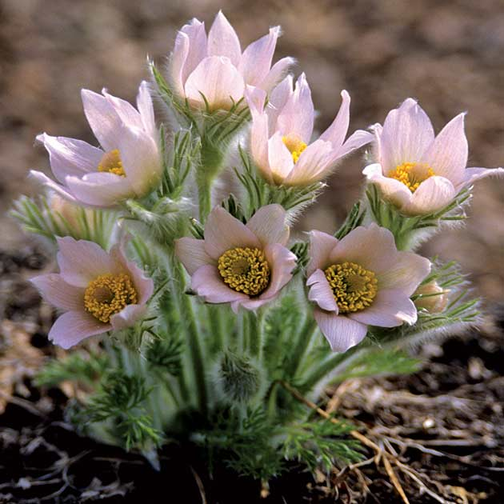
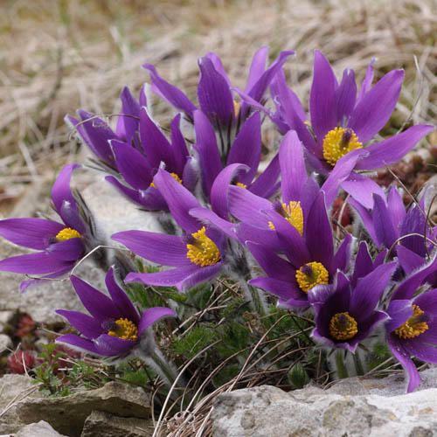
PULSATILLA
PULSATILLA NUTTALLIANA
PULSATILLA NIGRICANS

Slide 16
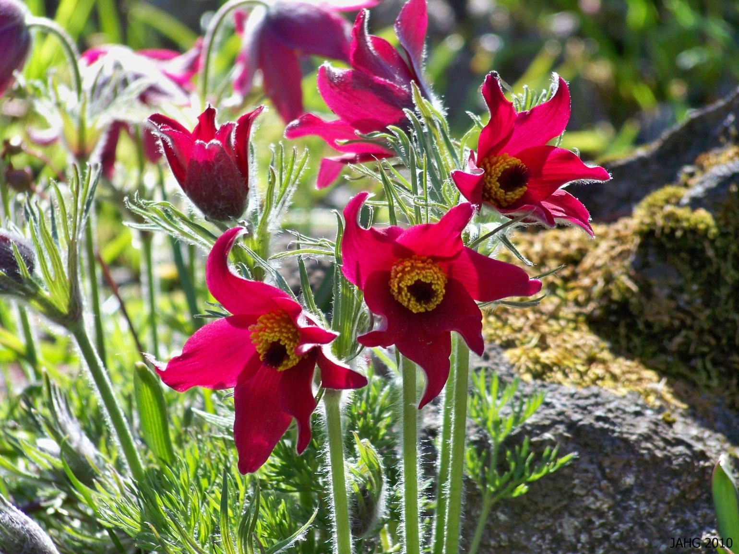
PULSATILLA VULGARIS

Slide 17
PHYSIOLOGICAL ACTION
The leaves of the recent herb have an acrid, burning, and nauseous taste.
- Its juice draws blisters "to the extent, it is said, of causing gangrene, if allowed to remain in contact with the part for a sufficient length of time; but these properties are, in a great measure, lost by dessication; and ruminating animals, such as sheep and goats, eat the dry Pulsatilla, if mixed with other herbs, without aversion or inconvenience."
- An active principle, Anemonin, has been isolated : it is inflammable and crystallises in colourless, odourless neutral needles.

Slide 18
Its action upon all of the mucous membranes is first, to produce a catarrhal inflammation, with unnatural dryness of the surface, which is soon followed by copious and profuse mucous discharges, rarely going on to ulceration.
- If these discharges are suddenly arrested, the serous and fibrous tissues take on an active inflammation.

Slide 19
Its effects are erratic in nature; a blenorrhoea of one mucous surface may change to another; for instance, a leucorrhoea may change to a bronchitis or a conjunctivitis.
- The dry stage is short and little marked (except sometimes in the respiratory tract); and much mucous secretion is the rule.
- As symptoms of this condition, the pathogenesis gives us, in the alimentary canal, raw throat; tongue furred white; breath fetid; taste deadened or variously altered (bitter, sour, salt, even putrid); foul or acid eructations, nausea, and inclination to vomit; sensation as if the stomach were spoiled, weight and pressure in the stomach, and mucous diarrhoea; in the respiratory tract, green or yellow discharge from the nose, and cough with much expectoration in the urinary mucous membrane, frequent micturition, with tenesmus, and a jelly-like sediment in the urine."-Hughes.

Slide 20
It produces catarrhal inflammationsof mucous membrane,HAVING THICK BLAND,GREEN YELLOWISH DISCHARGES.Venous congestion.

Slide 21
CONSTITUTION
Adapted to persons of indecisive, slow, phlegmatic temperament; sandy hair, blue eyes, pale face, easily moved to laughter or tears; affectionate, mild, gentle, timid, yielding disposition- the woman's remedy.
- Weeps easily : almost impossible to detail her ailments without weeping
Women inclined to be fleshy, with scanty and protracted menstruation
MIASM:PSORA+SYCOSIS

Slide 22
GUIDING SYMPTOMS
Symptoms ever changing; no two chills, no two stools, no two attacks alike; very well one hour, very miserable the next; apparently contradictory
Pains : drawing, tearing, erratic, rapidly shifting from one part to another are accompanied with constant chilliness; the more severe the pain, the more severe the chill; appear suddenly, leave gradually, or tension much increases until very acute and then "lets up with a snap"; on first motion.

Slide 23
Thirstlessness with nearly all complaints; gastric difficulties from eating rich food, cake, pastry, especially after pork or sausage; the sight or even the thought of pork causes disgust; "bad taste" in the morning.
- Great dryness of mouth in the morning, without thirst - Mumps; metastasis to mammae or testicle.

Slide 24
Derangements at puberty; menses, suppressed from getting the feet wet; too late, scanty, slimy, painful, irregular, intermittent flow, with evening chilliness; with intense pain and great restlessness and tossing about
Flows more during day Delayed first menstruation.
Sleep : wide awake in the evening, does not want to go to bed; first sleep restless, sound asleep when it is time to get up; awakes languid, unrefreshed

Slide 25
"All-gone" sensation in stomach, in tea drinkers especially.
- Diarrhoea : only, or usually at night; watery, greenish-yellow, very changeable; soon as they eat; from fruit, cold food or drinks, ice-cream

Slide 26
MIND
Weeps easily.
- Timid, irresolute.
- Fears in evening to be alone, dark, ghost.
- Likes sympathy.
- Children like fuss and caresses.
- Easily discouraged.
- Morbid dread of the opposite sex.
- Religious melancholy.
- Given to extremes of pleasure and pain.
- Highly emotional.
- Mentally, an April day.

Slide 27
Head
- Wandering stitches about head; pains extend to face and teeth; vertigo; better in open air.
- Frontal and supra-orbital pains.
- Neuralgic pains, commencing in rigth temporal region, with scalding lachrymation of affected side. Headache from overwork.
- Pressure on vertex.

Slide 28
Ears
- Sensation as if something were being forced outward.
- Hearing difficult, as if the ear were stuffed.
- Otorrhoea.
- Thick, bland discharge; offensive odor.
- External ear swollen and red.
- Catarrhal otitis.
- Otalgia, worse at night.
- Diminishes acuteness of hearing.

Slide 29
Eyes
- Thick, profuse, yellow, bland discharges.
- Itching and burning in eyes.
- Profuse lachrymation and secretion of mucus.
- Lids inflamed, agglutinated. Styes.
- Veins of fundus oculi greatly enlarged.
- Ophthalmia neonatorum.
- Subacute conjunctivitis, with dyspepsia; worse, in warm room.

Slide 30
Nose
- Coryza; stoppage of right nostril, pressing pain at root of nose.
- Loss of smell.
- Large green fetid scales in nose.
- Stoppage in evening.
- Yellow mucus; abundant in morning.
- Bad smells, as of old catarrh.
- Nasal bones sore.

Slide 31
Face
- Right-sided neuralgia, with profuse lachrymation.
- Swelling of lower lip, which is cracked in middle.
- Prosopalgia towards evening till midnight; chilly, with pain.

Slide 32
Mouth
- Greasy taste.
- Dry mouth, without thirst; wants it washed frequently.
- Frequently licks the dry lips.
- Crack in middle of lower lip. Yellow or white tongue, covered with a tenacious mucus.
- Toothache; relieved by holding cold water in mouth. [Coff.]
- Offensive odor from mouth. [Merc.; Aur.]
- Food, especially bread, tastes bitter.
- Much sweet saliva.
- Alternations of taste, bitter, bilious, greasy, salty, foul.
- Loss of taste.
- Desire for tonics.

Slide 33
Stomach
- Averse to fat food, warm food, and drink.
- Eructations; taste of food remains a long time; after ices, fruits, pasty.
- Bitter taste, diminished taste of all food.
- Pain as from subcutaneous ulceration.
- Flatulence.
- Dislikes butter.
- Heartburn.
- Dyspepsia, with great tightness after a meal; must loosen clothing.
- Thirstlessness, with nearly all complaints.
- Vomiting of food eaten long before.
- Pain in stomach an hour after eating.
- Weight as from a stone, especially in morning on awakening.
- Gnawing, hungry feeling.
- Perceptible pulsation in pit of stomach.
- All-gone sensation, especially in tea drinkers.
- Waterbrash, with foul taste in the morning.

Slide 34
Abdomen
- Painful, distended; loud rumbling.
- Pressure as from a stone.
- Colic, with chilliness in evening.

Slide 35
Stool
- Rumbling, watery; worse, night No two stools alike.
- After fruit.
- Blind haemorrhoids, with itching and sticking pains.
- Dysentery; mucus and blood, with chilliness.
- Two or three normal stools daily.

Slide 36
Urine
- Increased desire; worse when lying down.
- Burning in orifice of urethra during and after micturition.
- Involuntary micturition at night, while coughing or passing flatus.
- After urinating, spasmodic pain in bladder.

Slide 37
Female
- Amenorrhoea. [Cimicif.; Senec.; Polygon.]
- Suppressed menses from wet feet, nervous debility, or chlorosis.
- Tardy menses.
- Too late, scanty, thick, dark, clotted, changeable, intermittent.
- Chilliness, nausea, downward pressure, painful, flow intermits.
- Leucorrhoea acrid, burning, creamy.
- Pain in back; tired feeling.
- Diarrhoea during or after menses.

Slide 38
Male
- Orchitis; pain from abdomen to testicles.
- Thick, yellow discharge from urethra; late stage of gonorrhoea.
- Stricture; urine passed only in drops, and stream interrupted. [Clemat.]
- Acute prostatitis.
- Pain and tenesmus in urinating, worse lying on back.

Slide 39
Respiratory
- Capricious hoarseness; comes and goes.
- Dry cough in evening and at night; must sit up in bed to get relief; and loose cough in the morning, with copious mucous expectoration.
- Pressure upon the chest and soreness.
- Great soreness of epigastrium.
- Urine emitted with cough.
- Pain as from ulcer in middle of chest.
- Expectoration bland, thick, bitter, greenish.
- Short breath, anxiety, and palpitation when lying on left side.
- Smothering sensation on lying down.

Slide 40
Sleep
- Wide awake in the evening; first sleep restless.
- Wakes languid, unrefreshed.
- Irresistible sleepiness in afternoon.
- Sleeps with hands over head.

Slide 41
Back
- Shooting pain in the nape and back, between shoulders; in sacrum after sitting.
Extremities
- Drawing, tensive pain in thighs and legs, with restlessness, sleeplessness and chilliness. Pain in limbs, shifting rapidly; tensive pain, letting up with a snap.
- Numbness around elbow.
- Hip-joint painful.
- Knees swollen, with tearing, drawing pains.
- Boring pain in heels toward evening; suffering worse from letting the affected limb hang down. [Vipera.] Veins in forearms and hands swollen.
- Feet red, inflamed, swollen.
- Legs feel heavy and weary

Slide 42
Skin
- Urticaria, after rich food, with diarrhoea, from delayed menses, worse undressing.
- Measles.
- Acne at puberty.
- Varicose veins.

Slide 43
Fever
- Chilliness, even in warm room, without thirst.
- Chilly with pains, in spots, worse evening.
- Chill about 4 p.m.
- Intolerable burning heat at night, with distended veins; heat in parts of body, coldness in other.
- One-sided sweat; pains during sweat.
- External heat is intolerable, veins are distended.
- During apyrexia, headache, diarrhoea, loss of appetite, nausea.

Slide 44
Modalities
- Worse, from heat, rich fat food, after eating, towards evening, warm room, lying on left or on painless side. when allowing feet to hang down.
- Better, open air, motion, cold applications, cold food and drinks, though not thirsty.

Slide 45
THANK YOU

